Slide 1
HIE-ISOLDE Project:
Status Report
EXTRA COSTS AND ADDITIONAL RESOURCES
CERN, 29 January 2013
Yacine Kadi

Slide 2
Phase 1 Updated Schedule
 | 2013 |  |  |  |  |  |  |  |  |  |  |  | 2014 |  |  |  |  |  |  |  |  |  |  |  | 2015
 | J | F | M | A | M | J | J | A | S | O | N | D | J | F | M | A | M | J | J | A | S | O | N | D | J | F | M | A | M | J | J | A | S | O | N | D
LS1 & shutdowns
Refurbishment of the old ALEPH Cryo-Plant
Compressor installation and commissioning
Cryo-plant installation (cold box and transfer line)
Cryo-plant commissioning
HIE-ISOLDE SC Linac
Cryomodule 1 Tests (SM18)
Cryomodule 2 Tests (SM18)
Cryomodule 1&2 installation (ISOLDE)
Cryomodule 1&2 Commissioning (ISOLDE)
HIE-ISOLDE High-Energy Beam Transfer Lines
Power converters installation & Commissioning
Magnet installation & Commissioning
BI installation & Commissioning (HW)
Vacuum installation & Commissioning
Beam commissioning (phase1)
Start of the Physics at 5.5 MeV/u
 | 2016 |  |  |  |  |  |  |  |  |  |  |  | 2017 |  |  |  |  |  |  |  |  |  |  |  | 2018
 | J | F | M | A | M | J | J | A | S | O | N | D | J | F | M | A | M | J | J | A | S | O | N | D | J | F | M | A | M | J | J | A | S | O | N | D
LS2 & shutdowns
Physics at 5.5 MeV/u
Initially planned to start in May 2015, the Physics Program at 5.5 MeV/u is now expected to start in October 2015.
The above schedule is could be affected by unforeseen emergency activities that could arise during LS1.
Reprioritization of phase 2 and 3 is unavoidable.

Slide 3
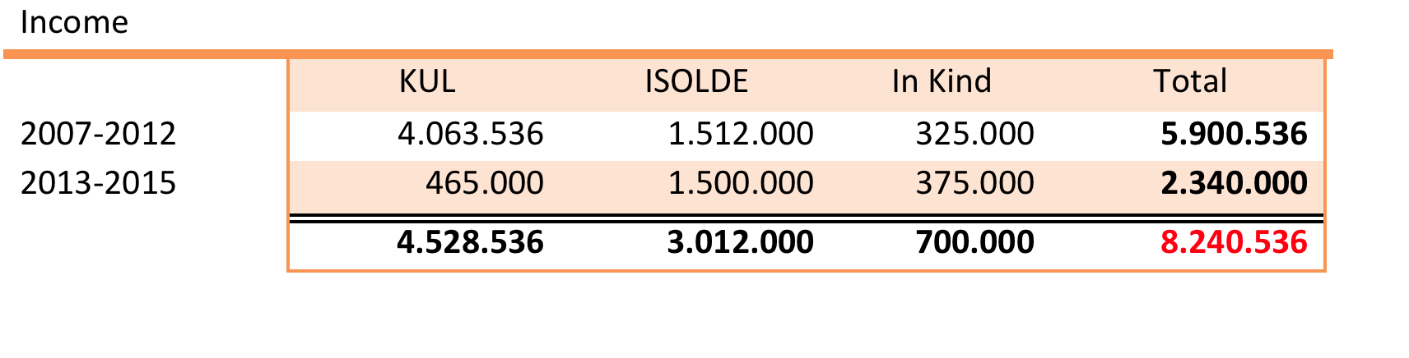
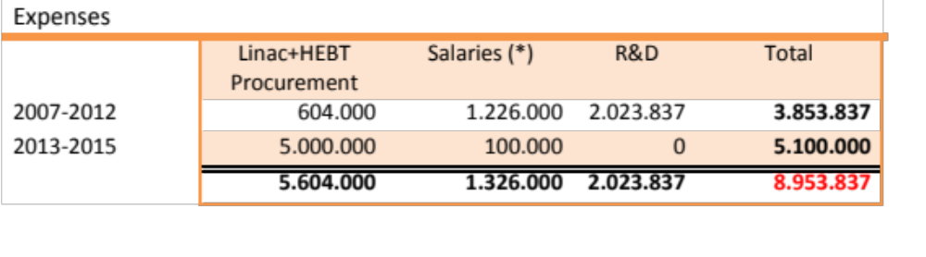
Cost: External Funding Phase 1
1.084.845
(*) to be considered additional expenses on salaries of 6.0 MCHF (2011-2014) already covered by EU-FP7-ITN Marie-Curie program: CATHI
The missing income of 0.7 MCHF should be covered through new applications:
  Belgian Big Science Project #2 through K.U. Leuven => Phase-2
  Local funds from Sweden through U. Lund
  COSA EU-FP7-ITN Innovative Doctoral Program 24 man x years

Slide 4
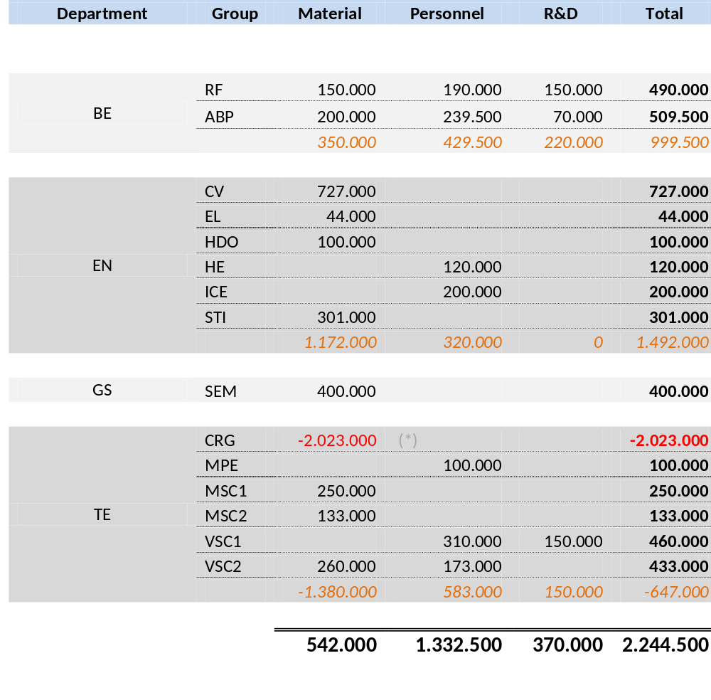
CERN Extra Costs Phase 1
(*) re-use of ALEPH cryo-plant

Slide 5
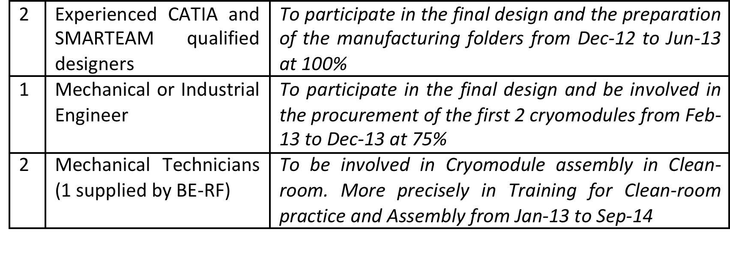
Missing Resources for Phase 1
For the CRYOMODULE: HR needs (8 man years)
All of these needs (the 5 man years listed above) have been filled by redeploying personnel from other projects. However, a short-term (3 year LD contract) position is requested to ensure the continuation of the experienced Mechanical Engineer currently assigned to the HIE-ISOLDE project beyond July 2013.

Slide 6
Missing Resources for Phase 1
For the CRYOGENIC PLANT: HR Needs (2.3 man years)
  HR needs are estimated to a total of 8.3 man years for the period (2013-2015). The need is for Engineers and technicians to be involved in “Cold box reinstallation” and “Compressor station reinstallation” mainly in the activities of: Project engineer, Mechanics/drawing, Process control, Instrumentation and Commissioning.
  All of these needs but, 2.3 man years, have been secured for the project.
For the Beam Instrumentation: HR Needs (2 man years)
  HR needs are estimated to a total of 2 man years during the period (2013-2015). Two electronic engineers are needed for a period of 12 months to develop: (i) the front-end analogue electronics for the Faraday Cup (in intensity and profile measurement modes) and the Silicon detector and (ii) the motion control for the beam diagnostic boxes.
  All of these needs will be filled by redeploying personnel from other projects.

Slide 7
CRYOMODULE: Status
General
  Conceptual design 100%
  Detailed design 60%
  Detailed drawings 20%
Priorities
  Start procurement processes for components requiring long delays
  Validate last active components solutions
  Instrumentation consideration
 | Done | In progress | Pending
Active components | Mechanical & cryogenics interfaces | Assembly procedures redaction, current leads | Quench protection system, RF interfaces
Alignment | Concept and procedures | Adjustment mechanism design Jacks procurement | Detailed design, drawings of supporting frame assembly
Vacuum | Concept, interfaces, instru. and product identification | Interfaces drawings Vacuum vessel drawings | Procurement and contract follow-up
Cryogenics | Concept, procedures, reservoir drawings, instrumentation list | Aleph fridge compatibility study Thermal shield specifications redaction | Response to cryogenics stop scenario. Thermal shield drawings
Survey | Concept, interfaces | Targets definition | Detailed design of supports
Assembly | Concept, general assembly sequence | Clean room procurement Detailed procedure redaction | Tooling detailed design
Instrumentation | Requirements | - | Selection, procurement, installation
Safety | Risk identification, calculations | Products selection | Procurement, installation
Contracts follow-up | - | Adjustment mechanism, helium reservoir | Vacuum vessel, thermal shield, supporting frame, bellows, instrumentation, tooling

Slide 8

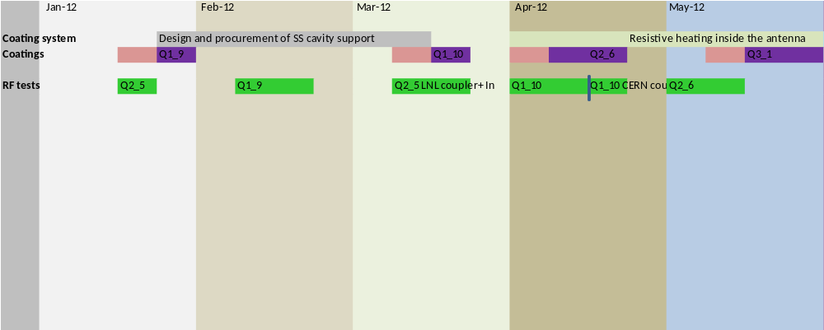
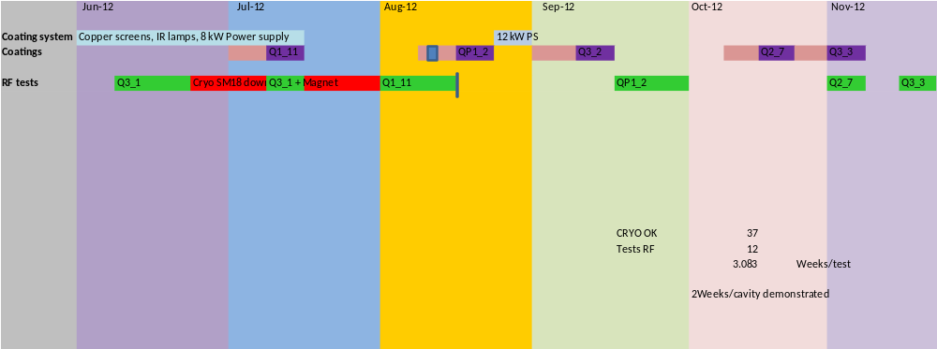
Cavity development work in 2012

Slide 9
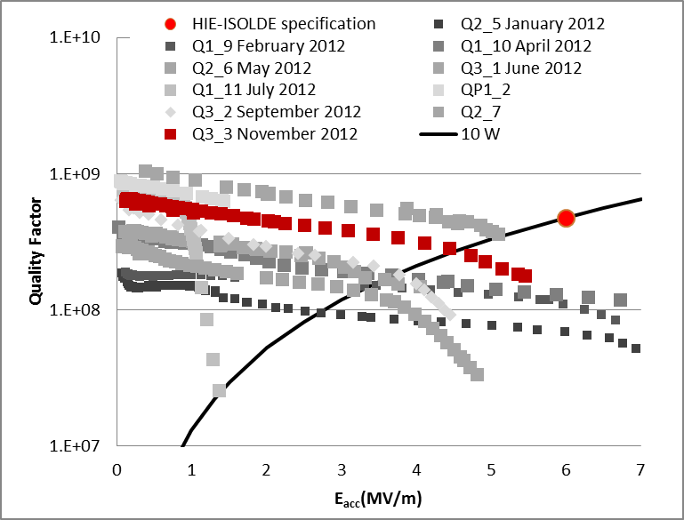
Cavity Test Results
Parameter/feature | HIE ISOLDE cavity CERN | ALPI cavity INFN-LNL
Substrate treatment | SUBU | Tumbling, EP then SUBU
Rinsing water pressure | 5-6 bar | 100 bar
Bake out temperature | 670ᵒC (~ sputtering T) | 600ᵒC (>sputtering T)
Sputtering temperature | 450ᵒC →690ᵒC | 300 → 500 ᵒC
Sputtering pressure | 3 10⁻¹ mbar | 2 10⁻¹ mbar
Number of layers | 12 | 12-20 layers
Power | 2 kW→11 kW | 5 kW (for 2.5 times smaller surface)
Cathode voltage | 1 kV | 1 kV
Bias voltage | -80 V | -120 V
Total electrical energy | 46 kWh | 15 kWh
Auxiliary electrode | 2 cm diameter, bias potential | 4 cm diameter (2/3 of inner conductor), rounded, bias potential
Film minimum thickness | To be measured | 2 µm
Sputtering gas | Argon | Argon
Venting gas | N₂ | N₂
vacuum joint | Viton | CF

Slide 10
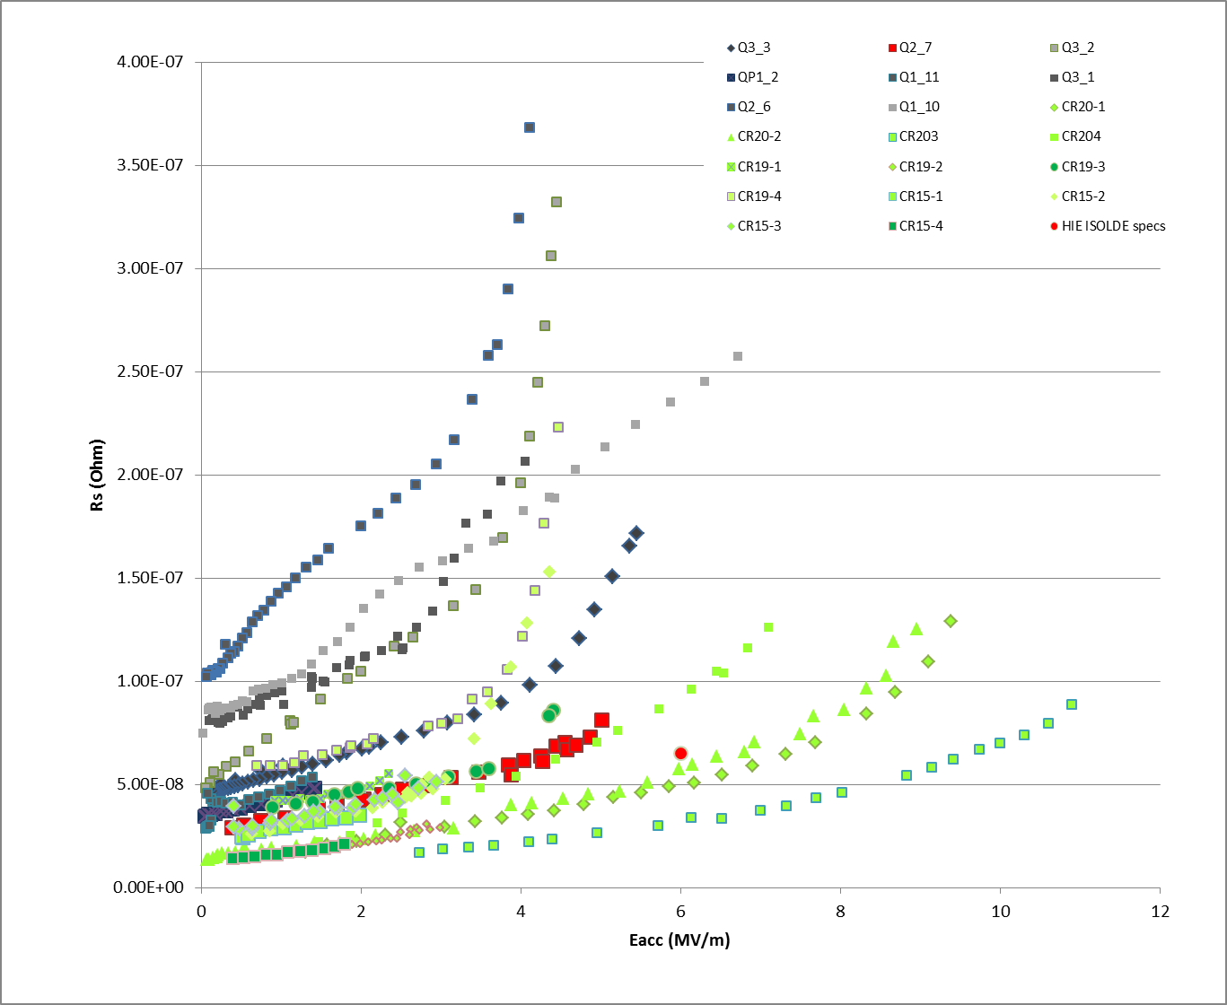
Comparison of HIE ISOLDE and ALPI QWRs
The slope of our best cavities is independent on Q₀ and close to the best ALPI cavities (rounded substrates)
Q2_7 ranks 9th out of 13 in terms of Q₀ and initial slope
Looks as if we were entering the distribution of the LNL cavities from below
Data from Legnaro vertical test courtesy of Anna Porcellato

Slide 11
Summary
Most recommendations of the previous cavity review were implemented:
  Reconsidered mechanical tolerances
  4 prototypes available since summer 2012
  Focused on dc bias sputtering
  Dummy copper cavity available and used for sample studies in autumn 2012
  Increasing cavity turnaround up to 2 weeks
  Setting up a backup test place in Orsay
  Continuing work on cavity ancillaries (tuning plate, coupler, RF line)
Cavity performance improved significantly in one year:
  1 MV/m @ 10 W in September 2011
  5 MV/m @ 10 W in October 2012
Remaining issues for cavity performance
  Film thinness on cavity top (high current region)
  Bad film quality on tip of the inner conductor (peak E→ field emission)
  Stability
  Statistics

