Slide 1


Report on HIE-ISOLDE Status & International Advisory Panel Meeting
Yacine Kadi on behalf of the HIE-ISOLDE project team
ISCC, 2 February 2011

Slide 2

Project Status
Submission of Spanish Grant proposal
      2 projects within “Industry for Science Program” => 250 k€, 4FTE => APPROVED
      MiCINN project => 998 k€, 1FTE => not retained
Interregional Program IV A of the European Union
      Construction of a fully equipped low-beta cryomodule prototype => 600 k€ => APPROVED
New Cavity RF tests taking place @ SM18
2nd prototype cavity in preparation
New layout of the facility almost frozen (new buildings)
IAP review Jan. 20-21, 2011

Slide 3
Material Budget
HIE-ISOLDE Linac (M. Pasini BE/RF) |  |  |  |  |  | Total | 2010 | 2011
SC Cavity RF | EIS-PRJ | WP2.1 | 69520 | BE | RF | 2269 | 0 | 221
SC Cavity Design & Manufacturing | EIS-PRJ | WP2.2.1 | 55601 | EN | HDO | 3700 | 196 | 544
SC Cavity Sputtering | EIS-PRJ | WP2.2.2 | 99796 | TE | VSC | 553 | 75 | 63
SC Cavity Sputtering (IS) | EIS-PRJ | WP2.2.2 | 99796 | TE | VSC | 355 | 4 | 73
SC Cavity Test | EIS-PRJ | WP4.1 | 69521 | BE | RF | 51 | 51 | 0
SC solenoids | EIS-PRJ | WP2.6 | 99157 | TE | MSC | 656 | 29 | 82
SC solenoids QPS | EIS-PRJ | WP2.6.4 | 99689 | TE | MPE | 200 | 0 | 30
Cryomodules | EIS-PRJ | WP2.4 | 99158 | TE | MSC | 4600 | 2 | 198
Cryomodules (MME) | EIS-PRJ | WP2.4.1 | 55602 | EN | HDO | 413 | 0 | 130
Cryomodule Test | EIS-PRJ | WP4.2 | 99159 | TE | MSC | 0 | 0 | 0
Beam Dynamics | EIS-PRJ | WP2.3 | 69522 | BE | RF | 0 | 0 | 0
Beam Instrumentations | EIS-PRJ | WP2.5 | 64520 | BE | BI | 1450 | 0 | 112
Beam Transfer Line | EIS-PRJ | WP2.7 | 99160 | TE | MSC | 1710 | 0 | 100
Linac Integration/Installation | EIS-PRJ | WP2.8 & WP4.4 | 55603 | EN | MEF | 166 | 18 | 28
Linac Commissioning | EIS-PRJ | WP4.5 | 69523 | BE | RF | 0 | 0 | 0
Vacuum | EIS-PRJ | WP2.9 | 99798 | TE | VSC | 1400 | 0 | 200
Survey | EIS-PRJ | WP2.10 | 61520 | BE | ABP | 201 | 0 | 65
Total |  |  |  |  |  | 17724 | 375 | 1847

Slide 4
Material Budget
HIE-ISOLDE Infrastructure (D. Parchet GS/SEM) |  |  |  |  |  | Total | 2010 | 2011
Civil engineering | EIS-PRJ | WP3.1 | 76155 | GS | SEM | 1645 | 4 | 773
Integration | EIS-PRJ | WP3.2 | 55613 | EN | MEF | 114 | 0 | 77
Handling systems | EIS-PRJ | WP4.3 | 55614 | EN | HE | 139 | 0 | 0
Transport & Handling services | EIS-PRJ | WP4.3 | 55617 | EN | HE | 232 | 0 | 46
Cooling & ventilation | EIS-PRJ | WP3.3 | 55604 | EN | CV | 2784 | 0 | 225
Electrical systems | EIS-PRJ | WP3.4 | 55605 | EN | EL | 1330 | 0 | 300
Cryogenic system | EIS-PRJ | WP3.5 | 99537 | TE | CRG | 4823 | 14 | 78
Power converters | EIS-PRJ | WP3.6 | 99641 | TE | EPC | 2225 | 0 | 269
Industrial Control systems | EIS-PRJ | WP3.7 | 55615 | EN | ICE | 56 | 0 | 56
Beam Control systems | EIS-PRJ | WP3.8 | 66520 | BE | CO | 70 | 0 | 28
Interlocks | EIS-PRJ | WP3.9 | 99688 | TE | MPE | 185 | 0 | 0
Total |  |  |  |  |  | 13603 | 18 | 1852

Slide 5
Material Budget
HIE-ISOLDE Design Study (R. Catherall EN/STI) |  |  |  |  |  | Total | 2010 | 2011
Target & Front end Design | EIS-PRJ | WP5.1, 5.2.2, 5.2.3 | 55606 | EN | STI | 556 | 0 | 255
HV and High Current Systems | EIS-PRJ | WP5.2.1 | 99223 | TE | ABT | 232 | 0 | 28
Beam Diagnostics | EIS-PRJ | WP5.3 | 64520 | BE | BI | 0 | 0 | 0
Layout upgrade | EIS-PRJ | WP6.1 | 55616 | EN | MEF | 111 | 0 | 0
Cooling and Ventilation | EIS-PRJ | WP6.2 | 55607 | EN | CV | 111 | 0 | 0
Electrical systems | EIS-PRJ | WP6.3 | 55608 | EN | EL | 0 | 0 | 0
Transport & Handling | EIS-PRJ | WP6.4 | 55618 | EN | HE | 58 | 15 | 43
Vacuum | EIS-PRJ | WP6.5 | 99799 | TE | VSC | 93 | 0 | 46
Survey | EIS-PRJ | WP6.6 | 61520 | BE | ABP | 0 | 0 | 0
Civil engineering | EIS-PRJ | WP6.7 | 76155 | GS | SEM | 46 | 0 | 0
LL controls | EIS-PRJ | WP6.8 | 55609 | EN | STI | 93 | 0 | 0
Off line separator | EIS-PRJ | WP7.1 | 55610 | EN | STI | 185 | 0 | 93
Separator areas | EIS-PRJ | WP7.2 | 55611 | EN | STI | 209 | 0 | 93
Experiment Hall | EIS-PRJ | WP7.3 | 55612 | EN | MEF | 111 | 0 | 56
Beam lines | EIS-PRJ | WP7.4 | 61522 | BE | ABP | 185 | 0 | 46
Total |  |  |  |  |  | 1991 | 15 | 660

Slide 6
Material Budget
Title | PPA | Work Package | Code | Dep. | Group | Total Request
HIE-ISOLDE Safety (A.P. Bernardes EN/STI)
Safety Coordinator | EIS-PRJ | WP8.1 | 70155 | GS | DI | 0
Radiation Protection | EIS-PRJ | WP8.2 |  | DGS | RP | 464
Access System | EIS-PRJ | WP8.3 | 72155 | GS | ASE | 153
Fire & Gaz Detection | EIS-PRJ | WP8.4 | 72155 | GS | ASE | 72
Total |  |  |  |  |  | 689

Slide 7
Status of External Funding
(assured)
R&D activity, part of LINAC funded from K.U. Leuven – Belgium (4.3 MCHF + 4 FTE) -> 2 MCHF available for 2011 and 340 kEUR/yr (2012-2015)
Contribution from ISOLDE Coll. (1.0 MCHF + 9 FTE) -> 840 kCHF for 2011 and 380 kCHF/yr (2012-2015)
Other beam quality investments (new RILIS, RFQ cooler, charge breeding) – funded by Sweden, UK and Germany
(4 MCHF)
Spanish Grant proposal:
    “Industry for Science Program” => 250 k€, 2FTE => APPROVED
    MiCINN project => 998 k€, 1FTE => not retained, to be resubmitted in April 2011
Interregional Program IV A of the European Union
    Construction of a fully equipped low-beta cryomodule prototype => 600 k€ => APPROVED

Slide 8
CATHI Open Positions
(until Jan.4 2011)
ESR2: Cavity and Cryomodule tests
ESR4: New Magnet
ESR5: Development and participation to the integration studies
ESR6: Development and participation to the control, alignment and positioning metrology
ESR8: Target material studies
ESR13: Cooling and Ventilation Design Study
ESR14: Design study of the vacuum system for the Front End of the Isolde facility

Slide 9
CATHI Positions to be opened
(Feb. 2011)
ESR9: Target conceptual design#1
ESR10: Target conceptual design#2
ESR11: Extraction optics and front-end design
ESR12: Low-level controls
ESR15: Off-line separator and High-resolution separator magnet
ESR16: RFQ cooler and pre-separator
ER3: Design study of a replacement charge breeder for REXEBIS

Slide 10
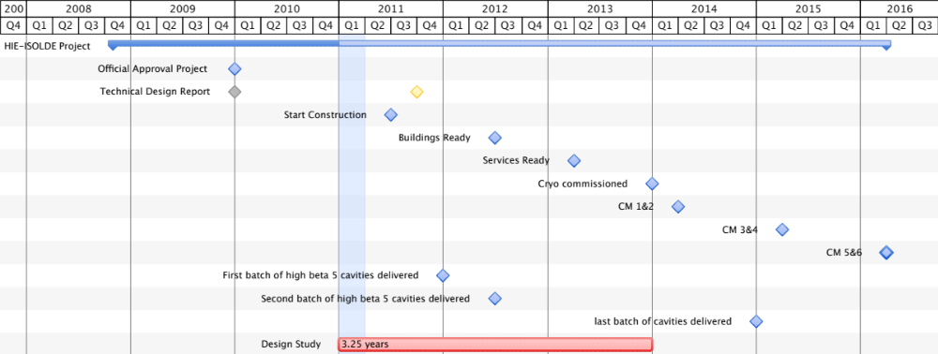
HIE-ISOLDE Schedule
Important milestones for Energy Upgrade:
Start project Jan 1st 2010
Start construction by Jun 2011
Launch Procurement of Cryogenics equipment:
  Finance Committee by Sep. 2011
Cryogenics installed and commissioned end 2013
High energy beam line (5.5 MeV/u) installed by Apr 2014
10 MeV/u Linac installed by 2015/2016
Installation organized inline with L4 and PSB commissioning
PSB SHUTDOWN
Physics @ 5.5 A MeV
5.5 MeV/u Linac commissioned
10 MeV/u Linac commissioned

Slide 11
Joint HIE-SC IAP meeting, Jan.20-21
14:00 Welcome (Sergio Bertolucci )
14:10 Framework and Physics (Yorick Blumenfeld)
14:55 Overview of the project; budget and management (Yacine Kadi)
1 5:40 Coffee
16:00 Technical choices and prototyping (Matteo Pasini)
16:45 High Intensity Design Study (Richard Catherall)
17:15 Implementation and Infrastructure (Erwin Siesling)
17:45 Safety (Ana-Paula Bernardes)
Friday Jan 21, 2011
8:30 IAP Closed Meeting
11:00 Preliminary oral report of IAP to Steering Committee
12:00 End
http://indico.cern.ch/conferenceDisplay.py?confId=123039

Slide 12
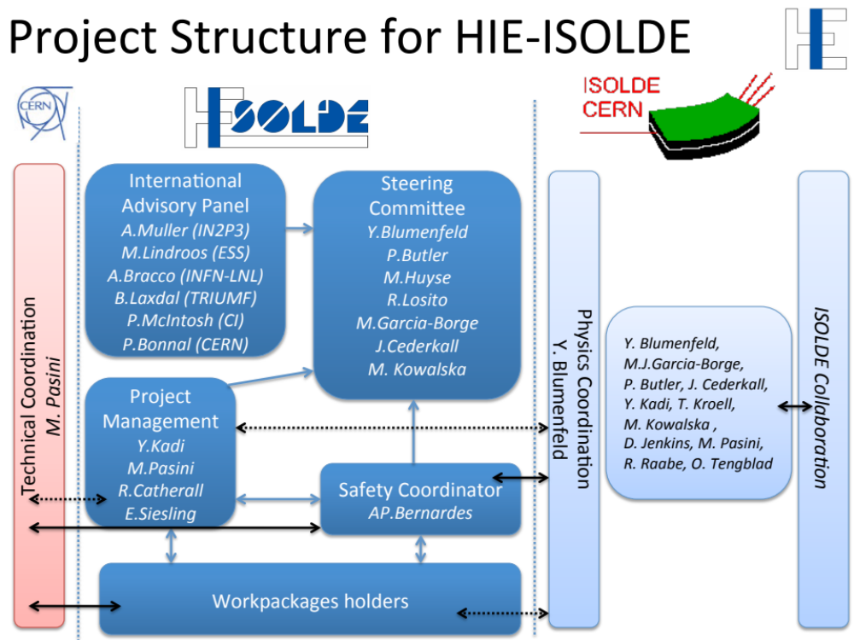
Project Structure of HIE-ISOLDE

Slide 13
Summary of Recommendations
Examine whether the technological choices made are optimal to reach the performance goals of the facility, and suggest eventual alternatives
  CERN sputtering support appears small and somewhat fractured in terms of prioritised resource availability. Steps must be taken to strengthen the internal specialist sputtering support to help overcome existing performance limitations.
Very strong statement: The cold RF tests (3) of the prototype cavity have been plagued by a series of difficulties ranging from RF cavity specific problems, mechanical workshop availability, stability of cryogenics in SM18 which stem from lower priority with respect to other projects. The low performance of this prototype RF cavity remains to be understood.
A second prototype cavity was delivered in December and is presently being sputtered. This will allow a faster turnaround of these tests.
The reasons for a low turnaround during the past year have been reviewed with the stake holders : increased resources and an improved involvement will be deployed. During 2011 five test campaigns are planned to characterize these cavities.

Slide 14
Planning of RF Measurements for Prototype Cavities 1 & 2
Jan. 10 – Feb. 15 => 4th cold RF tests of high-β prototype cavity#1
    10 – 14 Jan. => measurement of the coupler line -> thermalization is OK
    17 – 21 Jan. => extraction of cavity#1 and disassembly of coupler line -> done
    24 – 28 Jan. => fixing coupler line and reassembly of cavity#1 -> done
    31 – 8 Feb. => RF conditioning and tests -> in progress
Jan. 17 – Mar. 15 => 1st cold RF tests of high-β prototype cavity#2
    17 – 21 Jan. => conditioning of sputtering chamber -> done
    24 – 8 Feb. => preparation and sputtering of cavity#2 -> in progress
    9 – 18 Feb. => transport to SM18, assembly of cryostat and cool down
    21 – 4 Mar. => RF conditioning and tests
Mar. 1 – Apr. 15 => new cold RF tests of high-β prototype cavity#1
    New sputtering
Mar. 31 – May. 15 => new cold RF tests of high-β prototype cavity#2
    New sputtering

Slide 15
Resources
BE/RF
    G. Pechaud => préparation cavité avant et après dépôt, cavity transport and handling
    M. Pasini => fixing coupler line, RF conditioning and tests
    M. Therasse => fixing coupler line, cavity preparation, sputtering, RF conditioning and tests
    Max (FSU) => cavity transport and handling, sputtering chamber conditioning, rinsing
TE/VSC
    M. Thiebert => SUBU, sputtering chamber assembly in clean room
    P. Garritty => conditioning and sputtering
    S. Forel => SUBU, cavity light chemistry and inspection
    S. Calatroni => Sputtering and cavity inspection/quality control
TE/CRG
    Cryogenic system operator

Slide 16
Critical Aspects
BE/RF
    Availability of G. Pechaud => clean room operator, cavity preparation
    Availability of clean room in Building 252 and SM18
    Conflicts with cavity R&D for SPL, CLIC and LHC spare cavity
TE/VSC => ?
TE/CRG => ?

Slide 17
Summary of Recommendations
Examine whether the technological choices made are optimal to reach the performance goals of the facility, and suggest eventual alternatives
  CERN sputtering support appears small and somewhat fractured in terms of prioritised resource availability. Steps must be taken to strengthen the internal specialist sputtering support to help overcome existing performance limitations.
  An IAP organised workshop proposed to formally review cavity testing status and provide option routes to R&D success. To be coordinated by Peter McIntosh (IAP) within the next 3 months.
Agree with the proposal to organize a workshop but in 6 months: once (i) we have conducted sufficient RF tests on the two prototype cavities; (ii) the pre-series cavity is constructed and tested

Slide 18
Summary of Recommendations
Examine whether the technological choices made are optimal to reach the performance goals of the facility, and suggest eventual alternatives
  Industrialisation of the cavity fabrication requires a concerted effort and a stronger CERN responsibility needs to be taken. The EU Interegional 600 kEuro grant demands industrial collaboration to deliver a complete cryomodule and this therefore must be enforced.
  Cryogenic safety margin looks extremely tight compared to other facilities (30% c.f. 50% typically). Dynamic load from the linac will be the largest uncertainty due to cavity Qo variations and therefore suggest a re-assessment.
  Cryo plant configuration would benefit from a dual cold box system, which would provide operational flexibility to clean-up system without having to warm-up the linac. A re-assessment should be made.
  Concern on the cryomodule assembly which needs qualified expertise and cannot rely on inexperienced fellows and/or students. These resources must also remain available and consistent throughout the assembly period. Such critical CERN resources must be secured as appropriate.
  Space constraints in existing linac configuration are problematic and an assessment of new cryomodule implementation should be made to identify scope for increased flexibility.

Slide 19
Summary of Recommendations
Assess if the layout and equipment foreseen is well adapted to the scientific program as endorsed by the ISOLDE and n-TOF Committee (INTC)
  It was agreed that the material with the details concerning this point will be asked and analyzed for the next meeting. However, it was stressed that for a good exploitation of the physics opportunities new equipments are needed and some are indeed under study.
Ensure that the budget, manpower plan and time-line presented by the project management are realistic.
  The CERN staffing contribution looks unbalanced between fellows and specialist staff, which should be redressed.
  Implications of LHC manpower demand should to be factored into the delivery plan.
  Key resources must be identified and their time continuity maximised in the project planning process, alerting IAP when conflicts arise immediately, particularly across the peak demand over 2012/13 period.

Slide 20
Summary of Recommendations
Ensure that the budget, manpower plan and time-line presented by the project management are realistic.
  Evaluate possibility of external installation/integration contracts utilising CERN materials budget. If such funds could be made available, this would mitigate critical LHC resource conflicts.
  Contractual opportunities will require detailed specifications to be developed, which invariably will take more time and clear risk mitigation processes must be implemented to determine an optimum approach.
  Collaboration with SPIRAL-2, particularly with regards to high energy beam development and manipulation should be explored, looking for synergetic areas across both projects.
Examine the quality assurance and safety aspects of the project.
  Nice pre-study of the relevant radiation safety issues presented and no critical issues identified from the IAP. Propose that choice on having the experimental hall open or closed should be determined rapidly, so that hall layout and radiation safety provisions are clearly understood to facilitate installation planning and preparations.

Slide 21
Summary of Recommendations
Comment on the management structure and communication and collaboration strategies
  Appropriate and demonstrated project and documentation management processes in place.
  The impact of the requirement on the beam bunching needs to be understood better as space availability is extremely limited. The consequent implications and appropriate coordination need to be imposed.
More generally advise the project management on the actions necessary to ensure that HIE- ISOLDE becomes a unique and world-leading RIB user facility
  Strongly encourage pursuance of 10 MeV/u capability and high intensity design study, however presently emphasis should remain on completing in time the 5MeV/u linac based upon funding profile anticipated.

Slide 22
Summary
Positive review
Accelerate SC Cavity prototype cold tests @ SM18
Speed up Cryostat design
=> contacts with industry
RP studies should be performed => impact on layout of experimental facility
Enhance coordination with physics group and collaboration with SPIRAL2
Plan for 10 A MeV

Slide 23
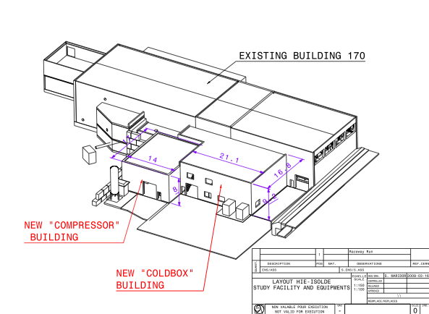

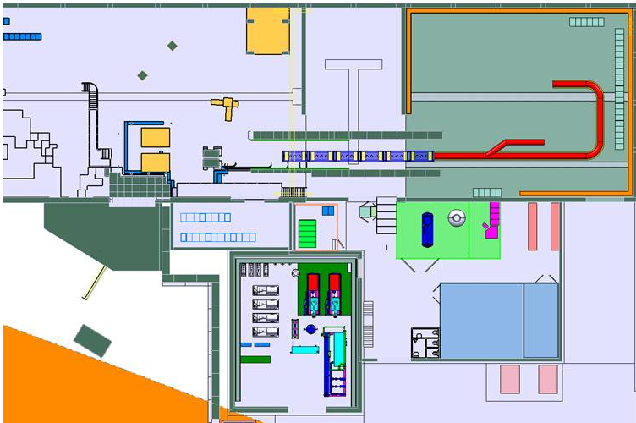
Thank you very much for your attention
CERN teams involved with the HIE-ISOLDE project
ISOLDE Collaboration
Ext. partners

