Slide 1


Report on HIE-ISOLDE Status
Yacine Kadi on behalf of the HIE-ISOLDE project team
ISCC, 6 July 2011

Slide 2

Outline
Launching of Market Surveys
Hiring of CATHI fellows
Budget allocation
International Collaboration
Cryomodule design
Cavity RF tests @ SM18
Summary

Slide 3
Market Surveys
Call for tender for dismantling and relocation of “hangar à camion” over => start of civil engineering at ISOLDE
      Deadline was June 15 => under selection
Market survey for the Cryogenic System has been launched (MS-3777, EDMS N°: 1146908)
      It will be followed by the issue of an invitation to tender to qualified and selected firms in August 2011 for a contract to be awarded in January 2012
Market survey for the design, supply, installation and commissioning of a chilled water plant, and of an heating, ventilation and air-conditioning equipment for the HIE Isolde infrastructure (MS-3785, EDMS N°: 1145842)
      It will be followed by the issue of an invitation to tender to qualified and selected firms and combination of firms in August 2011 for a contract to be awarded in December 2011 and a commissioning of the plant in January 2013

Slide 4
9 CATHI Positions Appointed
ESR2: Cavity and Cryomodule tests => Irene Mondino BE/RF (May 1st)
ESR5: Development and participation to the integration studies
=> Eleftherios Zografos EN/MEF (Aug. 1st)
ESR6: Development and participation to the control, alignment and positioning metrology => Carla Babcock BE/ABP (Sep. 1st)
ESR8: Target material studies => Michal Czaspi EN/STI (Aug. 1st)
ESR12: Low-level controls => Martino Colciago EN/STI (Aug. 1st)
ESR13: Cooling Ventilation Design Study => Polato Andrea EN/CV (Oct. 1st)
ESR14: Design study of the vacuum system for the Front End of the Isolde facility => Mario Hermann TE/VSC (Apr. 1st)
ESR15: Off-line separator and High-resolution separator magnet
=> Augustin Mathieu EN/STI (Sep. 1st)
ESR16: RFQ cooler and pre-separator => Jacobo Montaño EN/STI (Nov. 1st)

Slide 5
10 CATHI Positions still open
(Jul. 15, 2011)
ESR1: Cavity fabrication
ESR3: Beam Instrumentation
ESR4: Magnet Design
ESR7: Linac Commissioning
ESR9: Target conceptual design#1
ESR10: Target conceptual design#2
ESR11: Extraction optics and front-end design
ER2: Beam Instrumentation
ER3: Design study of a replacement charge breeder for REXEBIS
ER4: Radiation Protection Studies

Slide 6
Material Budget
As defined in MTP 2012
Total budget of 35.3 MCHF (2010 – 2016) with two funding sources:
  External funding (incl. Isolde Coll.)
    LINAC (17.7 MCHF)
      5.5 AMeV + beam line stage1 ~ 8.6 MCHF (6.3 MCHF secured)
  CERN budget
    Management (0.2 MCHF)
    Infrastructure (14.7 MCHF)
    Design studies for intensity upgrade (2.1 MCHF)
    Safety (0.8 MCHF)

Slide 7
HIE-ISOLDE Schedule
2011
2012
2013
2014
2015
2016
Q1
Q2
Q3
Q4
Q1
Q2
Q3
Q4
Q1
Q2
Q3
Q4
Q1
Q2
Q3
Q4
Q1
Q2
Q3
Q4
Q1
Q2
Q3
Q4
Beam Transfer Line
Civil
Main services
Cryo
CM 1&2
CM 3&4
CM 5&6
5.5MeV/u
10MeV/u
Isolde & REX Operations:
Main serv.
CM1&2
sd
sd
/////
long shutdown 2013
sd
sd
Jan 2013 Aug 2014
shutdown
/////
Isolde & REX perturbations
REX stop

Slide 8
Status of HIE-ISOLDE Collaborations
IPN-Orsay
    Discussions concerning special contribution (LLRF, cavity ancillaries
    Availability of test cryostat for HIE-ISOLDE cavity RF tests
    MoU in preparation
Korean MEST to allocate 200 kUSD/year for joining ISOLDE Collaboration => now awaiting final approval by Korean Parliament
BARC (India)
    Discussion concerning in kind contribution (production of copper cavity substrates and cryostats)
    Discussion with DAE (funding agency) for joining ISOLDE Collaboration
Application to Wallenberg Foundation on priority list

Slide 9
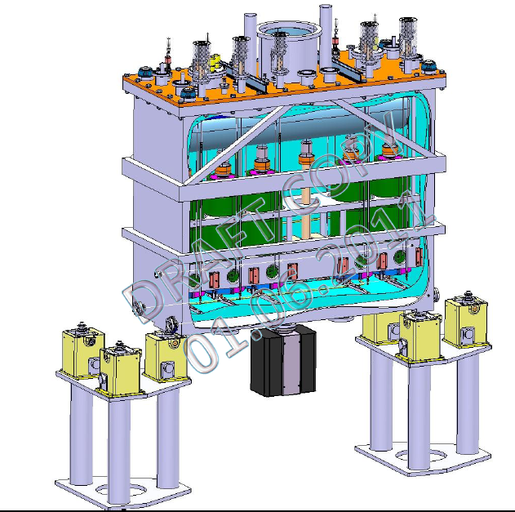
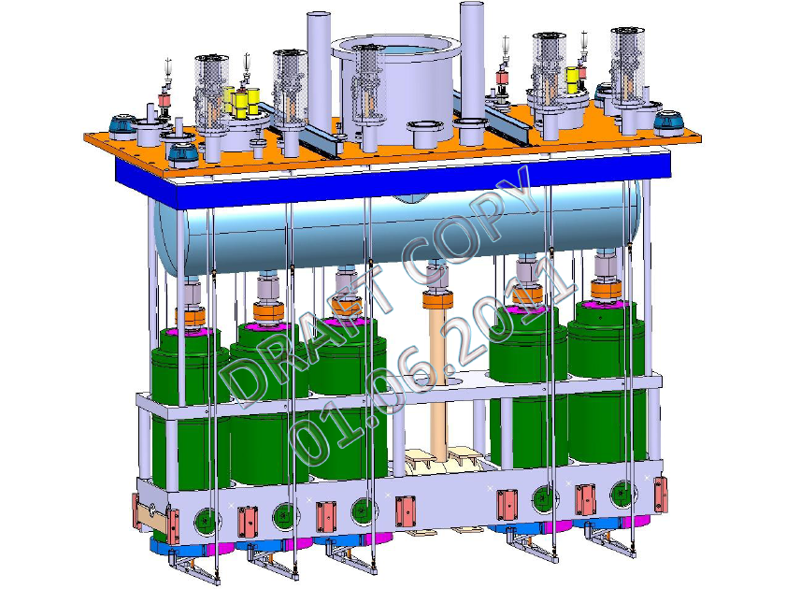
Cryomodule design near completion

Slide 10
Status of RF Measurements for
Prototype Cavities 1 & 2
Jan. 10 – Feb. 15 => 4th cold RF tests of high-β prototype cavity#1
    10 – 14 Jan. => measurement of the coupler line -> thermalization is OK
    17 – 21 Jan. => extraction of cavity#1 and disassembly of coupler line -> done
    24 – 28 Jan. => fixing coupler line and reassembly of cavity#1 -> done
    31 – 8 Feb. => RF conditioning and tests -> done
Jan. 17 – Mar. 15 => 1st cold RF tests of high-β prototype cavity#2
    17 – 21 Jan. => conditioning of sputtering chamber -> done
    24 – 8 Feb. => preparation and sputtering of cavity#2 -> done
    9 – 18 Feb. => transport to SM18, assembly of cryostat and cool down -> done
    21 – 4 Mar. => RF conditioning and tests -> done
Mar. 1 – Apr. 15 => new cold RF tests of high-β prototype cavity#1
    New sputtering -> INTERRUPTED
Mar. 31 – May. 15 => new cold RF tests of high-β prototype cavity#2
    New sputtering -> INTERRUPTED

Slide 11
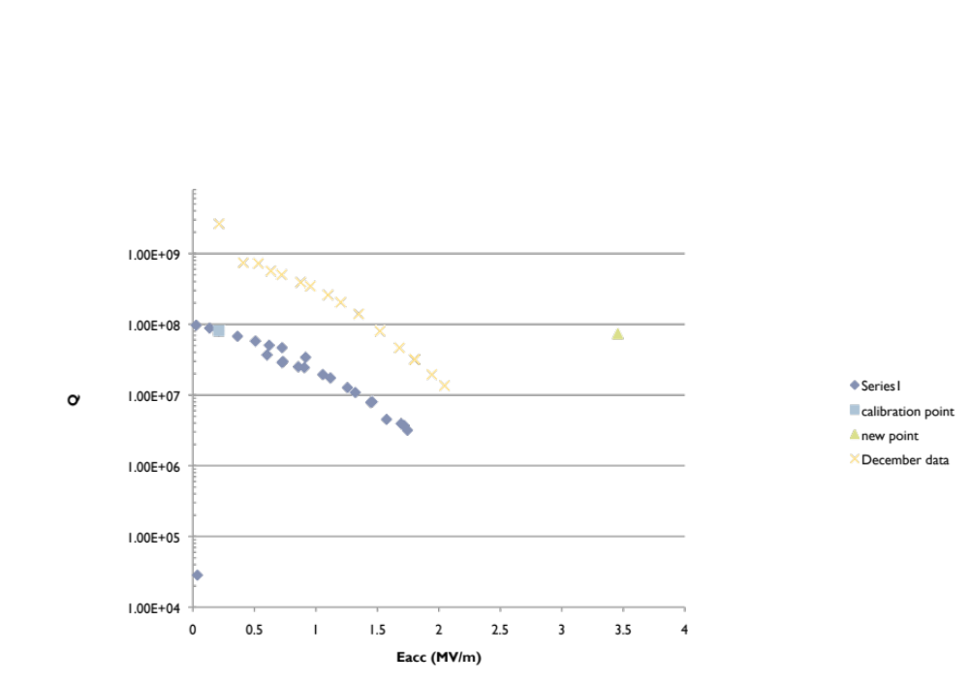
Q - E Measurements of Cavity 1
December 2010
February 2011

Slide 12
Q - E Measurements of Cavity 2
December 2010
Single point in March 2011
★
February 2011

Slide 13
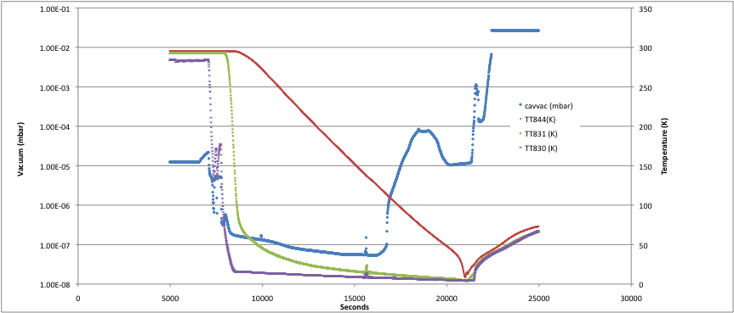
Cooldown of Test Cryostat @ SM18
Burned RF connector
Cold leak on the heat screen
CERN has and is putting considerable resources to solve this mishaps

Slide 14
Prospects for new RF Measurements
RF connector changed
Cold leak on the heat screen has been repaired and test cryostat is operational
SM18 Facility has shutdown for summer => RF measurements will resume end of August 2011
2 new inserts and additional thermal screen will be manufactured => accelerate RF test turnover (may even envisage 2nd test cryostat)
2 additional prototype cavities will also be fabricated
The turn around of the sputtering and test has improved from 6 weeks to 3.5 weeks

Slide 15
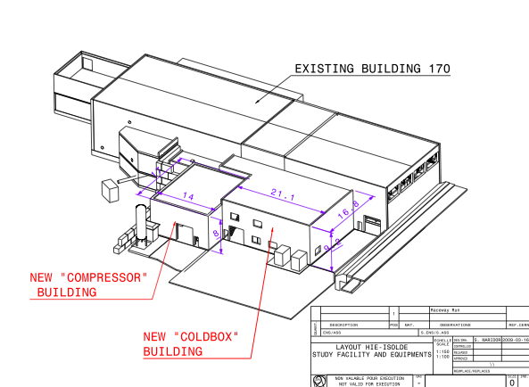

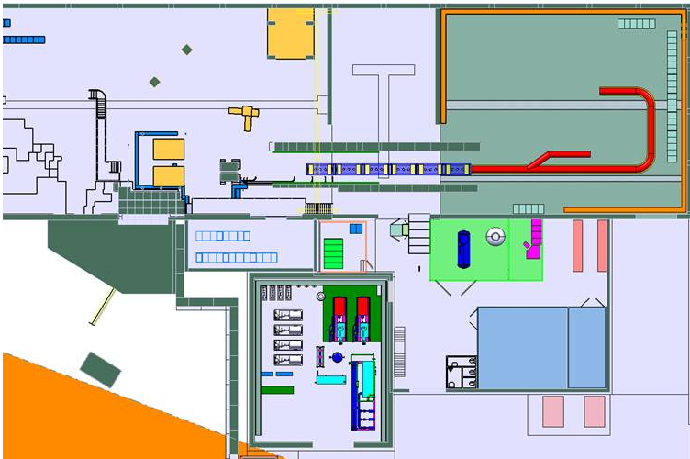
Thank you very much for your attention
CERN teams involved with the HIE-ISOLDE project
ISOLDE Collaboration
Ext. partners

