Slide 1
HIE-ISOLDE Project
Status Report
Isolde Collaboration Committee Meeting
CERN, 30 October 2012
Yacine.Kadi@cern.ch
Main Highlights & R&D Activities
Project Schedule
IAP recommendations
HEBT Lines
Budget
Outlook

Slide 2

HIGHLIGHTS (1/3)
Civil Engineering contract adjudicated and signed (IT+FR for 1185 kCHF) => construction works finalized (1.5 month delay)
HAVC System contract adjudicated and signed (IT for 1320 kCHF) => start of installation November 2012
Cooling System contract adjudicated and signed (IT for 1255 kCHF) => start of installation November 2012
      Copper forgings for cavity fabrication (8 + 2 options) => 4 companies => first 2 blocks delivered
      Cavity Alignment system design and fabrication => CATE
      SC Solenoids contract adjudicated and signed (DK for 390 kCHF: 4 + 2 options) => expect first 2 solenoids in 12 months
Invitation for Tenders
      Cryogenic Plant => + reply from Air Liquide and Linde => under review
      Clean room at SM18 => sent out
      Cavity substrate manufacturing => in preparation
      CM1 and CM2 vacuum + He vessels manufacturing via CATE => Technical specs being finalized
Market surveys
      HEBT lines magnets (dipoles, quadrupoles and steerers) => launched

Slide 3
HIGHLIGHTS (2/3)
HEBT line Review (April 25 & July 6 2012)
Cryomodule Technical Review (April 26-27 2012)
Risk Assessment (Aug-Sep 2012)
Design Study for the Intensity Upgrade well underway
      Target + Front-end
      Offline separator test bench
      HVAC + Cooling => nuclearization
      Charge Breeder => EBIS workshop Oct. 16-17 2012
SRF activities
      Cavity tests (more substrate, improved sputtering, procurement, etc…)
      Cavity ancillaries (RF coupler and tuner)
      LLRF (prototype, integration, etc…)
      RF controls and interlocks

Slide 4
HIGHLIGHTS (3/3)
Design of prototype Diagnostic Box
  AVS delivered Faraday Cup which was tested at REX-ISOLDE
  Body of the DB is next
  Additional Resources needed to develop the electronics for acquisition and motor control => circulate request (ISOLDE Coll. + Spanish/Portuguese Program)
  MS in preparation
Integration issues (building 170):
  Advance on tunnel/shielding design and integration
  Integration of power converter racks on mezzanine in building 170 => on hold pending decision from ISOLDE Coll.
  Integration of beam transfer lines => on hold pending decision from ISOLDE Coll.

Slide 5
Final list of risks assessed « high »
Highest: 4
1A: Learning curve on 1st cryo-module out of schedule
1C: Learning curve on 1st RF cavities out of schedule
2B: cryogenics procurement and industrialization strategy lead to delays / cost overruns
3: inadequate availability of CERN and/or contractors’ manpower
Should be considered: 6
2D : RF cavities procurement strategy
4B: need to redesign cryo-module
5: technical management of interfaces
6: HIE-LINAC not delivering to spec
7: Performance of series RF cavities
8A: Cryogenics late delivery

Slide 6
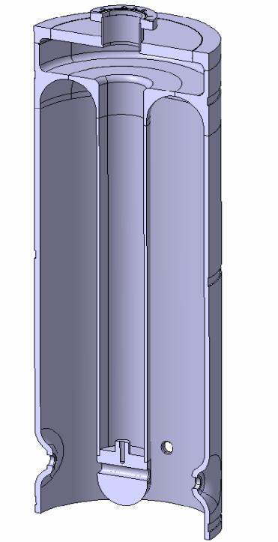
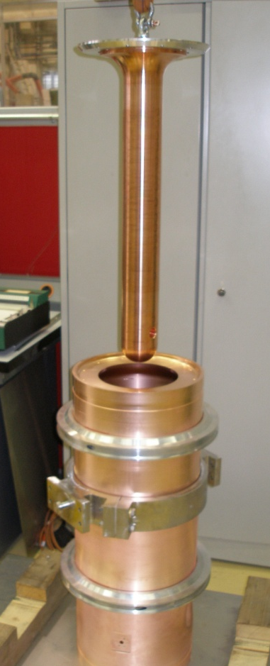
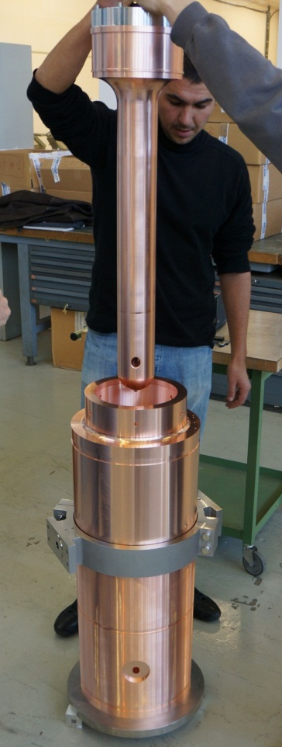
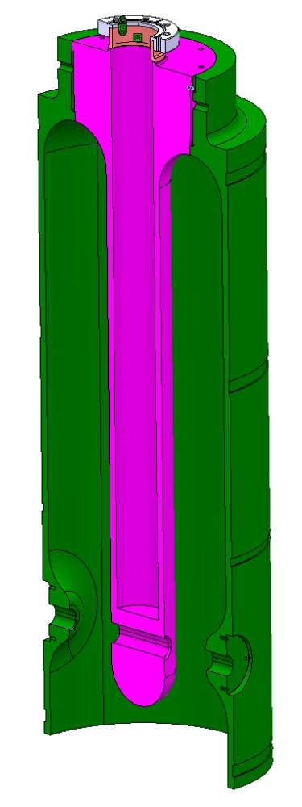
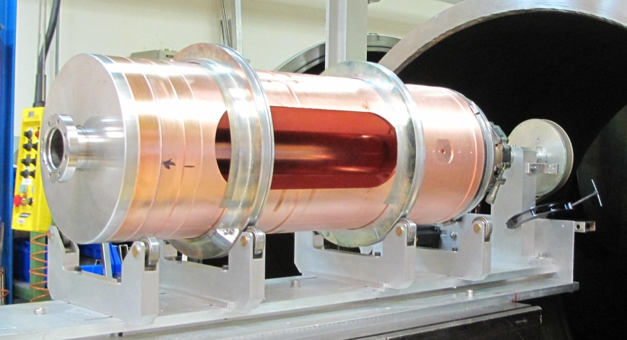
Cavity prototypes designed and built at CERN (W. Venturini)
  4 units “old design”: Q1-Q2-Q3-Q5
  (rolling, EB welding, deep-drawing)
  1 new design: QP1
  (3D machining in bulk copper, EB welding)
  1 cavity (Q4) manufactured for sputtering tests on samples
Note: Q3 and QP1 were left longer to reduce B on RF contact with tuning plate

Slide 7
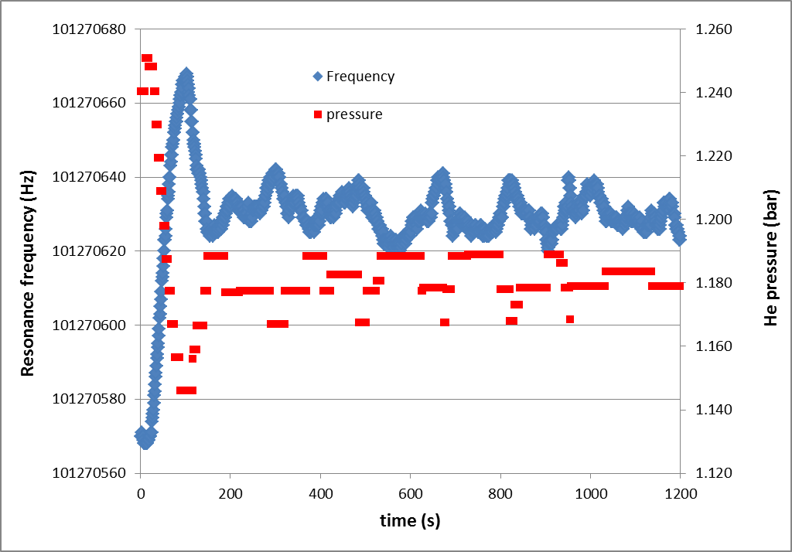
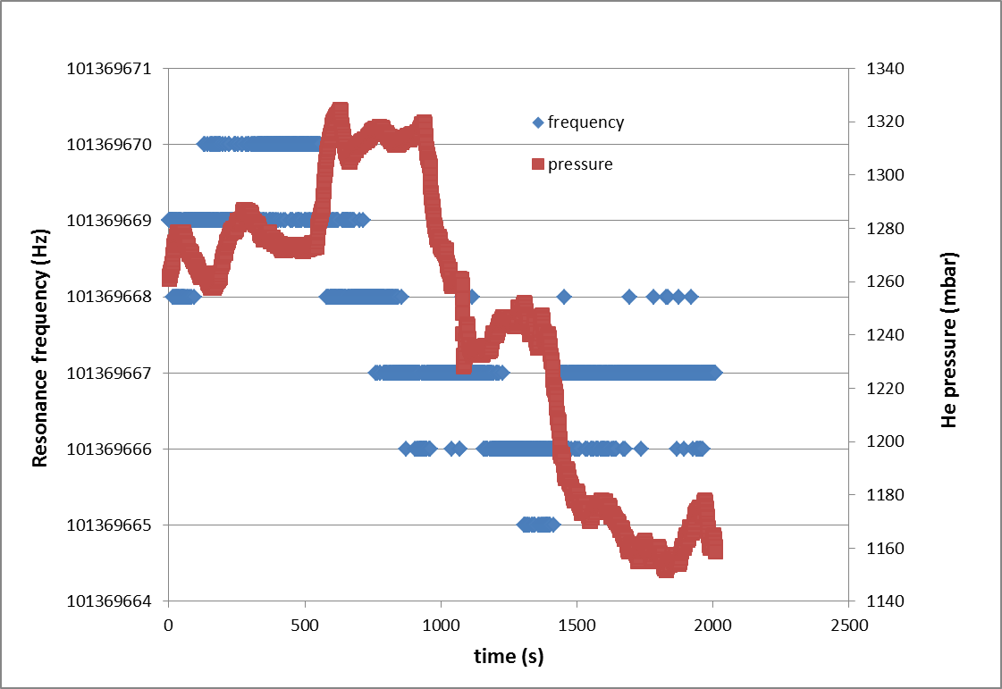
QP1: sensitivity to He pressure (W. Venturini)
~ 1 Hz/mbar
QP1 (new design)
Q2 (old design)
~ 0.01 Hz/mbar

Slide 8
QP1 thermal performance
(with high dissipation in the cavity bottom after Q-switch)
(W. Venturini)
0.5 K across the whole cavity height: OK

Slide 9
Test cavity performances in 2012 (W. Venturini)

Slide 10
Q1_11 first test results at 4.5 K
Most likely field emission from the tip of the inner conductor (tuning plate heating, exponential Q drop)
Was eliminated with He processing

Slide 11
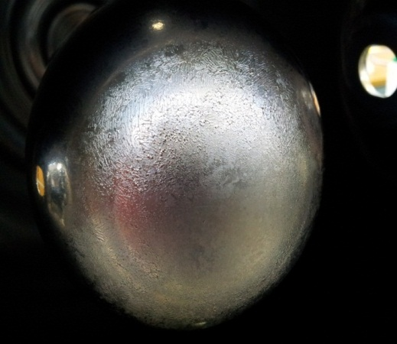
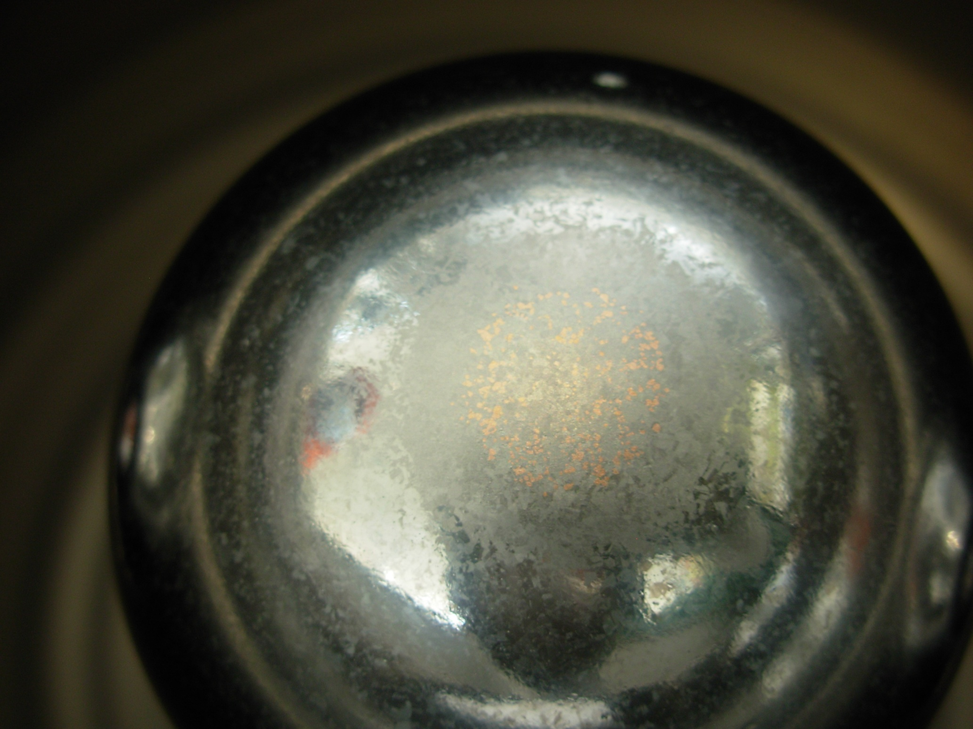
Last two cavities (Q1_11 and QP1_2)
Desired sputtering parameters almost reached (discharge power increased to 8 kW )
Q1_11: inner electrode at ground potential
  Corrugated film surface on the tip of the inner conductor
  Nb peel off at cavity lower edge
  Tested with flat Nb/Cu tuning plate
QP1_2: inner electrode at cavity (bias) potential
  Corrugated area on the tip was much reduced
  Better adhesion on lower cavity edge
  Tested with Cu/Be tuning plate

Slide 12
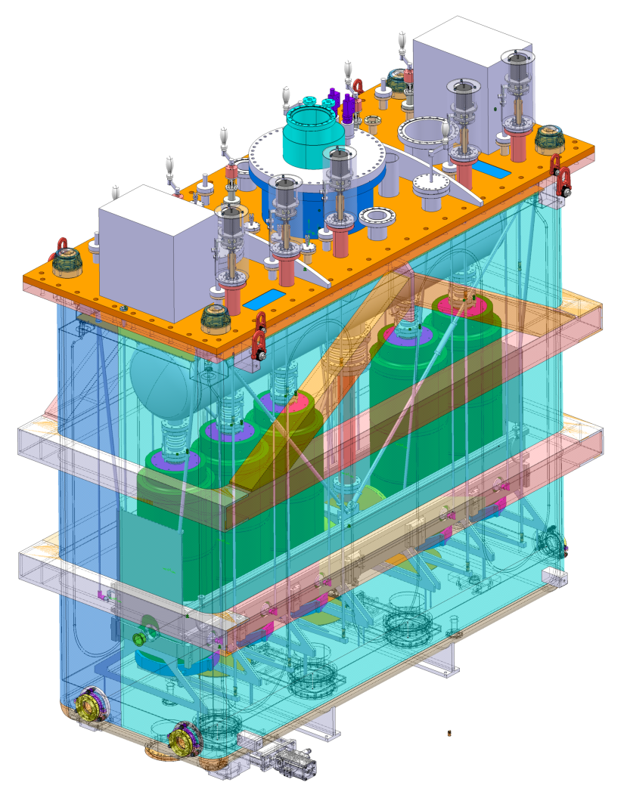
What's going on now and next steps
Design
  Support frame detail design
  Specific tooling conceptual and detail design
Specification Drawings
  Thermal Shield
  Support frame
Procurement
  Frame position Adjusters - industrial production underway
  Clean room – Out to industry next week
  (Vacuum and helium vessels) – Out to industry by mid October
  Thermal Shield – Out to industry by end November
  Support Frame – Out to industry by mid December
  External jacks - Out to industry by mid December
  Specific Tooling Out to industry in January 2013
Documentation
  Assembly procedures
  Technical specifications
  Product Breakdown Structure (PBS)
  Work-package description
New studies
  Integration of the Cryo-module into the shielding tunnel

Slide 13
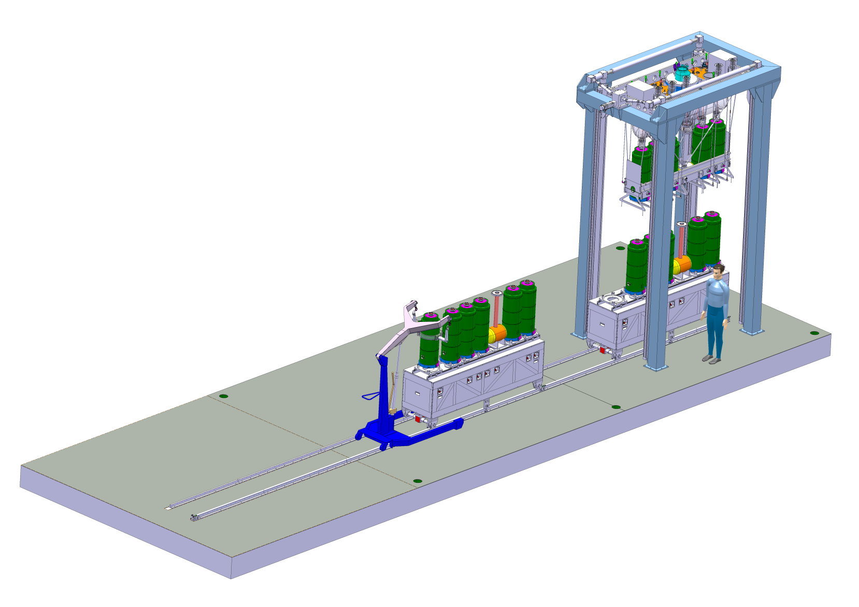
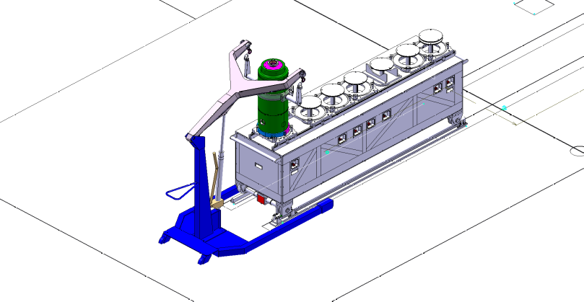
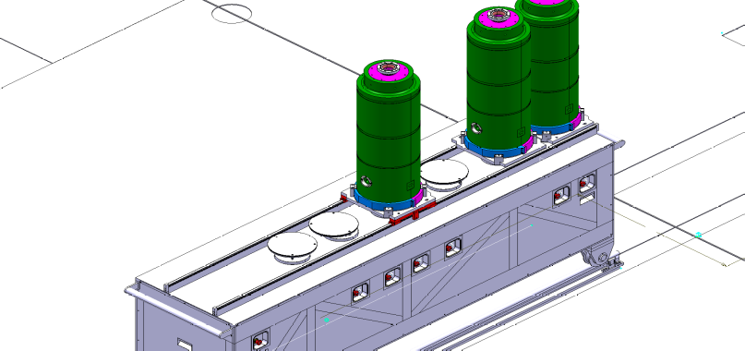
Specific Assembly Tooling
Sequential reception of the cavities
Position and verticality adjustment
Controlled and precise insertion of the cavity set under the assembly frame
Individual lifting of the cavities to allow insertion of support bars
Class 100 area
Class 10000 area
Pre-assembly area
Tooling allows selective insertion and extraction of any cavity or the solenoid

Slide 14
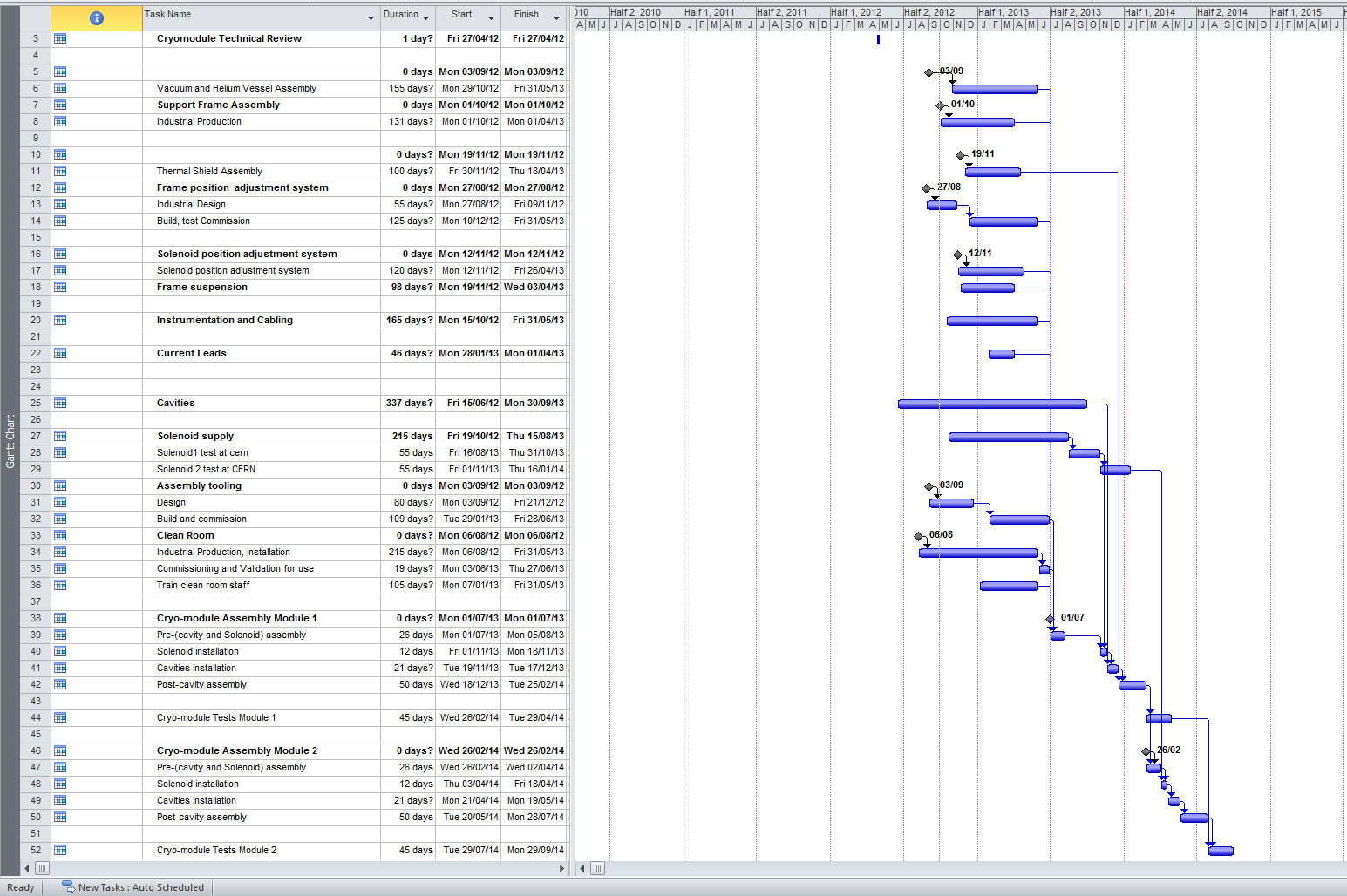
Planning
26-02-14 – 29-04-14
29-07-14 – 29-09-14
Delay of ~4 months with respect to the planning shown at SC meeting in May 2012

Slide 15
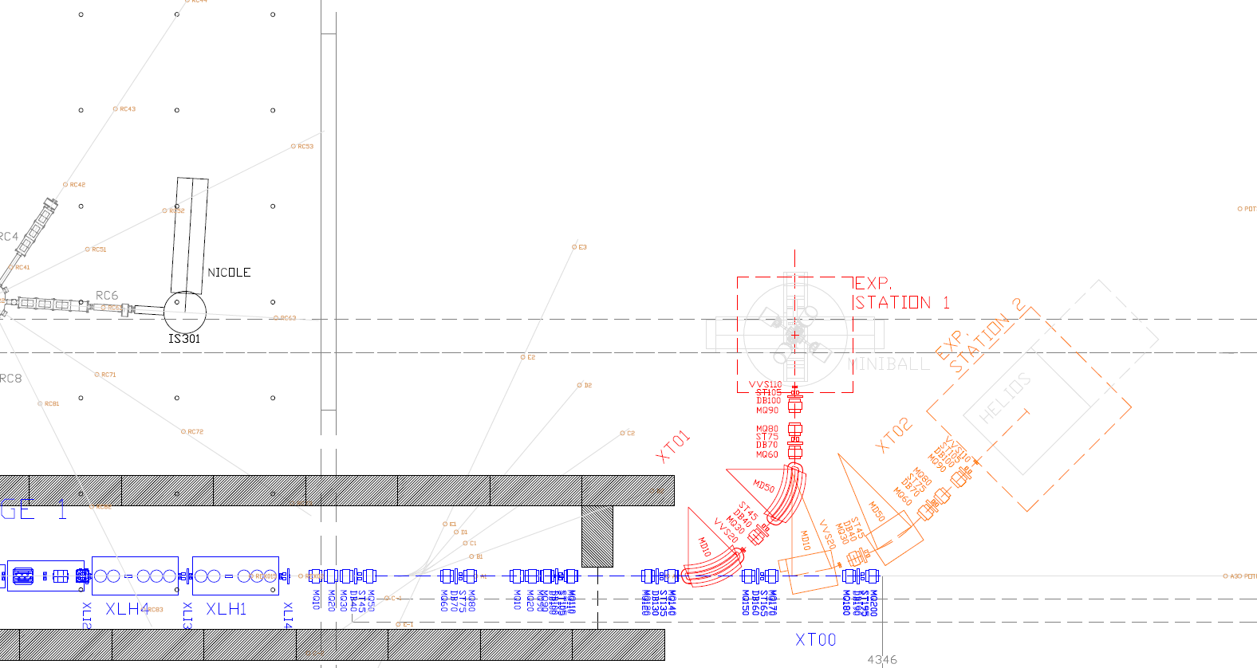
Latest HEBT design – stage 1
All details on EDMS (HIE-ISOLDE/HEBT LINES OPTICS AND LAYOUT)
  Drawings, layout tables and (new) madx reference optics files

Slide 16
Subsystems - diagnostics
DB functional and mechanical specification finished
Market Survey document in preparation
Prototype Faraday cup being tested at CERN
  Problems observed – see next talk
Prototype DB being assembled at AVS – acceptance test at AVS 5th October, now at CERN for further testing
Cabling needs defined and requests made
Concern about electronics (acquisition and positioning) progress – agreed new strategy with BE/BI to obtain extra resources

Slide 17
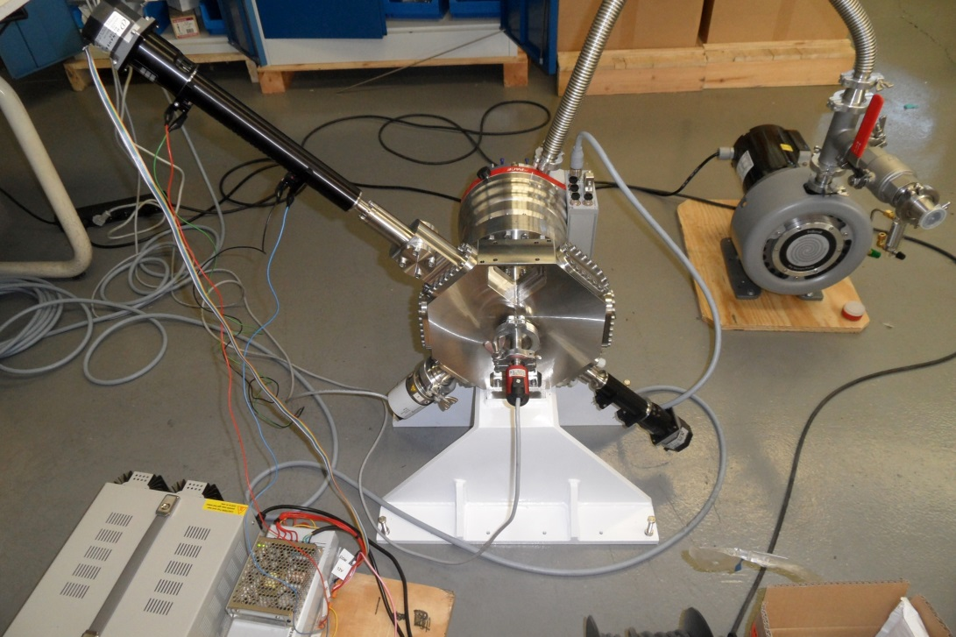
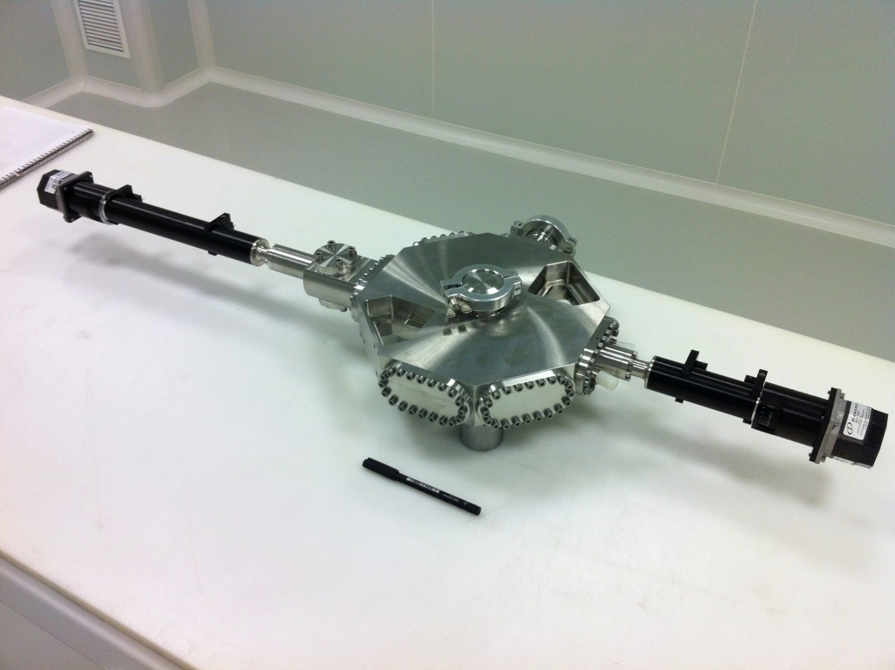
Diagnostic box

Slide 18
Subsystems - magnets
Requirements, specifications purchasing strategy fully defined
22.5 deg dipoles: Refurbishment ongoing, electrical and magnetic measurements to do. Missing specification details for spare coils.
45 deg dipoles: Electrical, cooling and vacuum interfaces defined, magnetic design done, mechanical design and technical specifications ongoing. Tendering end Oct. 12
Quadrupoles: Electrical and cooling interfaces done, vacuum and survey ongoing, magnetic design, mechanical design and technical specification ongoing. Tendering Nov. 12
Steerers: Design updated after CdR (water cooling), electrical, cooling and vacuum interfaces defined, magnetic design done, mechanical design being adapted to watercooled version, technical specifications started. Tendering end Oct. 12

Slide 19
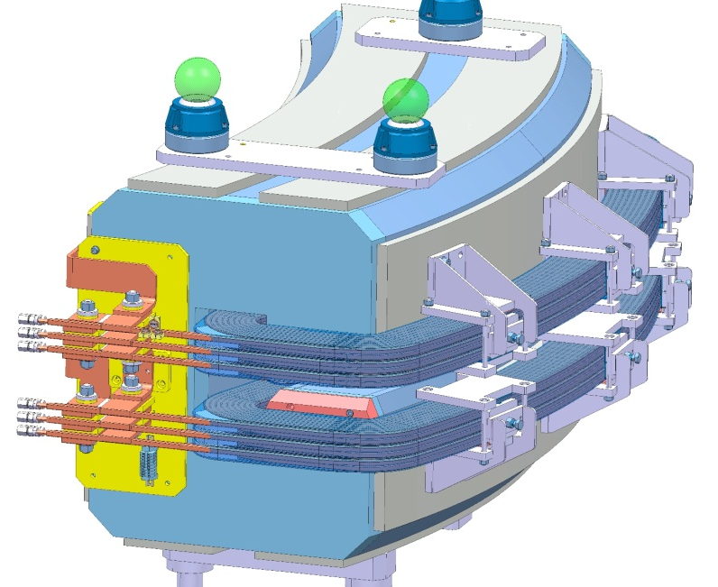
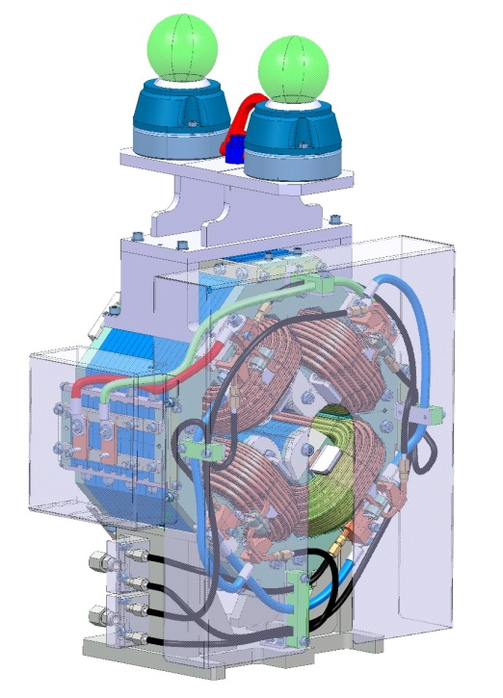
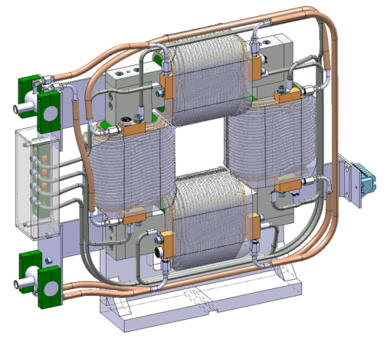
Magnets – present designs

Slide 20
Subsystems – power convertors
All requirements finalised and technical solutions being defined
FGC3s to be used for all control
Quadrupole:
  Industry. Potential solutions tested and a draft specification is almost ready. Current looping control needs some more work.
Steerer:
  CERN design and assembly. MS deadline is set for October and tendering in December 2012. The first batch is then expected at CERN in December 2013. Second batch in 2015.
Dipole:
  CERN S250 design. Power converters production in 2014.

Slide 21
Remaining issues/concerns
Performance of the Faraday cup in the DB
Electronics for diagnostic boxes (acquisition and positioning). Resources requirement defined – need to obtain the people.
Fast-valve effectiveness for protection of SC cavities
Shielding of HELIOS magnetic field
Decision of HEBT Line Layout

Slide 22
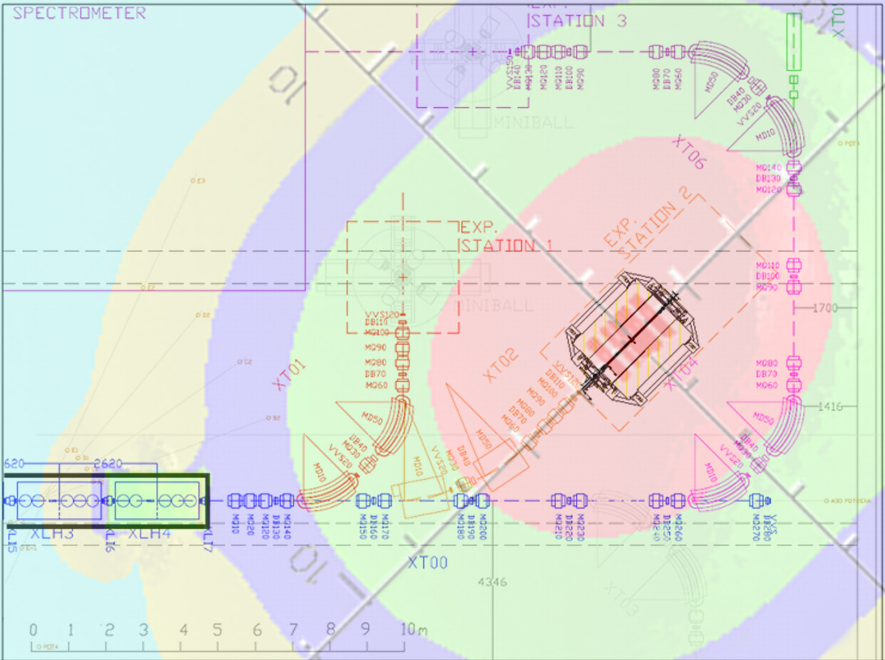
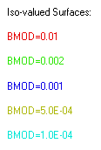
(100 Gauss)
Stray field from unshielded HELIOS solenoid (shown at XT02)
10 – 100 Gauss at beamline (max 8)
10 – 20 Gauss at Linac (max 2)
Local magnet shielding design being evaluated
J.Strachan

Slide 23
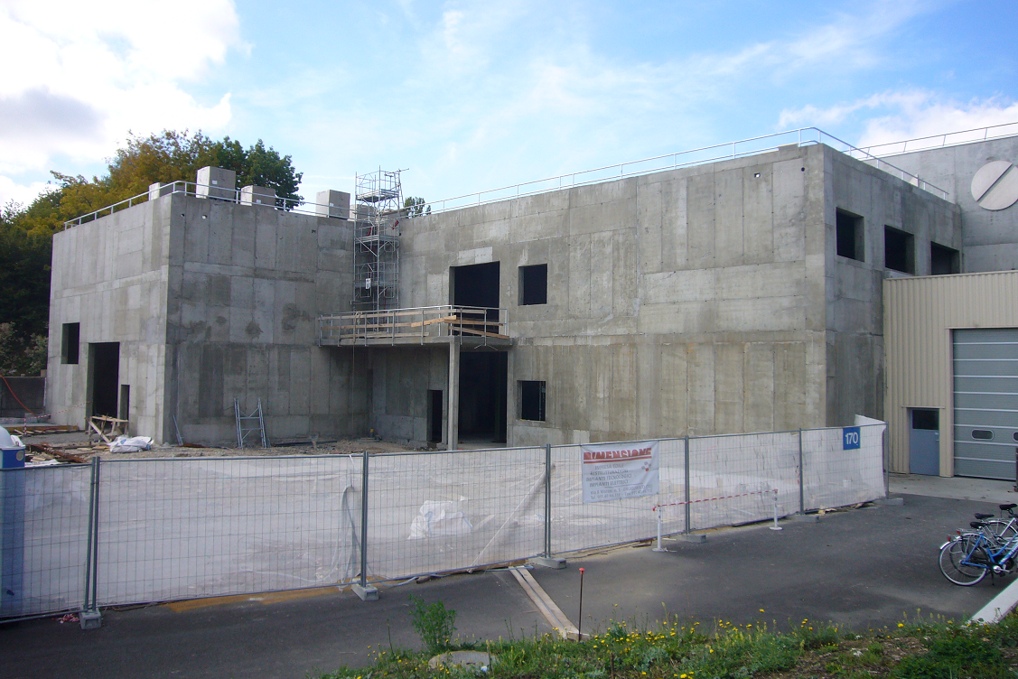
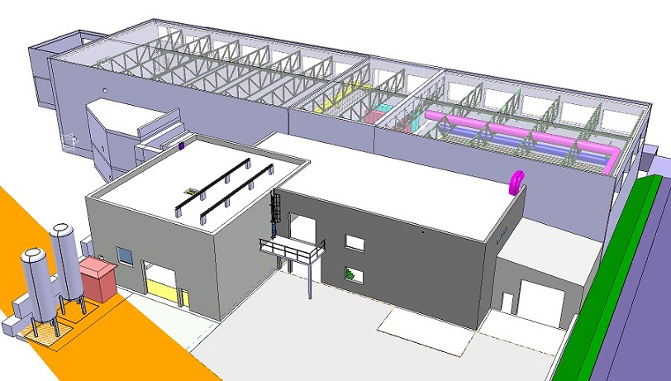
Civil Engineering
Compressor and Cold Box Building
Autumn 2012 !
Civil Engineering finished summer 2012

Slide 24
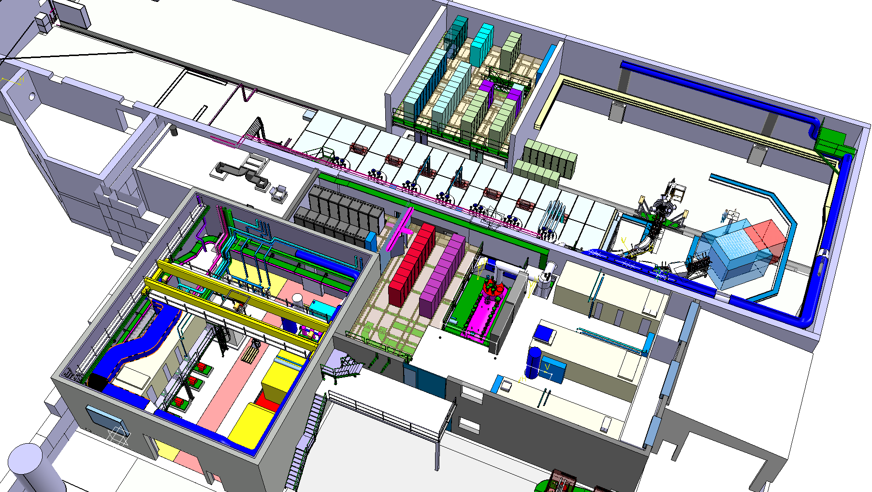
Racks sub systems
B. 170
B. 199
B. 198
Electrical systems: Oct 2012 – June 2013

Slide 25
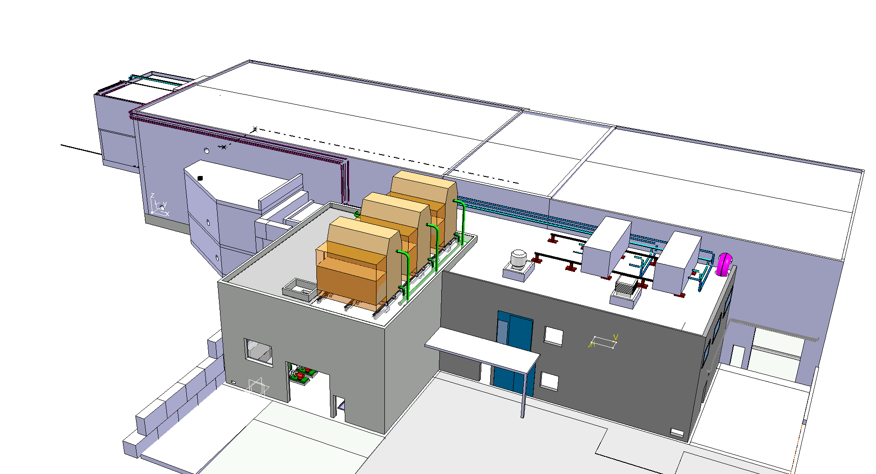
Cooling & Ventilation
Experimental hall 170
B. 198 compressor building
B. 199 cold box building
Cooling & Ventilation: Oct 2012 – June 2013

Slide 26
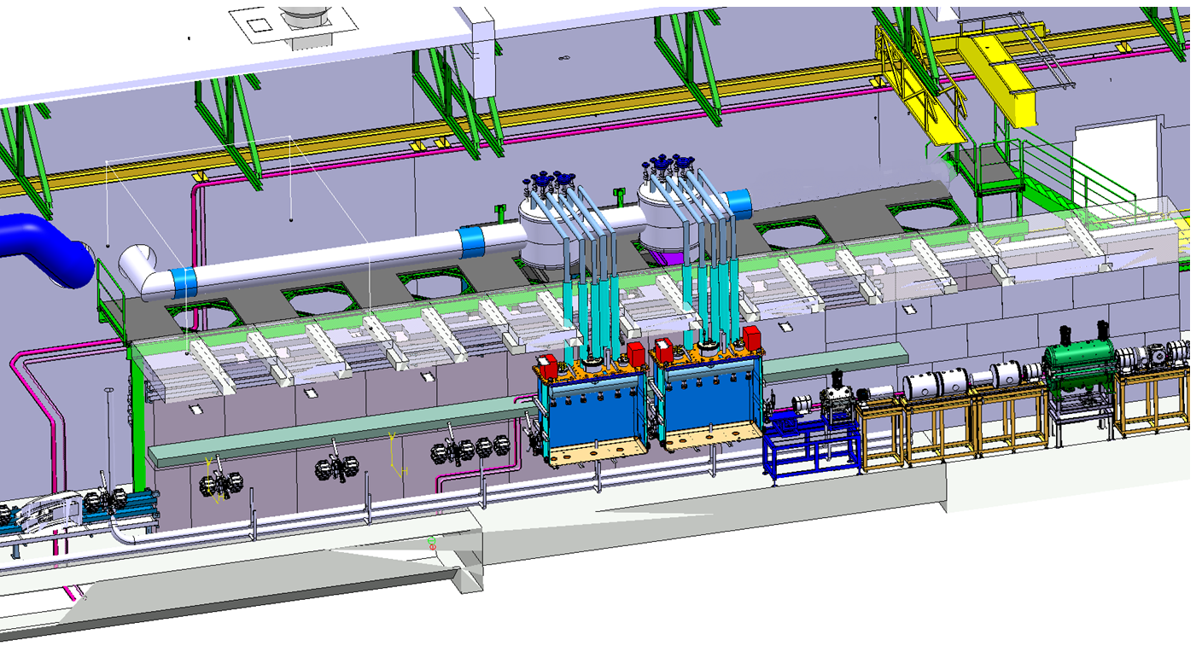
Modular Linac & Cryo Line
Courtesy: Stephane Maridor
2015
5.5MeV/u
Sep 2014 – Feb 2015
Cryo Cold Line- stage 1: January 2014 – June 2014
Linac CM 1&2 - stage 1: August 2014 – October 2014

Slide 27
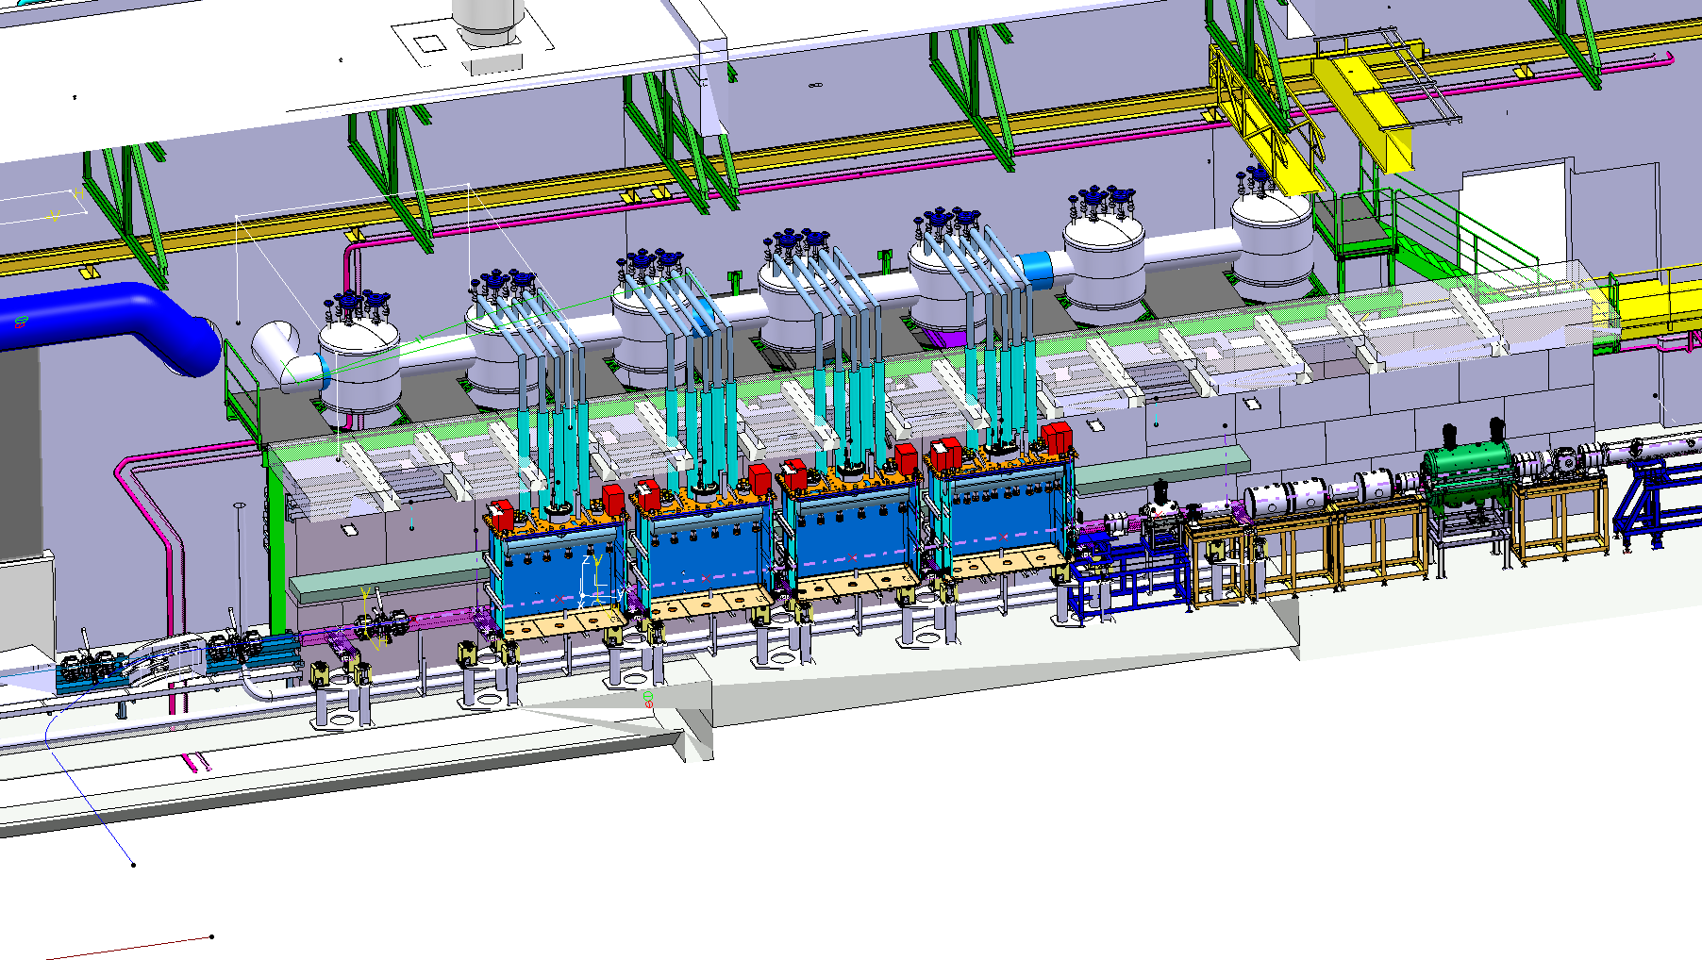
Modular Cryo Line
Courtesy: Stephane Maridor
2016 ?
10MeV/u
Cryo Cold Line- stage 2
Linac CM High-β 1,2,3&4 - stage 2a

Slide 28
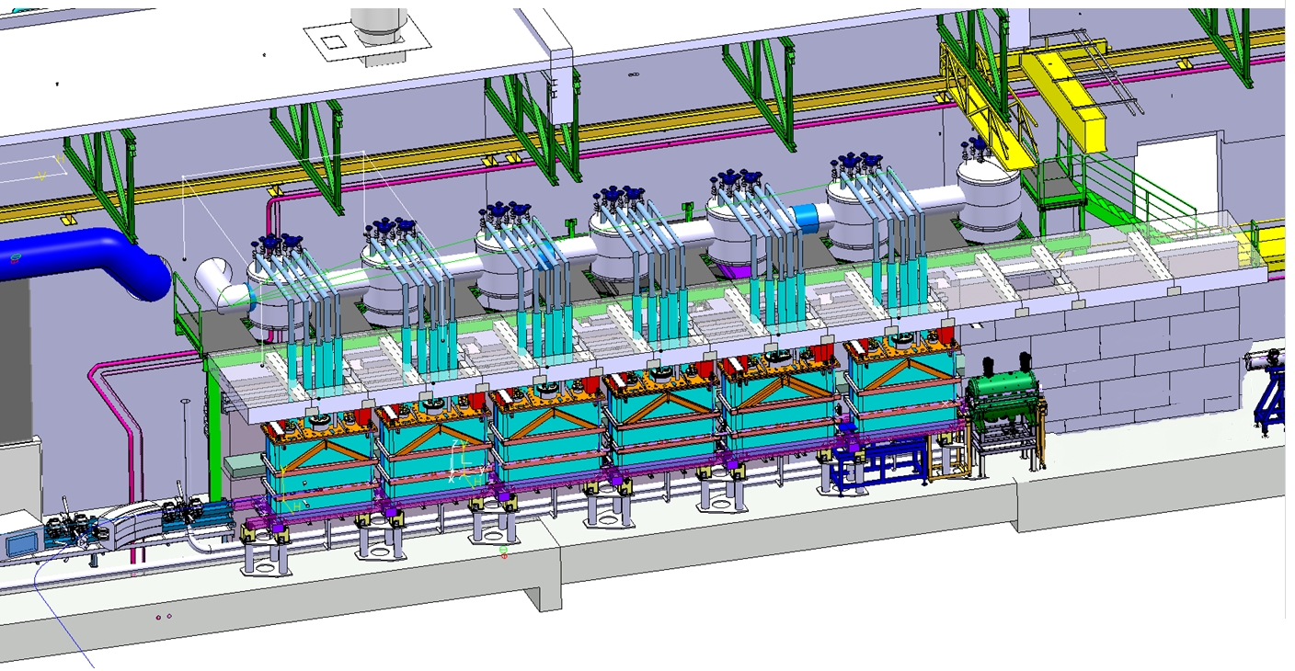
Modular Cryo Line
Courtesy: Stephane Maridor
Chopper Line
2017 ?
Cryo Cold Line- stage 2
Linac CM High-β 1,2,3 & 4, Low-β 1&2 - stage 2b
and Chopper Line

Slide 29
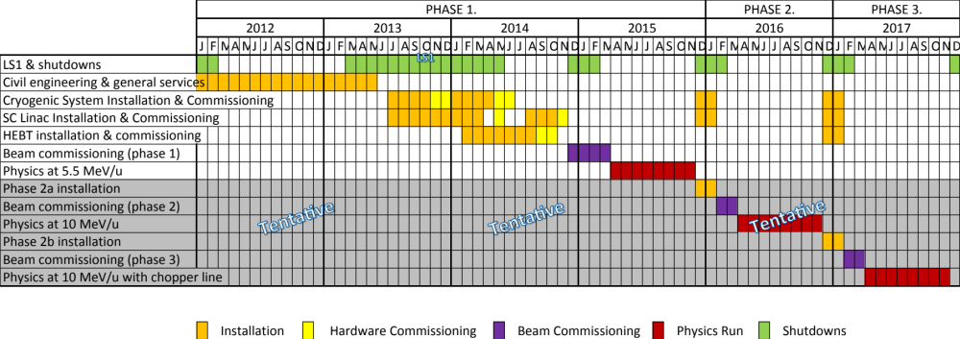
Main Issue
Procurement of Cryogenic System
  Analysing response of the 2 bidders (Air Liquide and Linde)
  Compressor system delivery November 2013
  Compressor commissioning March 2014
  Cold box + transfer line delivery July 2014
  Cold box + transfer line commissioning Jan/Feb 2015 =>
?
?

Slide 30
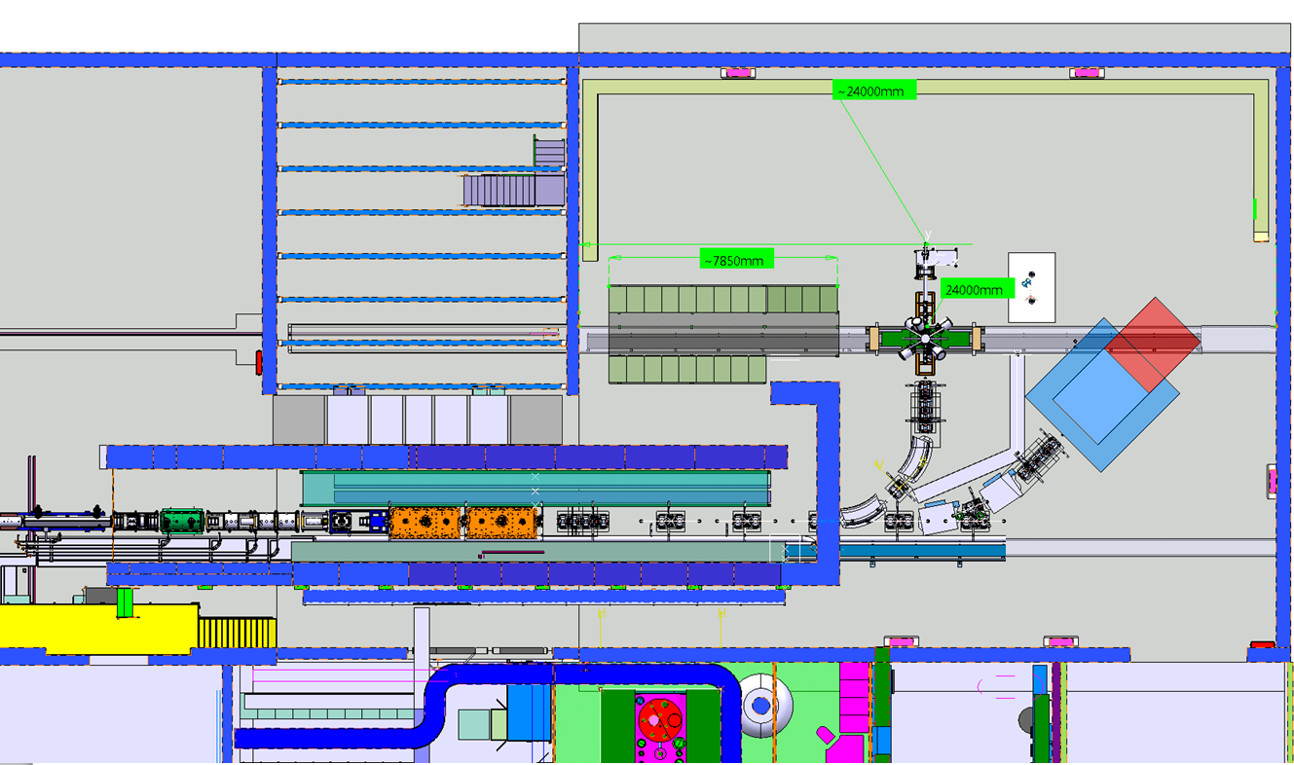


HEBT Stage 1
12 Tons
Steel frame work with
Magnetic shielding
approx size
5.5mL x 3.75 mW x 3 mH
Straight line with 2 experiment stations – Oct 2013 - Sept 2014
Miniball move: Oct 2013 – April 2014

Slide 31
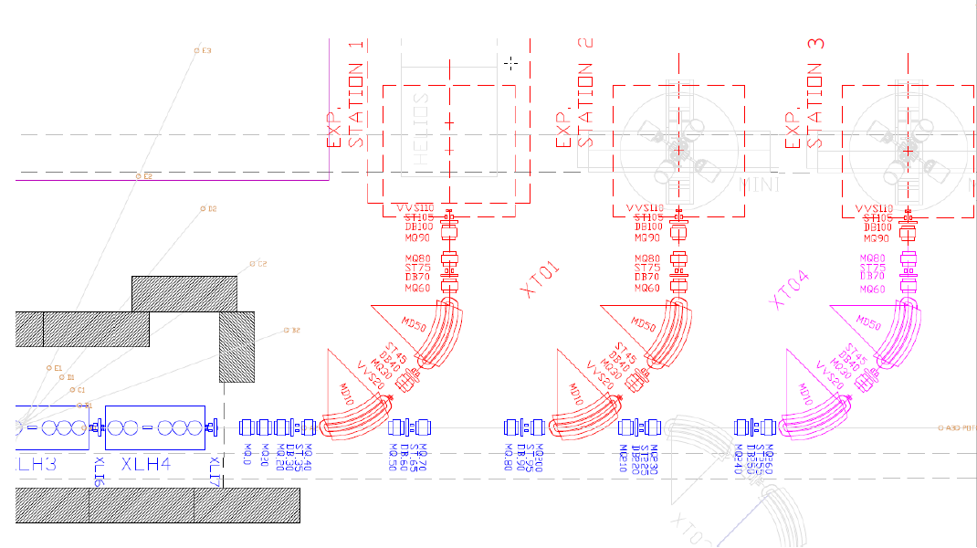
Proposed stage 1 HEBT layout

Slide 32
Follow-up of IAP (1/2)
Goals
  By September 2013, ensure 5 coated cavities cold tested
  By February 2014, ensure delivery of first cold tested cryomodule => April/May 2014
Recommendations
  "The committee supports the configuration for three beam lines and recommends to find the resources” to be endorsed by Isolde Coll. + HIE-SC and funding approved and secured
  Follow-up the risk assessment => define mitigation strategies for each of the main risks
  Finalize the access procedure to the vault with respect to ODH in a written analysis within the HIE-ISOLDE Safety File
  Secure cavity test in Orsay
  Obtain cavities within specification by Spring 2013
  Submit to the IAP the existing requirement and interface lists mentioned in the recommendation for the cryo module
  Assess the risk of contamination of DB + Critically review the cost for the BI of HIE-Isolde in the Cost & Schedule Review

Slide 33
Follow-up of IAP (2/2)
TECHNICAL COORDINATION:
  Produce a resource loaded schedule for all the components and subsystems => in time for the Cost and Schedule Review (Nov. 22, 2012)
  Prepare a 'document folder' containing the requirements, technical specifications, procedures, interface descriptions for each component and subsystem => in time for the next HIE-IAP meeting (April 8-9, 2013)

Slide 34
Budget Status (MTP-2012)
CtC of the project increased from 35.2 to 36.5 MCHF (2012 – 2017) => + 1300 kCHF = + 3.7% in 4 years:
Total resources of 175 FTE (2010 – 2015) => 105 FTE CERN Staff + 70 FTE External (CATHI + Isolde Coll.)
  External funding (incl. Isolde Coll.)
    LINAC (17.5 MCHF) => 16.9 – 17.3 MCHF
      5.5 AMeV + beam line stage1 ~ 7.9 - 8.3 MCHF => fully funded if extra contribution from ISOLDE Collaboration
      1 FTE from KUL (2012/2013) + New App. to Big Science 2012 => Nov. 2012
  CERN (19.0 MCHF)
    Management (0.2 MCHF)
    Infrastructure (16.0 MCHF)
    Design studies for intensity upgrade (1.9 MCHF)
    Safety (0.9 MCHF)
  Additional costs pending approval => Cost and Schedule review planned for Nov. 2012
    TE/VSC (+270 kCHF) = HEBT design modif. + FSU (2013 – 2016)
    TE/CRG (+1400 kCHF) = upgrade from 900 W to 1400 W (2013 – 2014) ?
    EN/HE (+120 kCHF) = cryomodule handling/transport (2013 – 2014)
    EN/CV (+730 kCHF) = higher contract adjudication costs (2013)
    BE/RF (+500 kCHF) = SC cavity and cryomodule test facility (2013 – 2014)
    DGS-RP (+180 kCHF) = extension f the monitoring system (2013 – 2014)

Slide 35
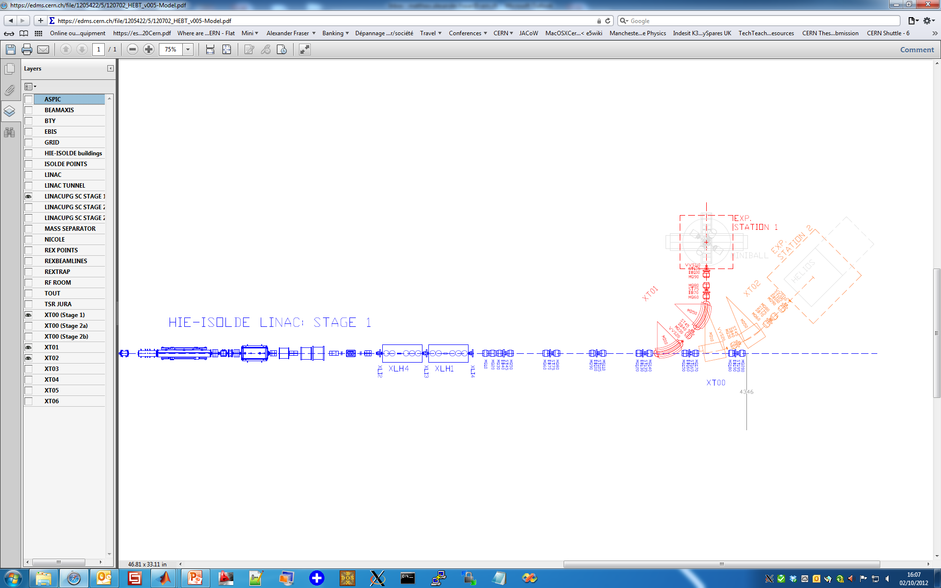
Savings from reduced ST/DBs?
Totals:
- 6 x DB
6 x ST
Question: Are the two steerers next to the experiment effective? Might be more effective to keep those in achromat and remove one of those near experiment
DB
ST
DB
ST
DB
ST
-DB
ST
-DB
ST
-DB
ST
DB
-ST
DB
-ST
DB
-ST
DB
ST
DB
ST
DB
ST
DB
ST
DB
-ST
-DB
-ST
DB
ST
-DB
ST
DB
ST
-DB
-ST
DB
ST
22 -> 16 ST magnets: 90 kCHF
44 -> 32 ST convertors: 120 kCHF
21 -> 15 DBs: 192 kCHF
Total: 402 kCHF

Slide 36
Needed Resources
Baseline – Phase-1
  0.8 to 1.2 MCHF
Alternative (3 beam lines)
  0.7 MCHF additional => 1.5 to 1.9 MCHF
Alternative (3 beam lines with savings)
  0.3 MCHF savings => 1.2 to 1.6 MCHF
Alternative (2 beam lines with savings in DBs+STs)
  0.7 MCHF savings => 0.8 to 1.2 MCHF
  => equivalent to Baseline – Phase-1

Slide 37
What’s Next
CATHI Mid-Term Report
  To be submitted by Dec. 31st 2012
Risk assessment:
  Mitigation & Follow-up
Cost and Schedule Review
  Nov. 22-23 2012
HIE-ISOLDE SC meeting
  Dec. 20 2012
Cavity Review
  Jan/Feb 2013 => IAP+Walter Venturini (BE/RF)
HIE-ISOLDE IAP meeting
  8-9 April 2013

Slide 38
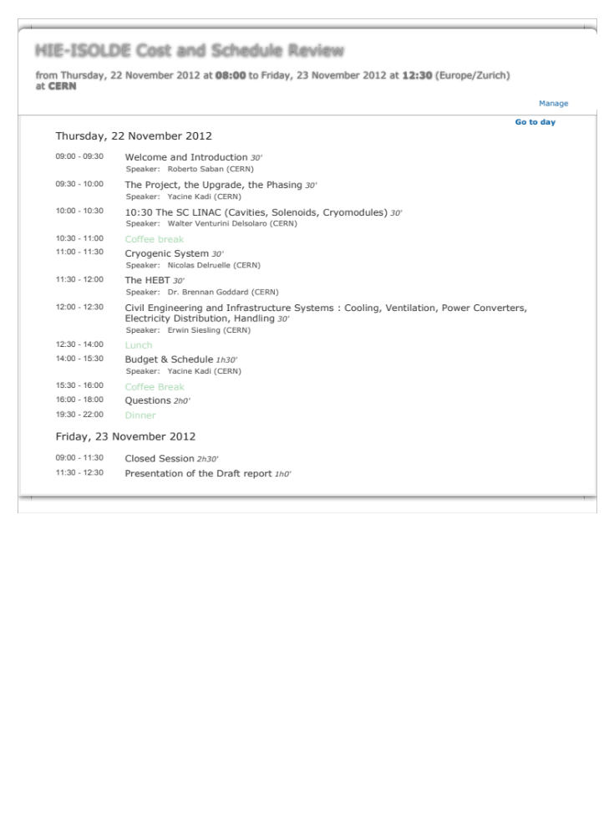
What’s Next

Slide 39
International Collaboration
Collaboration Agreement with CATE Consortium
  Agreement KE2012 signed by both parties: CERN and Lund University
  New Amendment to cover possibilty for the selected firms to contract the raw material on its own has been implemented => previously CERN was to supply the raw materials
  + feedback from Kirkholm in Danemark => fabrication of 2 cavity adjustment/positioning systems
Collaboration Agreement with BARC for in-kind contribution is in preparation:
  In kind contribution (cavities, etc…) in exchange of sputtering technology => not seen positively from AT Sector to be discussed at next SC meeting (Dec. 20 2012)
Collaboration with IBS-RISP (Korea):
  Visit of Prof. Kim chairman of IBS on Nov.19th - 20th 2012

Slide 40
OUTLOOK
Civil Engineering Works completed
Installation of Main Services (EL, CV, others)
Decision on the procurement of Cryogenic Plant (FC Dec. 2012)
Ready to launch procurement of first batch of high-beta cavities => via CATE + others
Ready to launch procurement of CM1 and CM2 => via CATE
Ready to launch procurement of HEBT phase-1
Cost and Schedule Review (22-23 Nov. 2012)

Slide 41
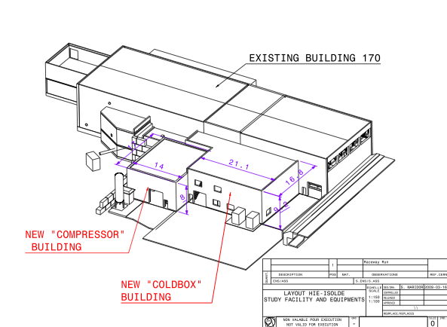
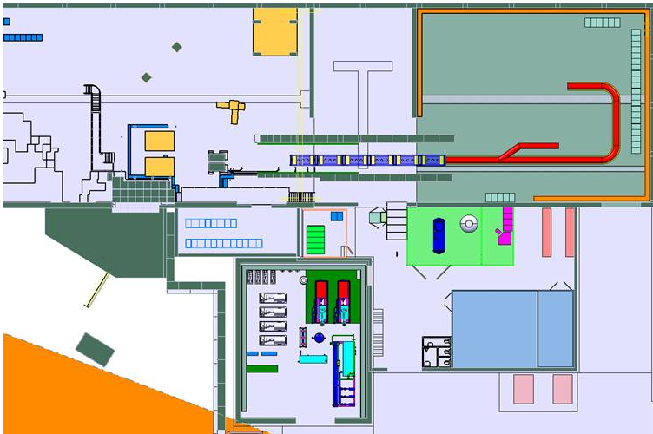
Thank you
HIE-ISOLDE web site -> http://hie-isolde.web.cern.ch/hie-isolde/
CATHI-ITN web site -> https://espace.cern.ch/Marie-Curie-CATHI/default.aspx

Slide 42
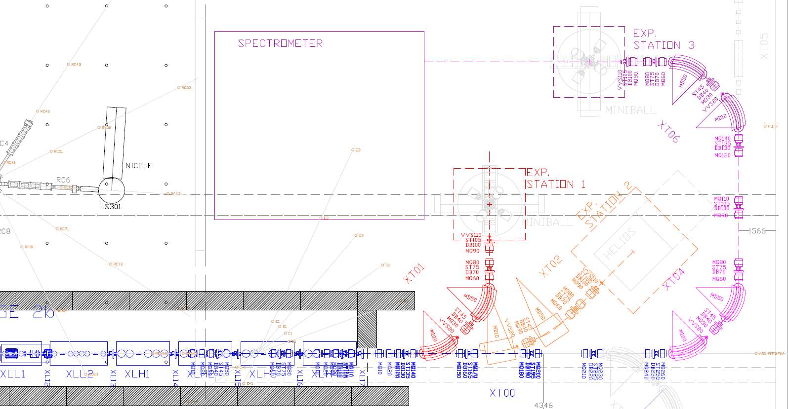
Latest HEBT design – stage 2b
All details on EDMS (HIE-ISOLDE/HEBT LINES OPTICS AND LAYOUT)
  Drawings, layout tables and (new) madx reference optics files

