Slide 1
PH Dept News
Long shutdown 1: Baseline Project
Project Leader Freddy Bordry
Injector shutdown Dec 2012-Mar 2014 means 1 year stop for ISOLDE Physics
LS2 will be in 2017-2018 when LINAC4 will be connected
Bldg 115 extension funded
Students Hans > Aug. 2012; Kara>Aug. 2014
Fellows: Janne and Deyan>Dec 2011; Thomas>June 2012. If good candidates apply possible to hire 2 new fellows in 2012.
ENSAR Technician Julien Thiboud available starting September 2011
ENSAR fellow Jan Kurcewicz starts Dec. 2011.

Slide 2
HIE-ISOLDE Physics Coordination Group
Y. Blumenfeld, M.J.G. Borge, P. Butler, J. Cederkäll, M. Fraser, M. Huyse, D. Jenkins, Y. Kadi, M. Kowalska, T. Kröll, M. Pasini, R. Raabe, E. Siesling, P. Van Duppen, O. Tengblad, F. Wenander
Meeting May 6, 2011
Beam Characteristics for HIE-ISOLDE

Slide 3
setup | Geometrical properties | Energy properties (FWHM values) | Timing | Power
MINIBALL (+general purpose reaction chamber) (input: M. Borge, T. Kröll, P. Van Duppen) | <3mrad + 2-3mm FWHM diameter (at 5-10 MeV/u energy)* | En. Spread: <1e-3 En. Accuracy: <1% En. Stability: ? | Would profit from microstructure required by HELIOS | About 26 kW
Spectrometer (input: J. Cederkäll, T. Kröll, , O. Tengblad) | EMMA-type: 1mrad + 1mm FWHM diameter at 5-10 MeV/u Gas-filled spectrometers: requirements like MINIBALL | En. Spread: <1e-3 En. Accuracy: <1% En. Stability: 0.1pm | Microstructure not required
HELIOS (input: D. Jenkins) | 3mrad + 5mm FWHM diameter at 5-10 MeV/u | En. Spread: <1e-3 En. Accuracy: <1% En. Stability: | Important (for 10MeV/u): resolution <2ns on target repetition rate: 1/100 ns no background (<1% acceptable) | below 25 kW
ACTAR (input: R. Raabe) | <2 mrad + 3mm FWHM diameter at 5-10 MeV/u* | En. Spread: <1e-2 En. Accuracy: En. Stability: |  | About 25 kW
TSR (input: Y. Litvinov) | 10π mm mrad geometrical acceptance at 5-10MeV/u | En. Spread: <2e-3 En. Accuracy: En. Stability: | Microstructure not required | 500 kW

Slide 4
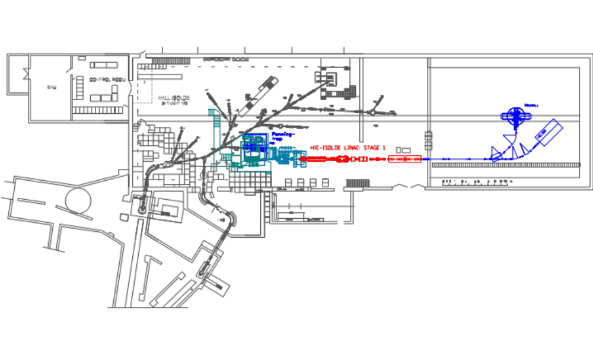
Layout 2014

Slide 5
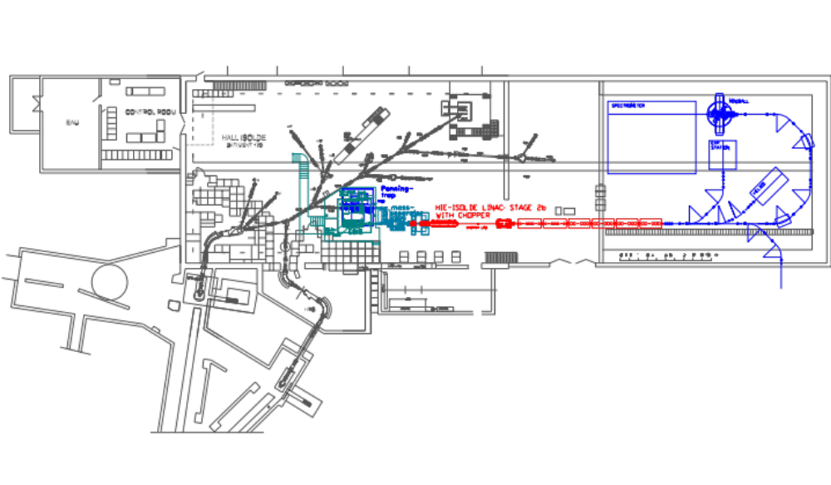
Layout 2016-17

Slide 6
Spectrometer Workshop March 2011
The outcome of the workshop is the following:
• Prepare a document by end of 2011.
• Next Workshop will take place in Madrid on February-March 2012 to discuss the document and prepare a strategy
• Time-Line: HIE-ISOLDE Physics 2014 is too early for spectrometer. Aim for the upgrade to 10 MeV and installation in 2016.
In addition, three Working Groups were established: physics case (convener T. Kröll), detectors (convener D. Mücher), and ion optics simulations (convener J. Uusitalo).

Slide 7
PSB upgrade or RCS? LS2 in 2017-18
Protons: | PSB upgrade | RCS
Energy | 2 GeV | 2 GeV
Repetition freq. | 0.83 Hz | 10 Hz
Max. intensity per pulse | 5.6e13 ppp (or 1.6e14 ppp) | 1e13 ppp
% of proton pulses | 40% | 60-70%*
Guaranteed p current | ca. 8 uA | ca. 10 uA
The BTY line should be upgraded to 2 GeV

