Slide 1
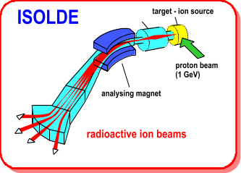

Technical Developments at ISOLDE
ISCC Meeting 3rd November 2008
R. Catherall / M. Lindroos

Slide 2
Outline
Ventilation Issues
RFQ Cooler
Fast Tape Station
REX
Target Developments
RILIS Operation 2008
Projects
HIE-ISOLDE
AB news

Slide 3
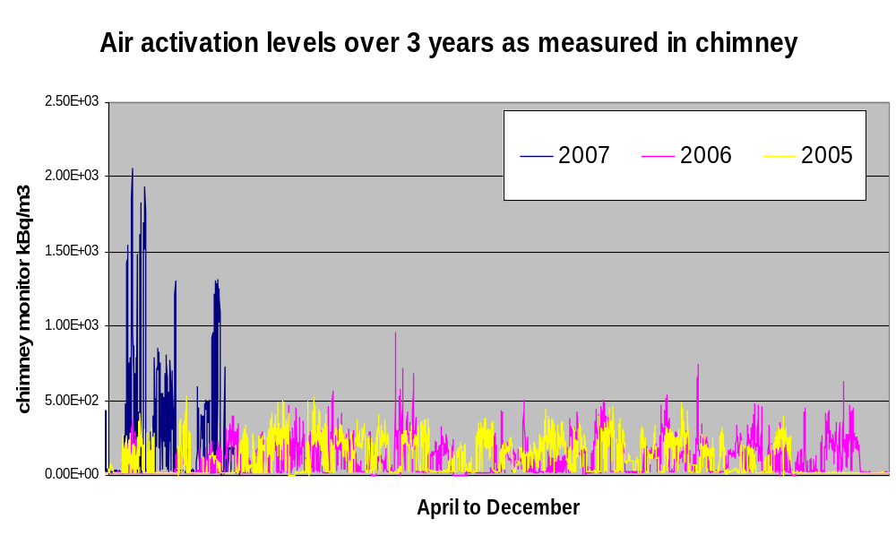
Ventilation Issues
2µA of p-beam on W converter GPS

Slide 4
History
2004 | Report on ventilation measurements
April 2005 | Completion of Class a Lab and modification of ventilation system
June 2005 | Addition of 3 metre high chimney. Air sampling position modification
2006/2007 | Anemometer replaced by Piton tube for a more precise ventilation flow rate measurement
2007 | P-beam intensity reduced to 1uA. 500kBq/m3 alarm installed at CCC
2007/2008 | Modification of ventilation system. Improvement of sealing the tunnel
May 2008 | Initial test results presented at ABOC
June 2008 | Stop the air pulsing into the zone
July 2008 | Further tests

Slide 6
Consequences
GPS limited to 1.5µA and HRS to 2.5µA
But the 500kBq/m³ alarm was still being triggered resulting in the need for further tests.
Tests have to be in collaboration with RP and compatible with physics schedule, target type, user requirements and Booster (alarm and stable conditions)
The more we measure, the more we find!

Slide 7
~60 mins

Slide 8
~ 60 mins

Slide 10
Correlation between external activated air measurements and the closed circuit purge ducting when the purge valve is closed. Indicating a leak across the valve.
Comparing a tritium equivalent to short-lived beta detectors requires a Fluka simulation on the portable monitor.

Slide 11
Conclusions
The peaks of ~700kBq/m³ seen in 2006 are due to 2 µA of p-beam on a target converter (240gcm⁻² instead of 45gcm⁻² for UC₂)
The graphs presented to the ABOC and RP in June 2008 are incorrect due to the underestimated time delay to saturation
The values of activated air emission are well below the values observed in May 2007 and are comparable to previous measurements in 2005 and 2006.
For a UC₂-C target: 2µA of p-beam release an estimated 520kBq/m³ of activated air for both separators after a delay of ~60 mins.
Investigations have uncovered other anomalies and provided “too much” data.
  The activated air emission measurement fluctuations when taking and stopping protons. (±60kBq/m³)
  The alarm at 500kBq/m³ has become an endless source of confusion and debate
  The previous limit of 1.5µA (GPS) and 2.5µA (HRS) were no longer valid and did not consider different target thicknesses.
  Highly sensitive detectors belonging to the users are measuring a higher than normal background in the hall thus providing the need for more measurements.
  A small activated air leak from the faraday cage closed circuit to the atmosphere has been observed. More measurements are required.

Slide 12
Decisions taken on the 25th July 2008
Allow 2µA of p-beam to be sent to each separator.
Increase the Arcon alarm to 650kBq/m³ alarm
  Justified by the reduction in ventilation flow rate.
  However, in the event of an increase of “false” gate monitor alarms, the proton beam current shall be lowered accordingly.
Apply for a derogation by RP to increase the alarm threshold for critical runs and the use of the W converter.
Date | Air flow (km3/h)
2006 | 14?
2007 | 10
April 2008 | 8.4
May 2008 | 7.8

Slide 13
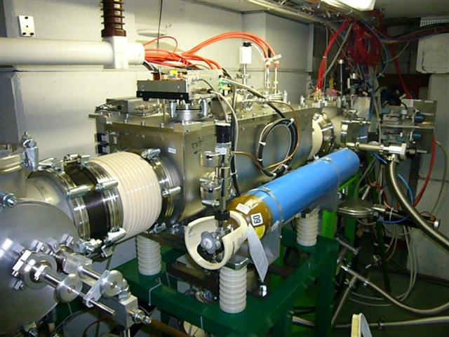
ISCOOL operation
2008 run
Successful and reliable first year’s run without major breakdowns
Operational aspects: full control of electrodes and RF via working set
Emittance performance: cooling from ~35π.mm.mrad down to ~2.2π.mm.mrad
Transmission: up to 80% through the RFQ (A>40), up to 100% through the beamlines. ISCOOL re-alignment done at the beginning of the 2008 run
Bunch mode performance: 20us bunch injection into REXtrap is possible improving trap transmission by factor 10 (A. Gustafsson, F. Wenander)
Points of attention:
- ISCOOL uses more He buffer-gas than expected (not a major problem but fills up the Isolde gas-recuperation tanks much faster)
- delicate RF amplifier: will be replaced including a spare (P. Fernier)
Upcoming consolidation: full vacuum sequence control (J. de Freitas)
E. Siesling

Slide 14
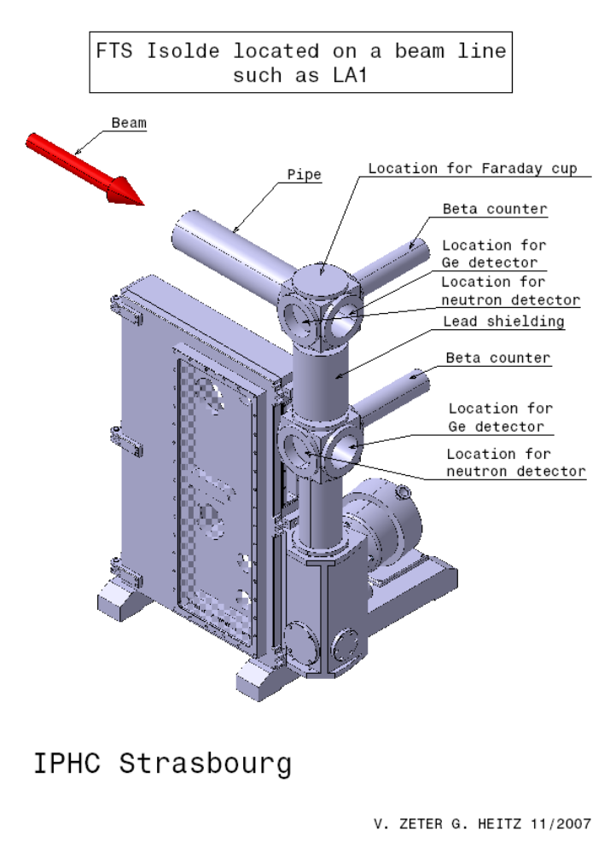
Fast Tape Station
IHPC – ISOLDE Collaboration started 5 years ago.
Installation at LA2 beam line this week.
FTS – 200ms transport time between point of collection and beta detector.
To be commissioned and calibrated in parallel with existing tape station during 2008 and 2009 before final replacement.
Cost 70kEuro

Slide 15
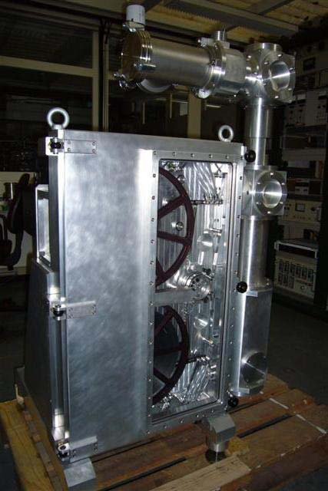
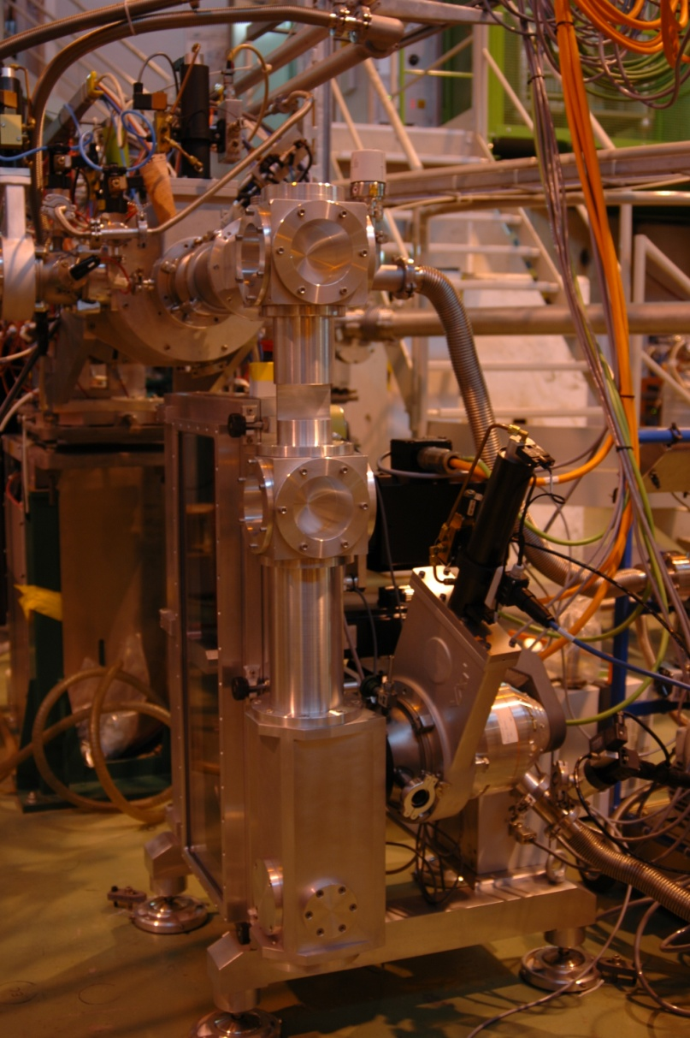
Fast Tape Station

Slide 16
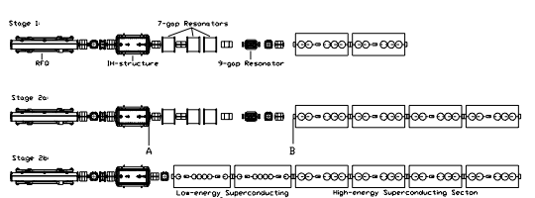
HIE-LINAC
Staged construction with machine installation during shutdown, i.e. no interruption of beam delivery
1.2 MeV/u
3 MeV/u
5.5 MeV/u
10 MeV/u
A SC LINAC based on Quarter Wave Resonators (QWRs) for the energy upgrade of REX-ISOLDE. The linac allows to reach energies up to 10 MeV/u and all intermediate energies starting from 1.2 MeV/u
Cavity R&D on going, first results expected by Feb 2009
M. Pasini, INTC 2008

Slide 17
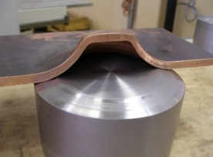
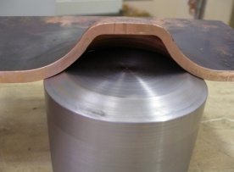
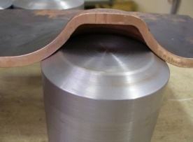
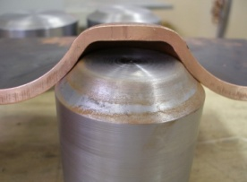
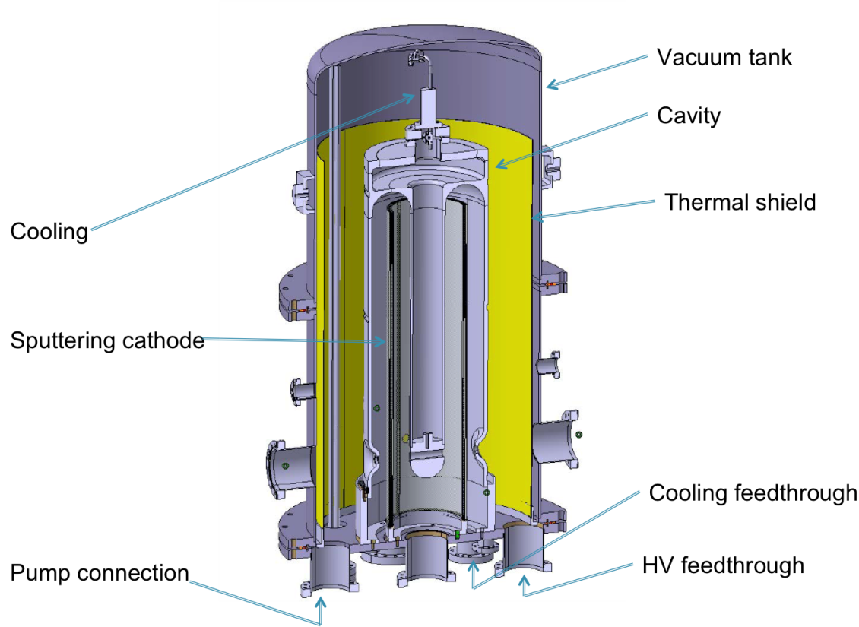
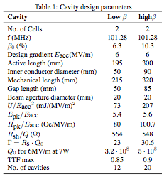
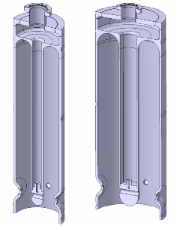
101.28 MHz Nb sputtered QW cavities
Low β
High β
Test manufacturing of the beam ports
Sputtering chamber design completed
M. Pasini, INTC 2008

Slide 18
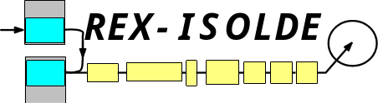
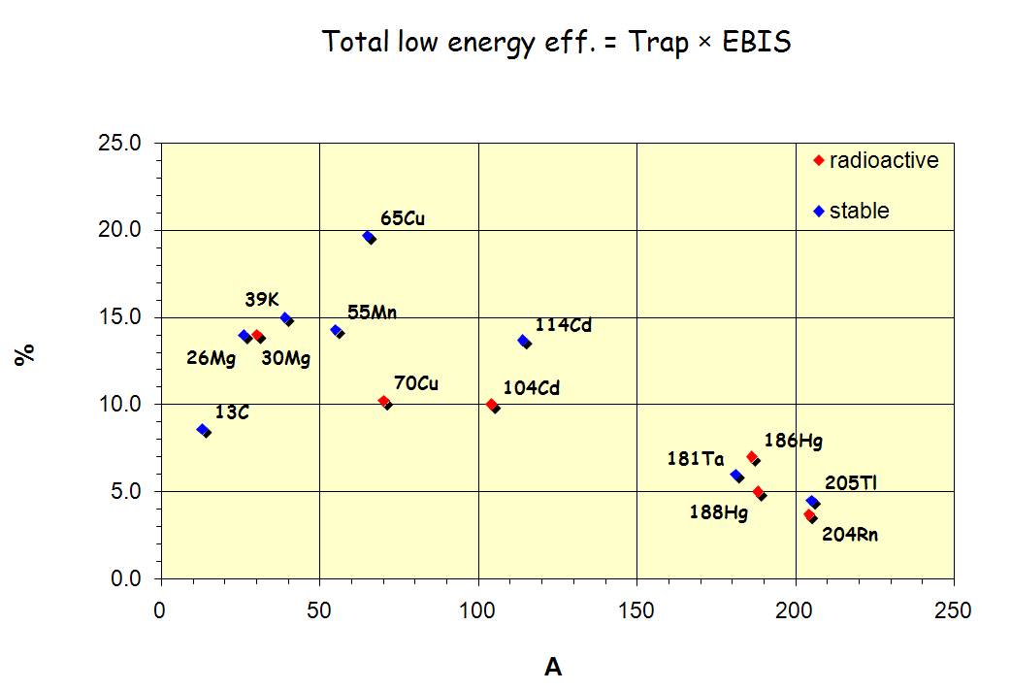
REX campaign 2008
(1) 10C from CO molecular beams
Second beamline 2.9 MeV/u
-> First C beam
(2) 61,62Fe and 61,62Mn
MINIBALL Coulex 2.9 MeV/u
-> Fe isotopes produced by in-trap decay of Mn
(3) 70mCu
MINIBALL Coulex 2.9 MeV/u
-> RILIS isomeric beam
(4) 202,204Rn
MINIBALL Coulex energy 2.8 MeV/u
-> Heaviest isotope so far
(5) 100,102,104Cd
MINIBALL Coulex energy 2.9 MeV/u
(6) 180,182Hg
MINIBALL Coulex energy 2.85 MeV/u
(7) 30Mg
Transfer reactions at MINIBALL 1.8 MeV/u
-> long run: 1.5 weeks
* 9C unsuccessful -> no beam seen at Miniball
* Linac amplifiers working very well but transmission still troublesome
A. Gustafsson, D. Voulot, F. Wenander

Slide 19
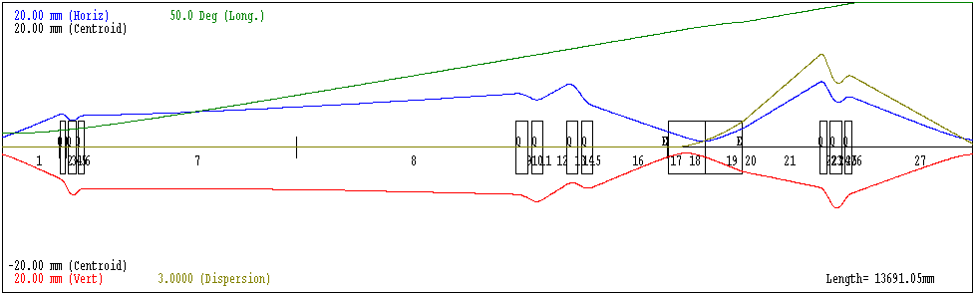
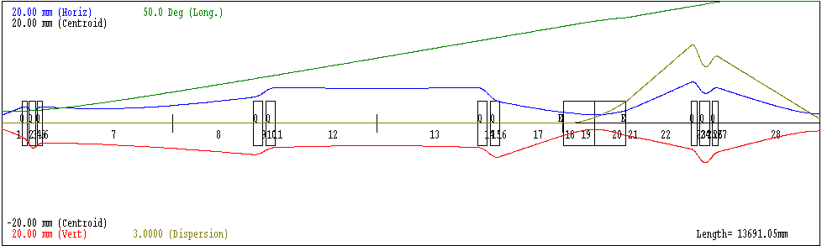
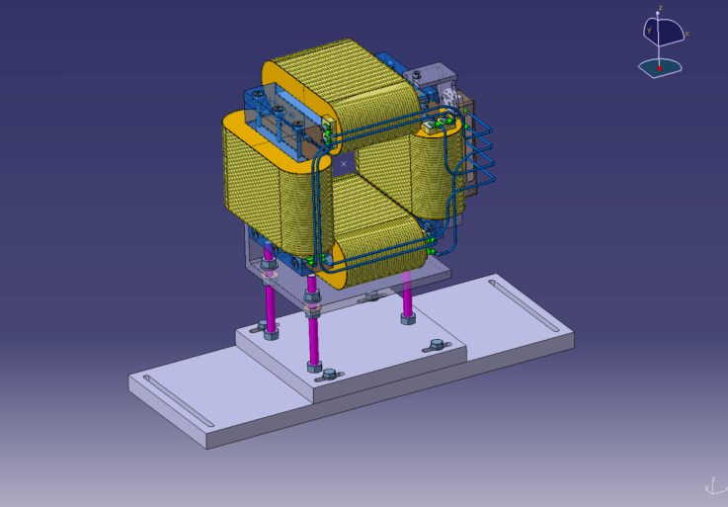
Shutdown works – main projects
Measure linac emittance directly behind 9GP (November)
Beamline modification (November)
  Move MQD2 and MQT5.2 to get less sensitive beam optics
  Improve linac stability end scalability
New magnetic correctors
  5 units under construction
  Installation April (can be installed after the start-up if necessary)
RF room cooling
  Close circuit ventilation with water cooled racks
  First test with heat exchanger supplied by Bertronix
7GP tuner consolidation
  New design more robust (based on Buncher tuner)
Preparations for REXTRAP consolidation on-going
A. Gustafsson, D. Voulot, F. Wenander

Slide 20
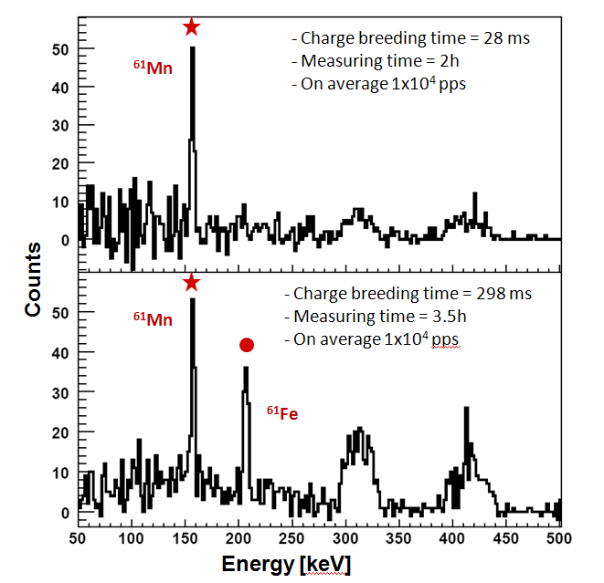
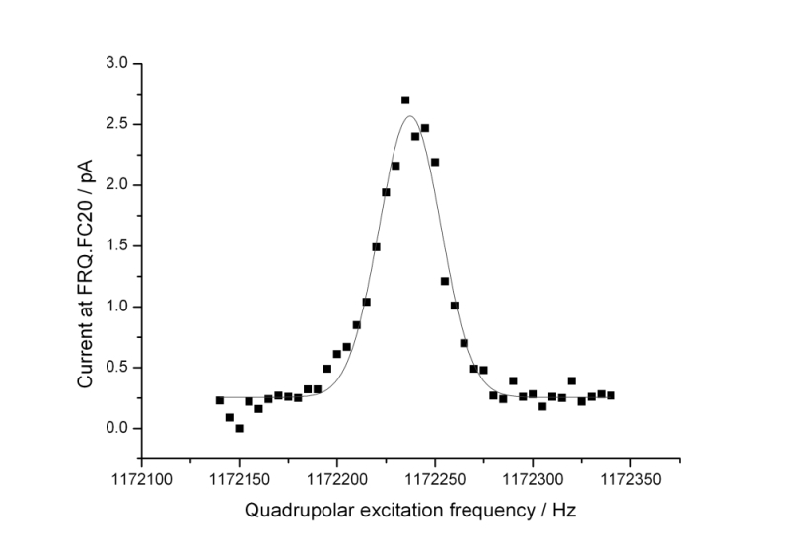
REX – New developments
In trap decay
-> Production of 61Fe beam from β-decay of 61Mn in REX-TRAP (presentation by J. Van de Walle and A. Gustafsson)
Pulsed injection from RFQ cooler into REXTRAP
MINIMONO ECRIS beam injection into REXTRAP
Redone isotopic mass purification with REX-TRAP
Now with high efficiency by using pulsed injection
(all 4 topics developed by A. Gustafsson at the ISOLDE workshop)
J. Van de Walle
Total efficiency = 3.3 %
m/dm = 3.2e4 > eff. = 6%
without RFQ cooler 0.5 % total efficiency for comparable setup
Current / pA
Quadrupolar excitation frequency / Hz
A. Gustafsson, D. Voulot, F. Wenander

Slide 21
FEBIAD ion source development
MOTIVATION:
→ Increasing the Krypton yield
→ Development of a Titanium beam
MK5 (“hot plasma”) AND MK7 (“cold plasma”) upgrades:
Element | He | Ne | Ar | Kr | Xe | Rn
Standard ionization efficiencies [Ber03] (%) | 0.14 | 0.36 | 2 | 4.3 | 11
Prototypes (MK7 and MK5 ionization efficiency (%) | 1.4 | 6.7 | 26 | 38 | 47 | 62*
* extrapolation
OUTCOMES:
→ Increase of ionization efficiencies by up to 10 times for noble gases;
→ Increase of ionization efficiencies by up to 3 times for the condensable elements;
→ Identification of ²²⁹Rn at ISOLDE.
Liviu Penescu AB-ATB-IF
[Ber03] U.C.Bergmann et al, NIM B 204 (2003) 220

Slide 22
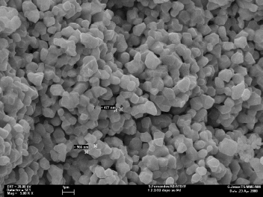
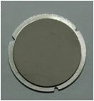
Target Material evelopments
Nanograined/ sub-micron targets:
Y₂O₃ (for ⁹C, ⁷²Kr beams).
High power oxide targets within EURISOL:
composite Nb/Al₂O₃ (for ¹⁸Ne)
Doped ZrO₂
~20μm
S. Fernandes, S. Mathot, L. Penescu, B. S. Nara-Singh, S. Sgobba, E. Noah,
D. Carminati, E. Barbero, P. Kasprowicz, et al.
T. Stora AB-ATB-IF

Slide 23
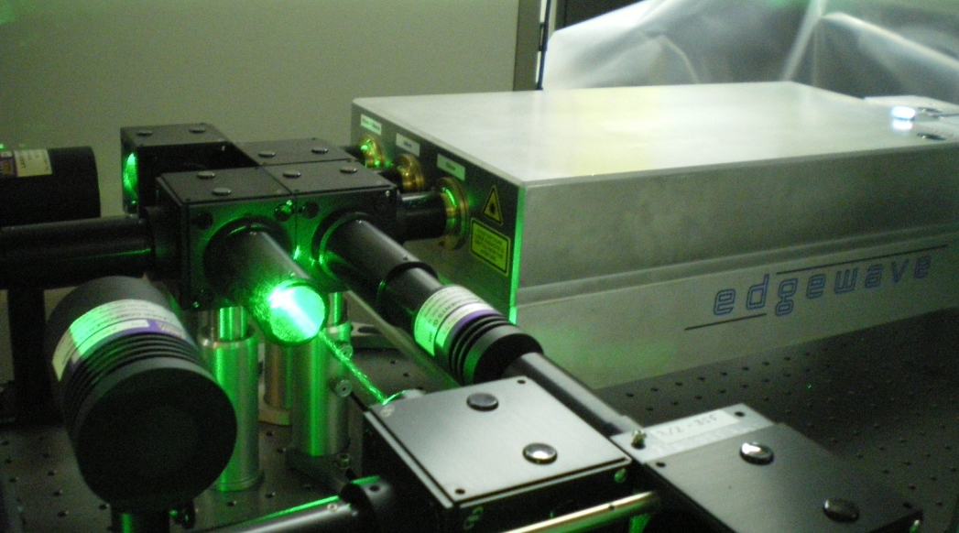


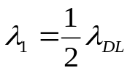
Nd:YAG lasers installed at RILIS
Diode Pumped Solid State Nd:YAG Lasers as replacement of Copper Vapor Lasers:
CVL
SSL
15 ns @ 11 kHz 8 ns @ 10 kHz
Green Beams
80 - 100 W @ 532 nm
Green Beams
45 W @ 511 nm
UV Beam
18 W @ 355 nm
Yellow Beams
35 W @ 578 nm
IR Beam
35 W @ 1064 nm
Ion beam produced with the SSL in 2008:
Ga, Tl, Be, Nd, Cu, Mg, Pb
CVL scheme
SSL scheme
Improvement of Ga ionization efficiency by SSL :
Two dye lasers were applied at 1st step of excitation - x 2
More power could be delivered to HRS target at the 2nd step of excitation
Better power stability
54%
46%
46%
V. Fedosseev

Slide 24
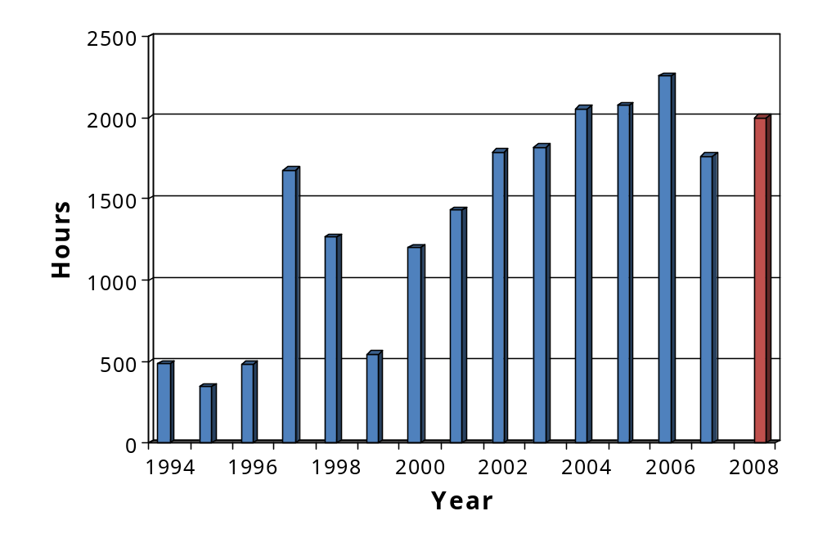
RILIS operation in 1994-2008
2250 h
~ 2000 h
1763 h
SSL ~ 60%
CVL ~ 40%
Percentage of RILIS produced beams for ISOLDE physics runs:
2006 – 52%
2007 – 48%
V. Fedosseev

Slide 25
On-going Projects
Fast Tape Station
Tilted foils in REX beam line
  On-going via PH drawing office
REX-TRAP consolidation project
  On-going but complicated
    AB-PO ready
    Vacuum interlocks
    Wave function generator?
    Communication protocol
    FE software
    Applications
WiTCH – REX mu-metal shielding
  On-going in collaboration with Leuven.
MISTRAL removal
  Smaller equipment during 2008/2009 shutdown
  22 ton magnet during following shutdown
Drawings
  Migration of all drawings from EUCLID to CATIA started in collaboration with TS.
Target disposal
  Intermediate solution until 2010. Functional and engineering specifications for a hot cell to be launched beginning 2009

Slide 26

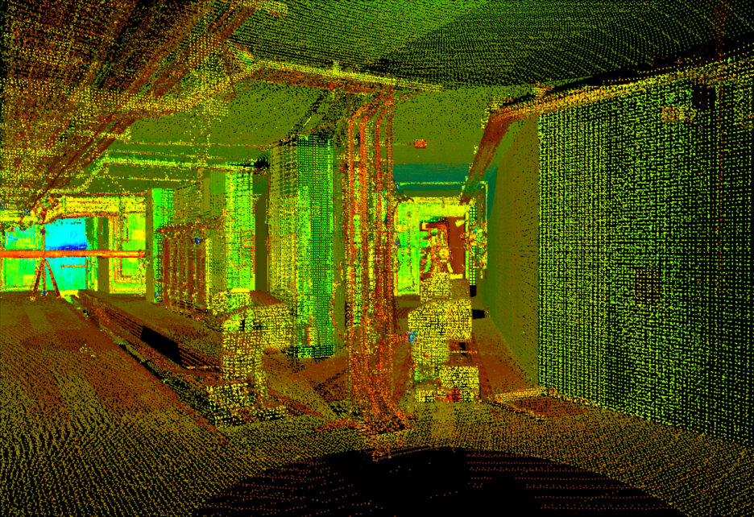
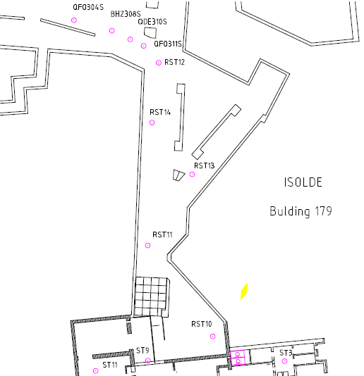
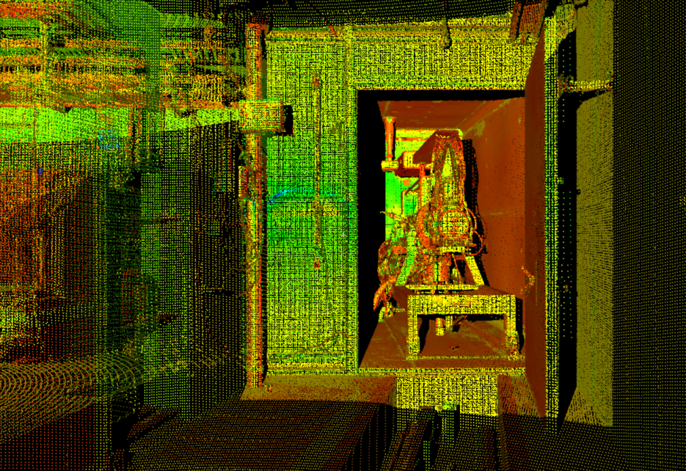
1.5 - The 3D Laser Scan
Cloud of point in the CERN coordinate system
Reference Points
J. Sarret, L. Bruno

Slide 27
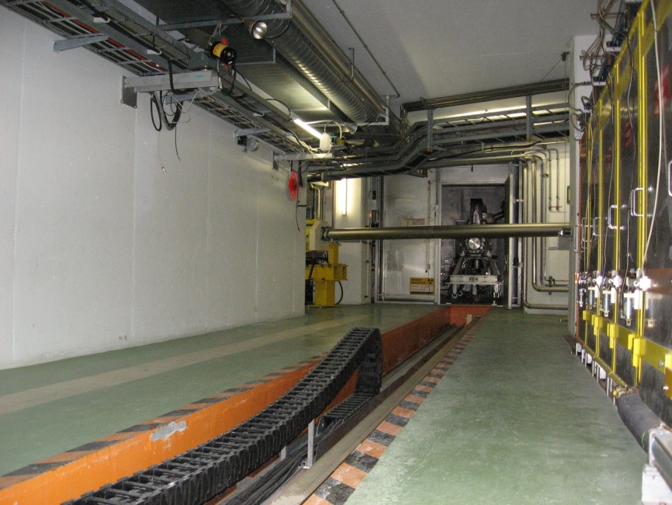
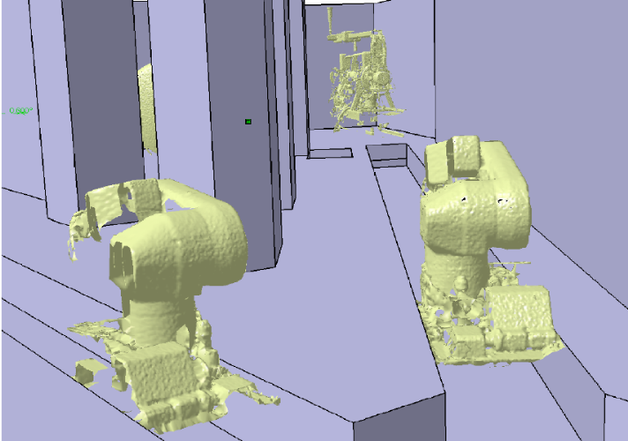
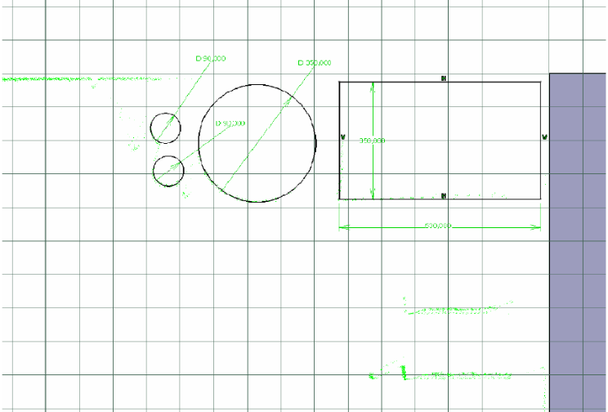
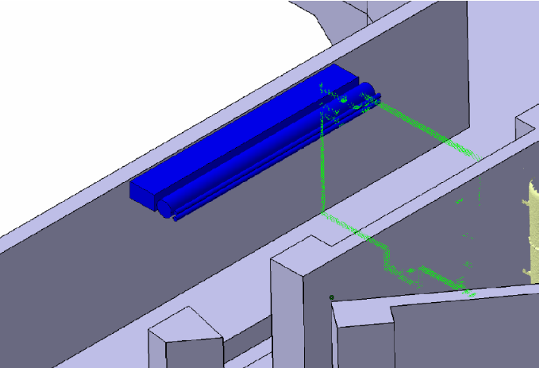
Incorporation of the 3D scan in the 3D model
Photographic documentation
J. Sarret, L. Bruno

Slide 28
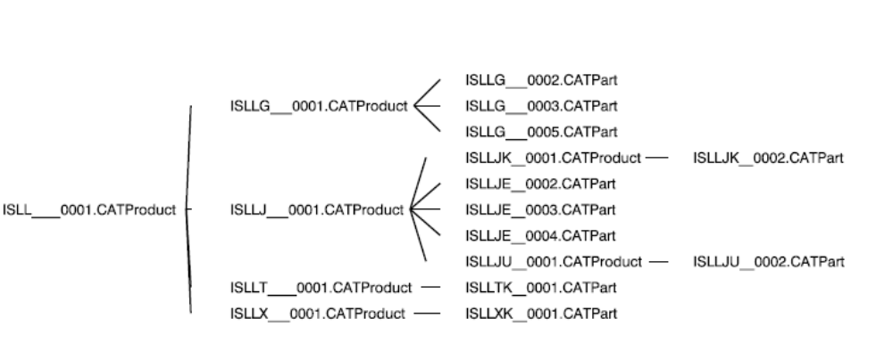
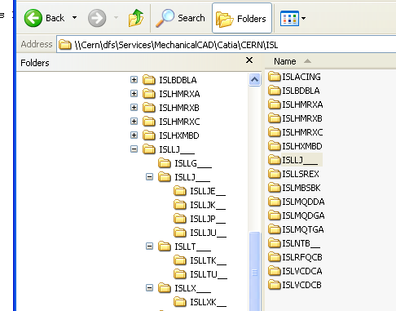
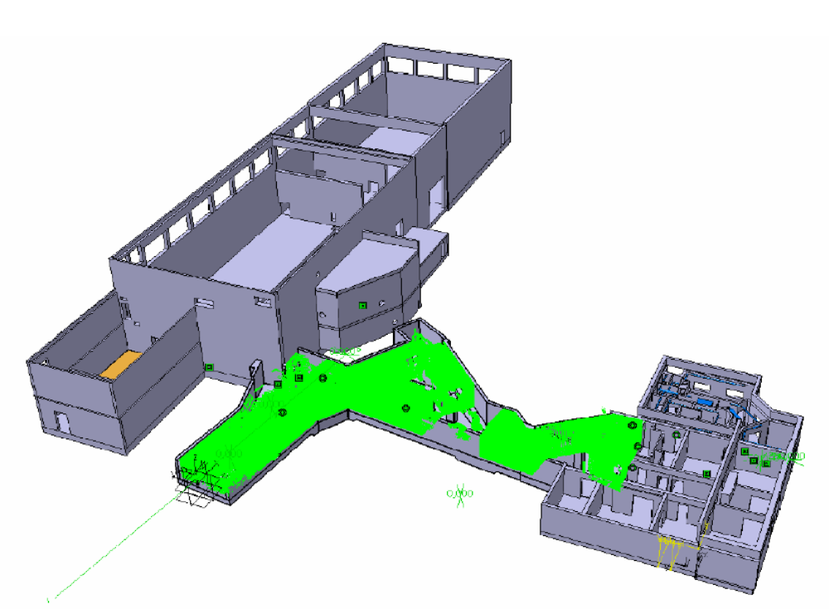
1.6 - The CATIA 3D model.
Catia 3D model referenced in the CERN coordinate system
J. Sarret, L. Bruno

Slide 29
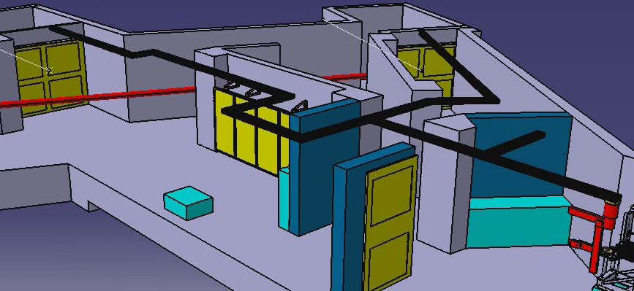
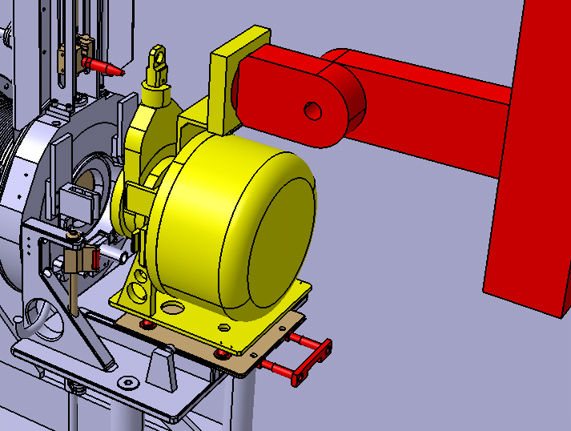
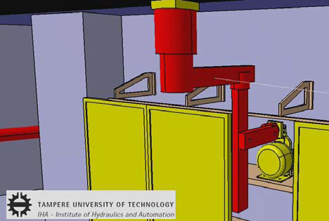
Handling Simulations
Proposal of an overhead robotic system by Tampere University of Technology

Slide 30

AB_ATB_IF
Departures 2008
  Liviu Penescu (Marie Curie Fellow)
  Elian Bouquerel (Marie Curie Fellow)
  Roman Wilfinger (Fellow)
  Pawel Kasprowicz (Technical Student)
  Daniel Carminati (Staff)
  Luca Bruno (Staff)
  Jerome Sarret (Unpaid Associate)
  Antoinetta (PH Staff)
Arrivals
  T. Giles (Staff)
  M. Owen (Staff)
  J. de Freitas (Technical Student)
  R. Cardinale (Associate)
6 requests through German PhD student programme

Slide 31
ISOLDE Overview
Technical Coordinator
R. Catherall
Target Production & Front Ends
ISOLDE & REX Operation
Support
Contributions
AB-ATB-IF
R. Catherall (SL)
M. Lindroos
T. Stora
E. Noah
S. Marzari
T. Giles
E. Barbero
B. Crepieux
M. Owen
S Fernandes (DS)
H. Richter (DS)
R. Cardinale (UPAS)
J. De Freitas (TS)
AB-OP
K. Hanke (SL)
E. Siesling
M. Eriksson
P. Fernier
E. Piselli
AT-VAC
S. Meunier
K. Weiss
H. Vestergard
E. Page
TS
Cooling and ventilation
Drawings
Electricity
Survey
AB-PO
J. Parra-Lopez
N. David
D. Matthieu
J. Schipper
AB-ABP
R. Scrivens (SL)
F. Wenander
AB-BI
G. J. Focker
C. Bal
M. Duraffourg
S. Bard-Peterson
AB
Applications AB-OP
Controls AB-CO
AB-RF
D. Voulot
SC-RP
A. Dorsival
Maxim Seliverstov,PNPI
Dmitri Fedorov, PNPI
Pavel Molkanov, PNPI
Anatoly Barzakh, PNPI
Yury Volkov, PNPI
Victor Ivanov, PNPI
Marica Sjoedin, KTH,
PH-IS
Equipment
Experiments
Development
Projects
AB-LPE
V. Fedosseev
B. Marsh
PH-IS
A. Herlert
AB-RF
Lee Neville
Johannes Broere
Jose Marques

