Slide 1
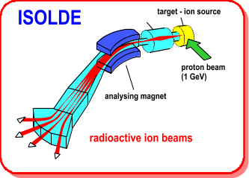
Technical Report for the ISCC Meeting
18th May 2009
R. Catherall/ M. Lindroos

Slide 2
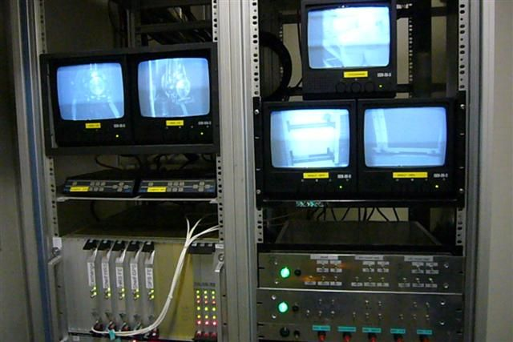
Modifications/Repairs
Target cooling water program modified and anti-return valve removed to allow a better start up of cooling system.
  EN-CV
Major overhaul of the ventilation system – EN-CV
Rabit irradiation system repaired – B. Crepieux
Improvement of the target zone cameras
  P. Fernier, S. Burger

Slide 3
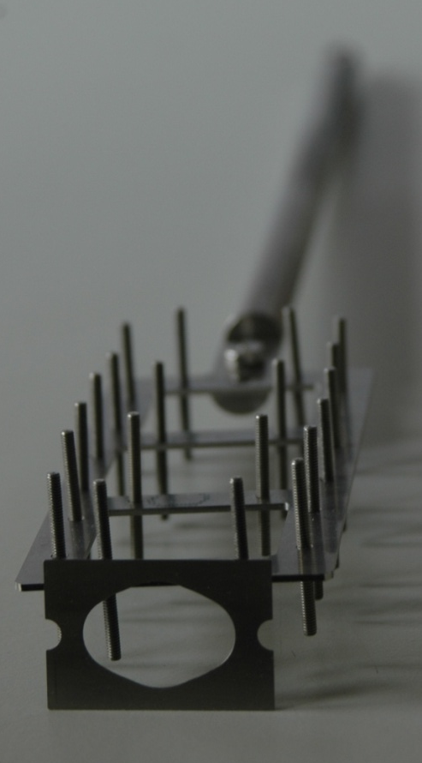
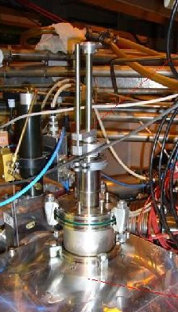
REX-ISOLDE
Installation of an MCP on the RA0 beam line going into the REXTRAP
Progress on the tilted foil holder and its installation being made

Slide 4
REX-ISOLDE
Low Energy
  The consolidation of the REXTRAP has been presented to IEFC (Injectors and Experimental Facilities Committee)
– awaiting approval and project status
  Low energy started up
    discharges in the trap mitigated
    pulsed trap injection barrier with high-current supplies tested
    EBIS cathode less performing – change later during the year
  Mass-resolving tests finished
    involving pulsed beam RFQ cooler, trap and EBIS
    ‘ready’ for real beam time challenge
  Installation of B-field shielding around REX mass separator started.
  Tested poly- and single-crystalline diamond detectors after the linac
for current, profile and energy measurements for HIE-ISOLDE
  4 days of REX operator training
    F. Wenander, D. Voulot

Slide 5
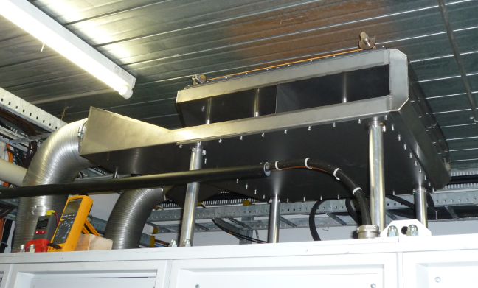
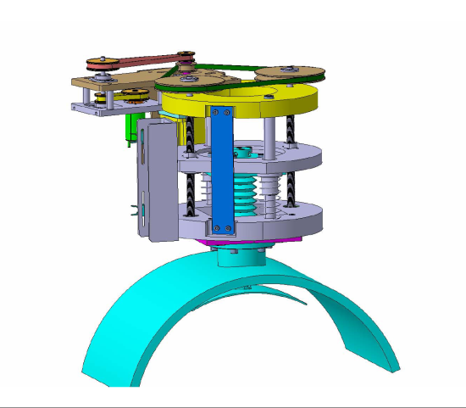
REX linac (1)
Water cooling for RF amplifiers:
objective: replace the air cooling system with closed-circuit water cooling
-> heat exchanger prototype installed and tested
-> modification of existing water circuit or dedicated closed-loop circuit under study
Impedance adapter for the 200MHz
objective: improve matching between amplifier and cavity to maximise output power
-> installed and operational
Consolidation of 7-gaps cavities tuner
-> new mechanics for the linear drive under construction

Slide 6
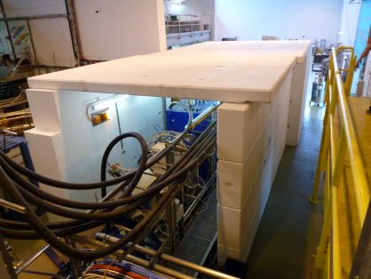
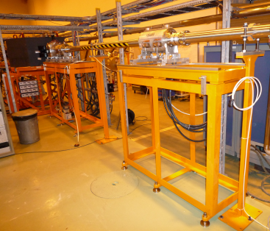
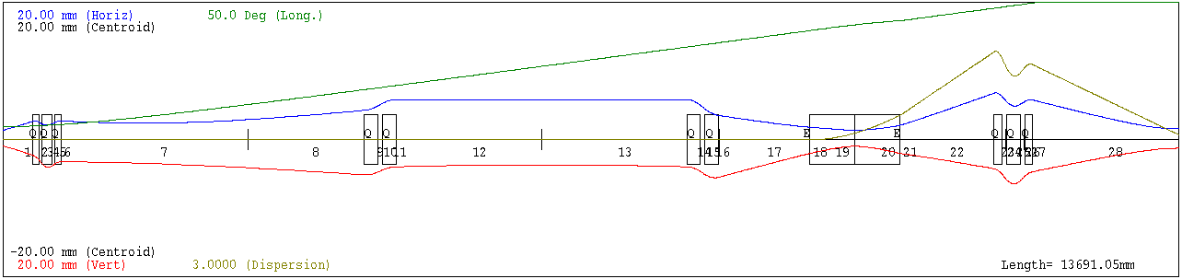
REX linac (2)
Linac shielding
objective: get rid of linac shielding on the cavities
-> simplify access and maintenance
-> improve safety
REX beam instrumentation control system consolidation
New magnetic steerers
-> to be delivered in November
New optics downstream the linac
-> improved transmission and reproducibility

Slide 7
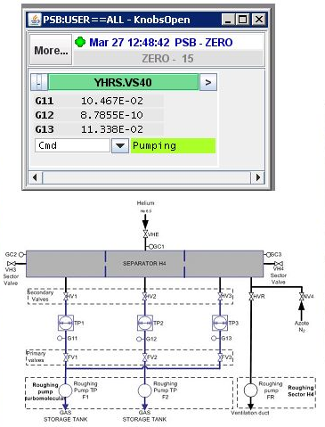
RFQ
Integration of RFQ vacuum controls into control system.
  J. de Freitas, H. Vestergard, E. Piselli
Successful construction and testing of a robust RF amplifier.
  P. Fernier

Slide 8
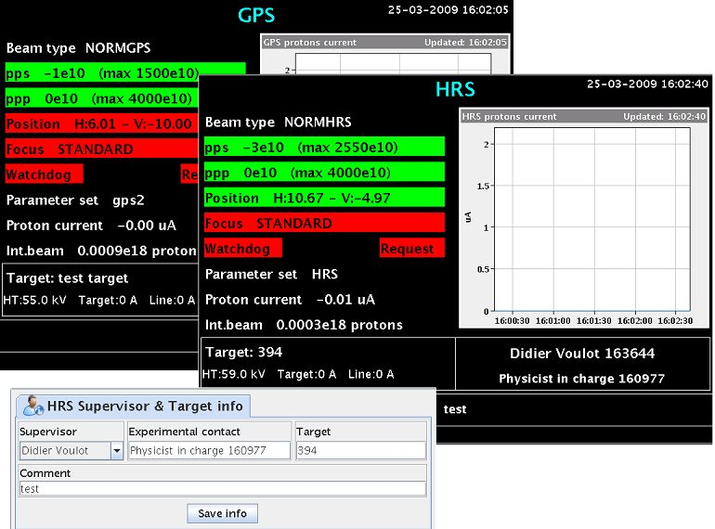
Booster
New Vistar including;
  P-beam intensity
  Focus alarm
  P-beam position
SEM Grid Tests;
  Beam profiles as a function of position and intensity
  E. Piselli, E. Siesling, T. Stora

Slide 9
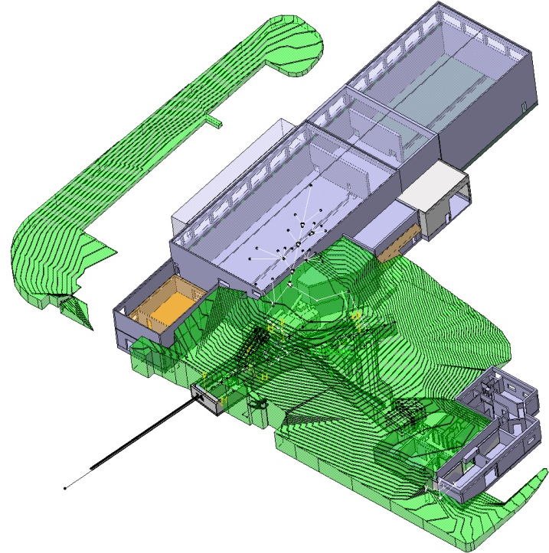
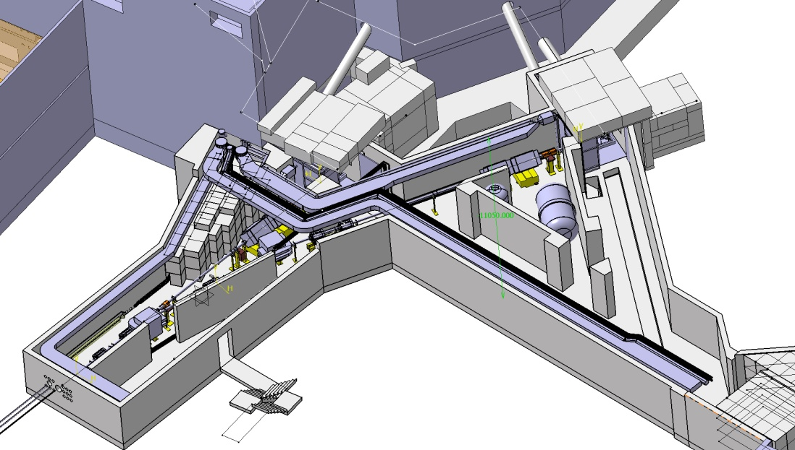
Drawings
From the laser scan to Catia
  Creation of detailed Catia model
  Being used by Agnieszka Leyko for Fluka simulations on present and future p-beam and shielding scenarios
Euclid and Pro-Engineer to Catia migration on-going for REX-ISOLDE
Catia models available for targetry
Planned integration of equipment models into hall
D. Voulot
S. Marzari
V. Baronzier

Slide 10
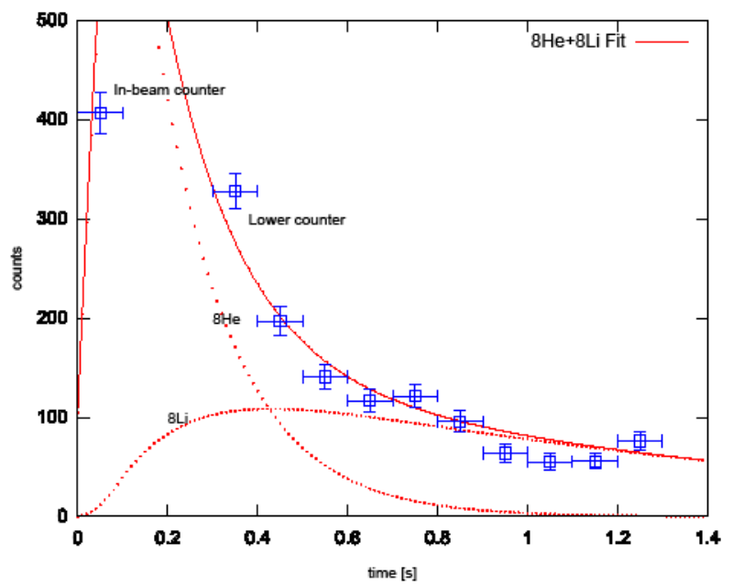
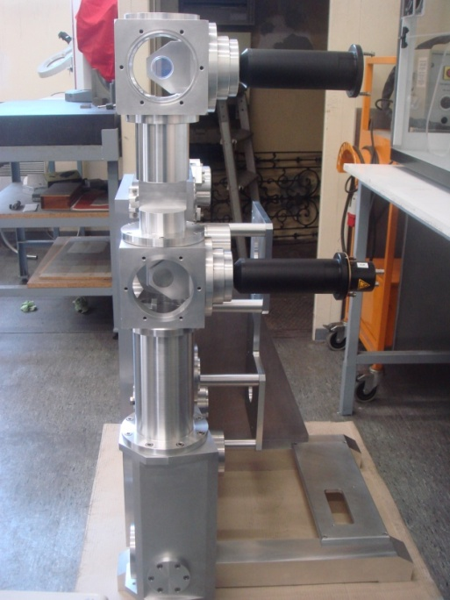
EN-STI-RBS
First measurements of ⁸Li and ⁸He in FTS
Calibration of FTS against old tape station on going
Test of BeO target with n-converter for the production of ⁶He was successful. Results pending
In parallel, n-flux measurements done with protons on converter.
  Analysis on-going
  T. Giles, T. Stora, E. Noah

Slide 11
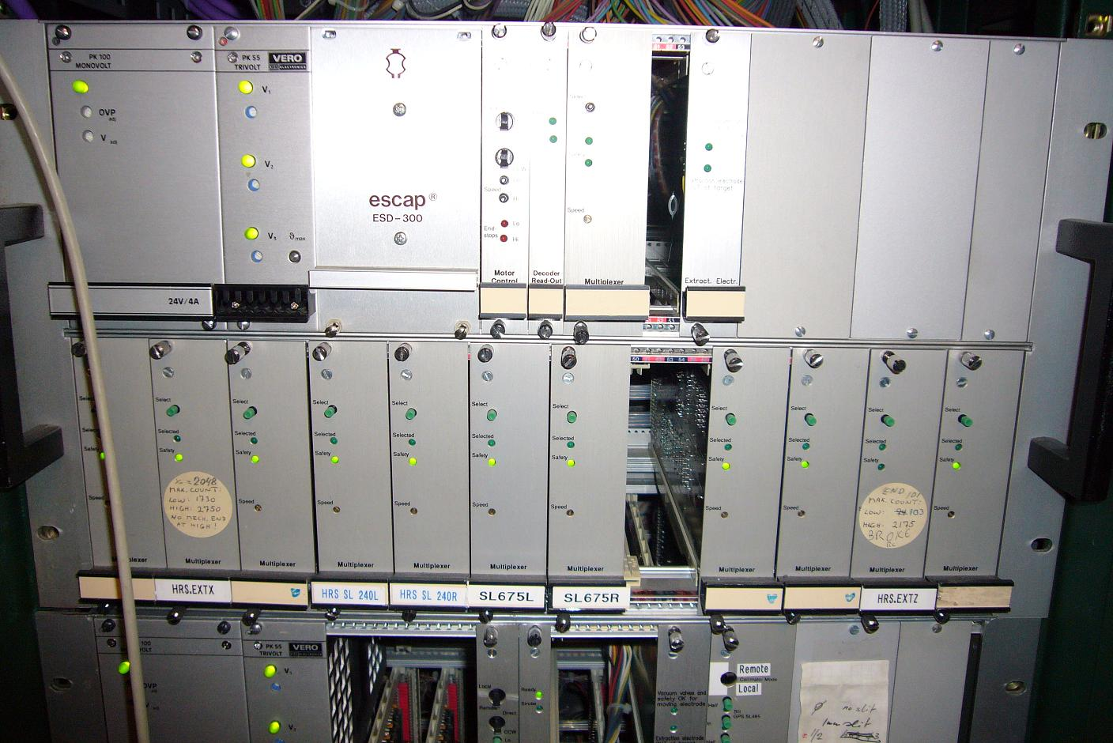
Difficult Start Up
Front End pistons
  An mechanical default in the replacement piston prevented it from working properly. A second replacement piston required modification of it’s support.
  The time required had consequences on the programmed laser tests during the cold check out period.
Stepping motor controllers
  Two motor drivers failed in one week
  No spares (~15 years old)
  Thanks to EN-STI-ECE for repair

Slide 12
Actualities!
Radiation Protection
  The operational radiation protection service is minimal
    1 technician
      All shutdown planning done around his availability
      Any absences can cause serious delays for both the technical group and physics
Vacuum Controls
  Minimum support from the vacuum controls section
  Consolidation is apparently planned for 2009/2010 but no news
Safety Audit
  Most of the ISOLDE community are undergoing interviews in view of exposing Safety Management shortcomings

Slide 13
EN-STI
One technical student for Fluka simulations on shielding in target area
  6 months as from March
One technical student for electronics development on FE6, tilted foils/motor controls
  1 year as from June 2009
Selection board for technician for Witch/REX
Lack of resources for target development

