Slide 1
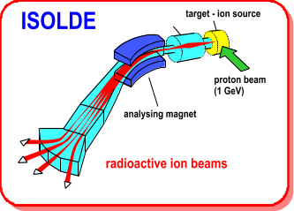


Technical Report for the ISCC Meeting 23rd June 2010
Richard Catherall EN-STI-RBS

Slide 2
Overview
ISOLDE Front End Exchange
HT Transfer Tube (Boris tube) Insulator Exchange + cabling
ISOLDE Vacuum System and Controls
Shutdown work summary
  Target Area and Experimental Hall
REX
  Low energy, cathode issues and Linac consolidation
RILIS
News from EN-STI

Slide 3
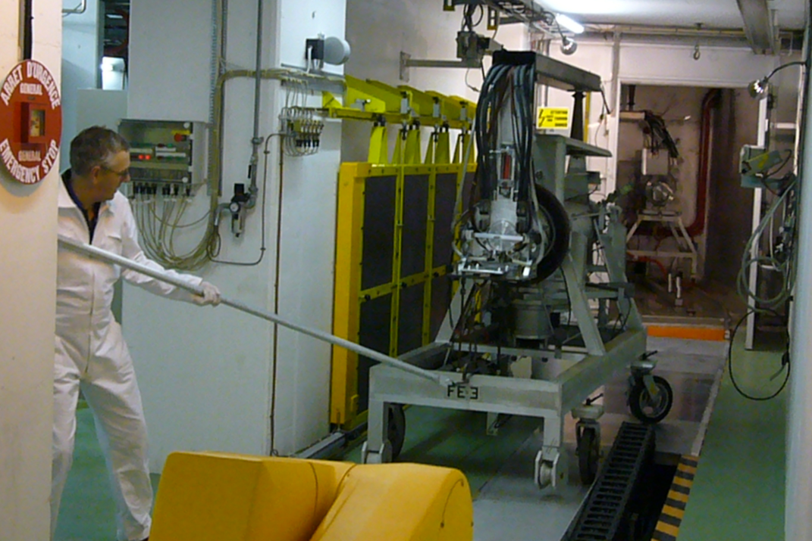
Front End Exchange
Not just a question of swapping:
  Power supplies
  FE Controls and Integration
  Vacuum systems and controls
  Cabling
  Compressed air
  Water distribution
  Alignment
  Mechanics
  Robot re-programming
  RP surveillance and Waste Disposal
  Planning, testing, commissioning
  Regular follow-up and schedule meetings
  Documentation
An excellent demonstration of teamwork across different CERN groups with the common objective of commissioning the FE before start-up in May.
 |  |  |  |  |  | [μSv] | [μSv]
 |  |  |  |  | Phase n° :
Découplage de la cible #415 et préparatifs |  |  |  |  | 0.5 | 445 | 588 | 668 | 132.1
Sortie Frontend 3 et préparation de la zone |  |  |  |  | 1 | 2168 | 1747 | 3252 | 80.6
Décablage et remplacement isolateur Boris tube |  |  |  |  | 2 | 1212 | 499 | 1818 | 41.2
Recablage HT, BT, air et eau |  |  |  |  | 3 | 1241 | 1662 | 1862 | 133.9
Installation FE6 et alignement |  |  |  |  | 4 | 2659 | 1189 | 3989 | 44.7
Couplage et connectique |  |  |  |  | 5 | 860 | 887 | 1290 | 103.1
Ajustements et tests |  |  |  |  | 6 | 1199 | 803 | 1799 | 67.0
 |  |  |  |  | TOTAL | 9784 | 7375 | 14676 | 75.4
Collective Dose Summary

Slide 4
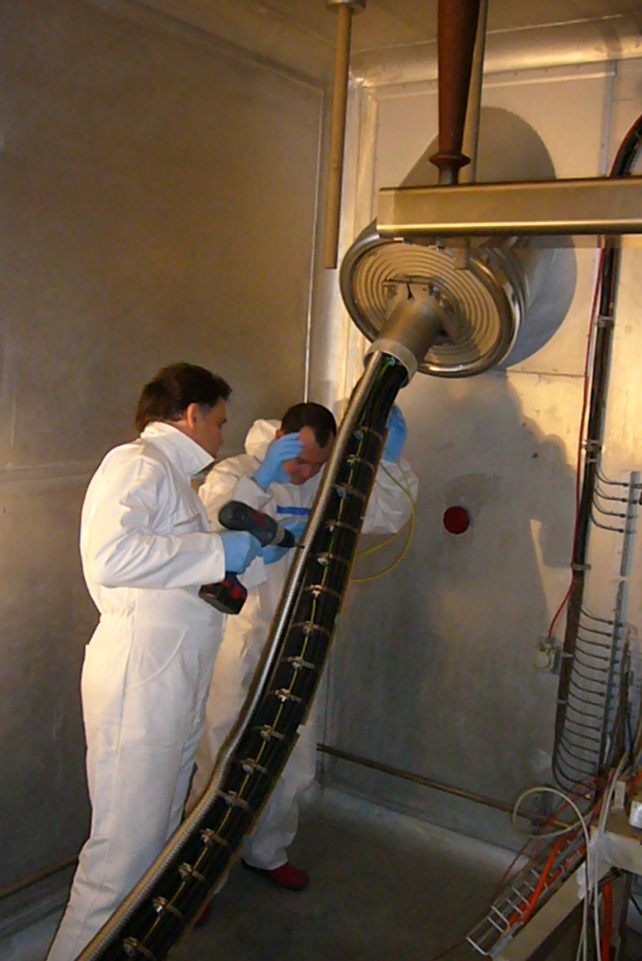
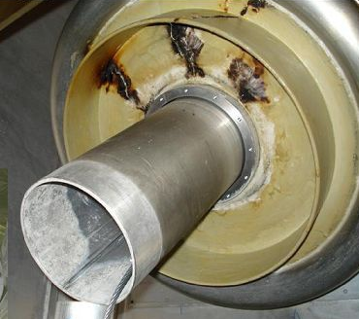
Boris tube insulator exchange & cabling
Insulator replaced while maintaining central HT transfer tube in position.
Insertion of main power cables from below while being hoisted from above.
Insertion of gas lines, water tubes and auxiliary cables.
GPS insulator showing signs of degradation.
  Two coats of Stycast epoxy applied to assure 60kV operation during 2010.
  Collective dose: 199 uSv

Slide 5
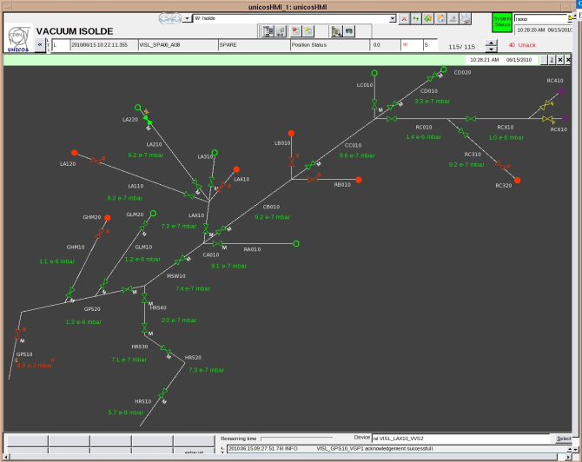
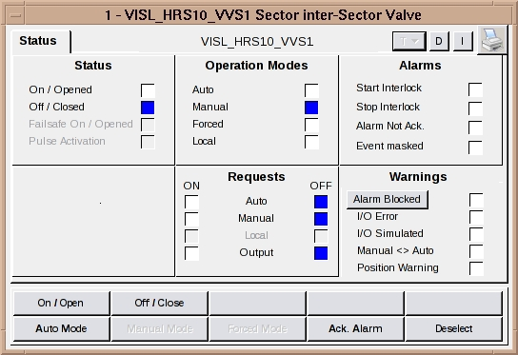
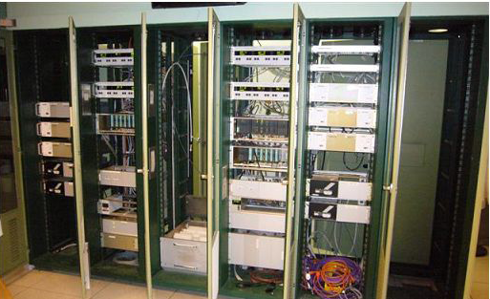
Vacuum System and Controls
Thanks go to TE-VSE and EN-ICE for implementing the new vacuum system and controls on time.
Included
  Cable removal and re-cabling
  Integration of new FE#6 controls with provision for FE#7 controls
  Major overhaul of controls equipment (gauges, controllers etc..)
  Modification of vacuum equipment (venting, exhaust gas storage, pumps etc)
  Inclusion of interlocks with other groups (Power, controls, fluids)
  Excellent collaboration

Slide 6
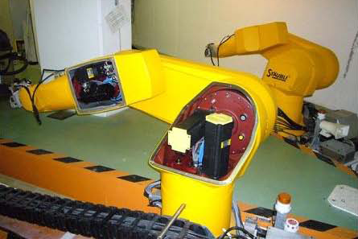
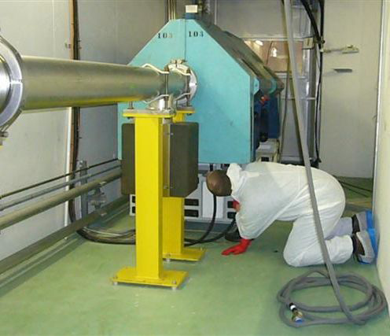
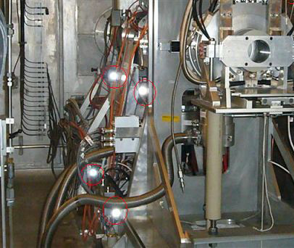
Shutdown work 1: Target Area
Remote Handling
  Robot revision
  Camera maintenance
  Installation of target coupling controls
  Faraday cage piston exchange
Infrastructure
  Alignment previsions
    To monitor HRS alignment from a distance
  Ventilation maintenance
    Filters, controls
  Vacuum maintenance
    Primary pumps, gas tank security
  FC cleaning
  FE maintenance
    extraction electrode tip exchange, piston exchange
  BTY magnet inspections
    Covering of exposed connectors

Slide 7
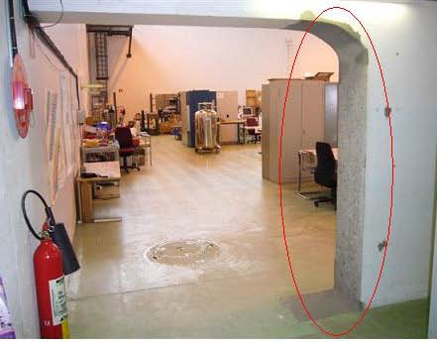
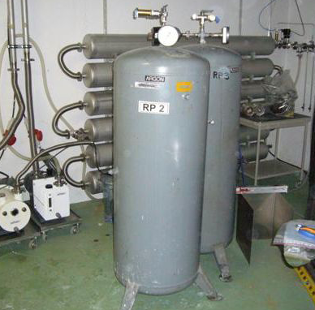
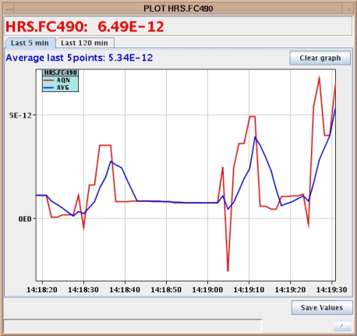
Shutdown work 2: Experimental hall
ISOLDE Hall
  RFQ amplifiers upgrade
    More reliable, migration of controls to FESA
  AC water leak repair
    No more “water in the hall”
  Vacuum
    Turbo and primary pump maintenance. Controls…
    Gas buffer tanks displacement outside separator area
  Civil engineering work
    Hole boring for cable passage, hole widening for MISTRAL removal
  Revision of power supply interlocks
    Due to new vacuum sections including RFQ + FE controls
  Scanner and FC maintenance
    Including BD controls and tape station maintenance
  Controls modifications (especially for new FE controls)
    Integration into FESA and work stations
  New applications
    Vistar alarms, automatic target start up sequence, FC display
  HT power supply repair and installation
    Astec 60kV replacing spare FUG supply
  Laser window exchange
  New fire detection System
  Spare cooling water pump repaired

Slide 8
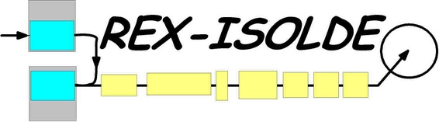
Low energy
REXTRAP control system upgrade in progress
    Timing specified and hardware tests on-going
    Sampling solutions under evaluation
    RF amplifiers being tested
    DAC and VME ordered
    PLC installed and operational (software to be changed)
    Pulsed power supplies in fabrication
    Meanwhile – present PROFIBUS communication problems corrected
REX separator shielding to WITCH magnetic field
Discussions about extending the shielding
Will have consequences for REX operation
– several modification required, to be discussed
REXEBIS SC magnet problems
After cooling filling, LHe hold-time decreased from 10 days to 15 h
System half-warmed up; leak tests at ~100 K and 77 K; no leaks found
Thereafter cooled down, now working
Good but unsatisfying / lacking explanation – will happen again without notice?
Plan to require a Twin EBIS from Manne Siegbahn Laboratory, Stockholm
F. Wenander

Slide 9
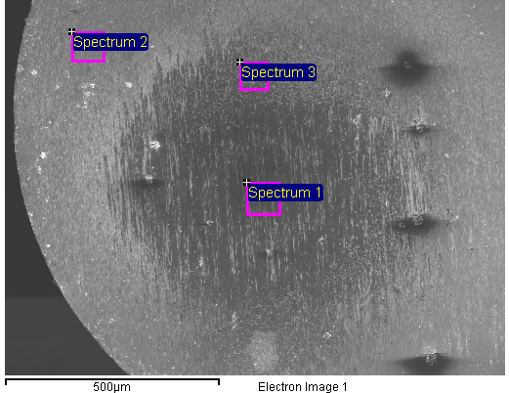
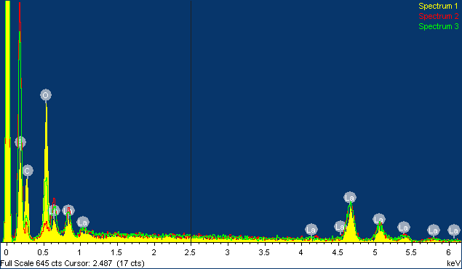
REX cathode
1. Intense cathode study during shutdown triggered by Be run Oct 2009
Cleaned Cu electrodes surfaces
Reduced conductive heat losses
New NEGs
Shunted cathode installed
SEM/EDS investigations
2. Start-up after shutdown
Little current emitted <->
poisoned cathode (i.e. changed work-function)
3. Back to usual heat loss configuration
Al₂O₃ isolators instead of steatites
Re-oxidized Cu electrodes
New cathode installed
4. Second cathode also poisoned
Used oxygen injection for cathode revival
Eliminated possible reason after reason
5. Number of tests and investigations performed
->
M. Scheubel
EN-MME
F. Wenander

Slide 10
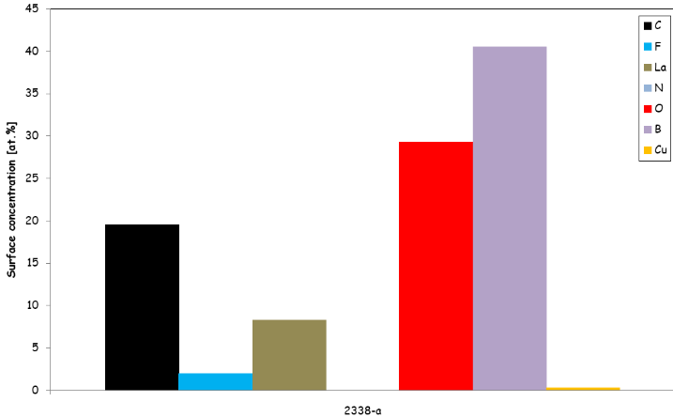
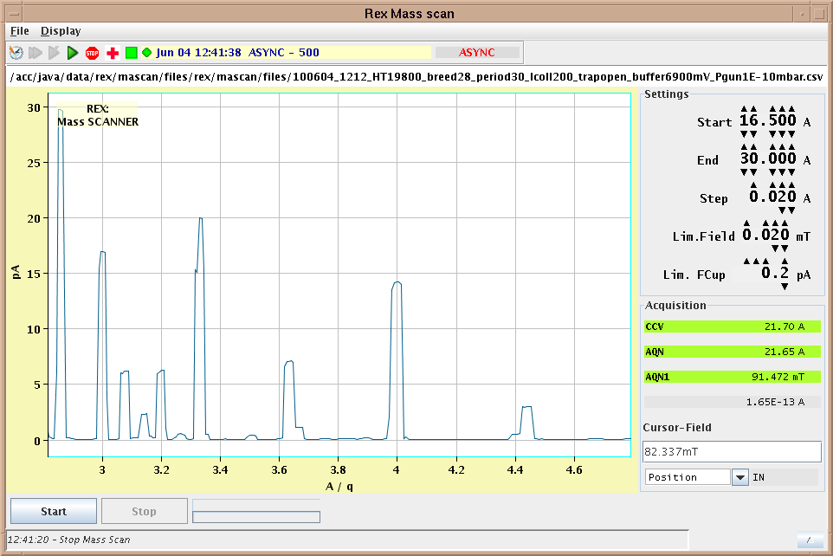
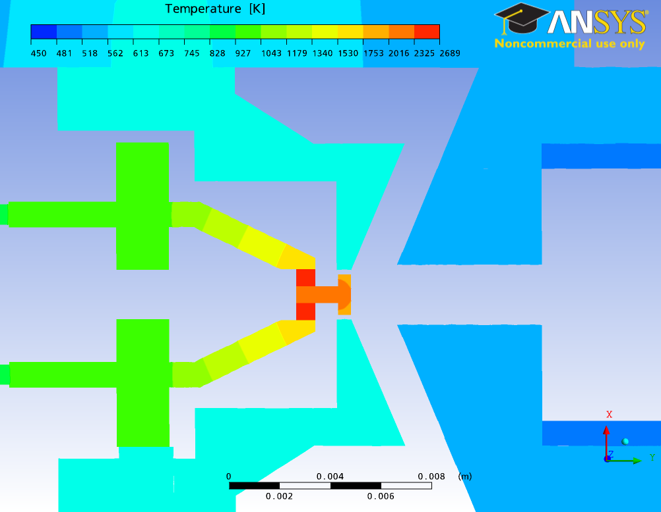
X-ray photoelectron spectroscopy (XPS)
* Relative atomic surface concentrations calculated from the photoelectron peak intensities in the XPS spectra
crystal orientation
surface contamination (XPS)
crystal stoichiometry (EDS)
surface roughness (SEM)
gas inlet (O₂ and CO₂)
temperature measurements
EBIS potential modifications
heat simulations
D.Letant-Delrieux
TE-VSC-SCC
Strong temperature gradient for given
thermal conductivity and emissivity:
back ≈ 2100K, front ≈ 1800K.
Wehnelt electrode: T ≈ 570K, ΔT ≈ 3K
Anode electrode: T ≈ 490K, ΔT ≈ 1K
* The spectrum reveals the presence of C (~20 at.%), La, O and B. (C and O normal)
* Traces of F are also observed, not confirmed
²⁰Ne⁷⁺
Residual gas spectrum
²⁰Ne⁶⁺
⁴⁰Ar¹²⁺
LaB₆
¹²C³⁺
¹⁶O⁴⁺
²⁰Ne⁵⁺
¹²C⁴⁺
⁴⁰Ar¹³⁺
¹⁶O⁵⁺
⁴⁰Ar¹¹⁺
²²Ne⁵⁺
²²Ne⁶⁺
⁴⁰Ar⁹⁺
M. Kronberger
BE-ABP-HSL
²²Ne⁷⁺
¹⁴N⁴⁺
Extremely good vacuum with new NEGs
F. Wenander

Slide 11
REX cathode cont’d
* No final conclusion or solution
* Short term action plan
  Exchanged to a different batch cathode 18/6
  Introduce gas leak close to gun
  Exchange for Cu electrodes with Ta inserts?
  Await results from manufacturer’s test-bench
* Long term action plan (options)
  Purchase similar LaB₆ from Kimball Physics
  20 weeks delivery time
    Small rebuilding of gun (~6 weeks, simulations excluded)
  Procure IrCe cathode from Russia
    major rebuilding of gun (>3 months excl tests)
  Setup test-bench
    (3 month to 1 year, depending on version)
F. Wenander

Slide 12
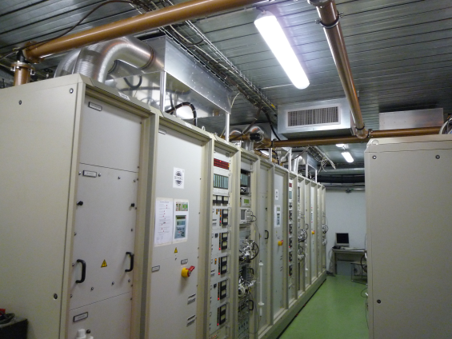
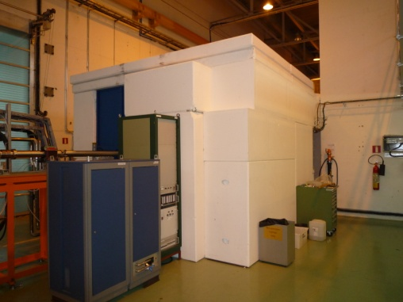
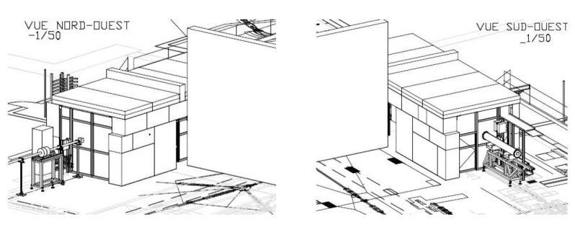
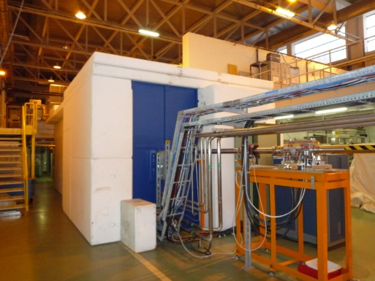
Linac consolidation I
Linac RF cooling and ventilation
  New ventilation for the RF room + Modification of RF amplifier (water cooling with heat exchangers)
  -> improve temperature stability + cleanliness
  -> longer RF tube lifetime (25kCHF/piece)
Linac shielding
Construction of shielding tunnel around the linac
  -> remove lead boxes on cavities
  -> faster and easier access to equipment
  -> less X-ray background at Miniball
Finished
Finished
D. Voulot & F. Wenander

Slide 13
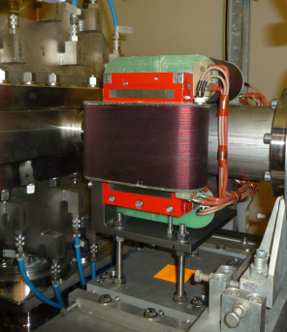
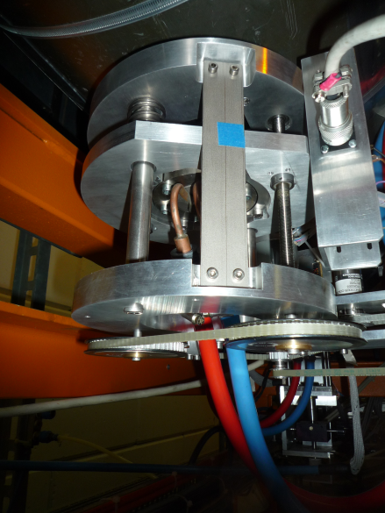
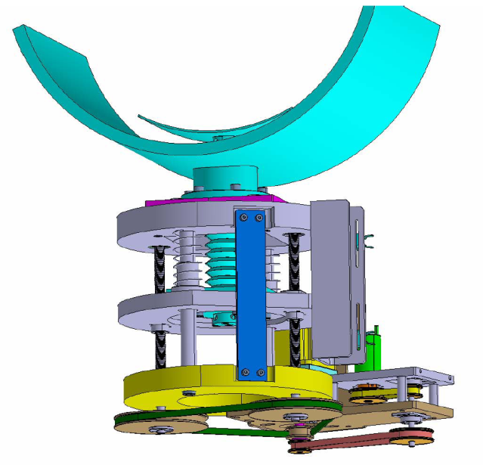
Linac consolidation II
Beam instrumentation controls
  Replace old Windows based control system with VME control server
  -> CERN standard (piquet support, easier to maintain)
  -> modular system (possibility of extension and modifications)
Commissioning
phase
4 units installed
(+1 spare)
Linac steerers
  -> improved beam optics
  -> scaling reproducibility
New tuner mechanics for 7-gaps
  Improve reliability and stability
  -> less RF interruptions
One already installed (7-gap3)
Two more units ready for installation
D. Voulot & F. Wenander

Slide 14
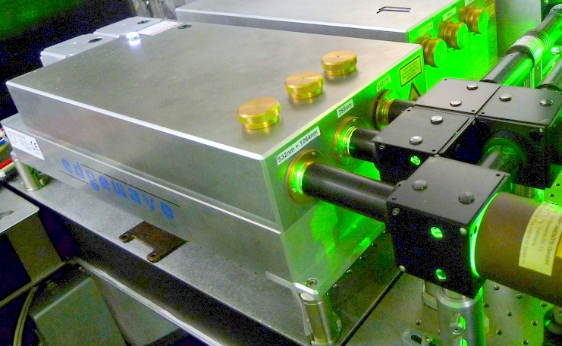
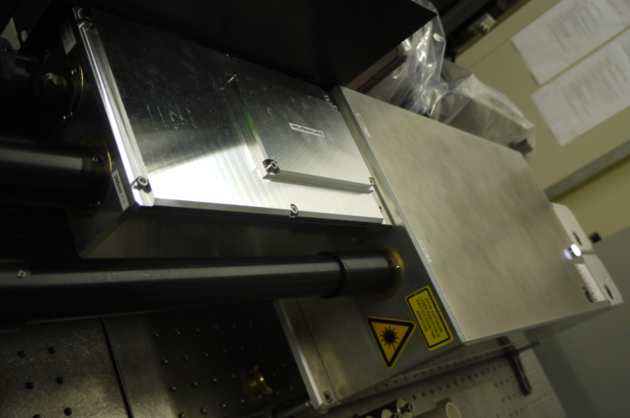
RILIS
RILIS: upgrade of Nd:YAG lasers
Reconfigured at Edgewave in 2009/10 shutdown
Nd:YAG 2008/2009
Nd:YAG 2010
Green Beams
85 W (+11 W)
@ 532 nm
2 Green Beams
110 W in adjustable ratios @ 532 nm
2 Green Beams
70 W + 15 W
@ 532 nm
UV Beam
18 W @ 355 nm
- Improved optics and external THG unit
UV Beam
18 W @ 355 nm
IR Beam
45 W @ 1064 nm
IR Beam 45 W @ 1064 nm
Rapid decline in power output
15W more green power
Degradation of THG crystal
Adjustable power distribution
Improved UV reliability
V. Fedosseev & B. Marsh

Slide 15
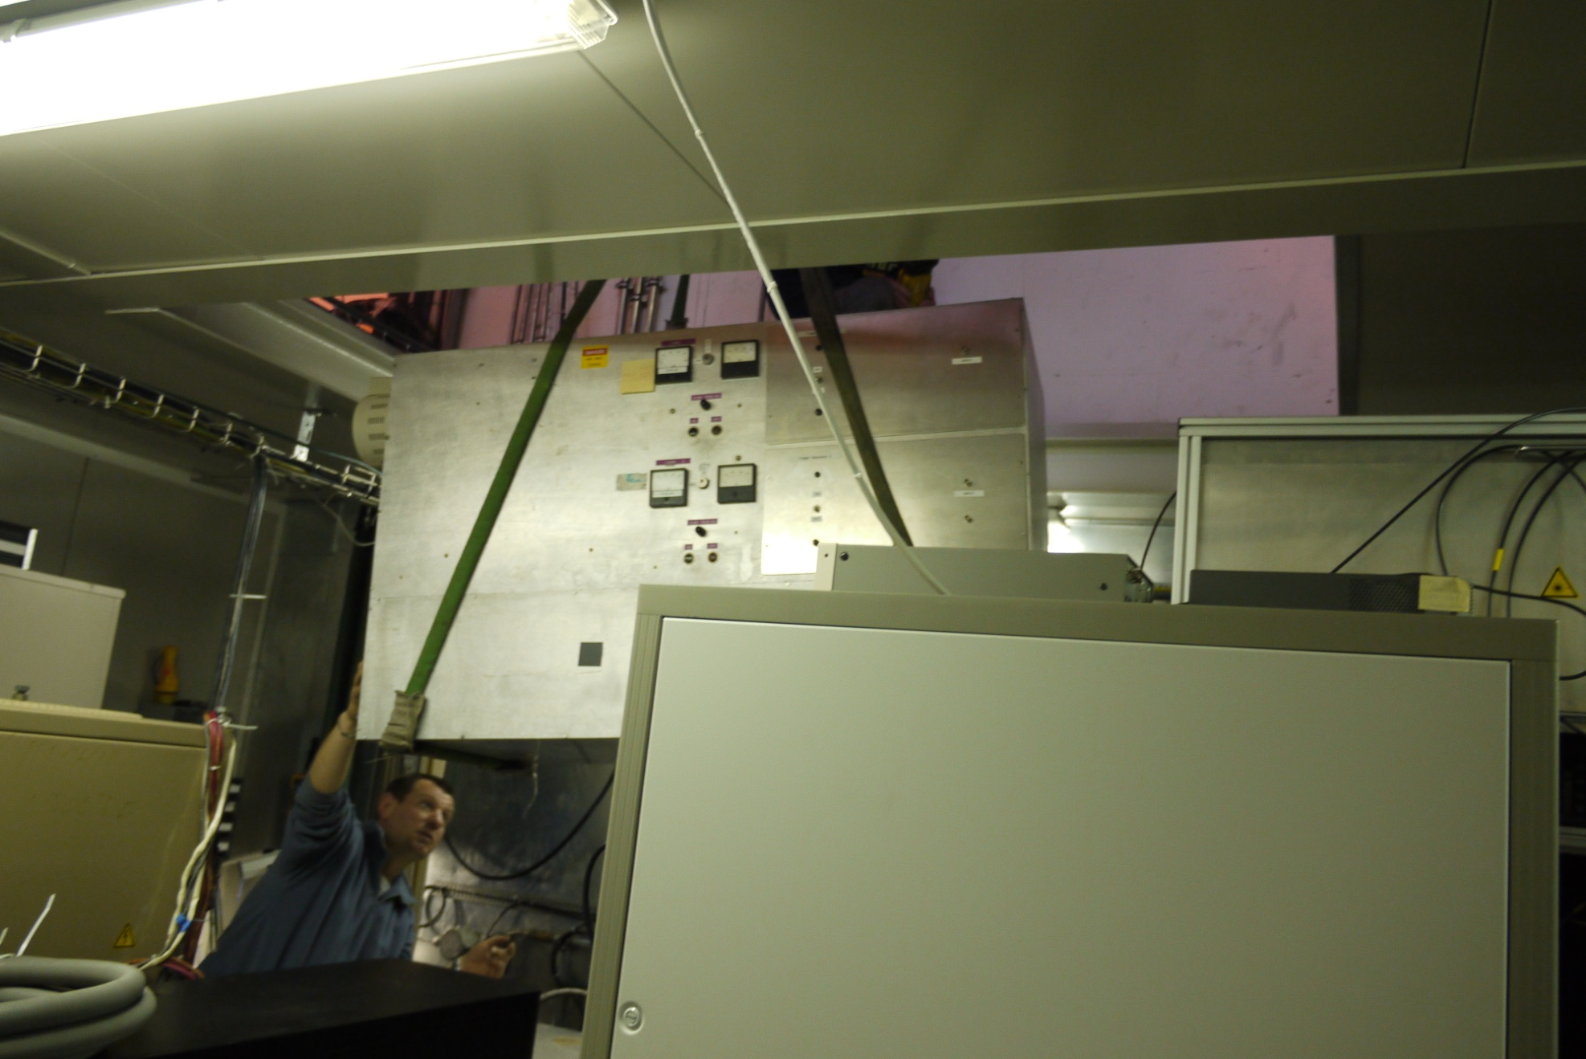
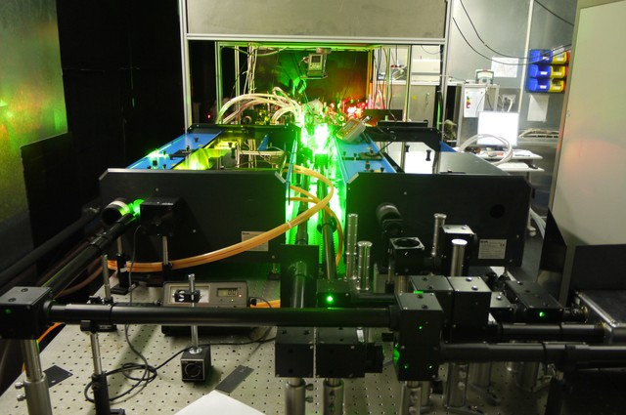
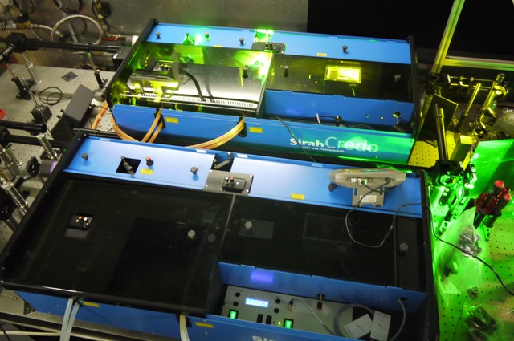
RILIS
Removal of Copper Vapour Laser and replaced with new Syrah Dye lasers
Benefits:
Greater efficiency and stability.
Higher UV power and better beam quality.
Enable UV pumping to provide beams in the 380 – 540 nm range.
Wavelength control via LabVIEW
V. Fedosseev & B. Marsh

Slide 16
News from EN-STI
Staff
  Arrival of A-P. Bernardes (safety)
  Alexander Stadler (Fellow)
    July 1st Hot cell design and target elimination
  Elodie Macario (Fellow)
    Octobre 1st, safety
  Florian Kiersch (Technical student)
    Fire risk assessment of ISOLDE target area
  Raul Fernandes Luis
    15th June, target development
  Yuriy Romanets
    1st June, Fluka simulations (HIE-ISOLDE)
Allocation of space for temporary target storage in ISR (3 years).
Arrival of high density uranium carbide from Luch, Russia.
  Tests planned for end of year
Front End #7 under construction

Slide 17
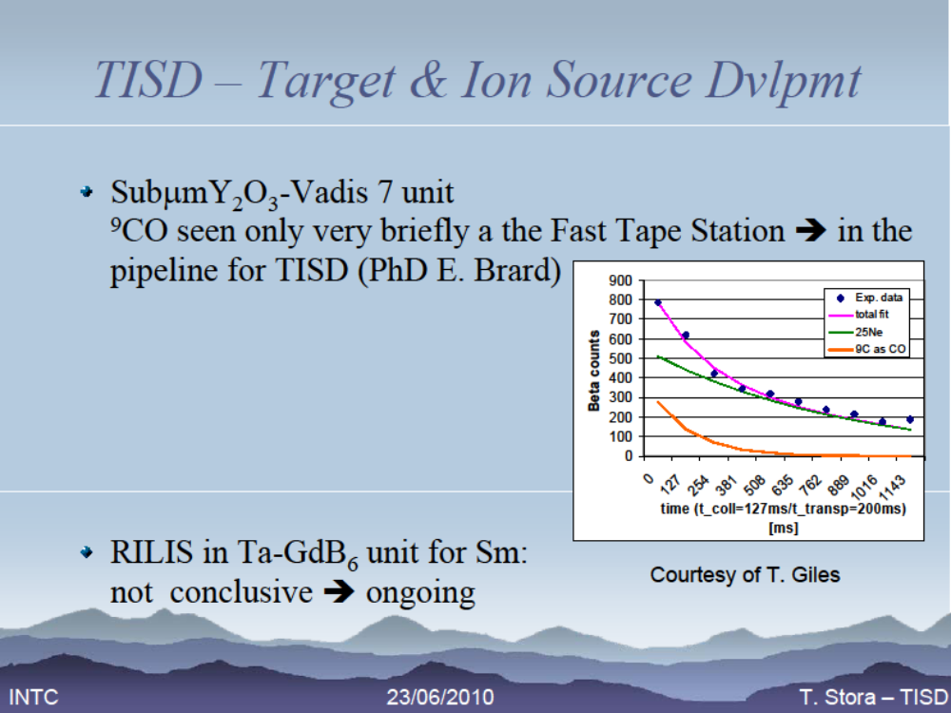

Slide 18
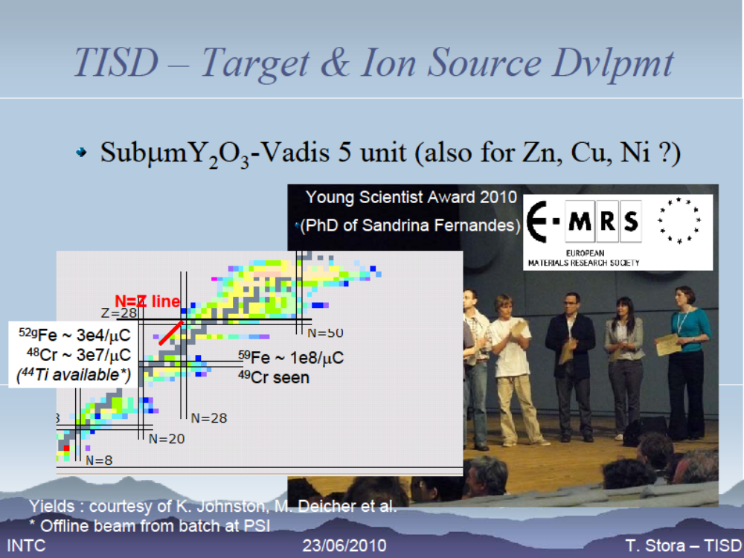

Slide 19
REX campaign 2010 so far
Implantation of stable Kr and Xe for Kolkata, India
preliminary postponed to week 27
Beam characterisation for HIE-REX started
⁹C beam to 2nd beam line, REX operational
ISOLDE target problems -> insufficient yield
(4) REXTRAP delivers beam to WITCH experiment
Hope for a better continuation!

