Slide 1
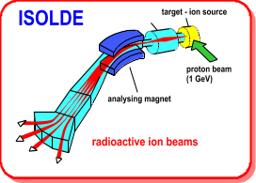

ISCC Technical Report & Report from the Standing Group for the Upgrade of ISOLDE
Richard Catherall EN-STI
2nd February 2011

Slide 2
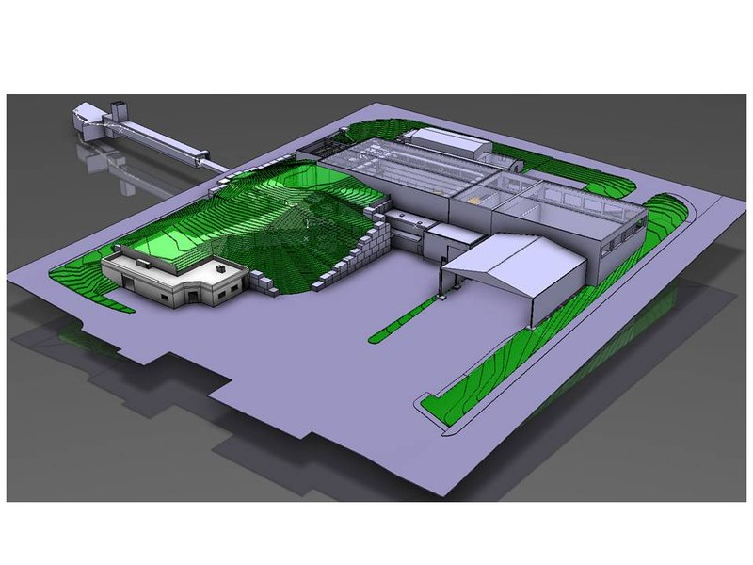
Agenda
Shutdown Work
  FE#7 installation
  REX upgrade
  RILIS upgrade
  On-going work
Safety
Office Space
Report from Standing Group for the Upgrade of ISOLDE

Slide 3
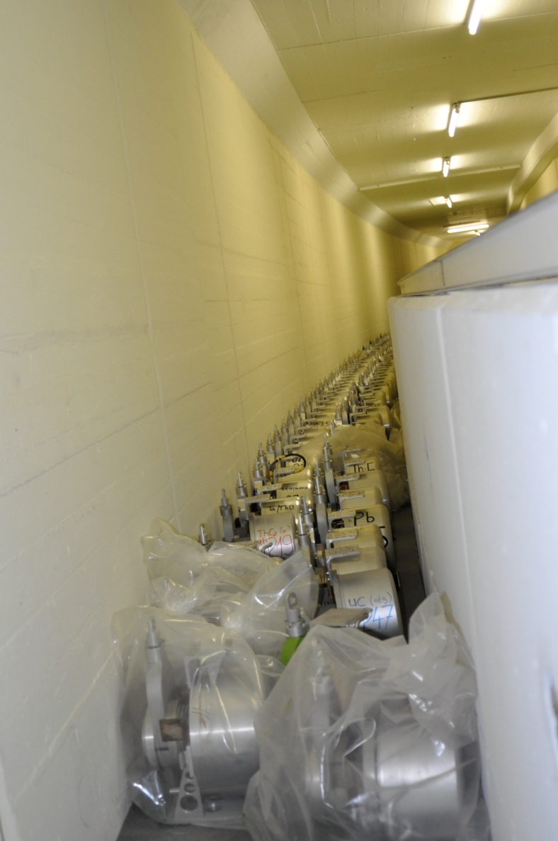
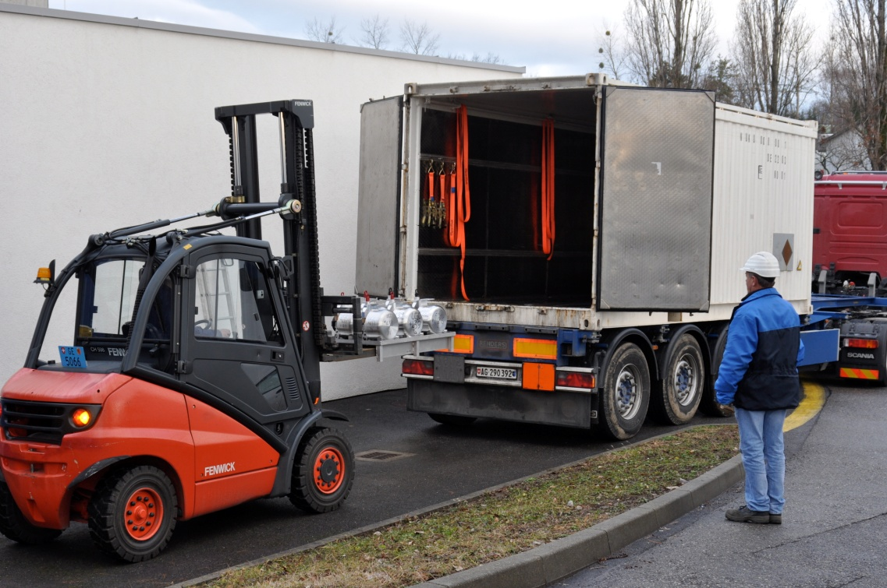
Target Removal
Shutdown Work
Use of Type A transport container as requested by RP.
  Implications to be assessed
New 5 year buffer zone under construction
  Gives time for hot cell construction
B. Crepieux

Slide 4
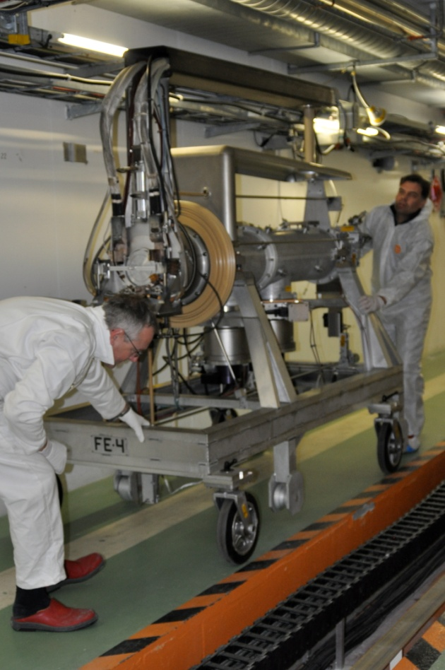
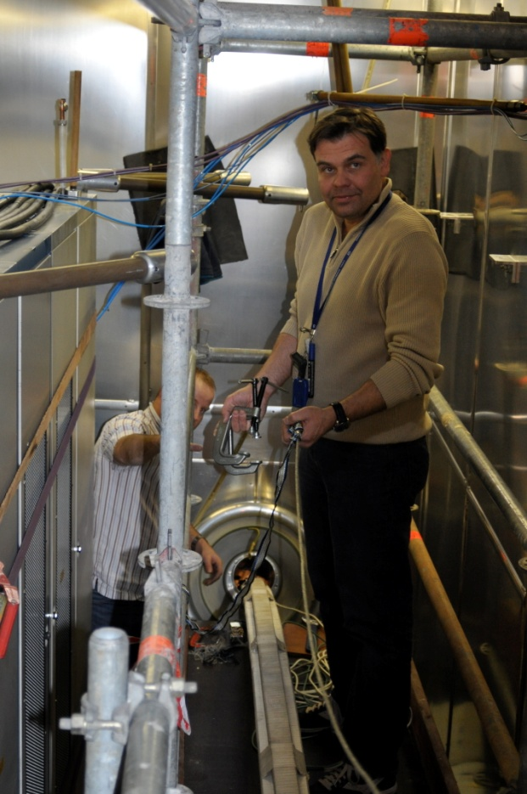
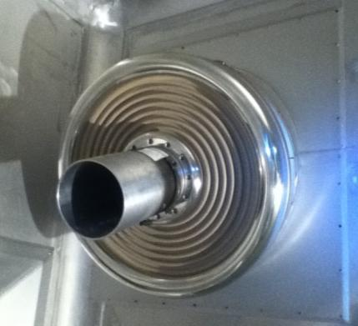
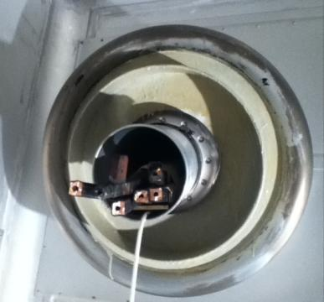
Front End #7
Shutdown Work
Front End #4 removed successfully
Cables and insulator successfully removed
New insulator in place
Difficulty in assuring cable passage between FE faraday cage and separator area.
Phases 1 → 80% of provisional collective dose
Phase 2 →~60% PCD
S. Marzari, T. Giles, T. Stora, E. Barbero, M. Owen

Slide 5
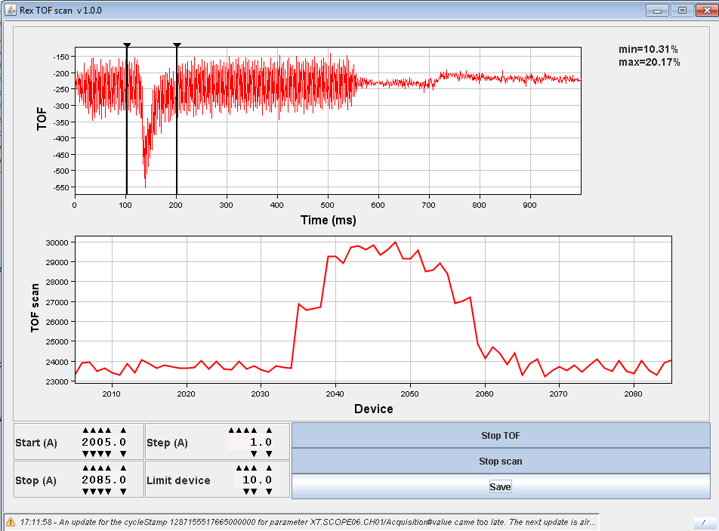
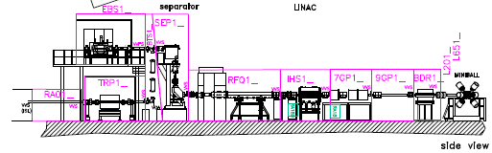
REX Upgrade
Shutdown Work
REXTRAP Controls
1. Dismantling of the old system (FINISHED)
2. Electronics racks cleared (FINISHED)
3. Hardware installation (ONGOING)
4. Local validation of PLC and power supplies (TO BE DONE during February)
5. FESA validation (ONGOING)
Applications
Timing editor application (ONGOING)
Electrode graph display (FINISHED…to be tested when all the hardware will be in place)
Time of Flight application (FINISHED)
Scanning application (TO BE DONE during February)
RF editor application (TO BE DONE during February)
REX Vacuum Controls
Cables removed
Cabling divided between TE-VSC and EN-EL as a function of priorities
  EBIS
  TRAP
  SEPARATOR
E. Piselli, J. Sanchez, F. Wenander, S. Blanchard

Slide 6
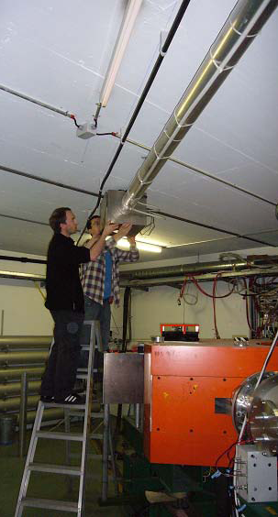
RILIS
Shutdown Work
Move the dye laser system to the new tables to make space for the new Ti:Sa lasers and move the pump laser chiller to the roof of the cabin.
Install the Ti:Sa laser system (Nd:YAG pump laser and 2 or 3 Ti:Sa lasers, plus multiple harmonic generation units).
Redesign the HRS launch mirror system to include a 4th path for ISCOOL pumping.
Install the laser path for ISCOOL pumping in the HRS separator zone.
  Optimize the little remaining space in the RILIS cabin
  remove the electronics racks and desks and replace with a new compact workbench and shelving area.
  Install a frame, laminar flowbox and safety shielding around the Ti:Sa section of the RILIS table.
LIST Tests on-going at off-line separator
  Tl ions have been extracted
  Preparations for installation on FE#7 on-going
B. Marsh, S. Roth, D. Fink & V. Fedosseev

Slide 7
On-going Shutdown Work
Shutdown Work
Pico-ampere meters for Faraday cups
  Cabling and hardware installation on-going
  Waiting for software installation
Redundancy in tunnel fire detection implemented
  Cause of “false” fire alarm in 2010
Tesla meters for the HRS magnets to be moved externally.
Complete renovation of ISOLDE timing
  New distribution hardware this shutdown
  Timing signal cards to be addressed next shutdown
General maintenance
  HT, vacuum, controls, robots,FE#6, beam instrumentation, power supplies, magnets
E, Siesling, G. J. Focker, D. Raffourt, P. Fernier, T. Giles

Slide 8
Safety
Safety
ALARA Level 3
  Most interventions in the shielded areas of ISOLDE are classed as level 3 ALARA with respect to the present criteria.
  The contamination criteria is the main reason for so many level 3 ALARA committees
    9/14 level 3 over last year.
  5 ALARA level 3 interventions addressed in the last 2 months
      Protocol still unclear
      4/5 interventions have been “accepted” by S. Myers – derogation
      High impact on resources and planning
Visits
  New rules for visits to controlled radiation areas…to be announced
Traceability
  Investigating possible use of Timber database (used by LHC) to monitor machine operation and RIB distribution.
A-P Bernardes, E. Macario

Slide 9
Office space – under discussion
Office Space
Removal of Class C lab in 275
    Requested by RP and makes efficient use of B. 275
    Initial discussions and plans under way to extend B115
Displace all ISOLDE personnel and labs to Bs 570 and 275?
  Nearer to ISOLDE
    More office space?
Remove B507 (light building) and build anew
  Include DAQ rooms (outside Class C perimeter)
  Visitor Centre? (outside Class C perimeter)
  Machine workshop
  Kitchen? (outside Class C perimeter)
  Cost estimate under preparation
Possibility to use offices in B54?

Slide 10
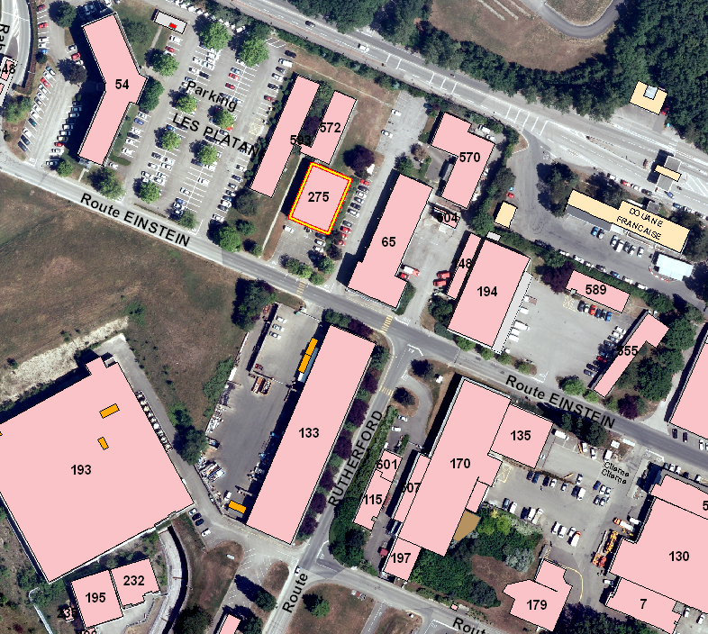
Office Space

Slide 11
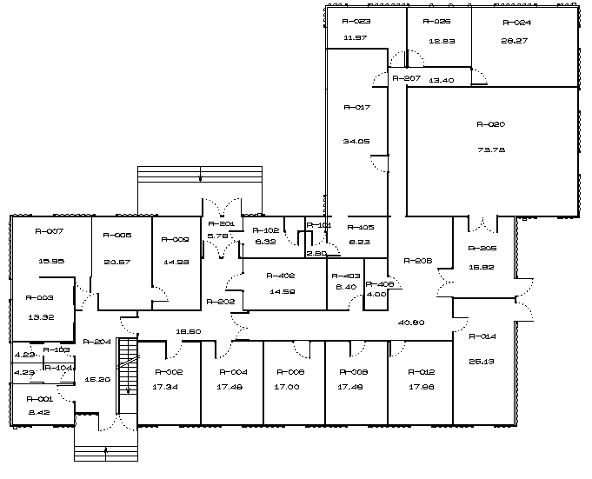
Office Space
Building 570

Slide 12
Synthesis
Office Space
Out of 25 offices owned, 20 offices used by PH
  360 m2 → ~260 m2 used
EN owns 3 offices and borrows 5 from PH
  50 m2 → 150m2 used
Number of offices available in B.570 – 15
  277m2
Number of offices available in B.275 – 6
  111m2
  Modifications to B570 will be required to increase surface area.
Total of 28 offices
410m2 office space
Total of 21 offices
388m2 office space

Slide 13
SGUI - Introduction
Report from SGUI
New members
  Magdalena Kowalska replacing Alex Herlert as ISOLDE Physics Coordinator
  Joachim Vollaire representing Radiation Protection and RP issues for new projects
  Klaus Hanke as Booster operations supervisor.
Mandate
  To address the short-term upgrades of the ISOLDE Facility excluding the HIE-ISOLDE project and to set priorities for future beam development.
  The frequency of the meeting shall be twice per year. The next meeting will take place on the 7th July 2011

Slide 14
Developments in 2010
Report from SGUI
The successful production of ¹⁴⁰Nd using RILIS. Nd beams can now be made available for physics. However, tests for the production of Sm beams are on-going.
The production of ¹²Be using thin foils. The priority of this development was changed to ¹¹Be in order to provide beam to IS430.
The High Density Uranium Carbide (HDUC) from Russia is currently being tested on-line
The LIST ion source at the off-line separator currently being tested.
Courtesy of T. Stora

Slide 15
New priorities
Report from SGUI
The development of ³⁰Na beams
The successful production of ⁷²Kr
The production of ⁸B beams.
  6 LoI’s have been presented in the recent INTC meeting.
Completion of the ¹⁴²Sm beam development
The following points were also retained
  The development of ⁹C beams should continue
    the experiment should not be scheduled until tests have been validated on-line.
  Better characterize the potential of VADIS/target combinations for the planning of future experiments.
    Sufficient time should be made available for testing

Slide 16
Production of long-lived beams.
Report from SGUI
Consequences when opening the machine to atmosphere for intervention.
In collaboration with RP, procedures will be drafted and preparations made for the opening of the REX machine taking into account the worst possible scenario.
  If the procedures proposed by RP are accepted and followed, and the level of activity remains low, physics with long-lived radioactive beams may be done at REX.
The INTC will be provided with information from RP and the Technical Advisory Committee describing the consequences for machine maintenance and chamber openings in case long-lived radioactive beams are accepted.
Limited consequences for the opening of REX (3 times per year )
MINIBALL will be most affected should the intervention times be long.
  Test at the end of 2011 by implanting beams into MINIBALL and characterizing the risks when opening the chamber.
F. Wenander, J. Vollaire

Slide 17
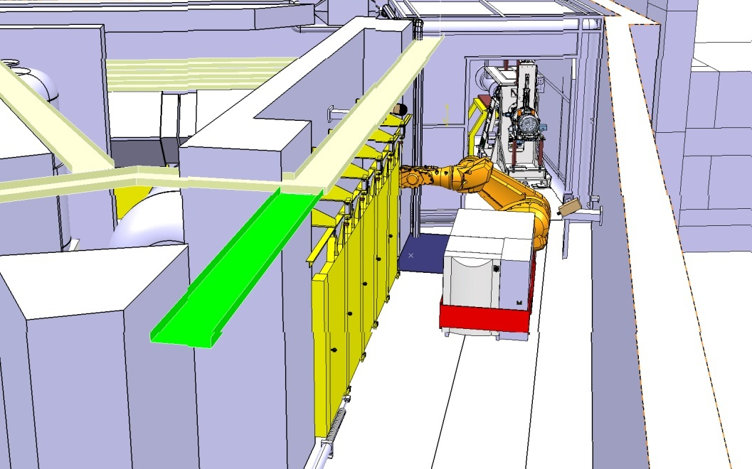
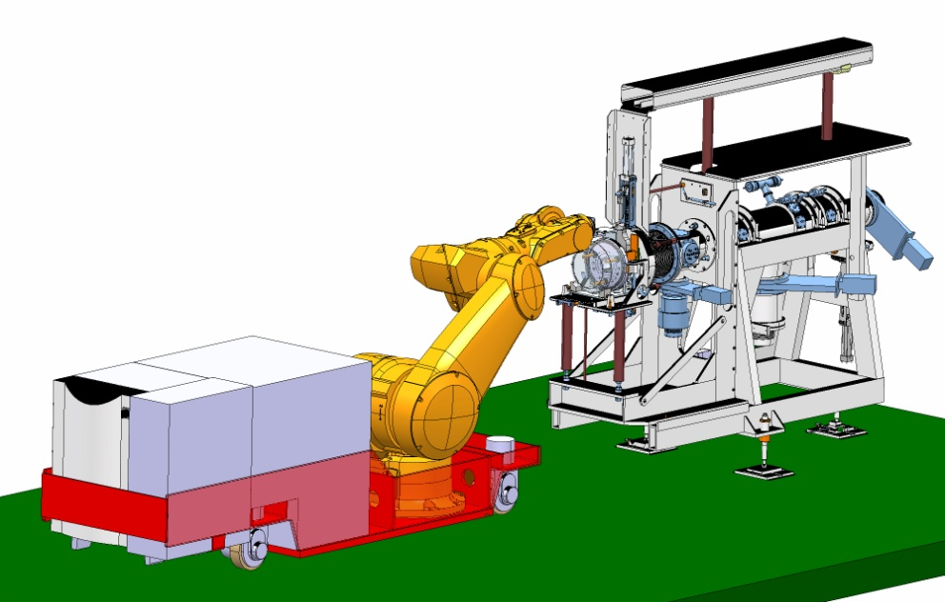
Target Area Upgrade (New robot)
Report from SGUI
There will be one system for both separators
The robot arm will be mounted on an autonomously guided vehicle (AGV)
The system will be stored externally to the target area
There will be an independent back-up in the case of failure
Emphasis on the inherent and operational safety file
Installation is for 2013
K. Kershaw, J. L. Grenard, B. Feral

