Slide 1

ISOLDE Technical Report
&
Long Shutdown Works
ISCC Meeting 28th January 2013
Richard Catherall EN-STI

Slide 2
Outline
Separator Operations
  GPS extraction electrode failure
  RFQ Cooler
  Tape station
  Alignment
Targets and Ion Sources
RILIS
LS1 works
  Target area
  Experimental Hall
  Laboratories

Slide 3
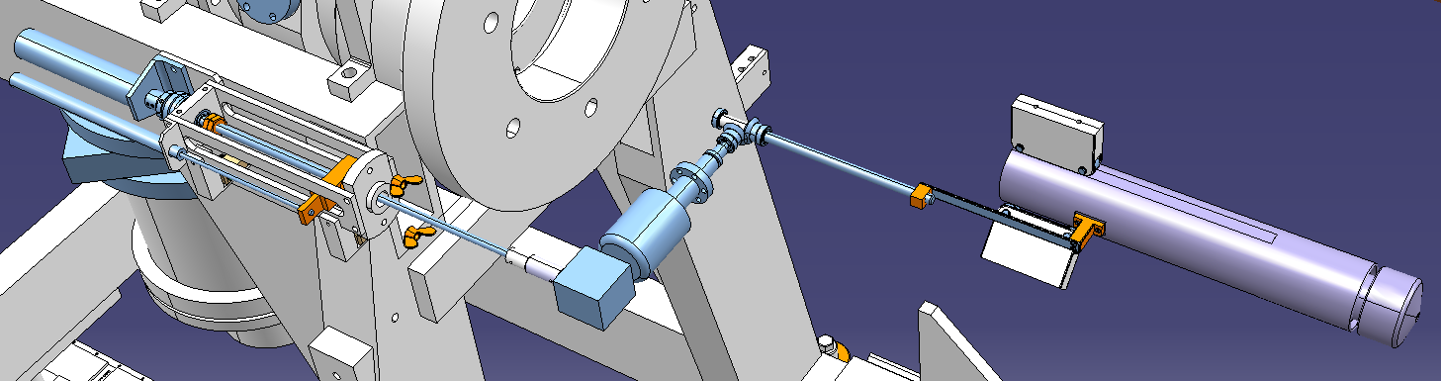
Separator Operations: GPS Frontend
Failure identified as being external
Excellent news for us
OK → Test positive
NOT OK → Failure on transmission
Moteur pneumatique
Embrayage
Traversée étanche rotative
Electrode
Vis mère extérieure
End stop
Ecrou et tige de transmission
Vis mère intérieure
Potentiomètre de position
Renvoi conique 90°

Slide 4
RFQ Cooler
Discrepancies in the transmission and operation of the RFQ Cooler as a function of: mass, operator, faraday cups, calculations etc
Alignment
  Current position to be verified/determined
  Removed and taken to Class A laboratory
  Alignment checked and modifications made
  Installation into beam lines
Gas valve
  Gas valve system for new RFQ Cooler will be duplicated for “old” one
RF amplifier
  To be followed with the RF group
Electrical connections
  Verified and corrected while in Class A Laboratory
New compatible RFQ Cooler being built within the Design Study
  Can be used for verification and testing in 3 months.

Slide 5
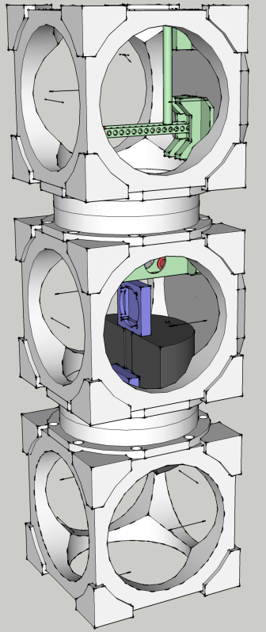
Tape station
The old one is/has come to the end of its lifetime.
  Discrepancies in measurements (factor of 10) especially towards the end of last year.
The Fast Tape Station (FTS)
  Vacuum leak finally repaired.
  Moved out from the LA2 line
  Controls issues still not solved (offer from P. Dessagne to help)
  Difficult to integrate into CAO beam line.
Build two identical tape stations during LS1
  Similar transport times as existing
  In beam measurements for short lived isotopes
  Support from EN-STI for controls and PH-SME for detectors
  Mobile unit will be available as a spare

Slide 6
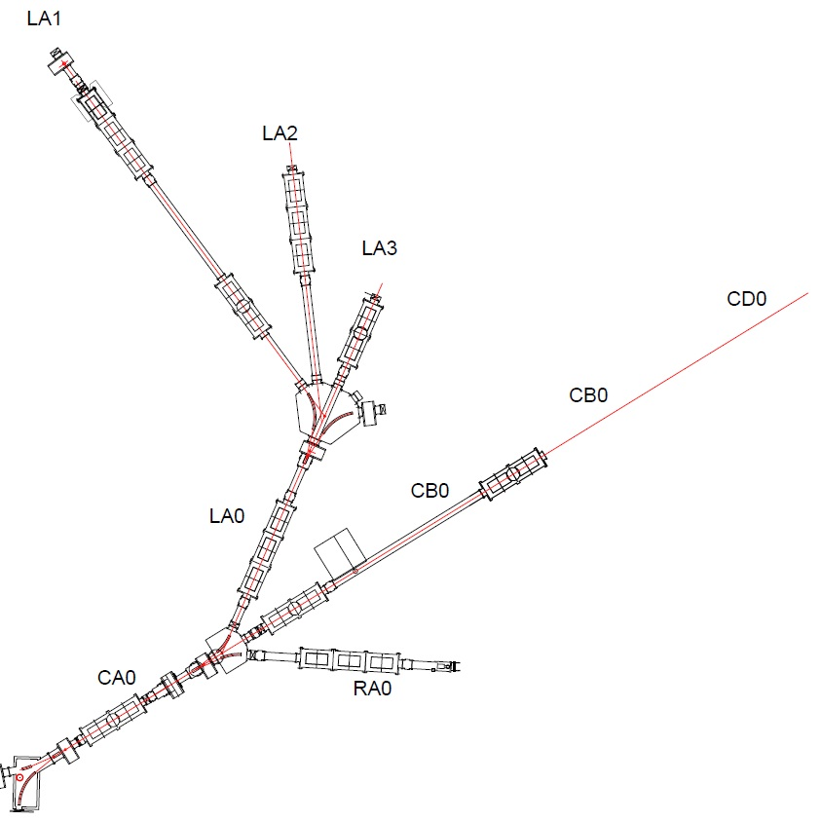
Alignment RESULTS – horizontal plane
bearings comparison
Line | Theoretical Bearing | Calculated Bearing | Difference Calc-Theo
 | [g] | [g] | [cc]
CA0-CB0-CC0-CD0 | 351.4121 | 351.4005 | -116
LA1 | 245.8565 | 245.8974 | 409
LA2 | 279.1898 | 279.2213 | 315
LA0-LA3 | 312.5232 | 312.4988 | -244
LC0 | 312.5232 | 312.5030 | -202
RA0 | 390.2997 | 390.3080 | 83
RB0 | 390.3010 | 390.2699 | -311
RC0-RC2-RC6 | 390.3010 | 390.2941 | -69
RC3 | 29.1899 | 29.1670 | -229
RC4 | 323.6343 | 323.6108 | -235
10cc ~ 0.16 mm/10m
+409cc
+315cc
-202cc
-244cc
LC0
-116cc
+83cc
Theoretical Bearing
Calculated Bearing

Slide 7
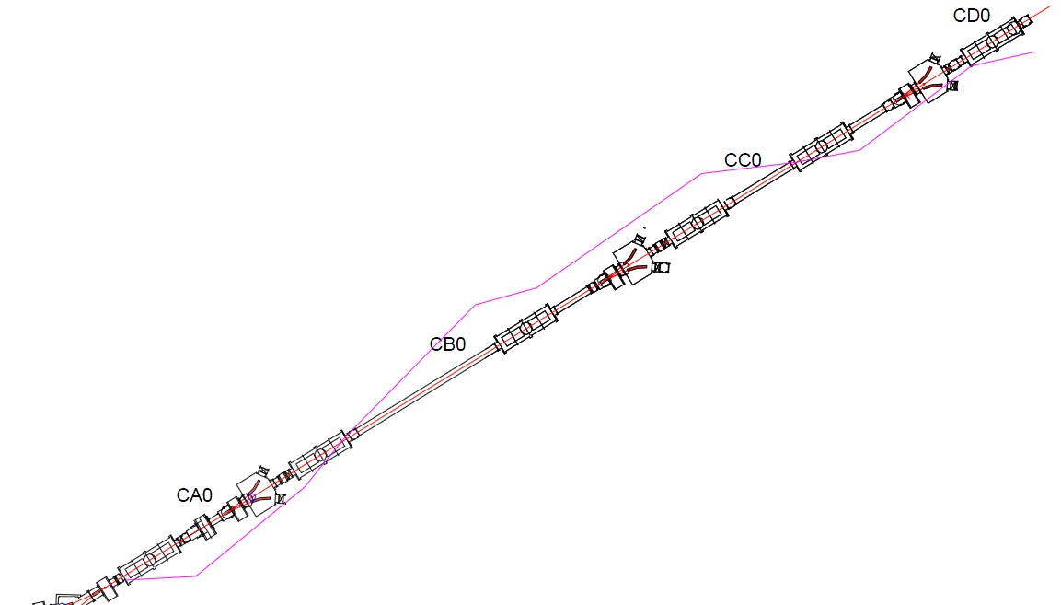
Alignment RESULTS – horizontal plane
main line CA0 – CD0
Line: CA0-CB0-CC0-CD0
Bearing [g]: 351.4005
Name | X [m] | Y [m] | Distance to line [mm]
CA0_Q_E | 1879.3962 | 2239.1236 | -0.1
CA0_Q_S | 1878.7661 | 2239.7807 | -1.1
CB0_Q1_E | 1877.3575 | 2241.2535 | -0.6
CB0_Q1_S | 1876.7272 | 2241.9131 | 0.1
CB0_Q2_E | 1874.9036 | 2243.8206 | 1.4
CB0_Q2_S | 1874.2733 | 2244.4785 | 0.9
CC0_Q1_E | 1872.8599 | 2245.9545 | 0.2
CC0_Q1_S | 1872.2301 | 2246.6140 | 1.2
CC0_Q2_E | 1871.3751 | 2247.5059 | 0.0
CC0_Q2_S | 1870.7443 | 2248.1640 | -0.7
CD0_Q1_E | 1869.3341 | 2249.6383 | -0.3
CD0_Q1_S | 1868.3920 | 2250.6219 | -0.9
Deviation scale 500:1
Relatively to the scale along the beam
Isolde Lines Survey Results – meeting 15.01.2013

Slide 8
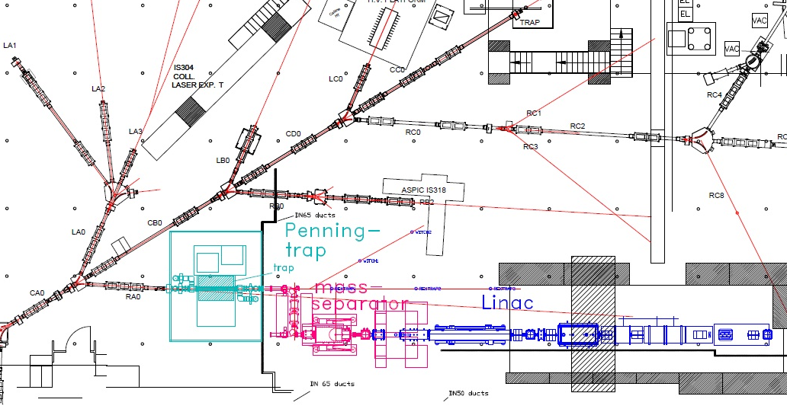
Alignment RESULTS – vertical plane
Proton beam height = 437.0015 (+10mm)
~ 10mm step
Zavg = 437.0172m
Dev: -1.5mm to +1.5mm
Zavg = 437.0073m
Dev: -1.8mm to +1.1mm
Isolde Lines Survey Results – meeting 15.01.2013

Slide 9
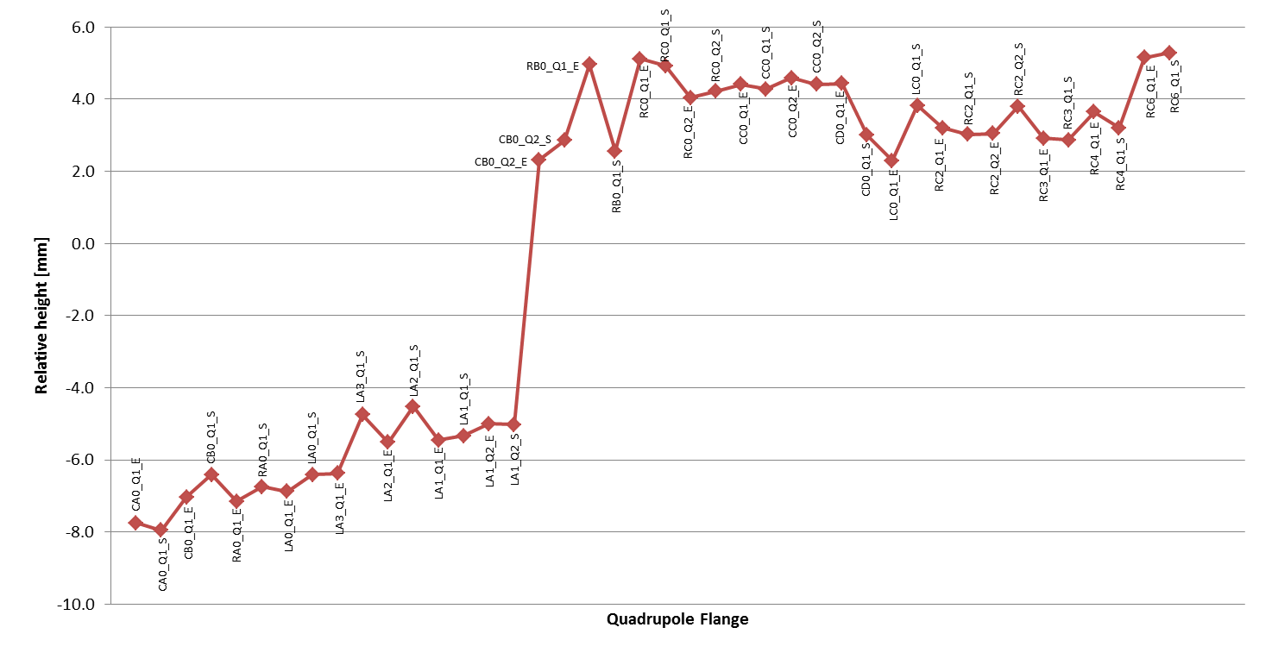
Alignment RESULTS – vertical plane
Isolde Lines Survey Results – meeting 15.01.2013

Slide 10
Target and Ion Sources
27 new units have been produced for online runs in 2012
  - Quite some more for offline tests, prototypes, plug target for GPS)‏
  - Out of which 15(13) UCx targets (the max is 12 !)‏
This is the highest number of units produced compared to previous years, especially UCx.
The main reason is the extension of the operating period of ISOLDE by a few weeks in 2012
We should not expect to run with such high number of units in the future

Slide 11
Prototypes
Out of the 27 units:
7 units were standard units.
6 units were prototypes:
  (salt target NaF470
  new converter geometry UC-n493
  Helicon v2.0 CaO497
  LIST v2.0 target UC488
  molten Sn+VADIS Sn491
  nano UCX UC498)‏
14 units incorporate developments from the past 5 years (ie VADIS or Re surface source, sub-mu SiC or nano Y2O3, cold quartz line, Titanium source + CF4, etc)‏

Slide 12
Some news from last proto.
Ti beams: Pure ⁴⁴Ti delivered as TiF₃+ from unit 486
  (n-rich ⁵⁴Ti beams also observed from Ucx)‏
New converter geometry UC-n493: results match or improve the predictions: need 2nd geometry
Helicon v2.0 CaO497: stable operation, bad optics (probably due to GPS electrode), better n-rich C, but not yet good ⁹C beams as CO+
LIST v2.0 UC488: widely recognized (ie EMIS2012)
  similar technology foreseen at TRIUMF
nano UCX UC498:
  Improved and stable ¹¹Be (x5 vs standard Ucx, x15vs database)
  as good and stable ³⁰Na; likely better n-rich Cs
  identified as promising material within ENSAR-ActILab

Slide 13
Support to operation
Piquet of 1 post-doc + 1 student during operation to measure yields and assist operation to tune the « special » units.
With the present foreseen plans of the TISD team, this will not be possible anymore in 2014, as many programs will finish by then (ie ENSAR-ActILab, betabeams)‏

Slide 14
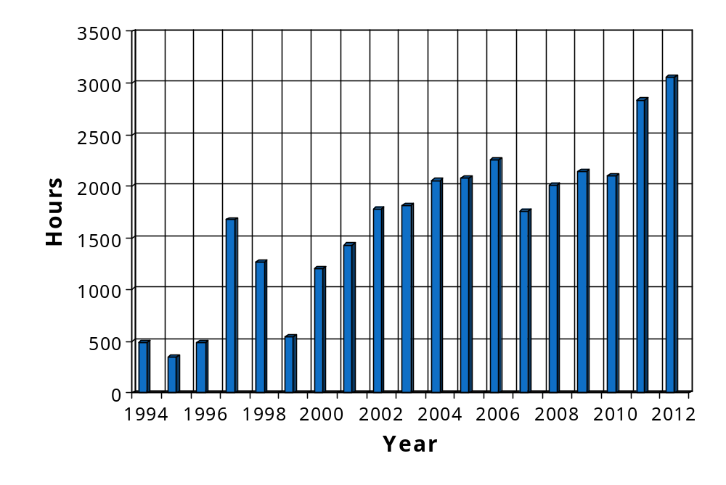
Record RILIS operation time in 2012
Laser ON time in 2012:
319 on-line shifts
3060 h lasers ON
Availability of two complementary laser systems (Dye and Ti:Sapphire) has ensured the increase of RILIS beam time in 2011-2012
Ion beams of 13 elements were produced with RILIS in 2012
Beam | Sm 2 runs | Ca 2 runs | Cd | At 2 runs | Au 2 runs | Be 3 runs | Dy | Mg 4 runs | Po 2 runs | Ag 2 runs | Zn | Cu | Mn
Planned | 208 | 272 | 192 | 300 | 172 | 446 | 88 | 296 | 206 | 96 | 198 | 112 | 148
Real | 212 | 359 | 253 | 345 | 262 | 278 | 111 | 378 | 206 | 113 | 124 | 69 | 208

Slide 15

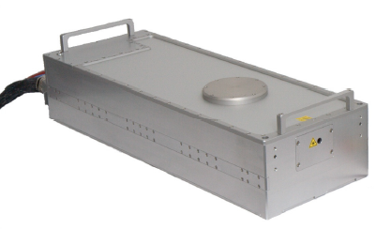
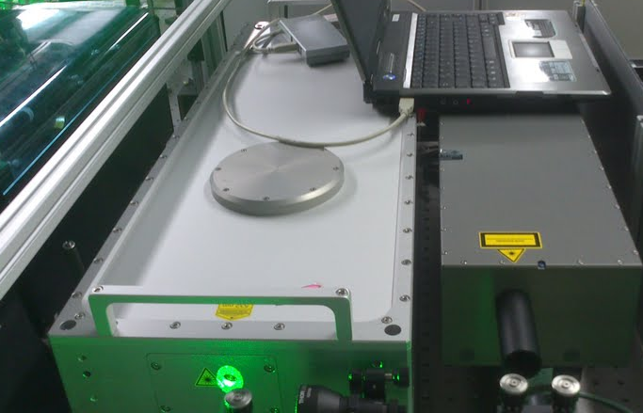
Blaze laser test
Test of non-resonant ionization step for the gallium scheme
40W at 10 kHz
17ns Pulse
Low Jitter
Gaussian beam
Much better transmission
efficiency to ion source
Blaze laser installed at RILIS on Monday 17th Dec!
Laser | Laser Power (on table) | Reference beam power in 3 mm aperture | Transport efficiency
Edgewave | 43 W | 370 mW | 33 %
Blaze | 15 W | 350 mW | 88%
Blaze | 40 W | 800 mW | 76%
A similar efficiency improvement should be expected for the 18 RILIS elements that use non-resonant ionization for the final step!
Power dependent thermal lensing in the beam transport optics is to be eliminated
B. Marsh et al., Stability test of a high quality Nd:YVO industrial laser for the ISOLDE RILIS installation. CERN-ATS-Note-2013-007 TECH

Slide 16
RILIS room extension
Required by safety
Existing laser room + SAS
RILIS
28 m²
REX EBIS
254 cm
320 cm
Extended part (SAS)
6 m²
IS COOLER
100 cm

Slide 17
ISOLDE RILIS future developments
GENERAL RILIS DEVELOPMENTS
Extension of RILIS cabin
  Enlarged entrance/storage and work area to maximize the useable laser laboratory space
Implement a dedicated, high power Nd:YVO laser for non resonant ionization
  High beam quality industrial laser could significantly improve efficiency for many schemes.
  Would simplify RILIS setup, increase reliability and reduce setup time.
  Testing was performed in December 2012 – CERN ATS note is written
On-call operation
  Installation of a machine protection and monitoring system to reduce reliance on shift-based operation
  To be implemented during LS1
IONIZATION SCHEMES
Investigate RILIS for refractory metals at ISOLDE
Improved RILIS schemes for the Dual RILIS system
IN-SOURCE SPECTROSCOPY
Installation of a reference cell at RILIS
Pulsed amplification of CW seeded Dye laser or TiSa
Improved motorization of Narrow-band TiSa
SELECTIVITY IMPROVEMENTS
Further optimization of LIST
Improving the laser ion time structure or using a time focus for effective beam gating

Slide 18

LS1 works – a preview
Target Area
Experimental Hall
Laboratories

Slide 19
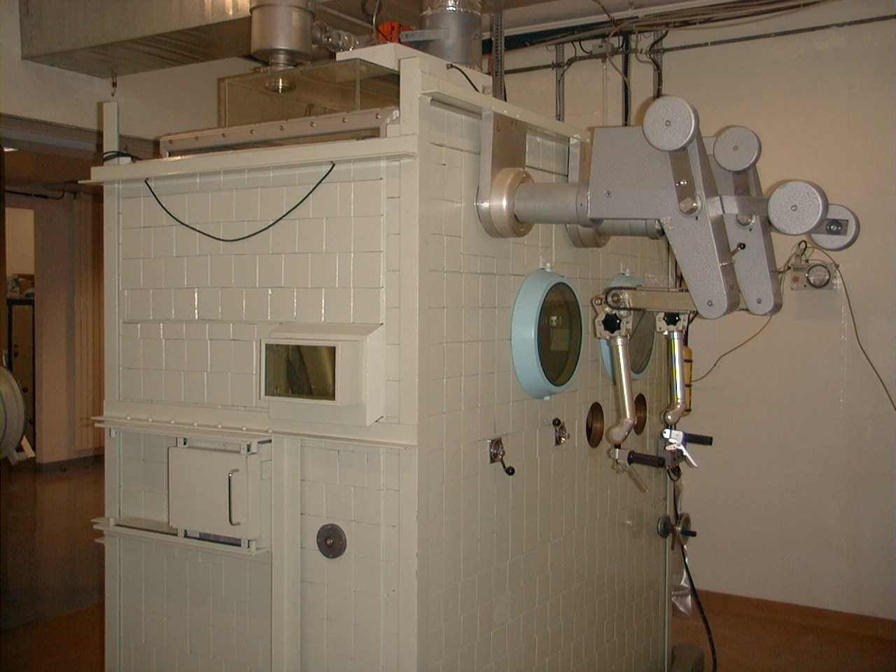
Hot Cell dismantling
Removal of existing hot cell to make room for new one
Some bricks to be used for new shielding
Manipulators to be recuperated
Start January 2013

Slide 20
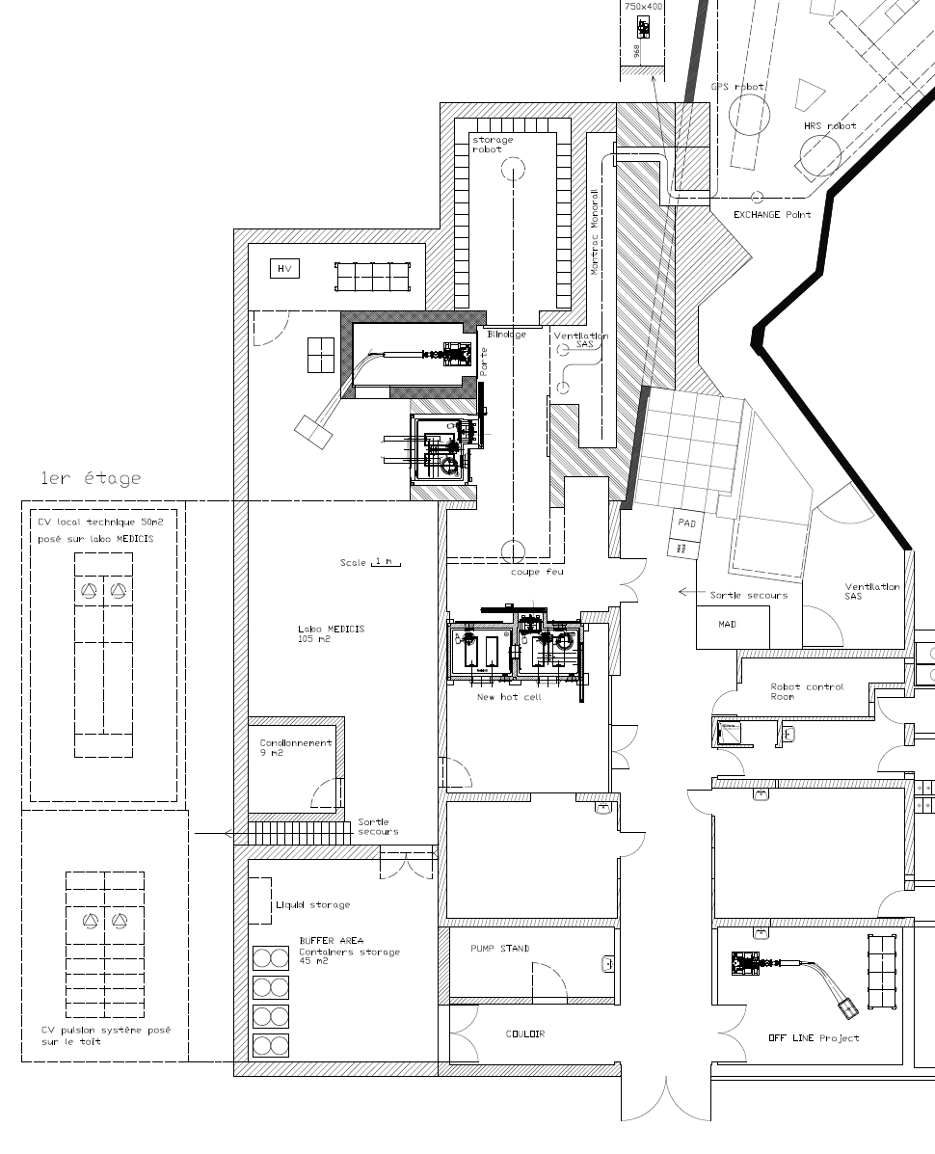
Target Storage and MEDICIS
Excavation work to start while waiting for planning permission
Final design still under approval
Needs to be finished by end of January for FC approval
+ building (finished end 2013)
+ new RABIT system
February 2013

Slide 21
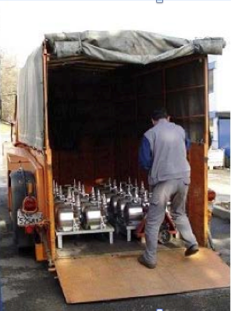
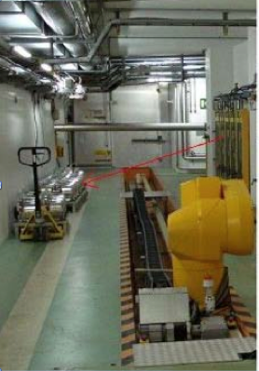
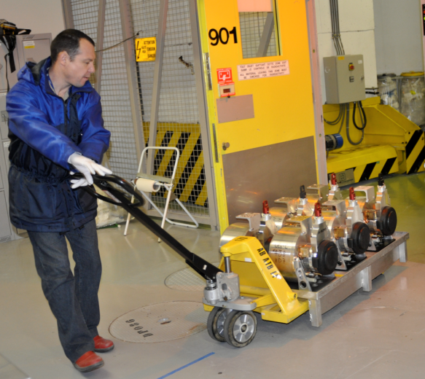
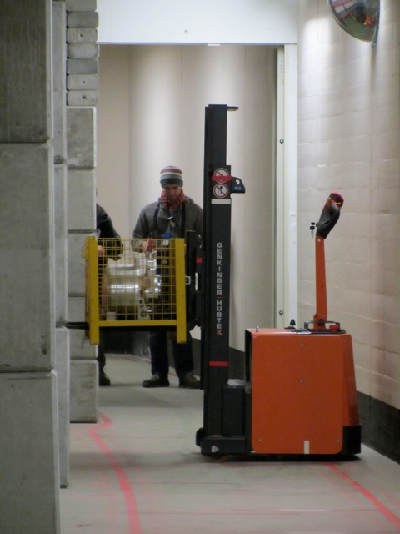
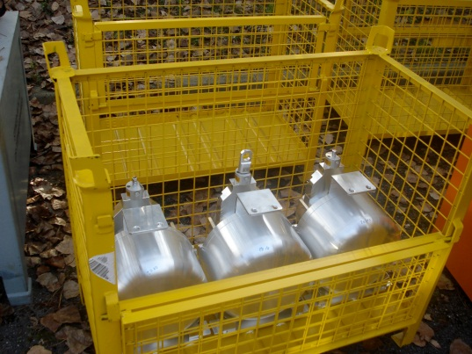
Target removal
Transport all used targets to ISR for storage
Identify those for eventual use in 2014
March 2013

Slide 22
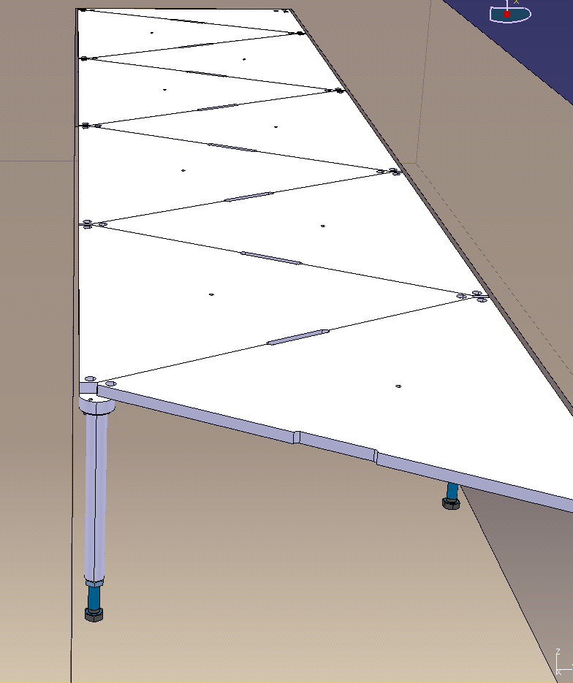
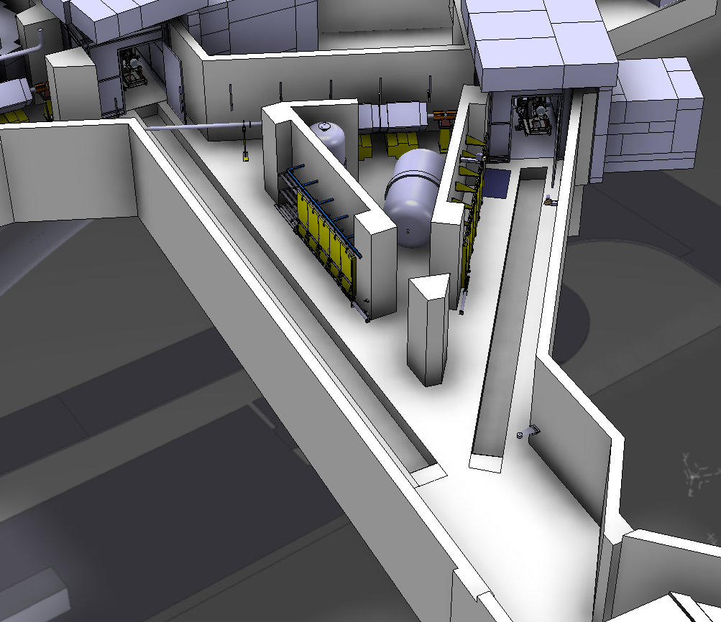
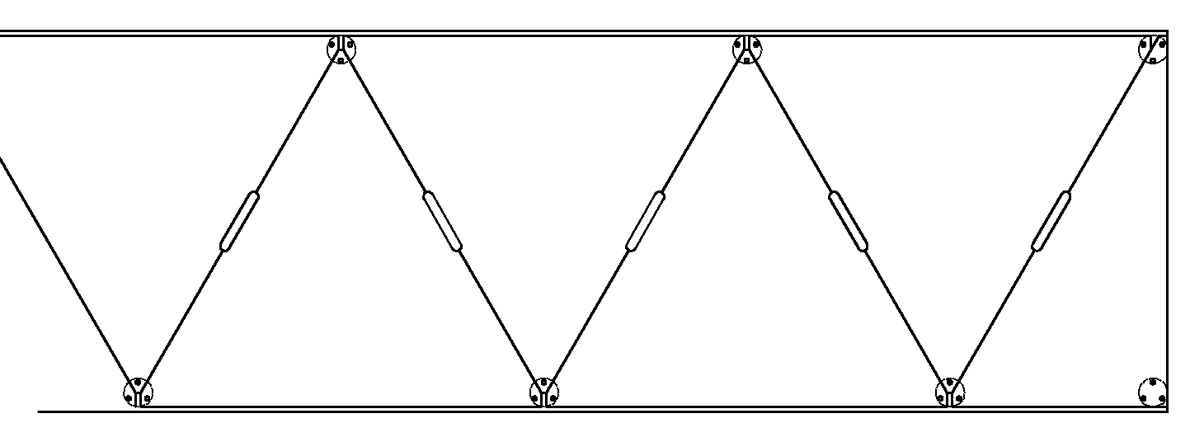
Covering of target trenches
Top view
880
800
April 2013

Slide 23
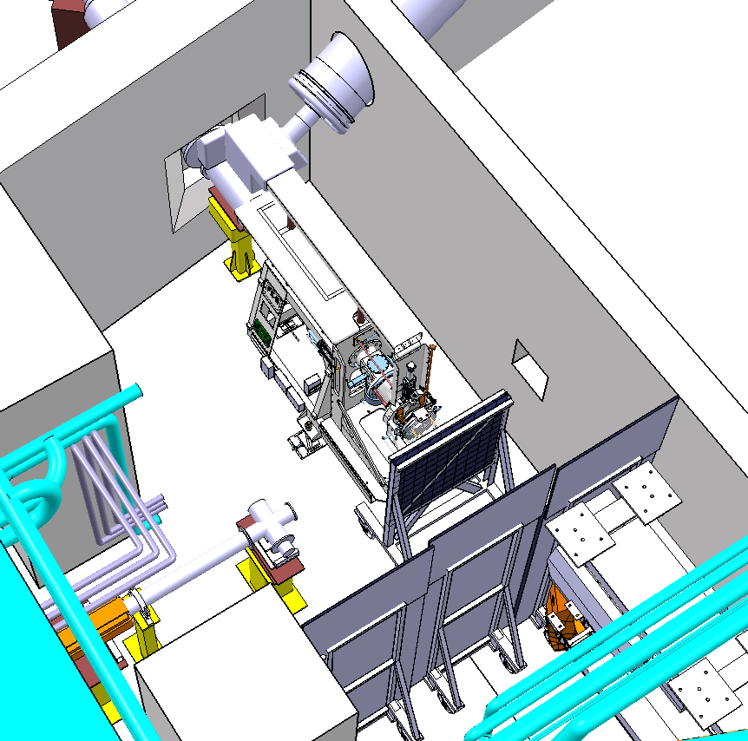
Installation of Shielding
5 cm de Pb
→ Briques ISOLDE
3 cm de Pb (1 cm de Pb à partir de 2.30 m)
→ Plaques de Pb
Beam dumps
Lead shielding panels
Fabricated by EN-STI-TCD
April 2013

Slide 24
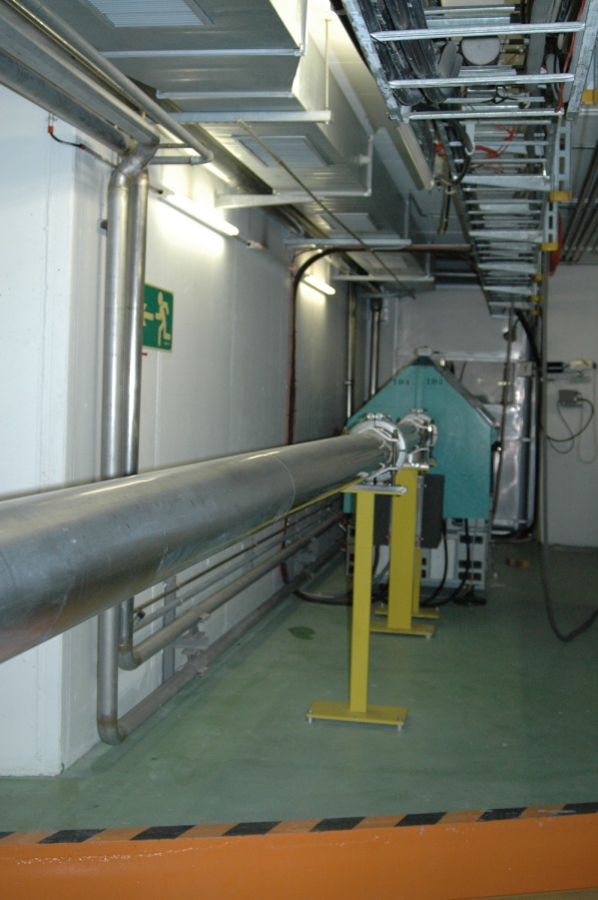
BTY pick ups
Mise à l’atmosphère
Démontage des pick-up
Démontage d’une chambre de transition de pick-up
Modification de l’électronique
Remontage
Test d’étanchéité
Remontage dans la machine
Remise sous vide
BTY.UES311 et BTY.UES202
June 2013

Slide 25
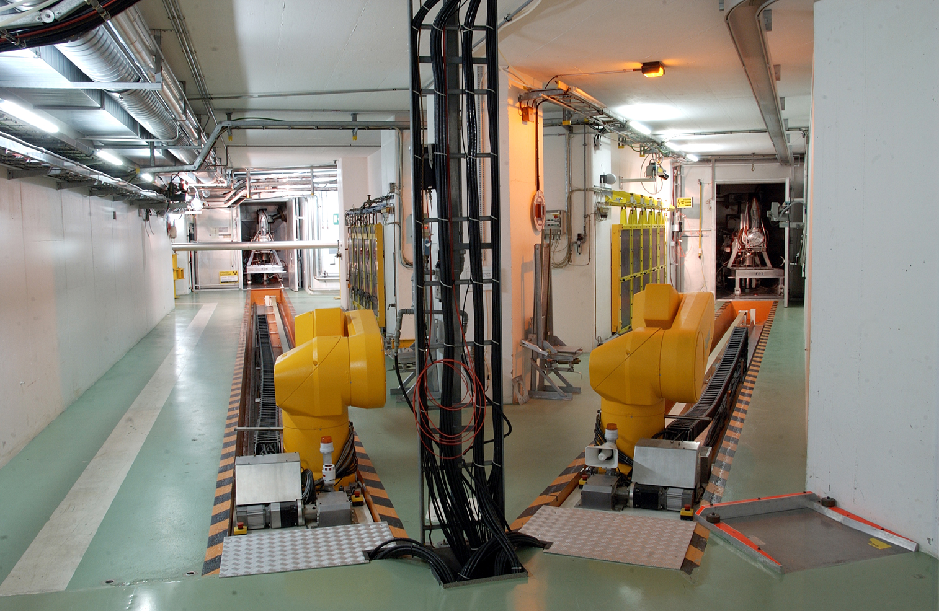
Robot dismantling
Removal of rails, robots, control room equipment, cables etc
August 2013

Slide 26
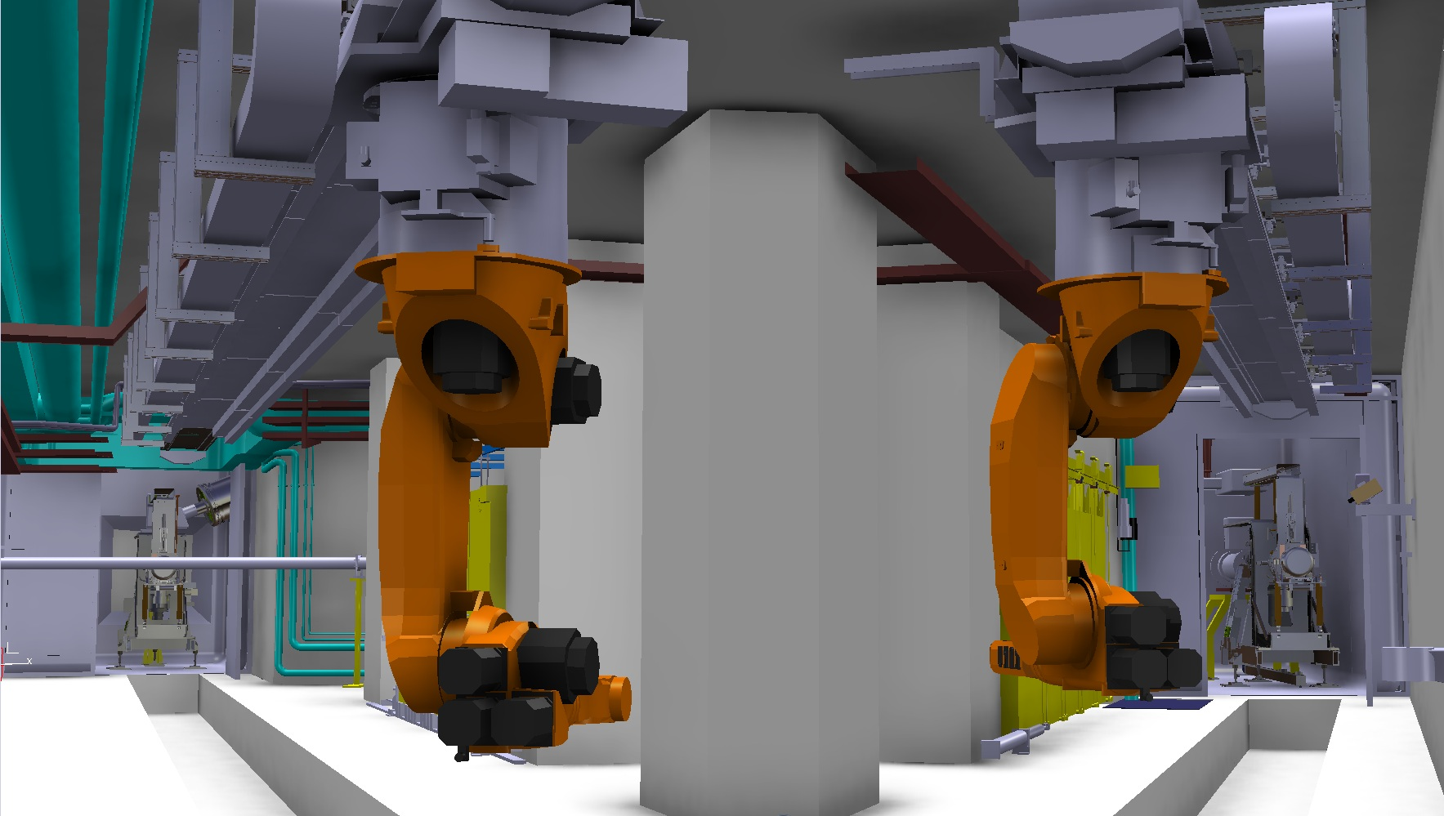
Robot Upgrade: installation
Rails, robots, cables etc…
September 2013

Slide 27
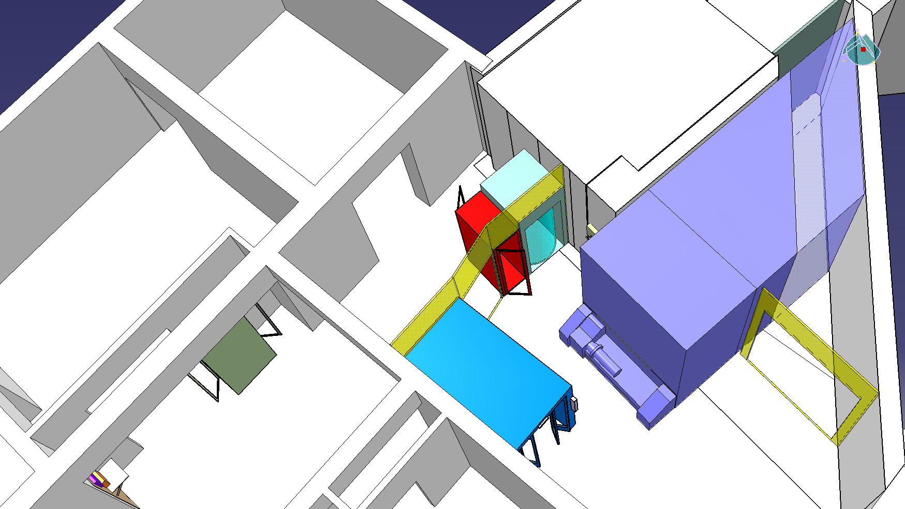
PAD-MAD Access
Pris en charge par GS-ASE-SSE
Consequences pour access
PAD
MMAD
CLEFS
CHECK POINT RP
December 2013

Slide 28
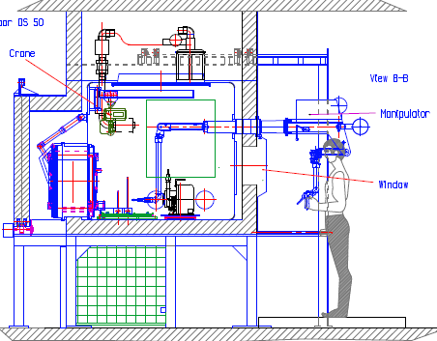
Alpha Gamma Hot Cell
Contract to be signed this week
All details defined
Compatible with existing ventilation system
February 2014

Slide 29
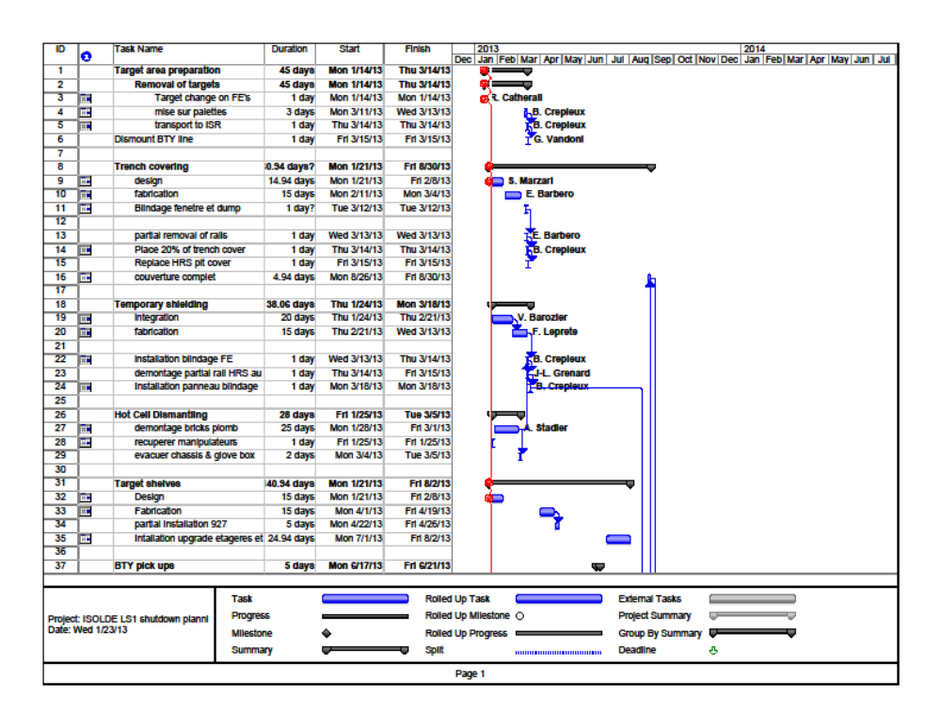
Planning and ALARA in progress

Slide 30
Experimental hall
Remove and open RFQ Cooler
RILIS
  Extension of laser lab
  Laser window modification
New patch panels and remote mass marker power supplies
Beam line adjustments
Vacuum maintenance
Beam instrumentation maintenance
Tape stations

Slide 31
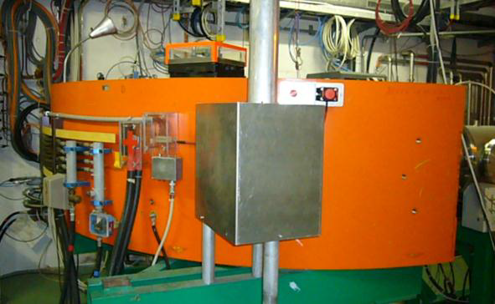
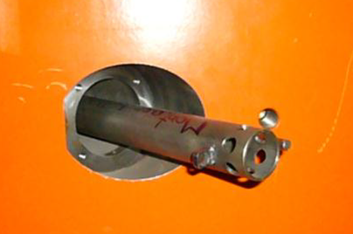
Laser windows
Modification of the HRS laser window holder
  Prolong tube in magnet → To replace the removal tool
  In order to facilitate the exchange of the window in the future
  Protection of orings from laser light needs to be integrated.

Slide 32
RILIS Extension
Option 1
RILIS
28 m²
REX EBIS
254 cm
210 cm
5.8 m²
IS COOLER

Slide 33
RILIS Extension
Option 2
RILIS
28 m²
REX EBIS
254 cm
320 cm
6 m²
IS COOLER
100 cm

Slide 34
RILIS Extension
Option 3
RILIS
28 m²
REX EBIS
254 cm
210 cm
4.3 m²
IS COOLER
100 cm

Slide 35
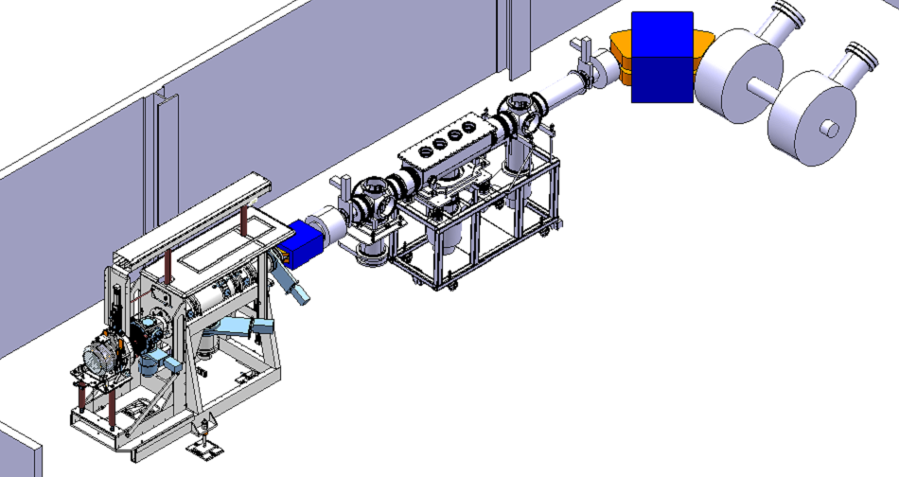
Laboratories
26-R-040 (old class C lab)
  Decommissioned as a radioactive laboratory in February 2013
  Be used as a lab for assembly of equipment, new off-line
New nano-material lab (safety)
Design Study activities
  FE #8 and #9, new RFQ Cooler, off line separator
Pump stand x 2
  Replace old Balzers and existing contaminated pumpstand in lab.
New pill press
  Required for nano-materials
Target development
  Uranium set-up
  Lead Bismuth loop
  N-converter geometry
Off line maintenance

Slide 36
Finally
Everything finished by the end of March 2014
Cold check starts the beginning of April
Separator courses probably end of May/beginning of June
Protons to ISOLDE 16th June 2014
…and don’t worry. Everything will be alright in the end.
And if its not alright…
It’s not the end!
Thank you for your attention

