Slide 1


ISOLDE Technical Report for the ISCC
Richard Catherall EN-STI
CERN, 3rd July 2012

Slide 2
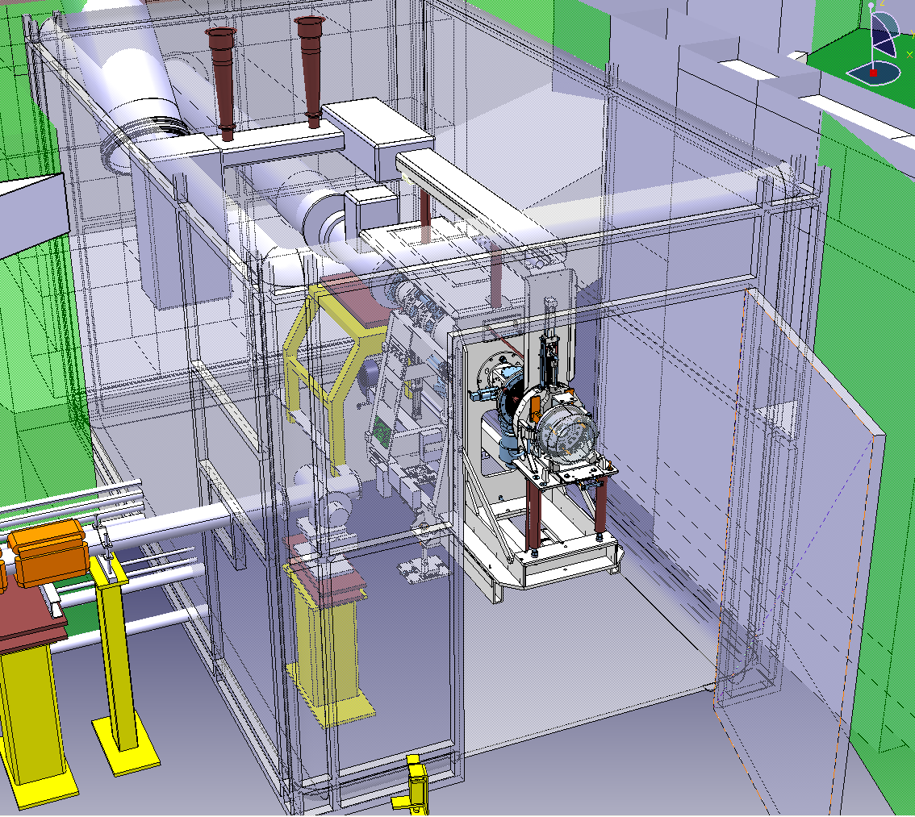
Agenda
Operations
  Targets (T. Stora)
  REX (D. Voulot)
  RILIS (V. Fedosseev)
  Infrastructure
Safety
Target Area Upgrade
  Design Study
  Robot replacement
  Hot Cell
  PAD/MAD
  Medicis
  Handling & transport
  Proposition

Slide 3
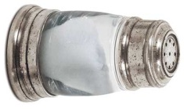


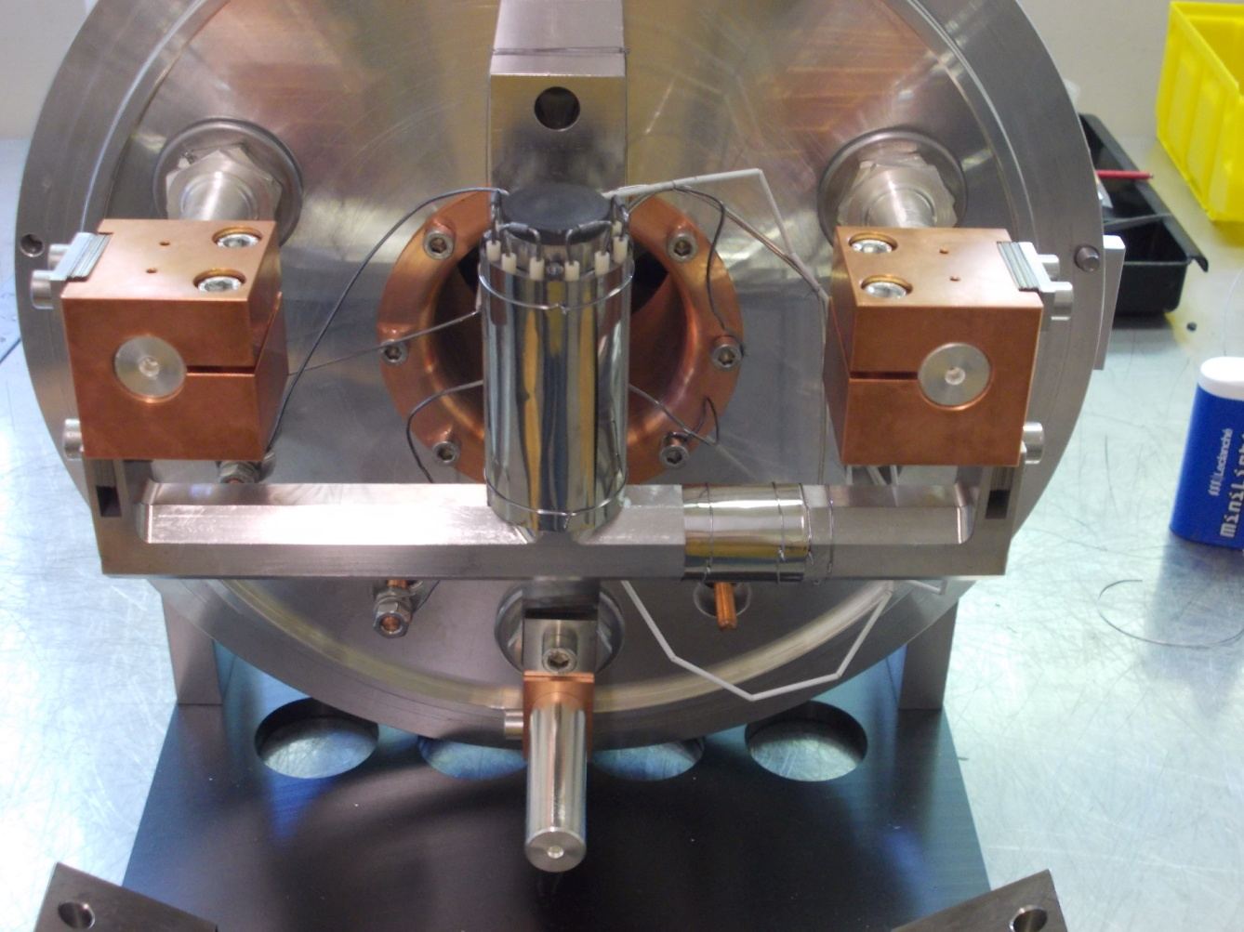
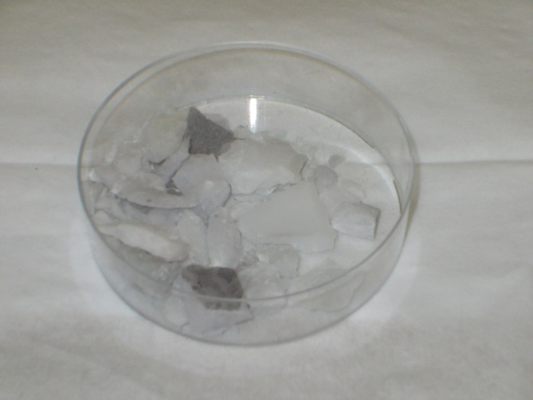
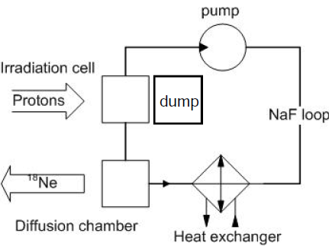
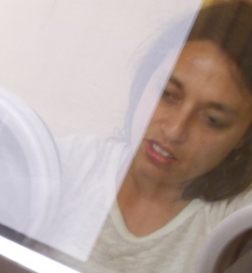
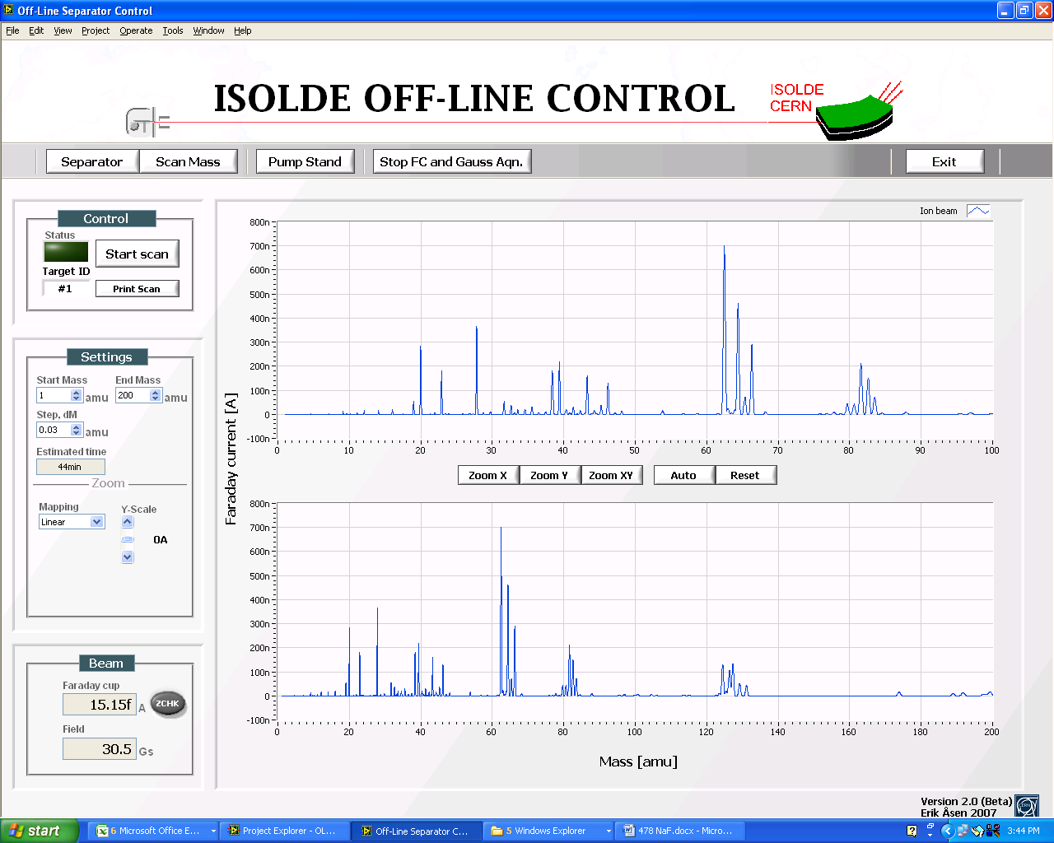
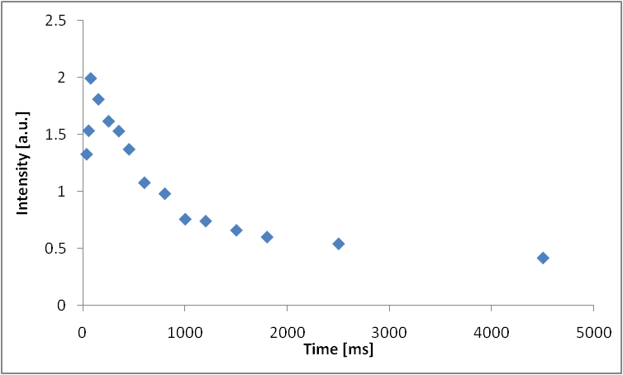
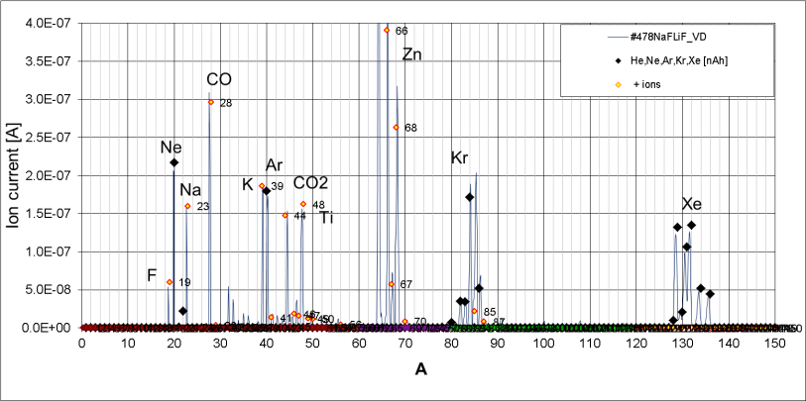
Molten salt target for β-beams ¹⁸Ne beams (ν emitter)
T.M. Mendonça¹, B. Crepieux¹, M. Owen¹, E. Barbero¹, S. Marzari¹, S. Cimino¹, R. Hodak², M. Allibert³, V. Ghetta³, D. Heuer³, E. Noah⁴, T. Stora¹
TISD team + MM-MME & TE-VSC contributions
¹ EN-STI-RBS, ² Comenius University Bratislava, ³ LPSC Grenoble, ⁴ DPN, Univ. Genève
NaF:LiF (39-61% eutectic
melt 650C)
²³Na(p, X)¹⁸Ne, ¹⁹F(p,2n)¹⁸Ne
7.5x24x15cm
2.1 L/s
6mA
160MeV
Transfer line
to ion source
800kW
Technical achievements:
Haynes 242 Alloy
(special machining,
corrosion resistant)
NaFLiF eutect. synthesis
Salt vapor condensation
(phase diagram, hydrolysis,
Fluka, ANSYS,
Ta+Alumina oven
Thermocouples)
Online with Protons !
40x15x15cm
CERN-2010-03 p110
INTC – IS 509
¹⁸Ne ISOL beam @ ISOLDE
from static salt target:
Concept
Salt condensation
Yield,
D [m2/s]

Slide 4
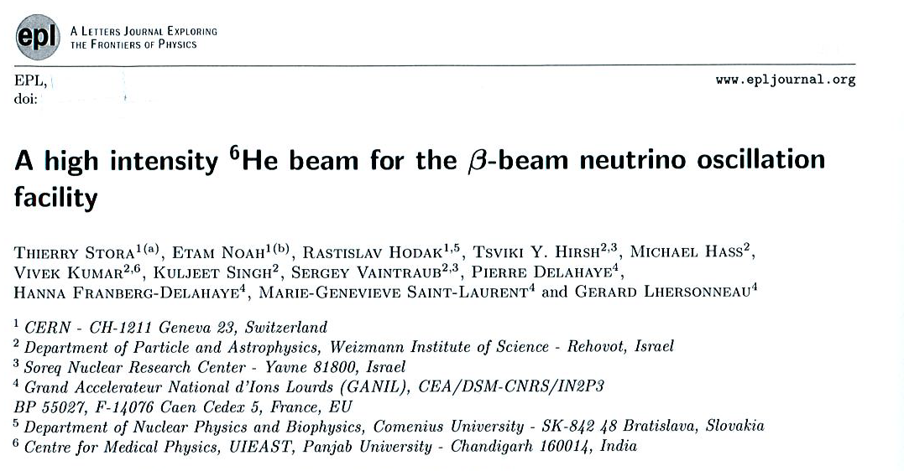
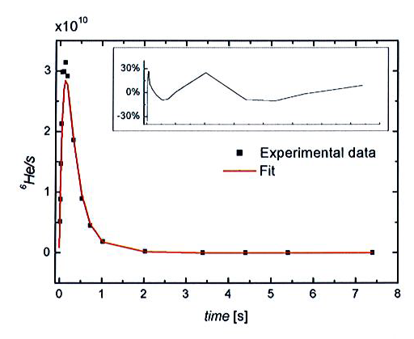
- Article is chosen as the EPL editor “highlight” (to be published in a next issue).
- First experimental demonstration of high intensity beam of ⁶He
on BeO target by (n,α) reaction with spallation neutrons
New theoretical fit of isotope release based on diffusion and evaporation time constants from ISOLDE targets
Molten salt target:
Results at ISOLDE already anticipated in CERN’s activity report

Slide 5
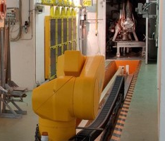
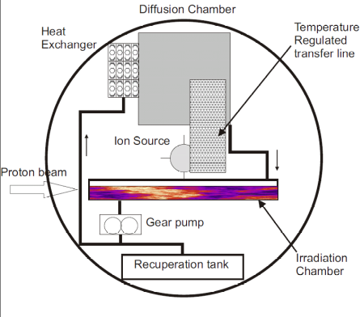
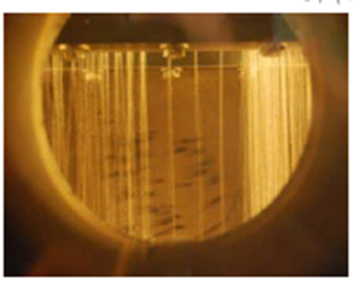
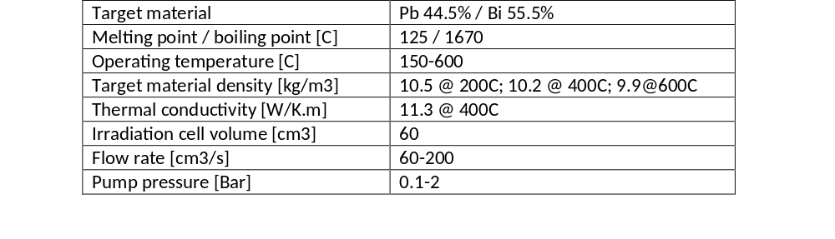
Pb/Bi loop online tests in 2015 for EURISOL
Institutes | Role in the collaboration | Person(s)
LENAC/SPhN/IRFU, CEA, Saclay | Safety file and licensing | V. Blideanu, A. Marchix
PSI, Villingen | Instrumentation | D. Schumann
IPUL, Salaspils | Offline Pb/Bi loop tests | K. Kravalis, E. Platacis
SINP, Kolkata | Radiochemistry | S. Lahiri
CERN, Geneva | Coordination, Design, ISOLDE interface, online tests | T. Stora, A. P. Bernardes, J. Vollaire, M. Delonca, C. Maglioni
SCK-CEN, Mol | CFD simulations, selection of components | P. Schuurmans, L. Popescu, M. Schyns
Kick-off 10th May
4 years project
Endorsed by CERN A&T sector
Budget 450 kCHF + in-kind contrib.

Slide 6






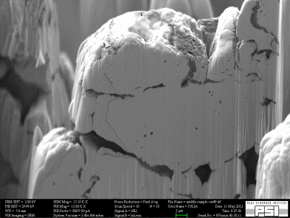
ActiLab (JRA in FP7-ENSAR) & Actinet
2μm
A. Gottberg, J.P. Ramos, C. Degueldre, C. Borca, D. Grolimund, I. Günther-Leopold, A. Andrighetto, C. Lau, P. Delahaye and T. Stora
FIB and Swiss Light Source @PSI
Identification of open porosity and grain size at the μm/sub-μm level in ISOLDE UCx
Before irradiation (contrary to previous publications in the field)

Slide 7
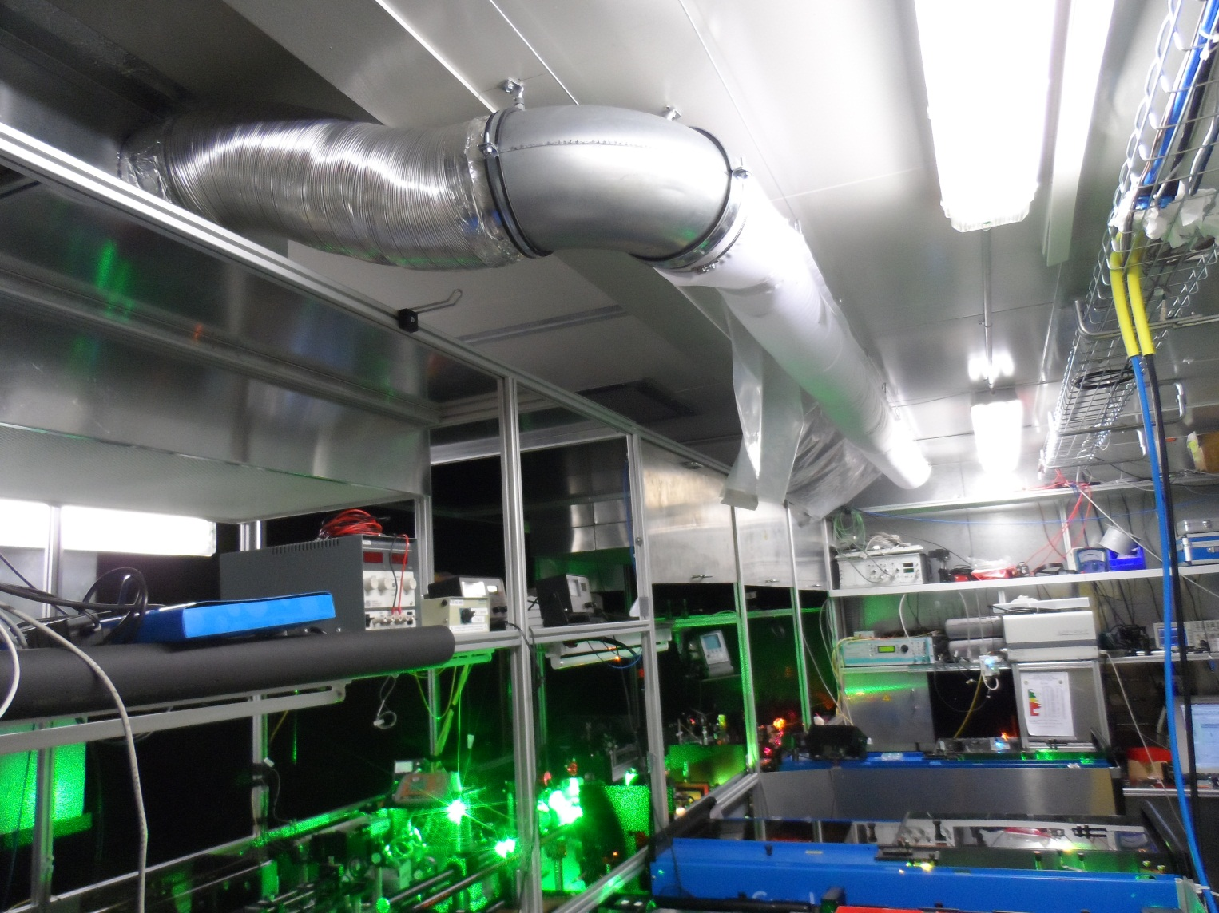
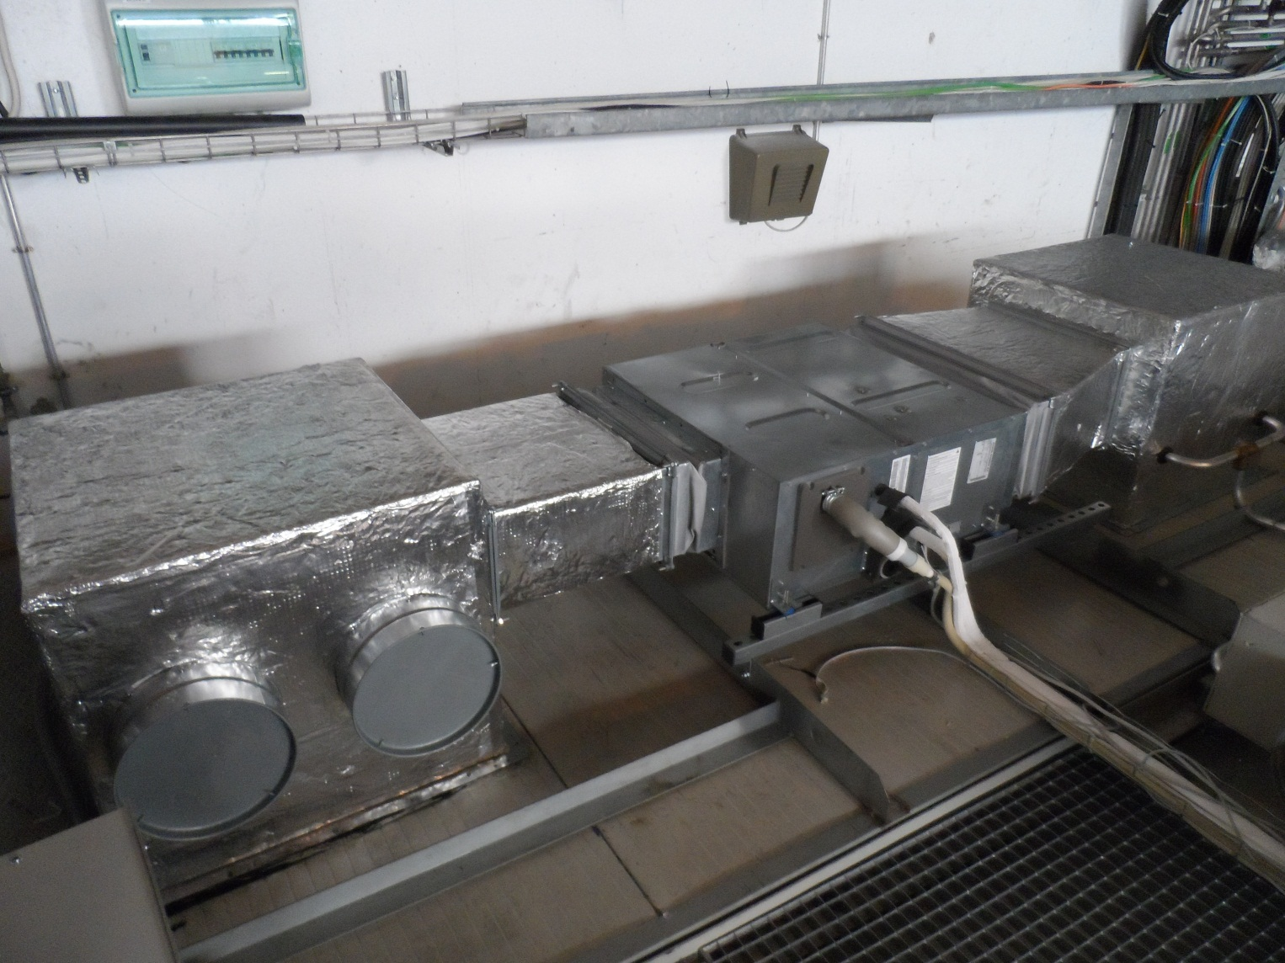
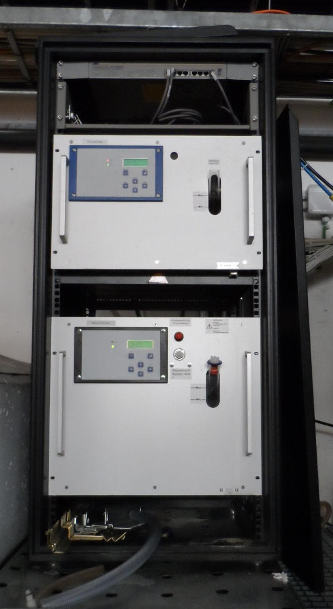
New air conditioning for RILIS
Installed during the winter shutdown
Laser cooling chiller moved to the roof:
Air temperature in RILIS laser room is higher but more stable.
Air humidity is low and constant
Drift of laser beams is reduced

Slide 8

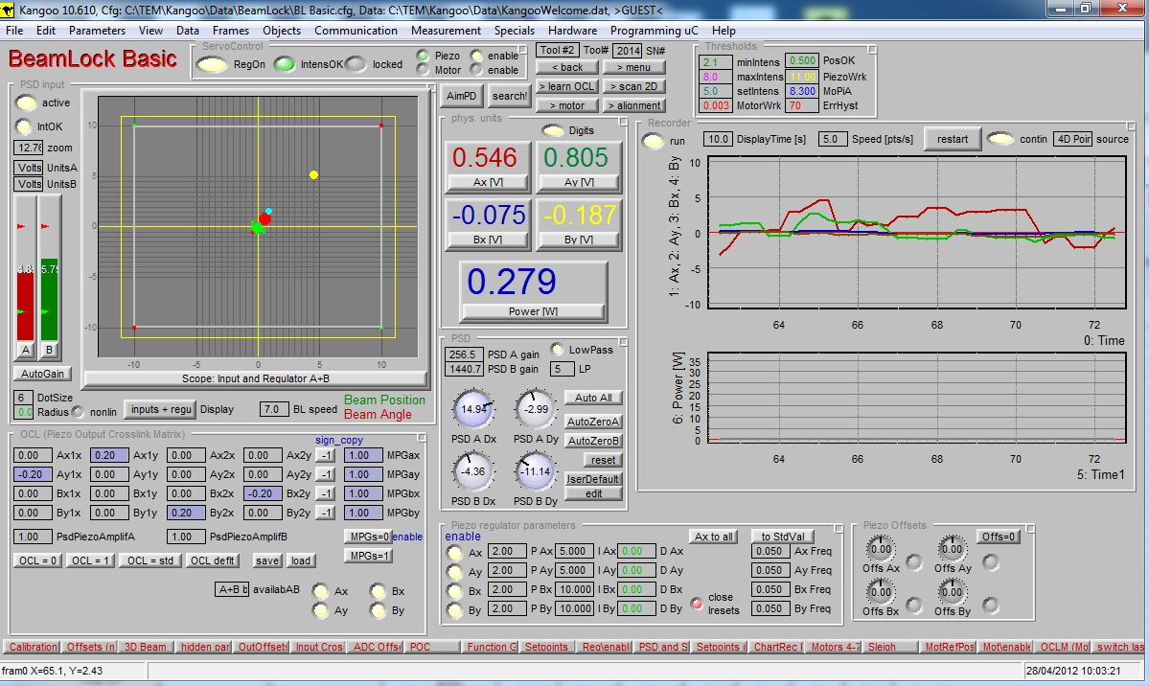
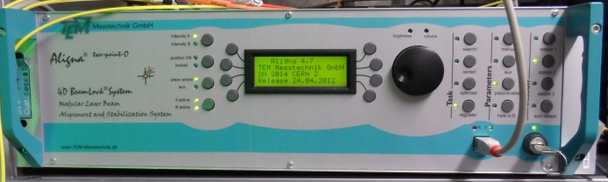
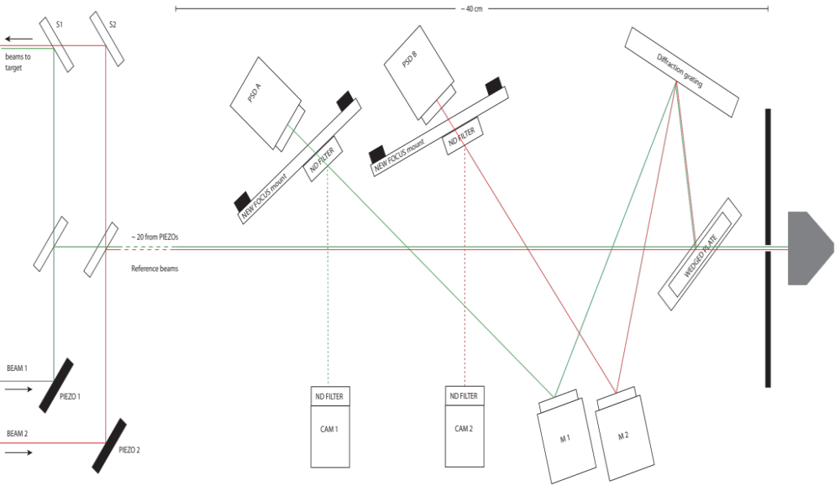
Laser beam stabilization
Commercial system adapted to RILIS conditions
Piezo actuators for fast beam displacement
Stabilization of high and low frequency beam fluctuations
Currently capable of stabilizing up to two visible or IR beams

Slide 9
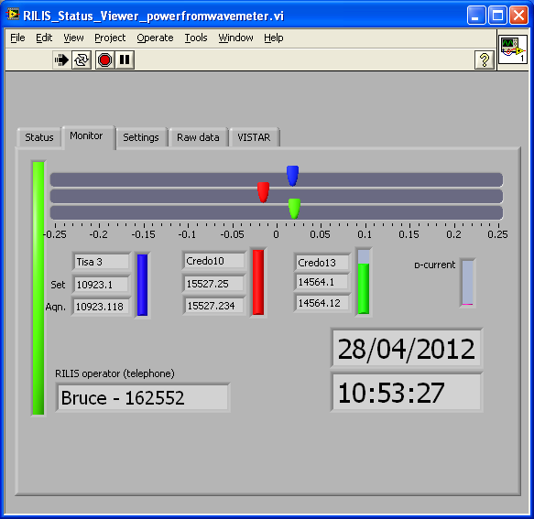
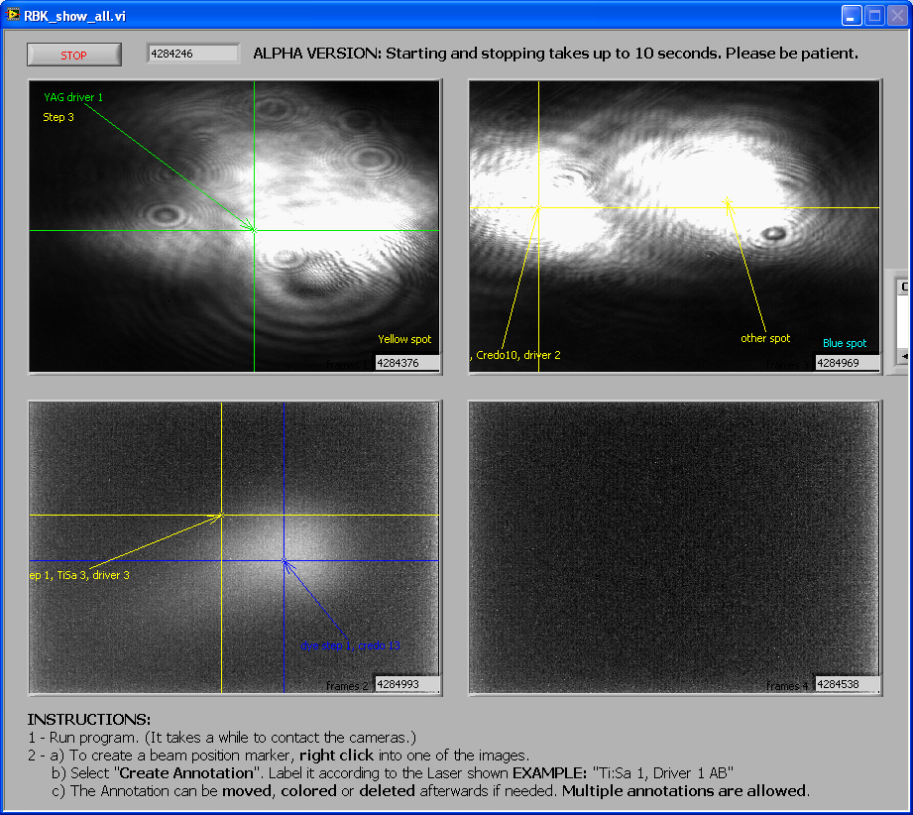

RILIS status monitoring
Essential RILIS parameters are published to a Labview DSM.
All values are accessible from the CERN technical network
RILIS monitor display is published to a website for remote monitoring
Power
Wavelength
Proton current
Reference beam
images
https://riliselements.web.cern.ch/riliselements/LASERS/

Slide 10
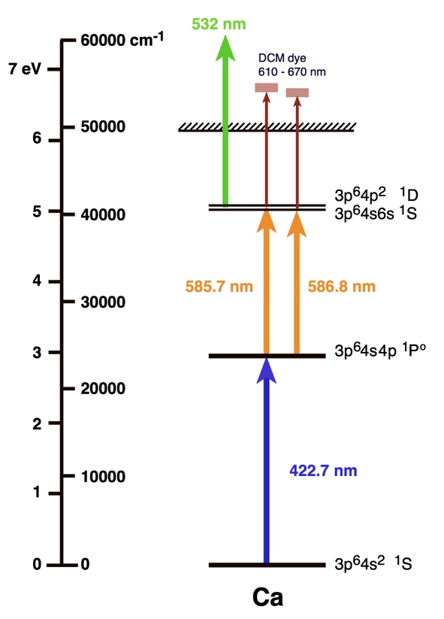
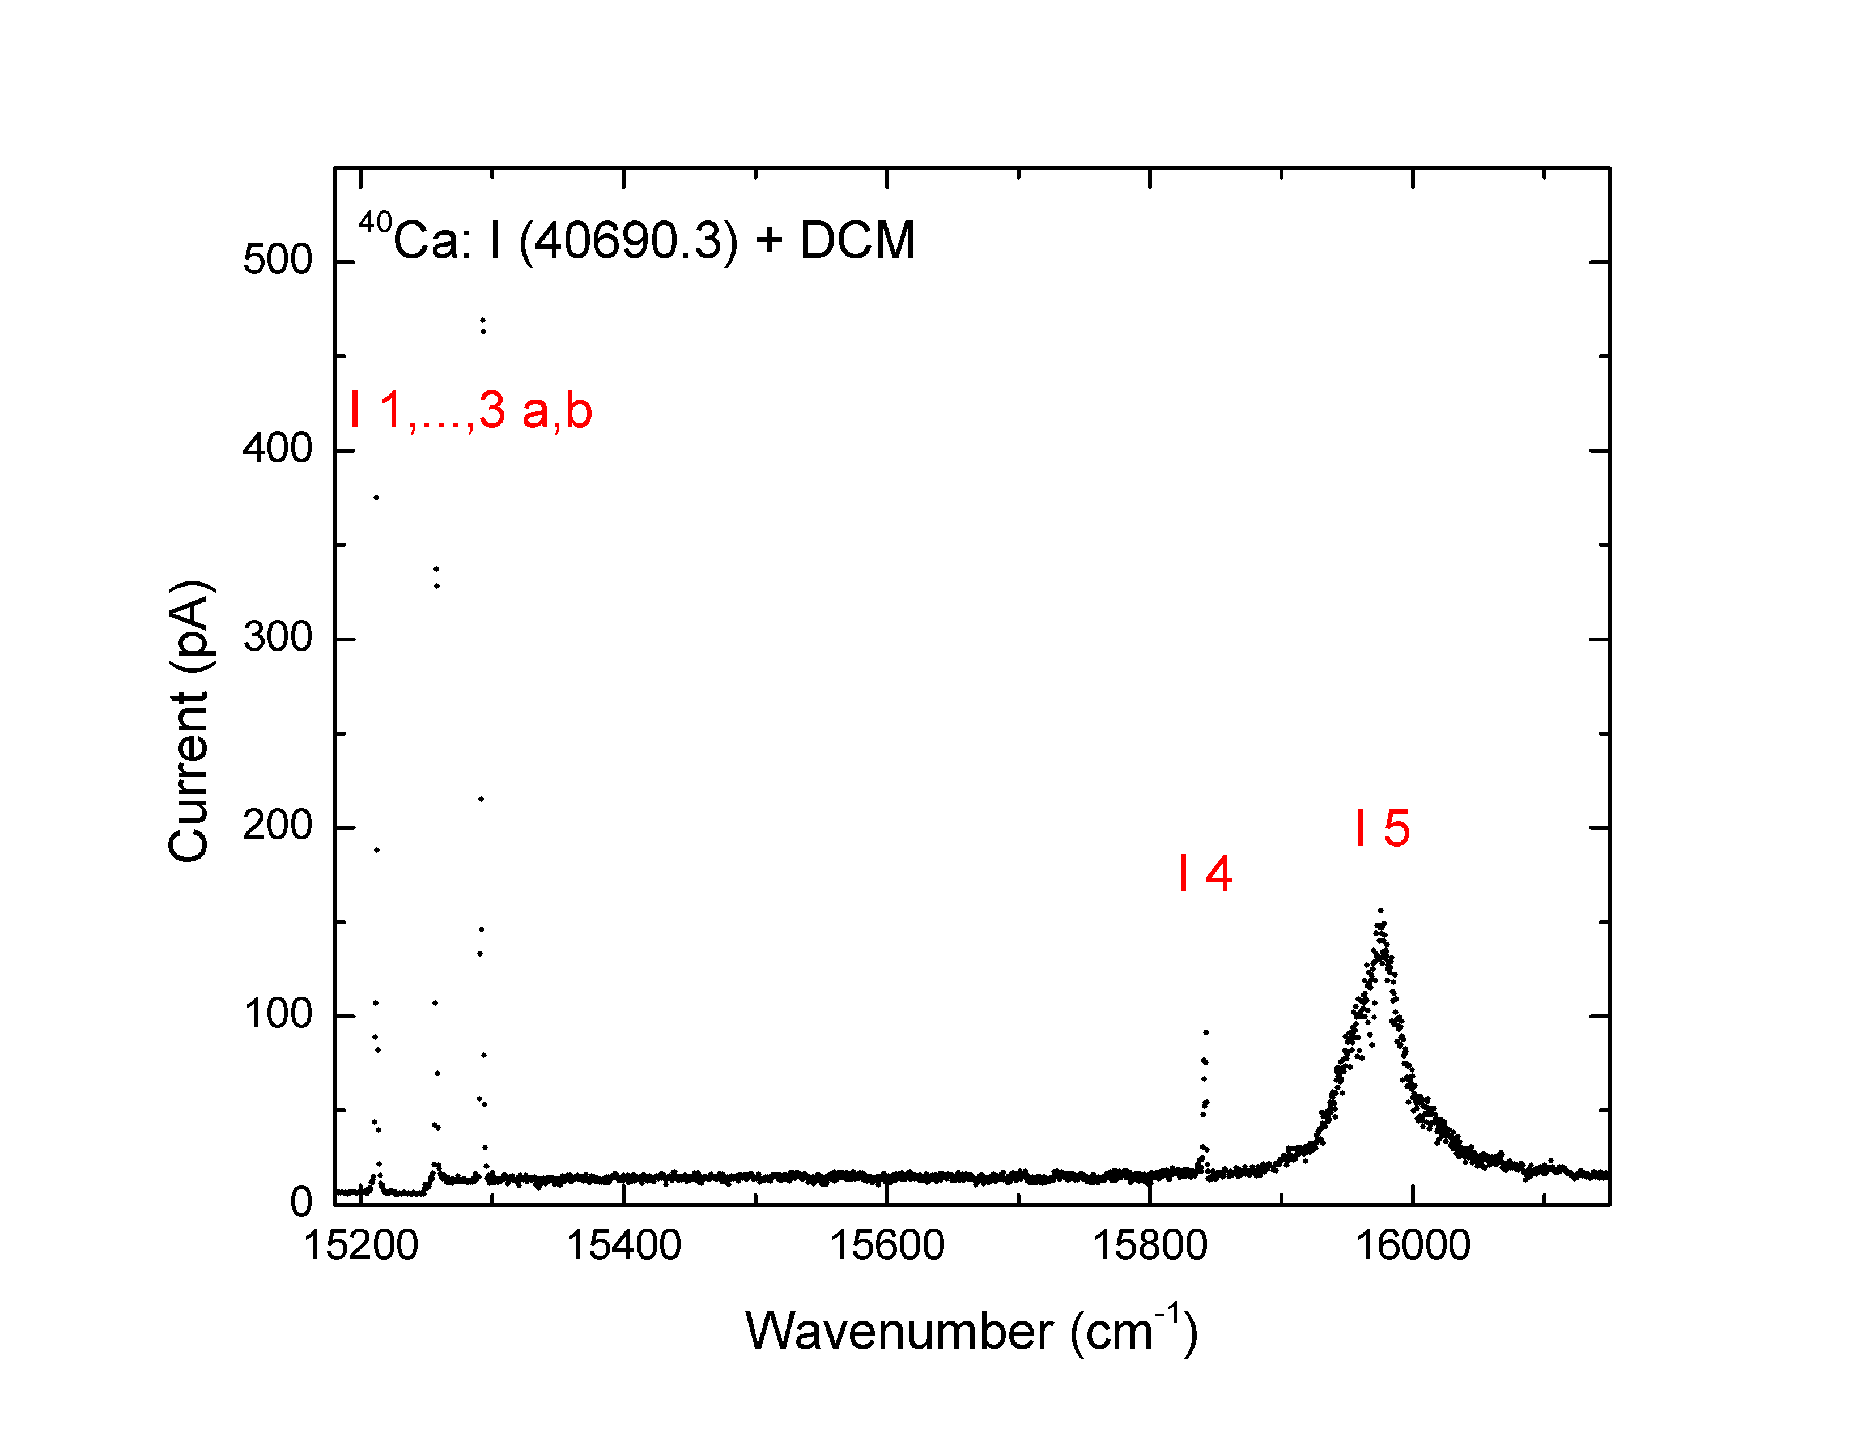
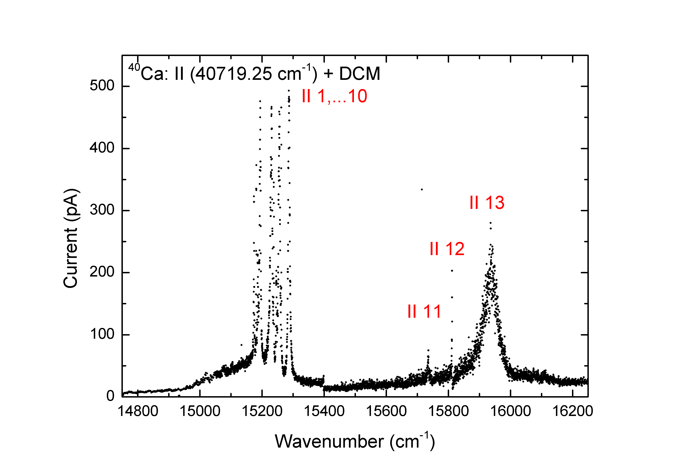

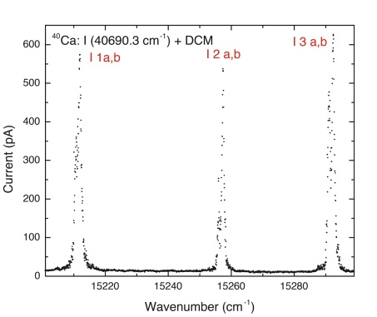
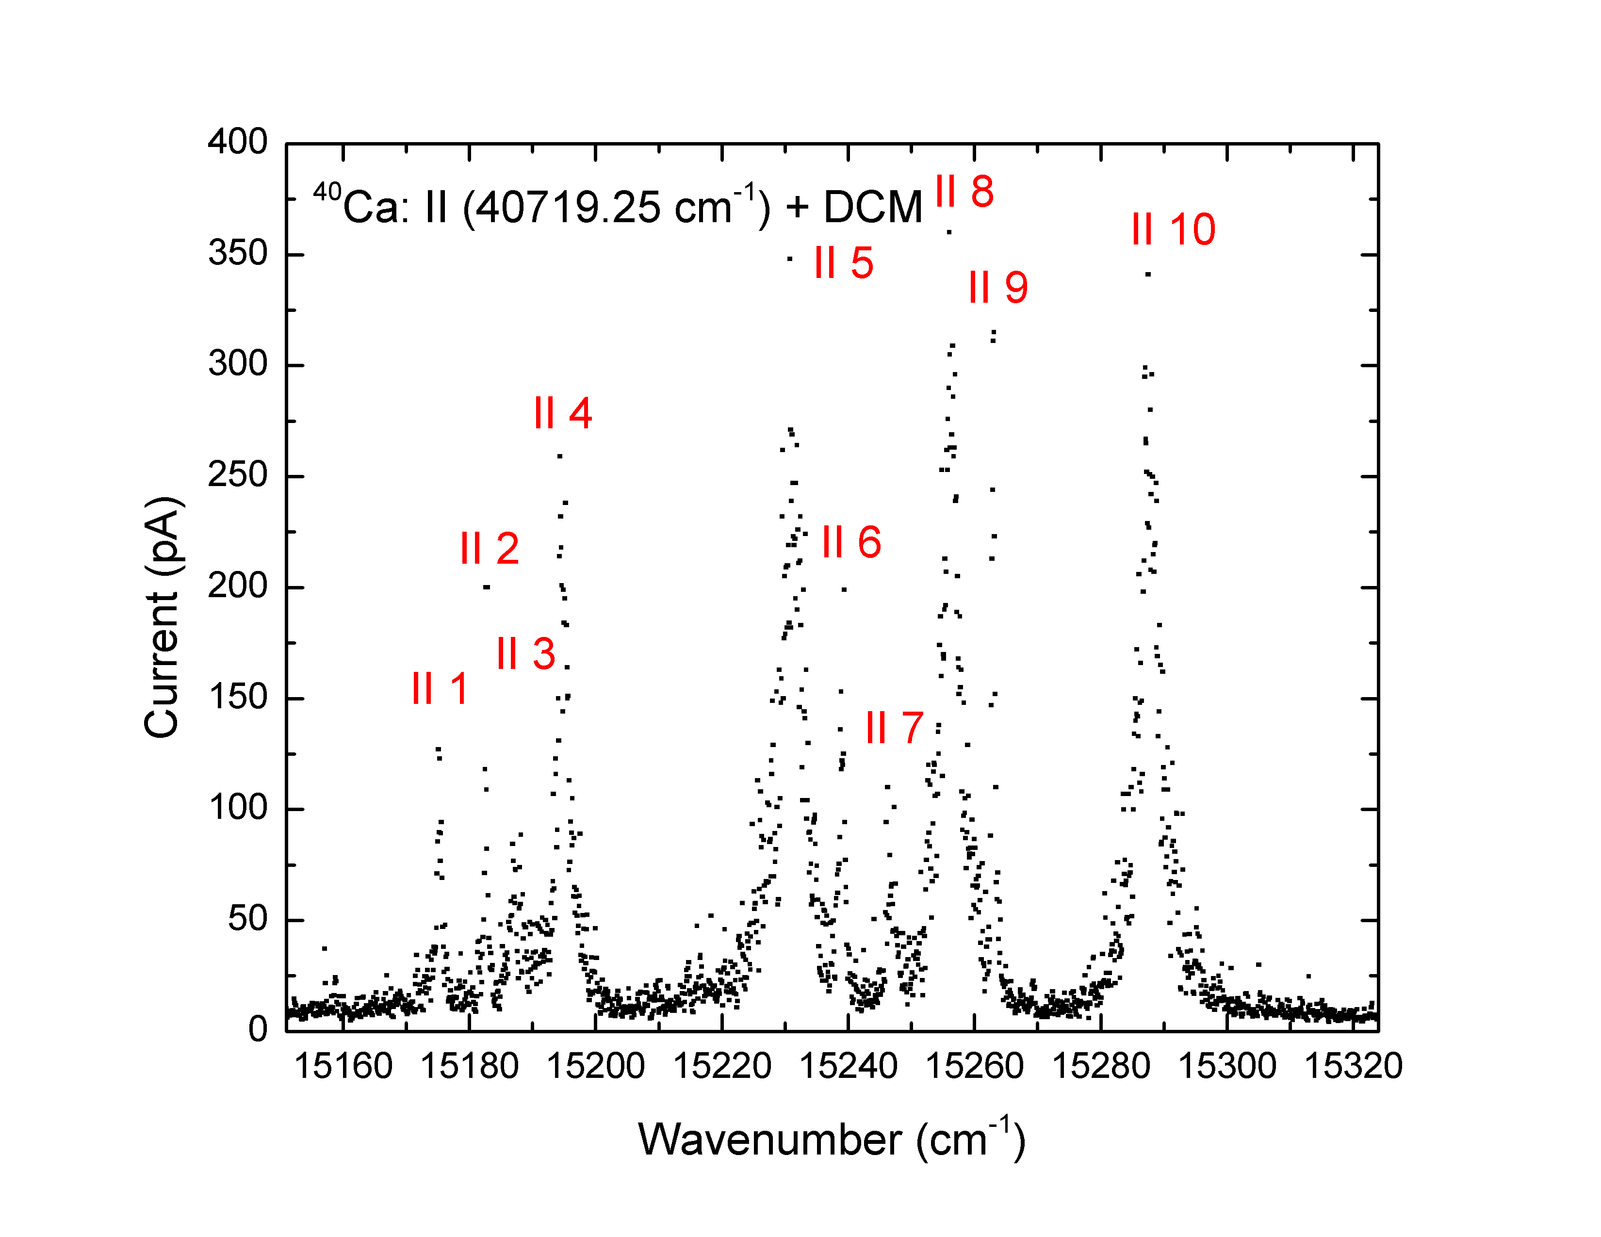
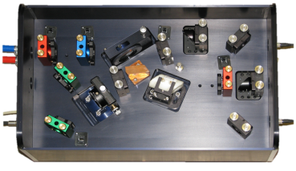
New RILIS beam: Calcium
The ionization scheme of Ca is developed applying combination of Ti:Sapphire and dye lasers
Strong transitions to Auto-ionization states are found by scanning the wavelength of 3rd step dye laser:
dye laser
dye laser
Ti:Sa laser + frequency doubling
Used for IS529, IS532
Laser / Surface > 100

Slide 11
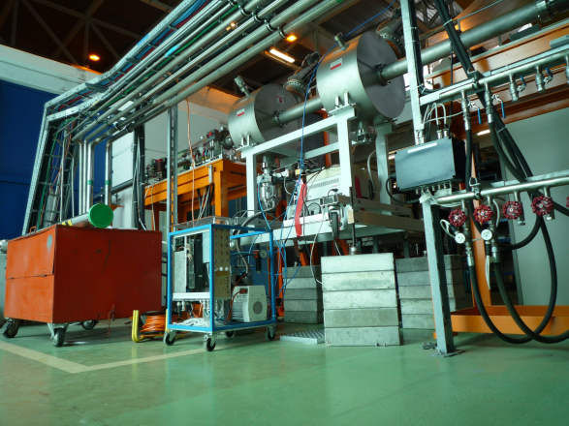
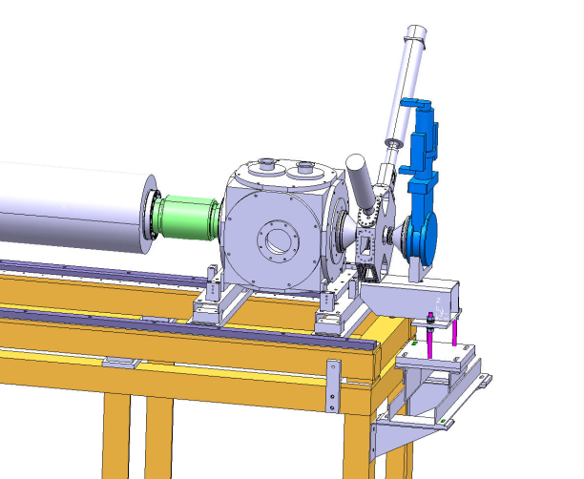
REX campaign 2012
IS524 123Cd
(2) IS478 72Kr
Finally successful!
(3) IS496 140,142Sm
...
* Already two successful runs, one ongoing
* 10 runs schedule until September (+ a few more until November)
Many beamtime request for HIE-ISOLDE MDs
-> transverse emittance measurements
-> HIE diagnostics box commissioning
-> Si-det test for TOF measurement
-> PIN-diode detector for EBIS slow extraction signal
-> RP measurement of X-ray background in the hall
->...
Emittance meter behind the linac
HIE diag. box on L20 (BE/BI)

Slide 12
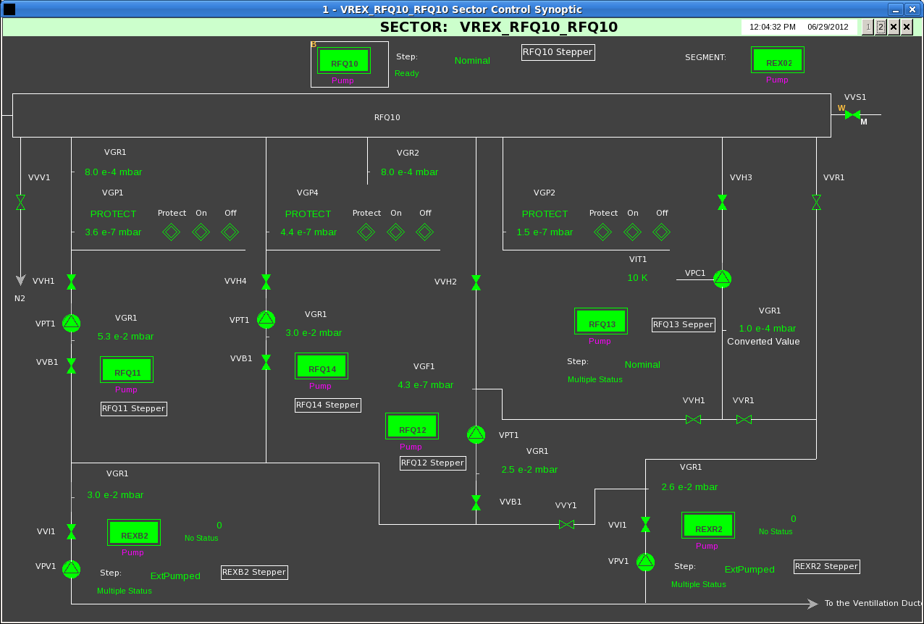
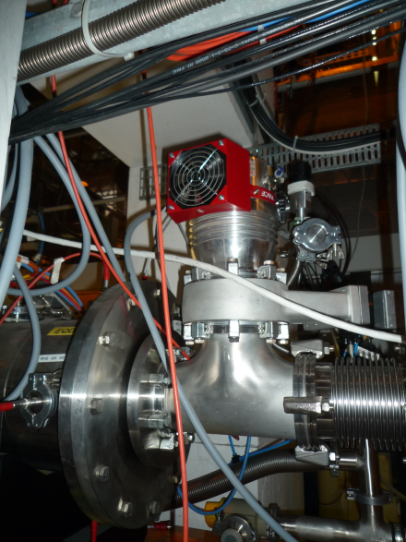
Improvement of RFQ section vacuum
New turbo installed on RFQ section
Replacement of vacuum window for MCP system in DB2
Now all the section is < 5e-7 mb
Presently running 142Sm34+ no sign of transmission loss

Slide 13
Infrastructure
Migration of GM classes to the CERN standard FESA classes for most of the equipment at ISOLDE.
  Magnet controls to follow suit.
Tests on automatic beam transport optimization successful
Application interlock on beam intercepting devices in path of laser green light
Fencing of ISOLDE hill (to be refined)

Slide 14
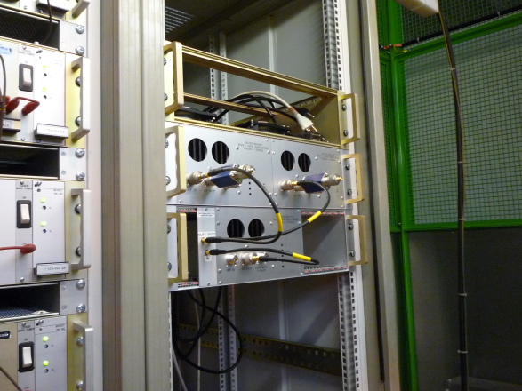
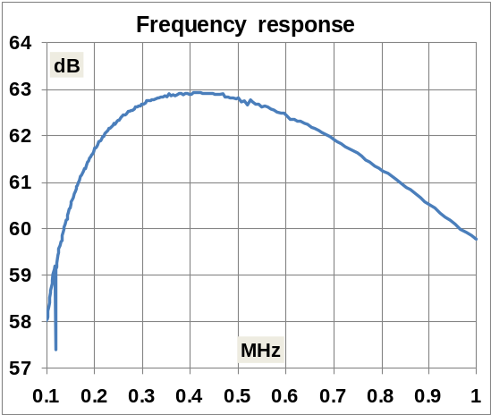
ISCOOL RF amplifier
New RF amplifier has been tested offline
Hardware installed in RFQCB cage, ready for commissioning (waiting for cabling)
Control system hardware to be installed in July (VME crate + fiber optics ethernet connection)
Aiming for operational test and validation in the second half of the runs
(Full control system with OASIS monitoring signals and console application to be deployed later)

Slide 15
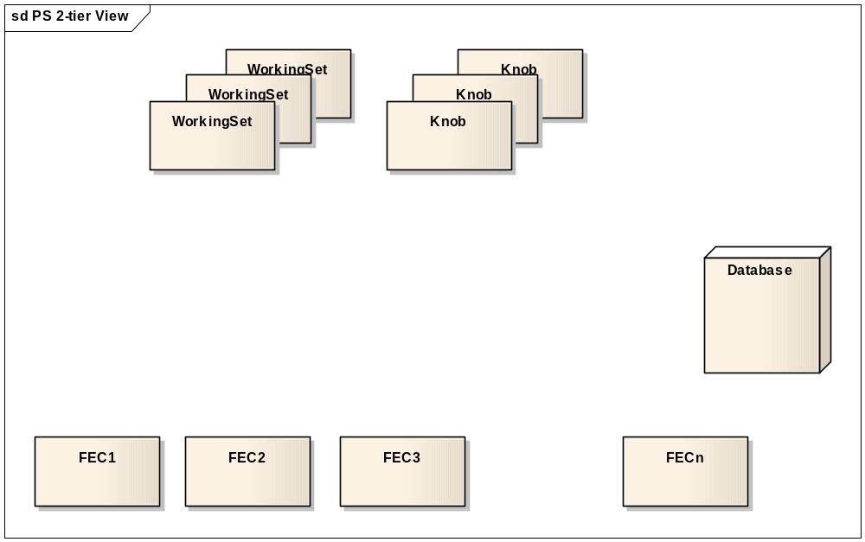
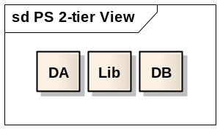
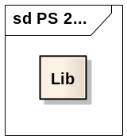
Non-InCA architecture
...

Slide 16
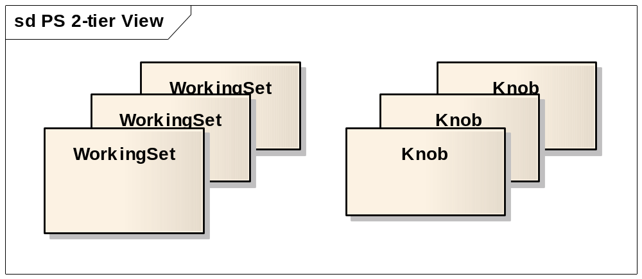
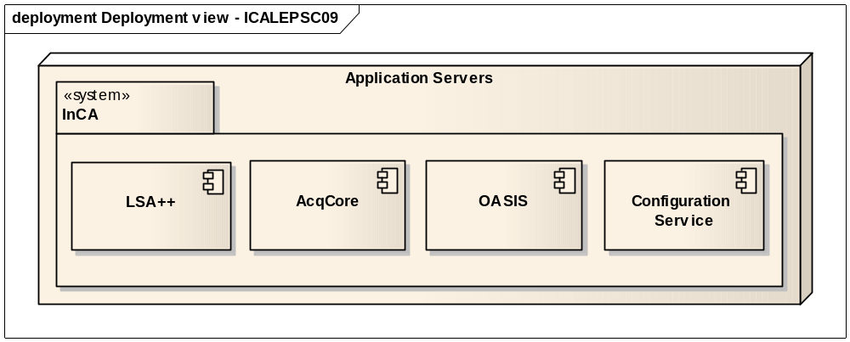
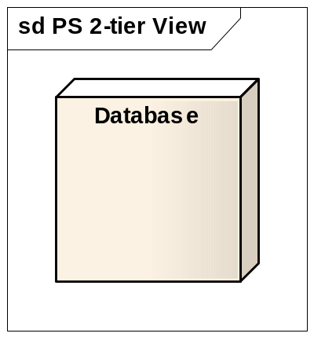
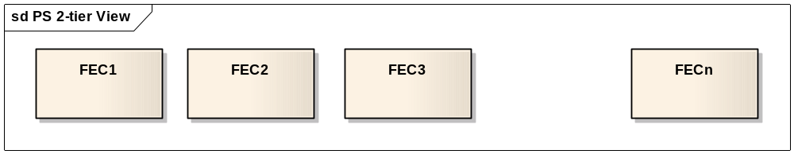
Injector Controls Architecture
...

Slide 17
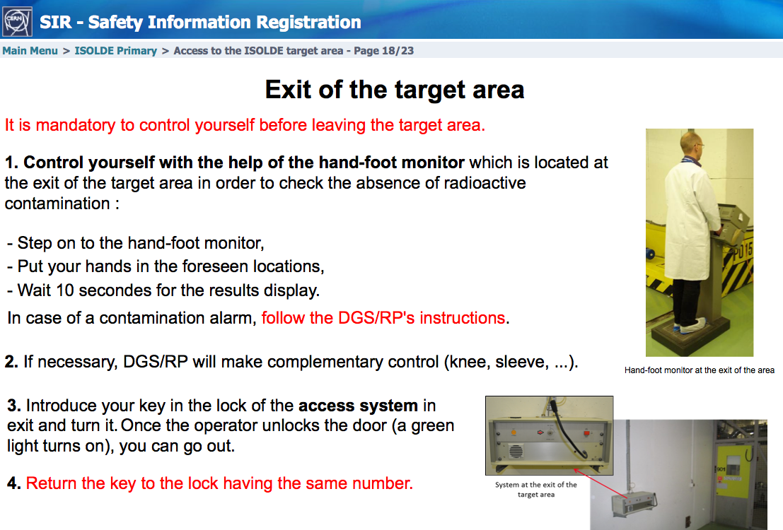
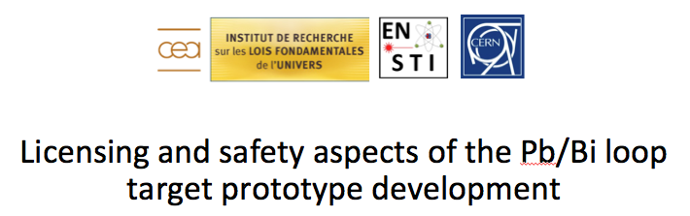
  ALARA addressed by EN-STI-RBS in 2012 ISOLDE
    5 ALARA III
    9 ALARA II
Safety course specific to ISOLDE primary area on line on SIR →
Objective: Be prepared for the LS1
(Link with access data base planned for December 2012)
← CEA/IRFU/LENAC and CERN Safety collaboration started to perform various safety studies on target prototype

Slide 18
Agenda
Operations
  Targets (T. Stora)
  REX (D. Voulot)
  RILIS (V. Fedosseev)
  Infrastructure
Safety
Target Area Upgrade
  Design Study
  Robot replacement
  Hot Cell
  PAD/MAD
  Medicis
  Handling & transport
  Proposition

Slide 19
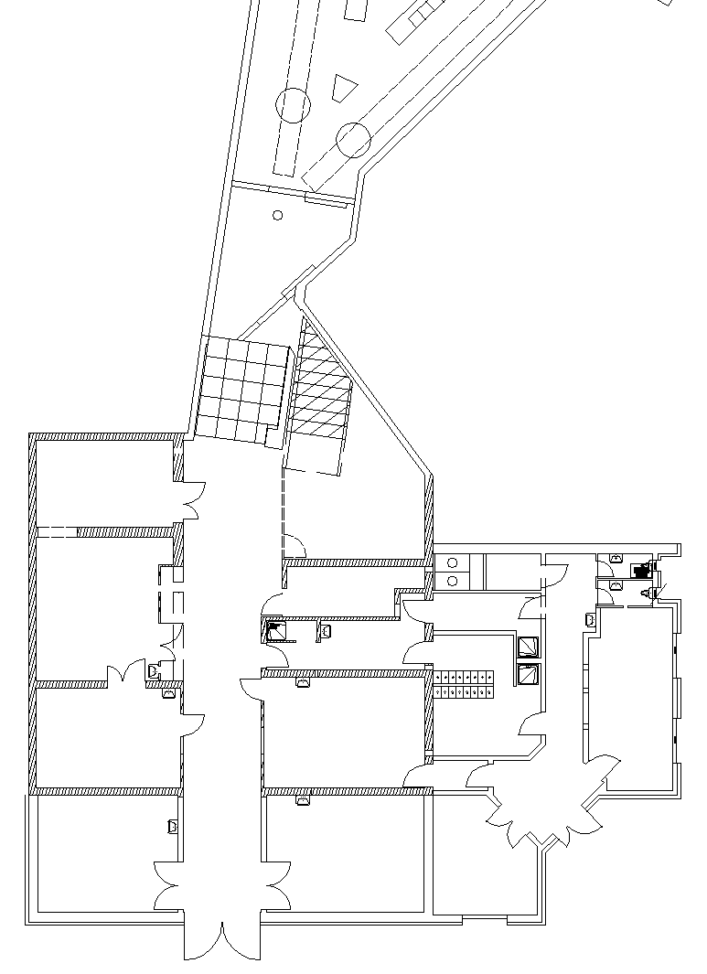
HIE-DS design study
Activated air release/ventilation
  WP of HIE Design study (by Andrea Polato)
  Creation of a SAS between target area and the class A laboratory
  Target and beam dump cooling
  Reduction of contamination risks from target area to class A laboratory
  Best efficiency of the ventilation
SAS ?

Slide 20
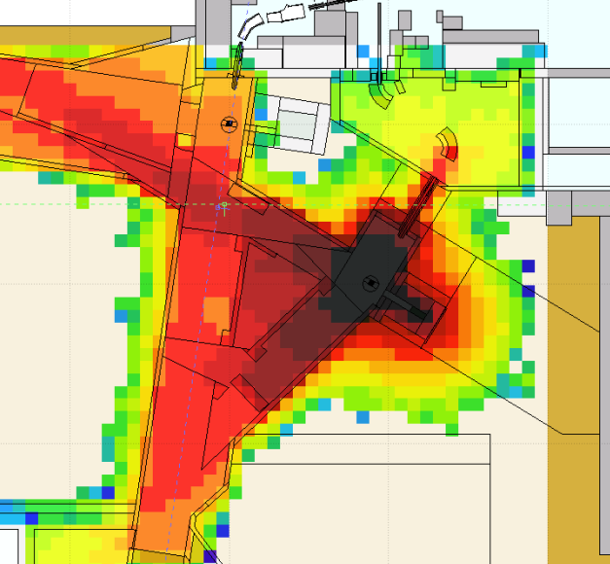
HIE-DS design study
Additional shielding
  WP of HIE Design study (L. Morejon)
  Creation of 2 removable shielded close to targets
  Reduction of air activation into the target area
  Fluka Simulation under study

Slide 21
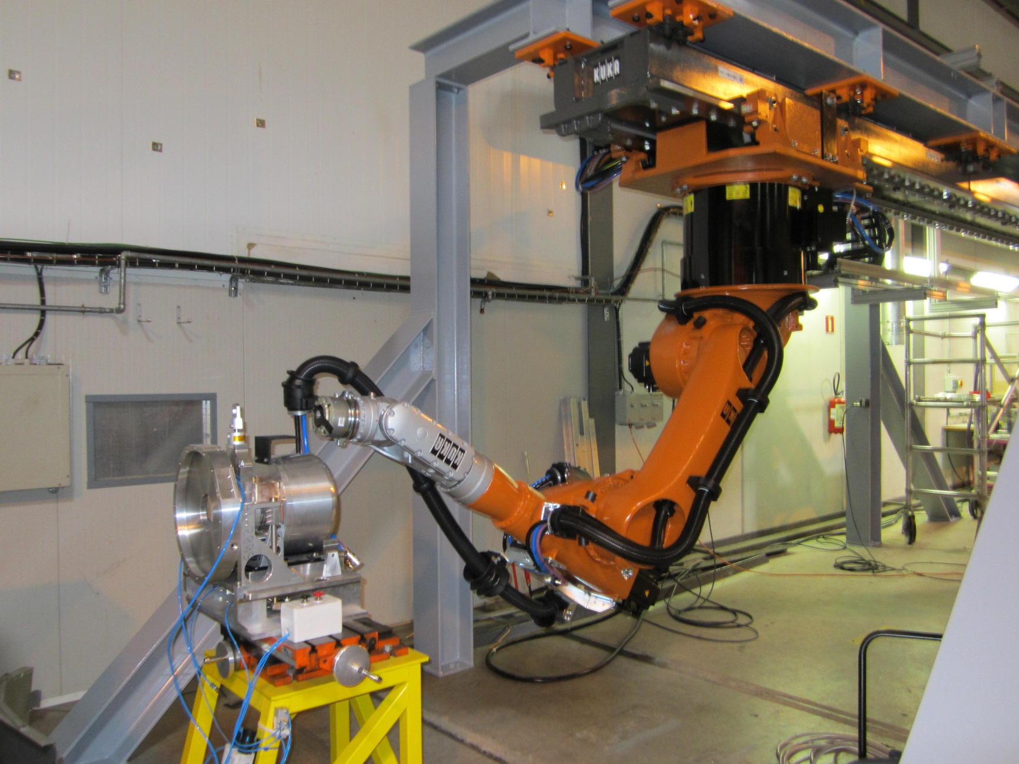
Robot Upgrade

Slide 22
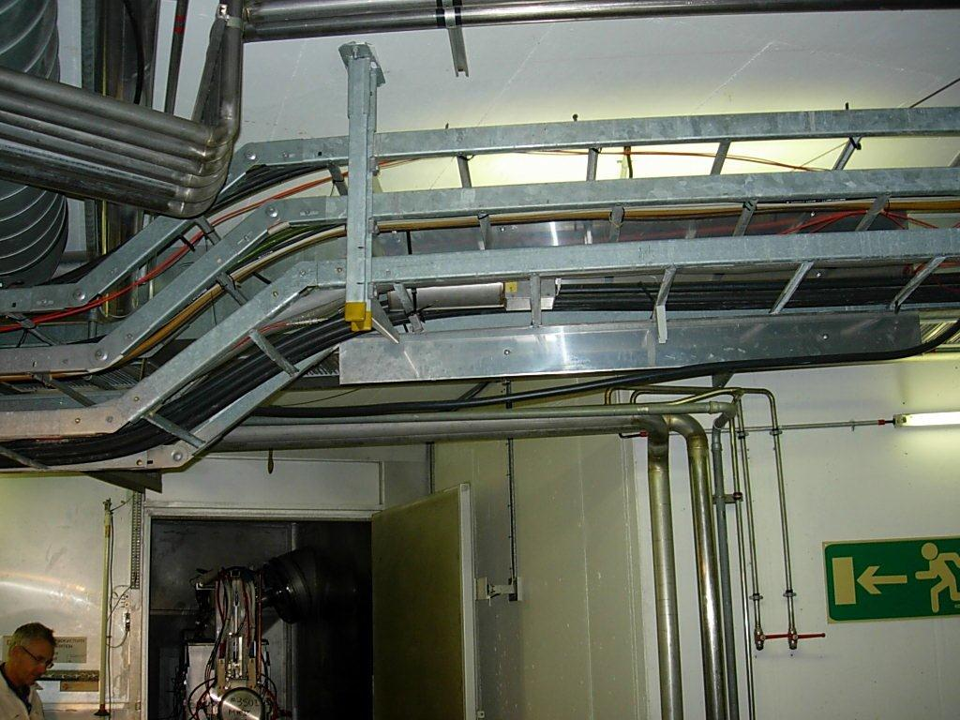
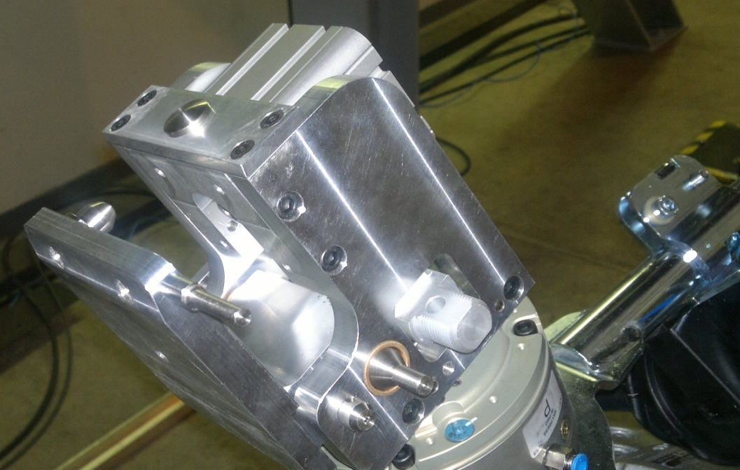
Robot Upgrade
Test stand almost complete
Test of long cables done
Integration on-going
  Issue in front of GPS faraday cage
New gripper design with quick release
Interlocks, redundancy, functional requirements …etc

Slide 23


Hot Cell
Functional specs completed
Technical specs under completion
Market survey has been launched
Aiming for the December 2012 Finance Committee
Oxidation process to be finalized this year
New buffer zone in IS5 complete

Slide 24

PAD-MAD Access
Installation planned for the end of 2013
Version with new target storage being investigated
Robot barrier will be integrated
MAD can be removed for Front End passage
PAD
MMAD
CLEFS
CHECK POINT RP
No PAD/MAD in the hall for secondary zones
- physically impossible
An alternative solution is under investigation
EDMS no.1145495

Slide 25



MEDICIS
New RABIT for MEDICIS
  Project under inquiry (S.Marzari)
  Informal market survey done
  Functional specification done
  Possibility to irradiate samples just ahead the beam dump
  Pneumatic fast transportation from irradiation station to the hot cell

Slide 26


MEDICIS
MEDICIS principle
Freely available
KT Fund

Slide 27







Target life cycle and Handling
Pallet Handling with
1 remote controlled
Vehicle (existing)
By Robots
Move by lots of 6 hot target/pallet to ISR
Return by lots of 6 decayed targets/pallet to Isolde for dismantling in the hot cell
Move waste containers into the truck for Paul Schaerer Institut (PSI)
Deliver the new target to the exchange point for the robots by hand
New
Target
19 m2 area for container storage and for targets back from ISR waiting for hot cell dismantling (too small ?)
New hot
Cell (2013)
To ISR (~3 transports/year 3x10 = 30 targets/year)
Back from ISR (~4/y)
To PSI (1/y)

Slide 28
Overview
Strong interactions between projects
Approved projects 2013
New Hot cell
2 New Robots
New Cameras
PAD-MAD
New ventilation
and cooling
Targets-frontend
upgrade
Additional
shielding
HIE-Design study
New storages
Remote handling vehicle
New RABIT
MEDICIS lab
Handling optimisation
MEDICIS

Slide 29

Integration
Proposed Layout :
In green: Approved projects
new robots,
cameras,
PAD-MAD,
hot cell
In orange: HIE-DS
new ventilation and cooling,
additional shielding,
targets and frontend upgrade
In blue: new storage and MEDICIS

Slide 30


Handling optimisation
New remote handling vehicle
  Project under inquiry (by Keith Kersaw & Stefano Marzari)
  Informal market survey and potential suppliers visit done
  Reduction of risks for hot target transportation
  Add new functionalities and flexibilities like:
    Hot target autopsy
    Increase re-use of old targets for Isolde facility
    Recovery/backup of Kuka Robots
    Camera inspections
  Simplifications in ALARA committees
Possible design examples

Slide 31
Thank you for your attention
Acknowledgements
  A-P. Bernardes
  S. Marzari
  A. Stadler
  T. Stora
  GS-ASE, BE-OP
  D. Voulot
  V. Fedosseev
  L. Hernandez, V. Vlachoudis
  J-L. Grenard, B. Feral, K. Kershaw
  A. Polato
  G. Kruk

