Slide 1
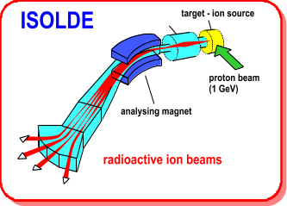
Technical Report
ISCC Meeting 16th February 2009
R. Catherall, M. Lindroos.
EN-STI-RBS

Slide 2
Outline
Shutdown Work
  Target Area
  ISOLDE Hall
  REX
  Target Production Section
HIE-Isolde

Slide 3
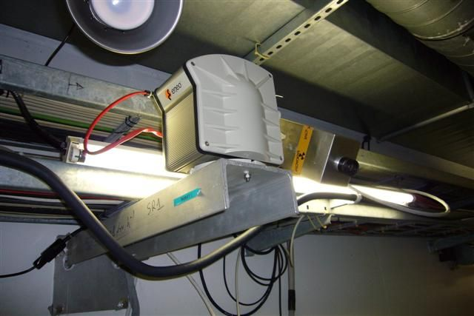
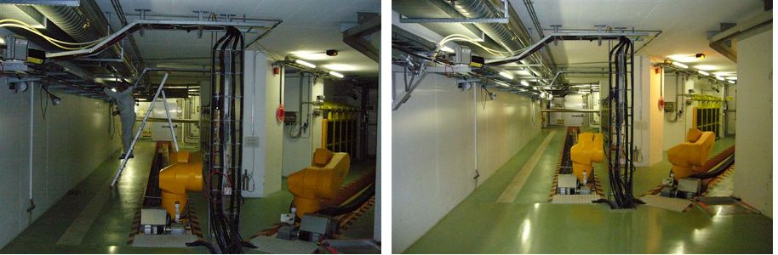
Target Area
Improvement of cameras and motorization in the target area
  P. Fernier
Replacement of neon and security lights - E. Siesling
Before
After

Slide 4
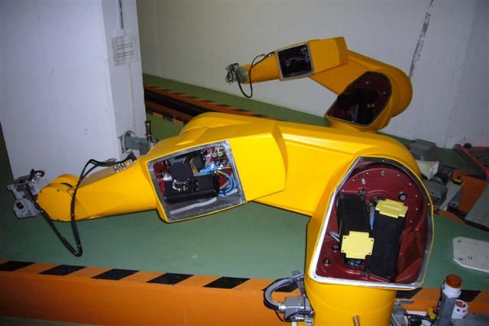
Target Area
Robot repair, maintenance and check
  Staubli S. A., E. Siesling
Target removal
Safety checks
Ventilation and cooling interventions
BTY beam line checks
  BLM’s, magnets
Cables for new FE turbo pumps
Front end maintenance

Slide 5
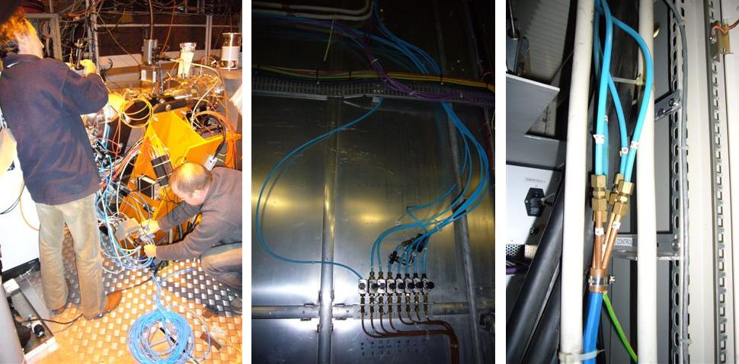
ISOLDE
Compressed air tube replacement
  Due to a frequent breakdown of compressed air tubes (hardened with time) during 2008, a decision was taken to replace all 400 metres
  E. Barbero, M. Owen

Slide 6
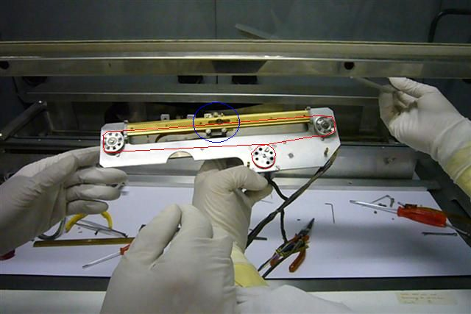
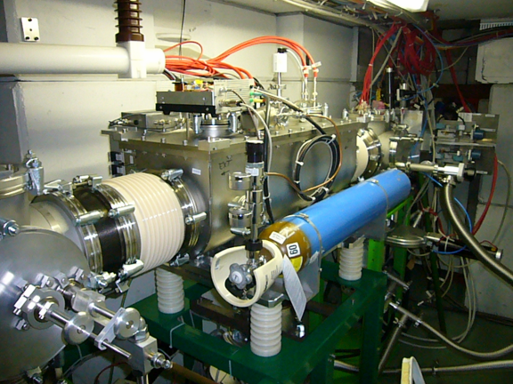
ISOLDE
Repair of Scanners, wire grids and fixed needle beam scanner
  M. Durrafourg, G. J. Focker
Integration of RFQ Cooler into vacuum system
  J. de Freitas, H. Vestergard

Slide 7
ISOLDE Hall
Vacuum pump maintenance
Target cooling water regulation
Power supply maintenance and modifications
Cabling
  Vacuum interlocks, power supplies
Drawings
  Migration from Euclid to Catia, updating etc.
Fast tape station controls and integration
Laser barrack interlocks
…etc

Slide 8
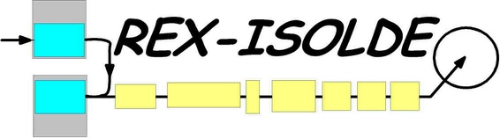
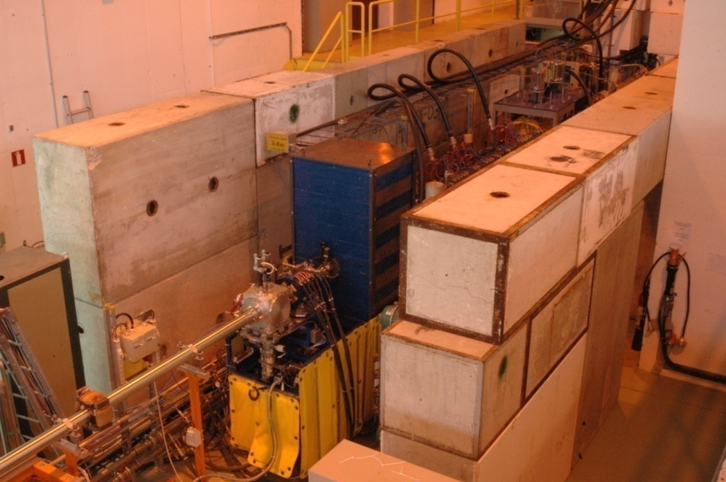
REX
Shielding
  In view of removing the close-clad lead shielding and to limit the x-ray exposure in the hall, the construction of a shielding tunnel around the REX linac is under way.
  D. Voulot
Implementation of new alignment reference points before shielding installation
Remaining:
  Lighting
  Fire alarms
  Roof
  Removal of lead shielding and end-closure installation with shielded interlock doors... shutdown 2009/2010

Slide 9
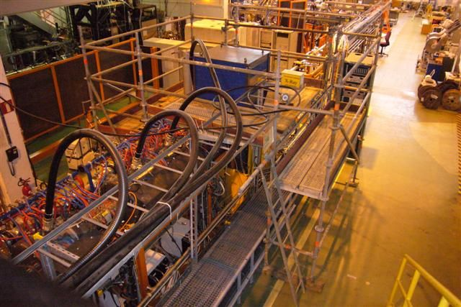
REX
One good reason to remove lead-clad shielding!

Slide 10
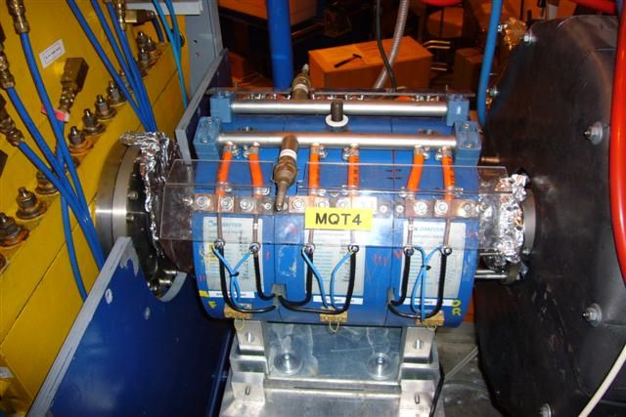
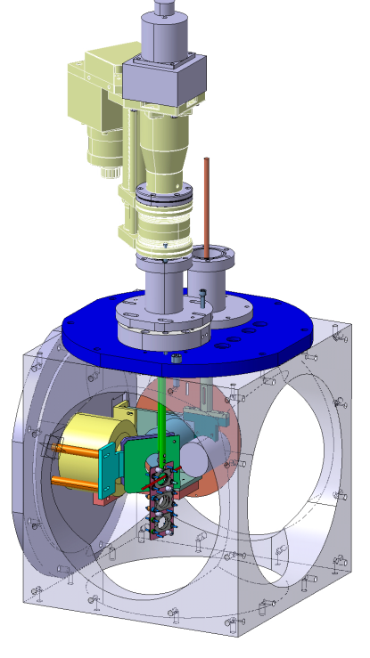
REX
Repair and re-installation of the MQT4 focusing magnet.
  D. Voulot, A. Newborough
Displacement of MQD2 between 9 gap and bender
  D. Voulot
Development and design of tilted foil mechanism for polarized beams.
  F. Wenander, D. Mladinov
Installation foreseen during shutdown.
Controls to be integrated.

Slide 11
REX
Magnets
  Power supplies installed for future corrector magnets, protection to be installed…
REXEBIS
  General maintenance, verify motor generator, exchange electron cathode…
REXTRAP
  Diaphragm on extraction side to be installed, improve 60kV insulation…
RF
  Implement auto-restart of HIS in PLC, maintenance of 7 gap, interlocks…
Vacuum
  General vacuum maintenance and consolidation, interlocks, gauges…
Controls and Applications
  Element scanning vs faraday cup, debugging, modify equiparray input, finish applications for REXEBIS…
Beam Diagnostics
  Consolidation of diagnostics boxes, check MCP’s …
Alignment Cooling Documentation ….

Slide 12
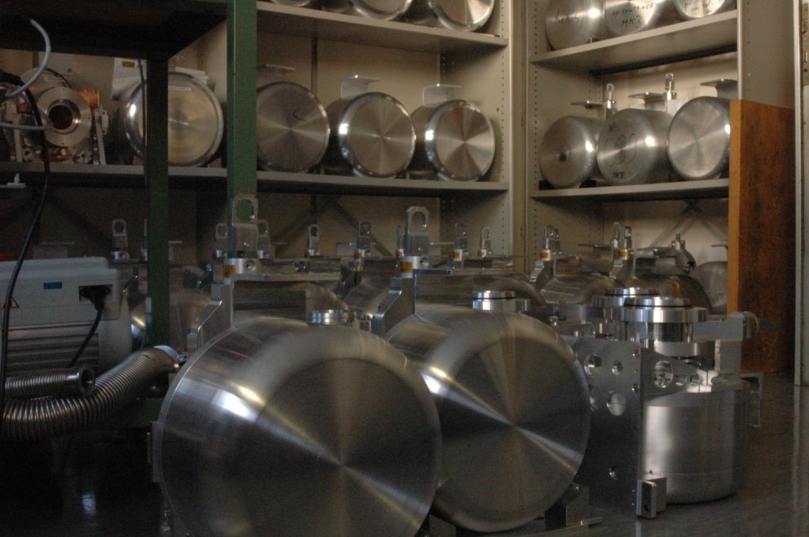
EN-STI-RBS
Delivery of the first batch of 35 targets constructed under the new contract with Alca, Italy
  S. Marzari
Adoption of the Versatile Arc Discharge Ion Source (VADIS) for all plasma targets in 2009. Expected improvement in yields of all elements.
  L. Penescu, T. Stora
Element | He | Ne | Ar | Kr | Xe | Rn
ISOLDE MK7 ionization eff. (%) | 0.14 | 0.36 | 2.0 | 4.3 | 11 | -
ISOLDE VD7 ionization eff. (%) | 1.4 | 6.7 | 26 | 38 | 47 | 62

Slide 13
Acknowledgements
Detailed planning well defined by E. Siesling
  Follow up and weekly progress reports
Most of the planning organized around the availability of A. Dorsival from Radiation Protection
  Multi-tasks in multi-areas. Availability most appreciated.
…and thank you to all those who are participating in the ISOLDE shutdown work.

Slide 14



Slide 15
HIE-ISOLDE: Next step with three objectives
ENERGY: REX energy upgrade and increase of current capacity (Matteo Pasini)
  Energy upgrade in 3 stages: 5.5 MeV and 10 MeV/u and lower energy capacity
INTENSITY: ISOLDE proton driver beam intensity upgrade - strongly linked to PS Booster improvements including linac4 (INTENSITY WP, Richard Catherall)
  Faster cycling of the booster
  New target stations for ISOLDE
  New targets
  New target handling system
QUALITY: ISOLDE radioactive ion beam quality – more than half already financed through the ISOLDE collaboration
  Smaller longitudinal and transverse emittance
    Done – RFQ cooler operational
  RILIS upgrade and LARIS construction
    Done
  Charge breeder upgrade
  Better mass resolution
  Continue target and ion source developments

Slide 16
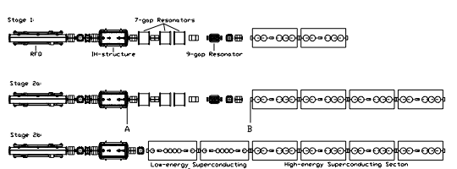
ENERGY WP: The proposed HIE-LINAC
3 stages installation
1.2 MeV/u
3 MeV/u
5.5 MeV/u
10 MeV/u
Standing group for the upgrade of the ISOLDE facility meeting TTC Meeting, Geneva Nov. 4, 2008

Slide 17
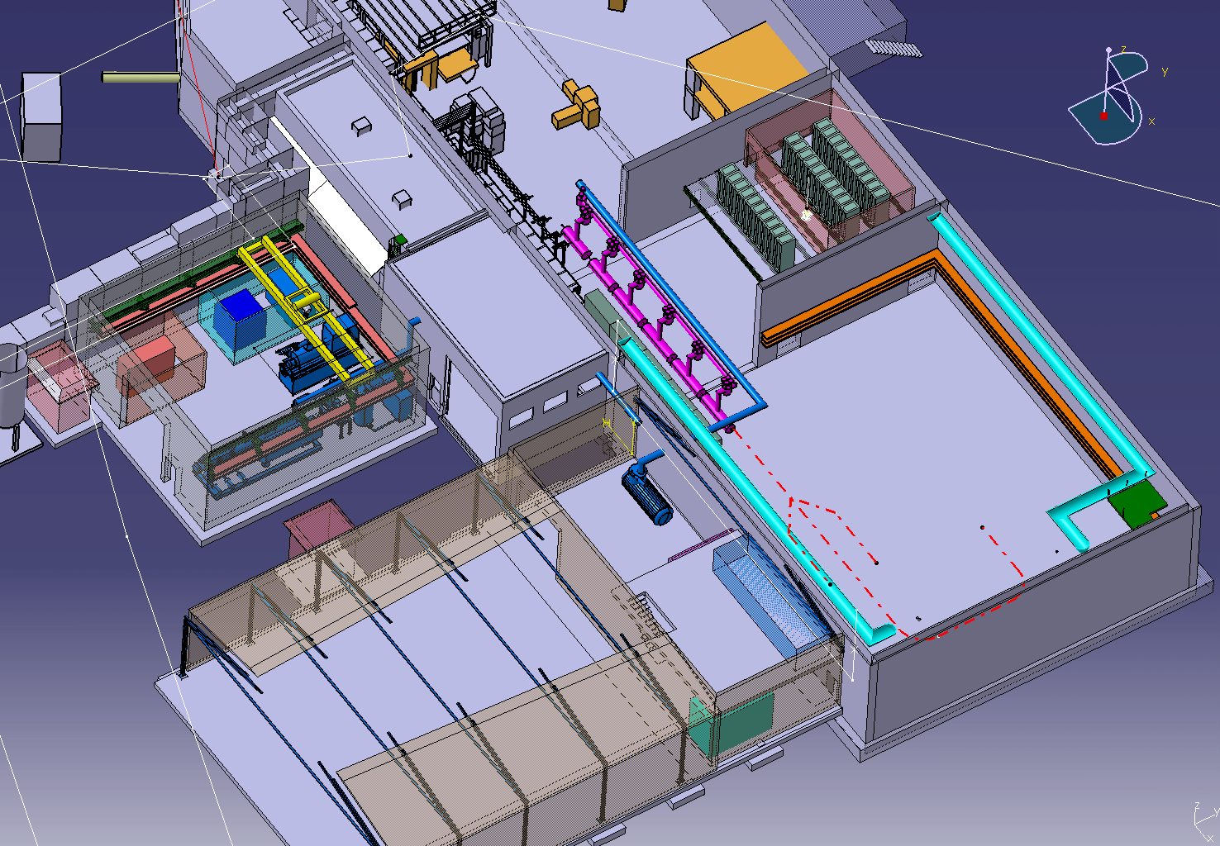
ENERGY WP: The proposed HIE-LINAC Layout

Slide 18
INTENSITY WP: Higher driver beam intensities
Cost for the faster cycling of the booster included in this proposal
  Linac 4 will have major impact on the ISOLDE “targetry” and the project includes necessary modifications for linac 4 (but not the cost of linac 4!)
Target handling, targets, waste handling and general safety in target area
  Major improvement of working conditions for radiation workers compared to present situation and fully in line with European legislation

Slide 19
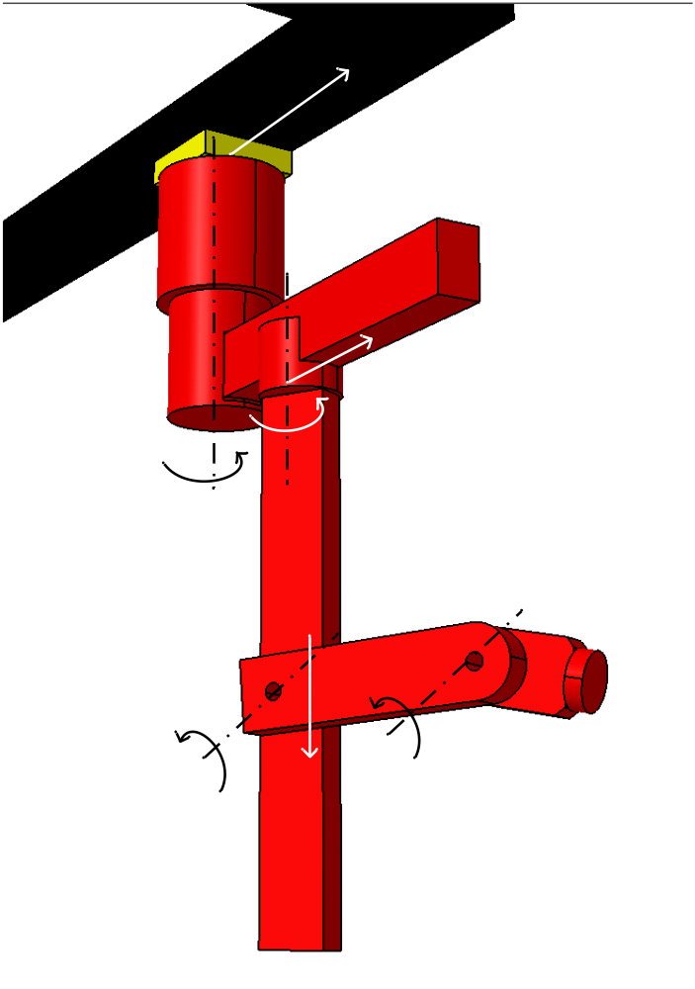
Manipulator concept design
6-DOF Manipulator mounted on ceiling monorails
Equipped with tool changer for mounting different tools
Recoverable by decoupling (remotely) rail gear drive
High lifting capacity (FFE)
Target & electrode accurate / sensitive operations
Options:
  Teleoperation with force reflection into Master
  ...

Slide 20
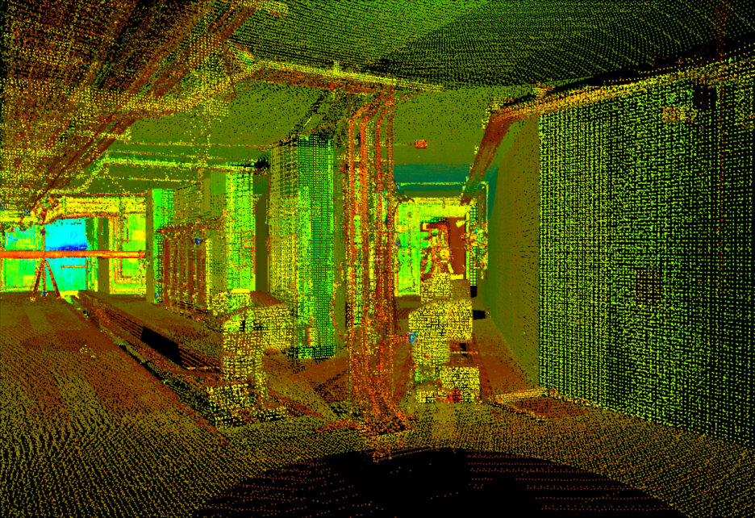
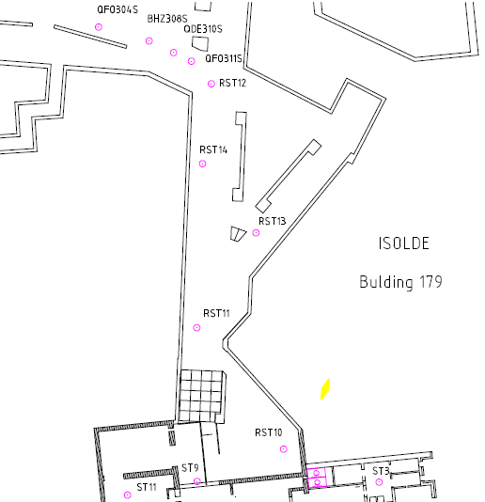
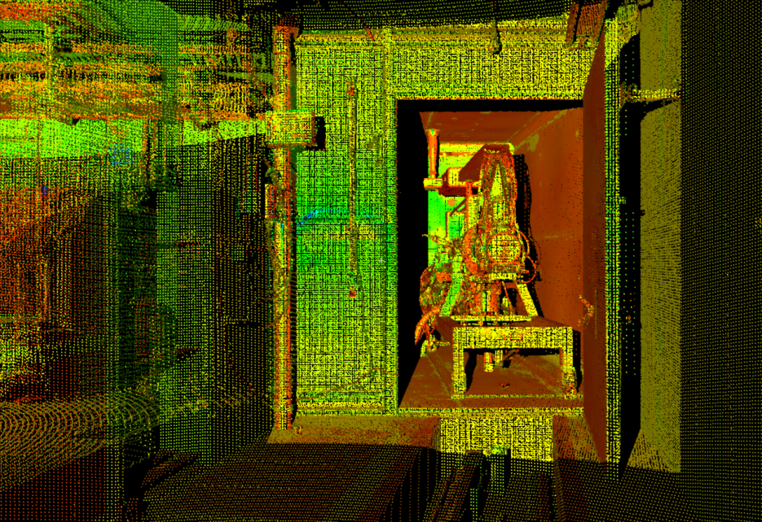
1.5 - The 3D Laser Scan
Cloud of point in the CERN coordinate system
Reference Points
J. Sarret, L. Bruno

Slide 21
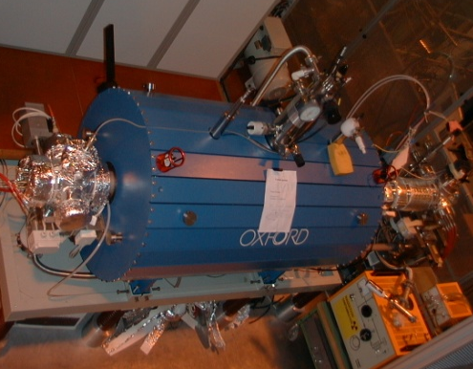
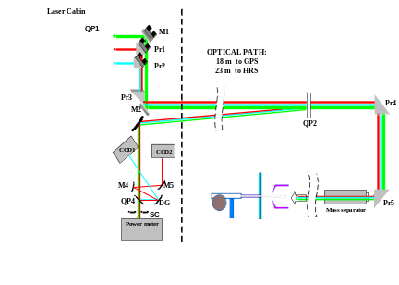
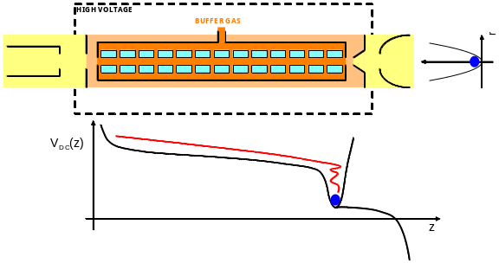
QUALITY: well controlled beam characteristics
Beam manipulation with traps and ionization with lasers permits tailoring of RI beams for Users
Essential to strengthen target R&D to keep ISOLDE as a world leading ISOL lab.
Major contribution received from UK and Sweden for RILIS and RFQ cooler (2655 kCHF)

Slide 22
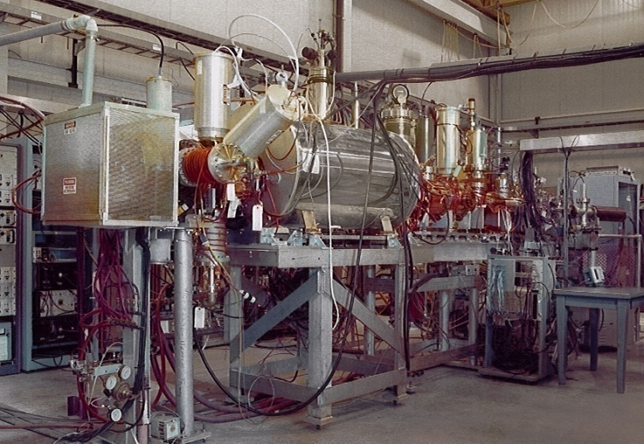
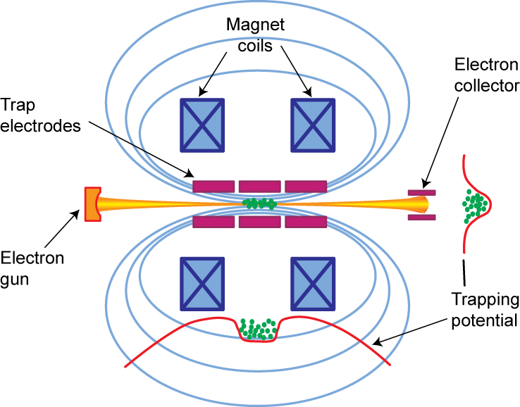
REX space charge limits – REX trap and chargebreeder
The low energy stage at REX can today not handle the full intensity of some ISOLDE beams:
  A new EBIS with higher fields and higher electron currents
  A RFQ cooler for operation in continuous injection mode (ACCU mode) with the EBIS
  Proposal submitted to the DOE in collaboration with MSU, TRIUMF, LLNL, MPI-K and ORNL

Slide 23
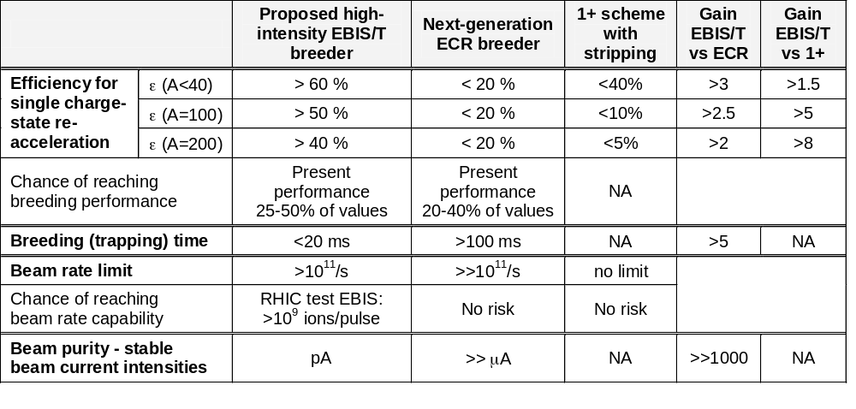
DOE proposal - Comparison EBIS/ECR/1+
 | Proposed High-Intensity EBIT | MSU EBIT | TITAN EBIT | BNL test EBIS | REX-EBIS
Electron beam energy (keV) | < 60 | < 30 | < 60 | <30 | < 6
Electron beam current (A) | < 10 | < 5 | <5 | <20 | < 0.5
Central current density (A/cm²) | <10⁵ | <10⁴ | <10⁴ | <600 | <200
Magnet design | Helmholtz Coil + Solenoid | Helmholtz Coil + Solenoid | Helmholtz Coil | Solenoid | Solenoid
Maximum magnetic field (T) | 9 | 6 | 6 | 5 | 2
Trap length (m) | 1 m | 0.5 m | 0.1 m | 0.7 m | 0.8 m
O. Kester et al.

Slide 24
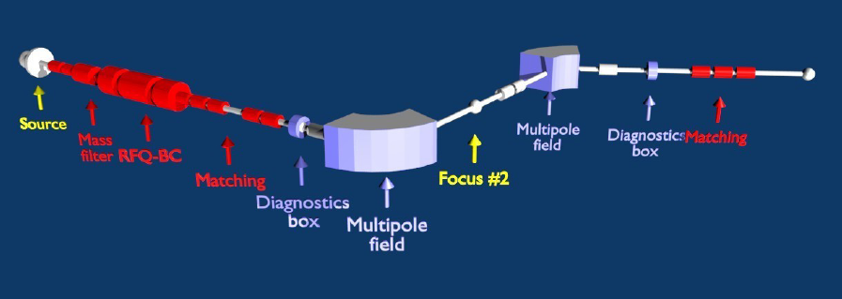
Upgrade of HRS
Improved emittance, multipole corrections and instrumentation
Challenge to implement it at existing facility

Slide 25
HIE-ISOLDE external contribution: Where are we?
External grant from Belgium
Second grant from Belgium approved for both physics programme and SC linac construction for HIE-ISOLDE
Proposal submitted in the UK for HIE-linac
Approved WP in EUCARD for R&D on thin film techniques
RFQ cooler WP and RILIS WP financed and (almost) completed
Proposal being prepared in the US to DOE for joint development of new high-intensity EBIS
Discussions with CERN Mgt on CERN contribution.

Slide 26
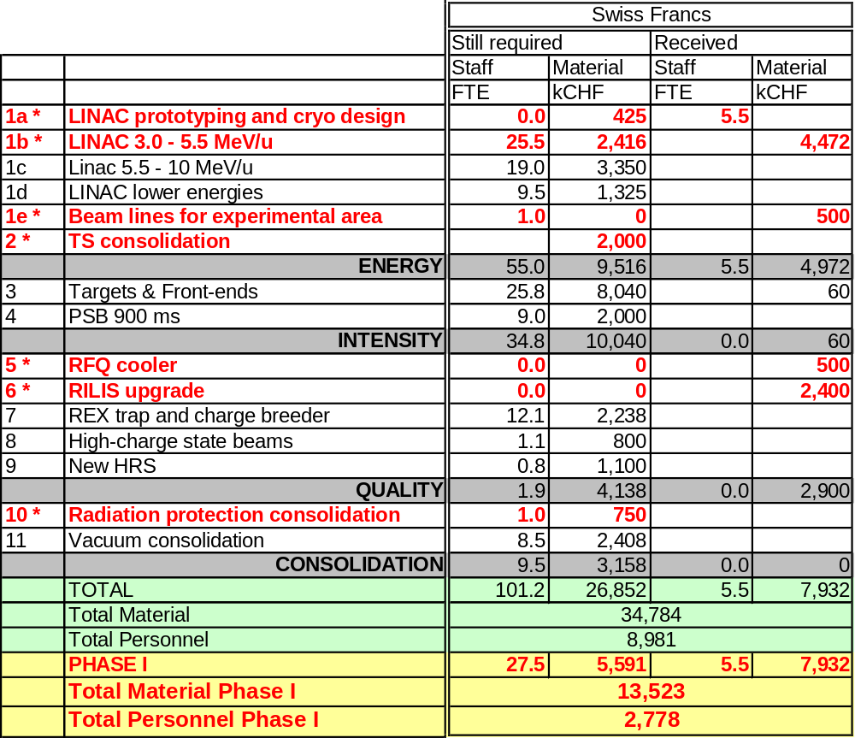
Total all parts of project

Slide 27
Next steps
The HIE-ISOLDE project
  Presentation at workshop for CERN non LHC meeting
  Full project approval
  Review panel of HIE-LINAC R&D work on first Belgium grant, 15-16 June 2009
New grant proposals , in-kind contributions and collaborations
  HIE-linac (UK grant proposal)
  New EBIS construction, commissioning and installation (DOE proposal)
  New High Resolution Mass separator
    Looking for collaboration partner(s)
  Study and engineering support for intensity upgrade (SPES, EURISOL collaboration)
    Highly complex, interaction with other ISOL facilities is essential
    Looking for collaboration partner(s)
  Target development (ESS-S training program)
    New beams and higher instantaneous beam power
    Looking for collaboration partner(s)

