Slide 1
HIE-LINAC status report
Matteo Pasini BE/RF

Slide 2
R&D activity
RF – Beam dynamics studies
High β cavity prototype
  Copper substrate manufacturing
  Chemical etching
  Nb sputtering
RF sub-system prototypes
  Tuner
  Power coupler
SC solenoid prototype
Cryomodule design
In parallel preparation of a test stand for QWR at CERN
M. Pasini SRF09 Berlin, 20-25.09 2009

Slide 3
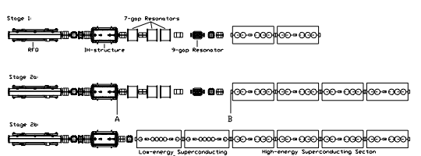
HIE-ISOLDE LINAC - layout
3 stages installation
1.2 MeV/u
3
MeV/u
5.5 MeV/u
8
MeV/u
10 MeV/u
M. Pasini SRF09 Berlin, 20-25.09 2009

Slide 4
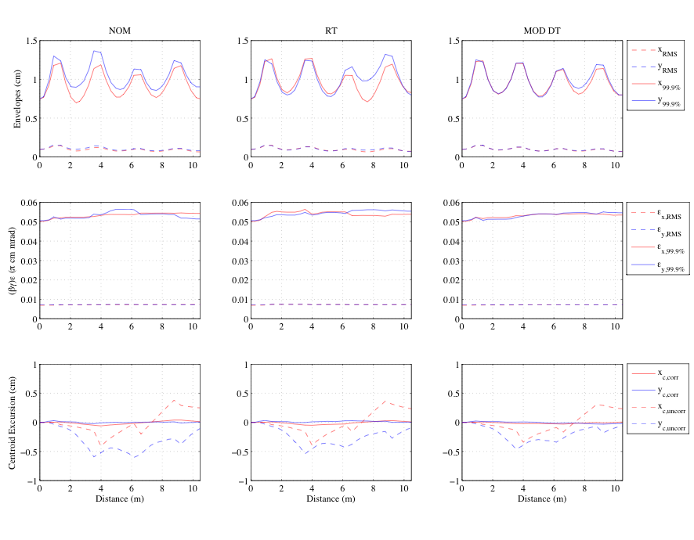
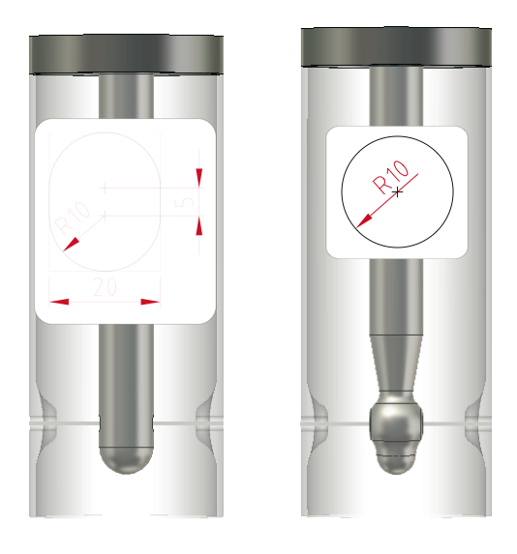
RF – Beam Dynamics studies
Beam Port shape studies
THPPO026
M. Pasini SRF09 Berlin, 20-25.09 2009
Notes:
Intense studies to match the SC linac to the existing machine. In particular we have looked at different drift tube shapes in order to fully understand the dynamics and the production of halo particles that dilute the beam emittance. The result of the study are reported in a internal cern note before which will be published at the end of the month. The main achievement is that an optimal tune of the optics was found and allow an overall emittance growth on few % even in case of misalignment and other machine errors.

Slide 5
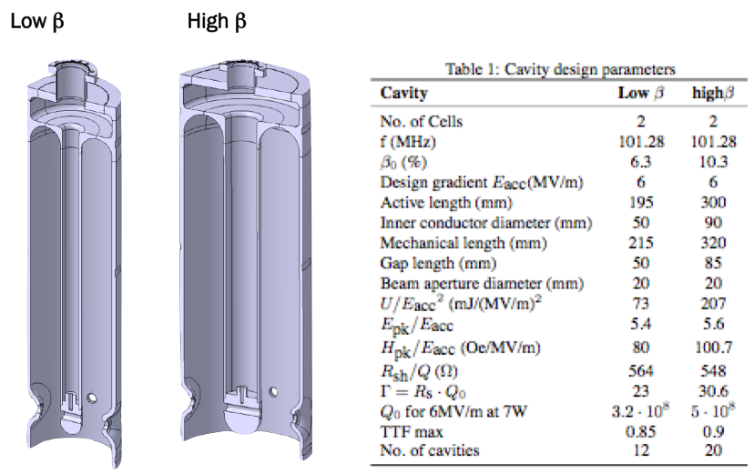
QWR cavities (Nb sputtered)
M. Pasini SRF09 Berlin, 20-25.09 2009
Notes:
High beta cavity design has been confirmed and a prototype has been constructed (test will happen the second week of December)

Slide 6
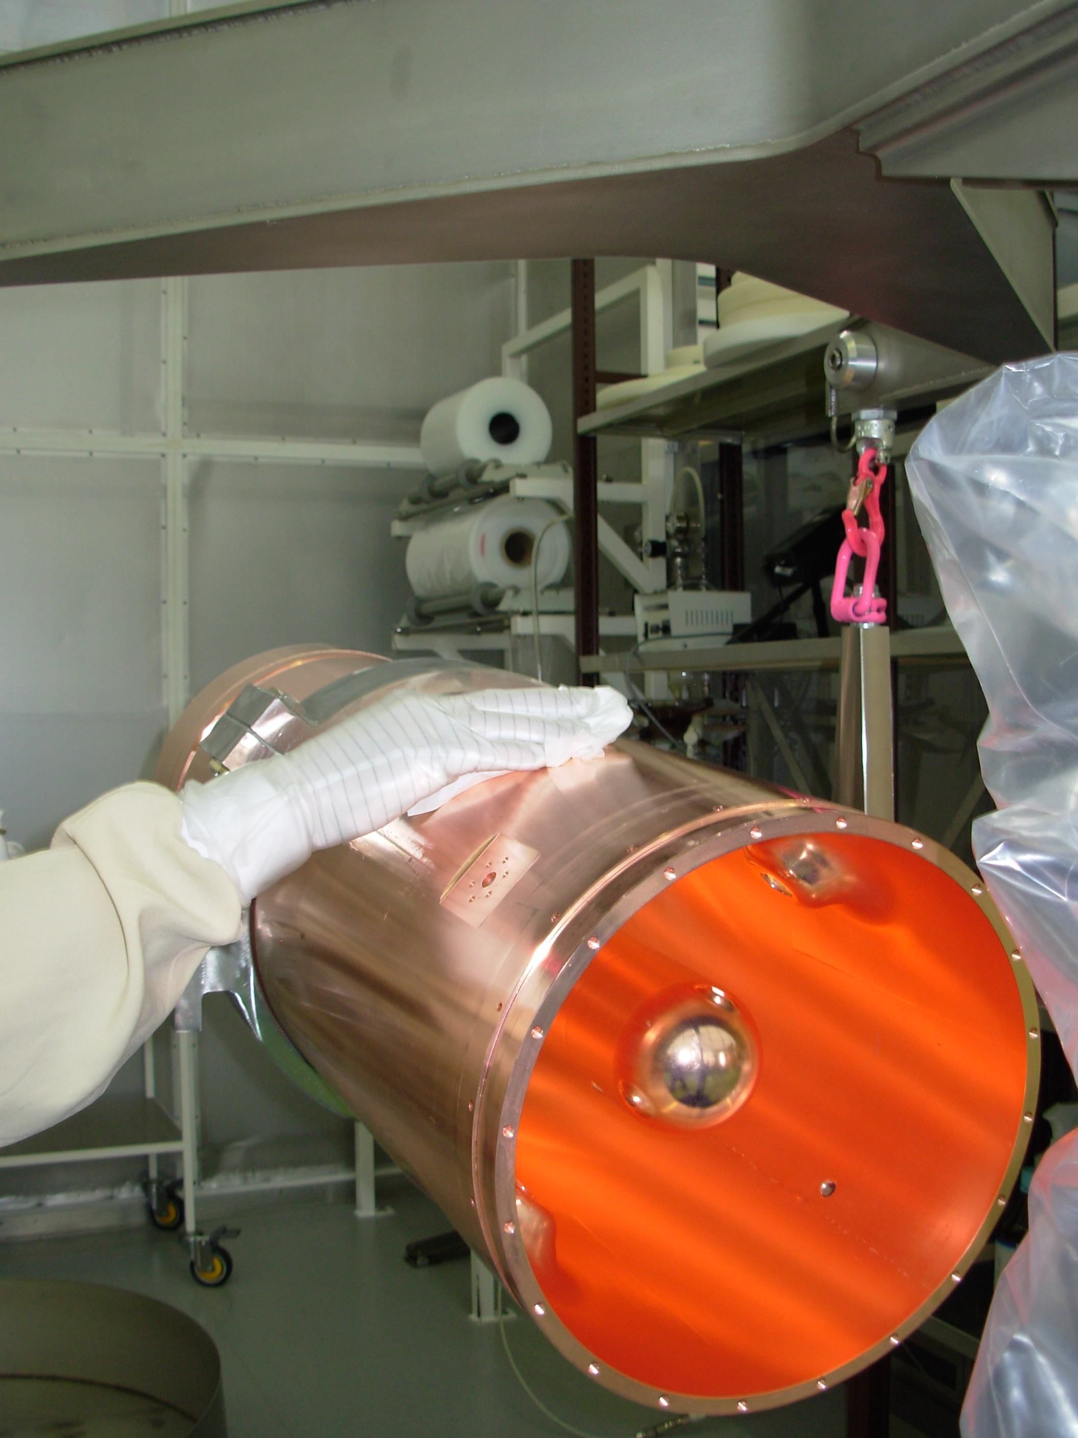
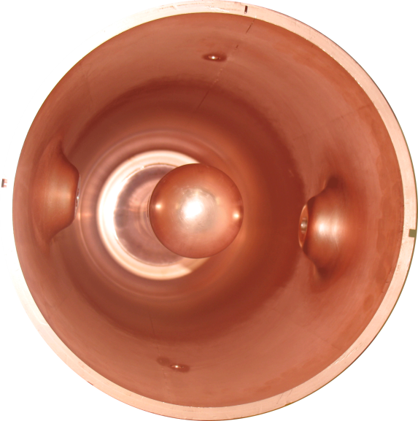
High –beta cavity final welding and cleaning
THPPO010
M. Pasini SRF09 Berlin, 20-25.09 2009
Notes:
Cavity has been sputtered successfully with the magnetron technique (new technique for this kind of cavity geometry)
All the cavity ancillaries are have been designed and are now in fabrication

Slide 7
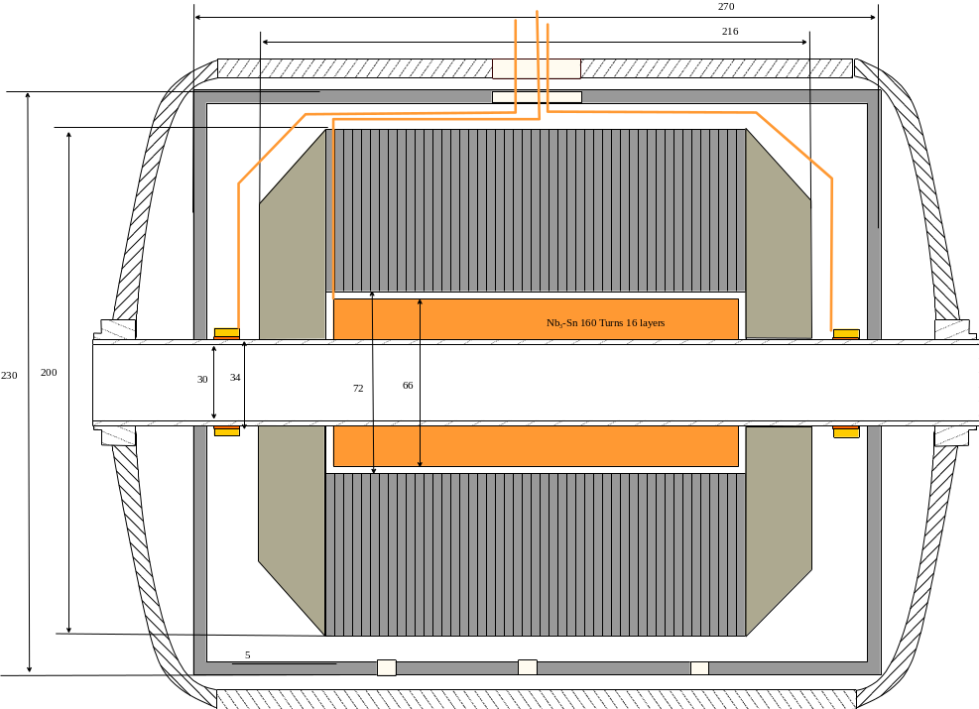
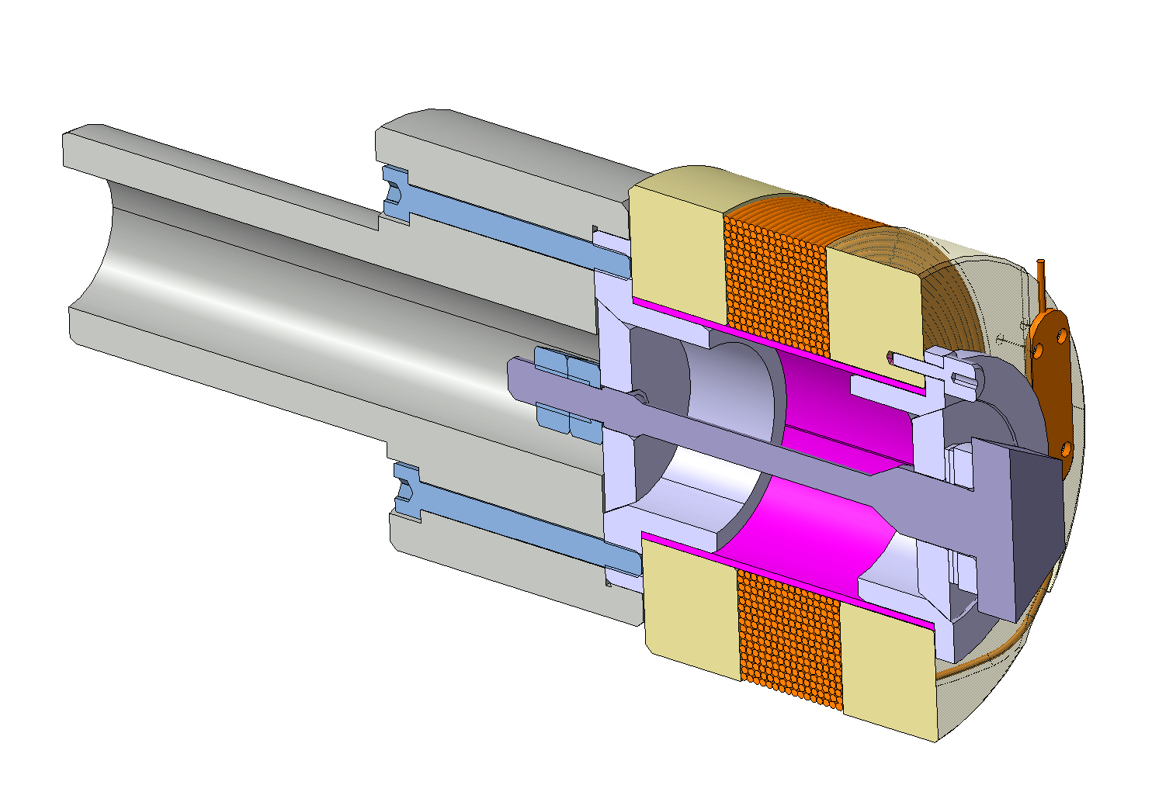
SC solenoid prototype (Nb3-Sn technology)
Magnetic length | 0.16 | m
∫ B² dz | >16.2 | T²m
Max mechanical length | <0.4 | m
Operating temperature | 4.5 | K
Inner Diameter | 30 | mm
Mechanical drawings for the model are completed
M. Pasini SRF09 Berlin, 20-25.09 2009
Notes:
Model of the SC solenoid has been constructed test will happen beginning of next year.

Slide 8
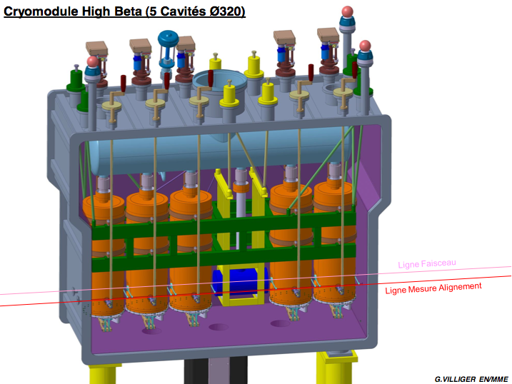
Cryomodule design
Features:
Single vacuum cryostat
Side loading of the cold masses
Independent alignment of the cavities w.r.t. solenoid
Heat shield cooled by He cold gas
M. Pasini SRF09 Berlin, 20-25.09 2009
Notes:
Conceptual design of the cryomodule completed, need to start detailed design

Slide 9
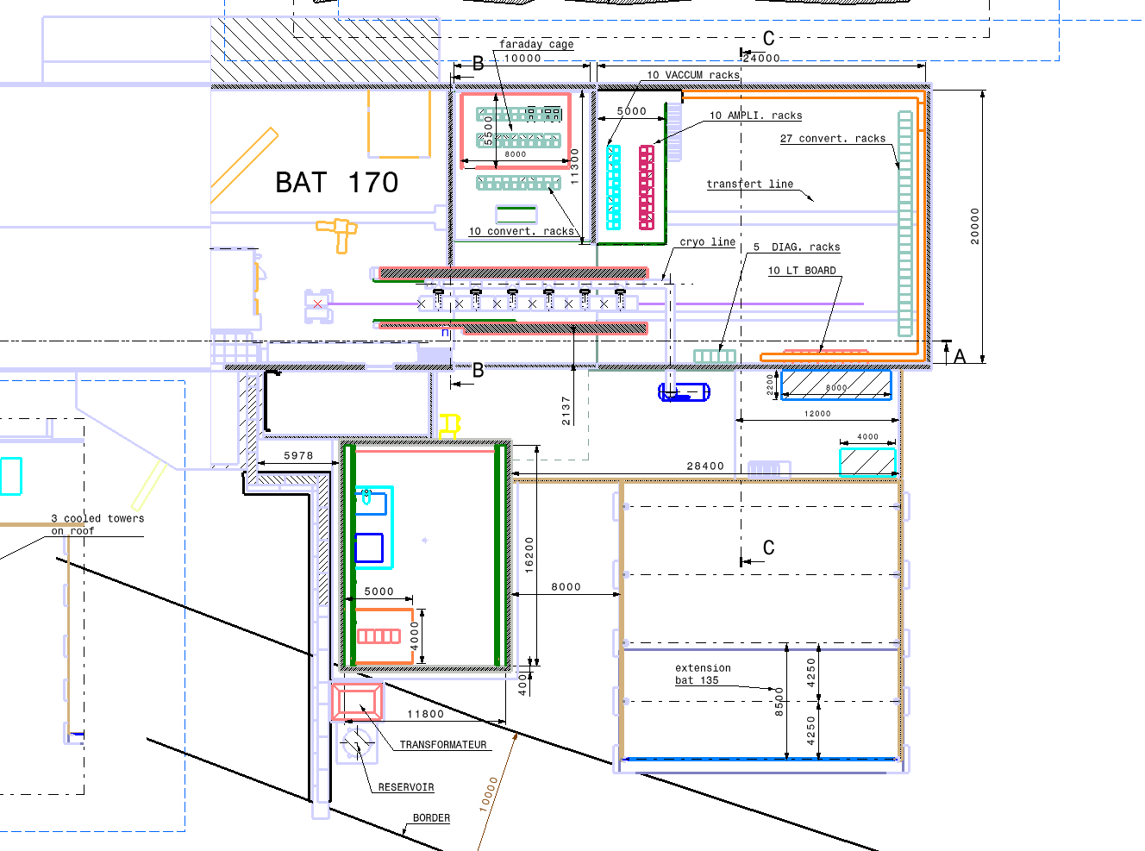
The HIE-ISOLDE facility
M. Pasini SRF09 Berlin, 20-25.09 2009
Notes:
Civil engineering study in advanced status. Will be ready to detailed design at the beginning of next year. Construction is expected to last 18 months and will start depending on cash flow available from cern.

Slide 10
Summary
Cavity prototype completed. Tests to be done @ TRIUMF before the end of the year
Cryomodule concept design completed, will start detailed design as soon as manpower is available
Preparation of test bench at Cern of QWR resonators (new test cryostat is planned to be ready by Feb/Mar 2010)
Complete Cavity configuration test is planned by the end of 2010.
M. Pasini SRF09 Berlin, 20-25.09 2009

