Slide 1
Coordinator’s report
.
Magdalena Kowalska

Slide 2
Shifts 2012
Shift balance: 1009 open shifts for IS experiments, 53 shifts for LOIs
Shift requests: 833 shifts for 71 IS exp vs 657.5 in 2011; 40 shifts for 14 LOIs
20 IS experiments with no beam requests
REX requests: 377.5 shifts (IS + LOIs)
Scheduled | 2012 | 2011
Weeks with protons | 37 | 29
All shifts (IS+LOI+MD) | 565 | 491.5
Shifts for IS exp | 539 | 440
Shifts for LOIs | 26.5 | 31.5
# of IS exp | 51 | 61
# of LOIs | 10 | 8
REX runs / exp | 11 / 17 | 10 / 14
REX shifts (IS +LOI) | 221.5 | 190.5
Average shifts/day | 2.08 | 2.31
Delivered | 2012 | 2011
Protons | 11.5e19 | 8.05e19
All shifts (IS+LOI+MD) | 529 | 463.5
Shifts for IS exp | 416 | 313.5
Shifts for LOIs | 15.5 | 16
REX shifts (IS +LOI) | 221.5 | 190.5
Average IS shifts/day | 1.61 | 1.55

Slide 3
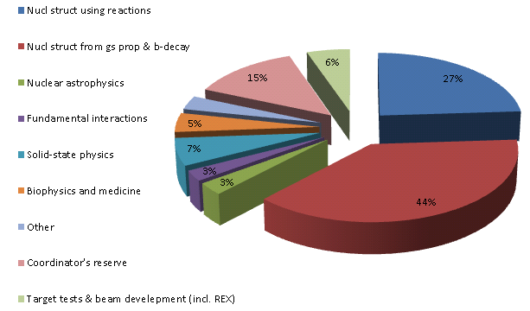
Delivered shifts 2012

Slide 4
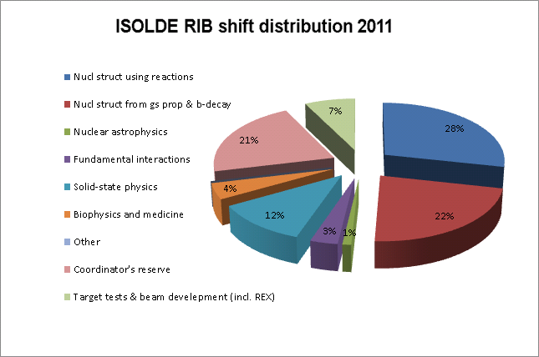
Delivered shifts 2011

Slide 5
Remaining shifts
Low-energy IS experiments (including WITCH): 364.5 shifts
Post-accelerated REX experiments: 216.5 shifts
HIE-ISOLDE shifts (Oct12): 429 shifts

Slide 6

Physics since last meeting & LS1
New method and groups - incomplete fusion with T-REX: Milano & Cracow
TISD: CaO-Helicon (on GPS) to produce C and possibly Ar beams
The only WITCH run this year
44Ti for astrophysics (GPS): 44Ti source from PSI, setup behind REX
Mn for COLLAPS (Manchester) and some SSP users
Hg for TAS (1st run since a few years) and priority collections
11Be which failed in the summer
LS1 times:
Protons to ISOLDE: from June 16, 2014
Protons stop on December 15, 2014
Protons back to ISOLDE – April 2015 (very preliminary)

Slide 7
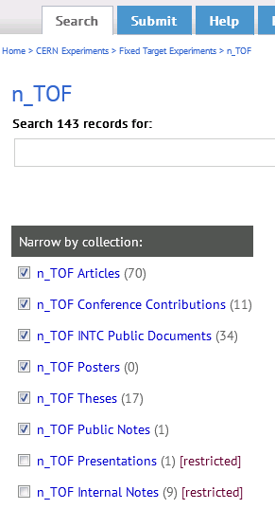
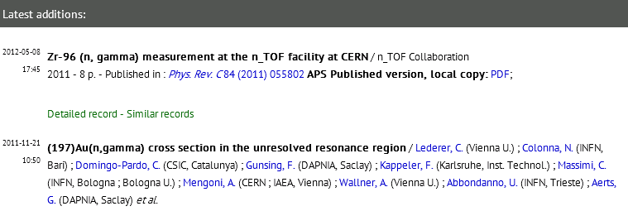
ISOLDE publications
CERN library encourages us to create an ISOLDE “space” in CDS (CERN Document Server)
  Their team can find Theses and INTC documents,
  But our experimentalists would need to register their articles (small work for each experiment, but large if everything done by one person)
Follow-up that ISOLDE theses are put in CDS
Acknowledgements in articles?

Slide 8
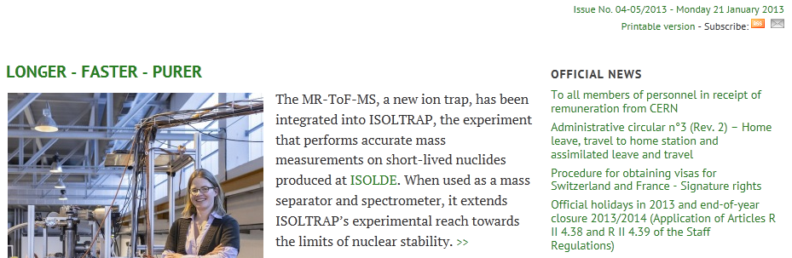
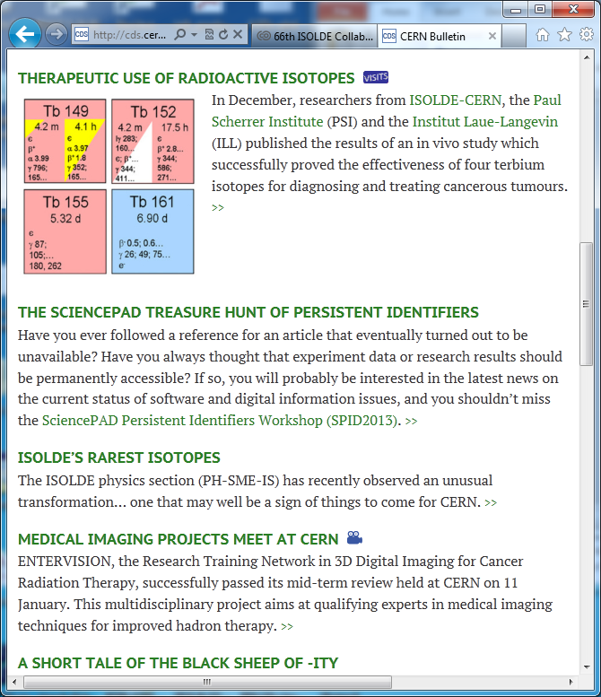
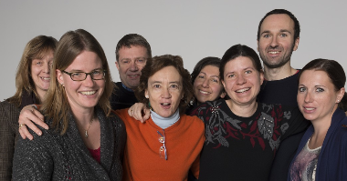
CERN Bulletin about ISOLDE
CERN Bulletin

Slide 9
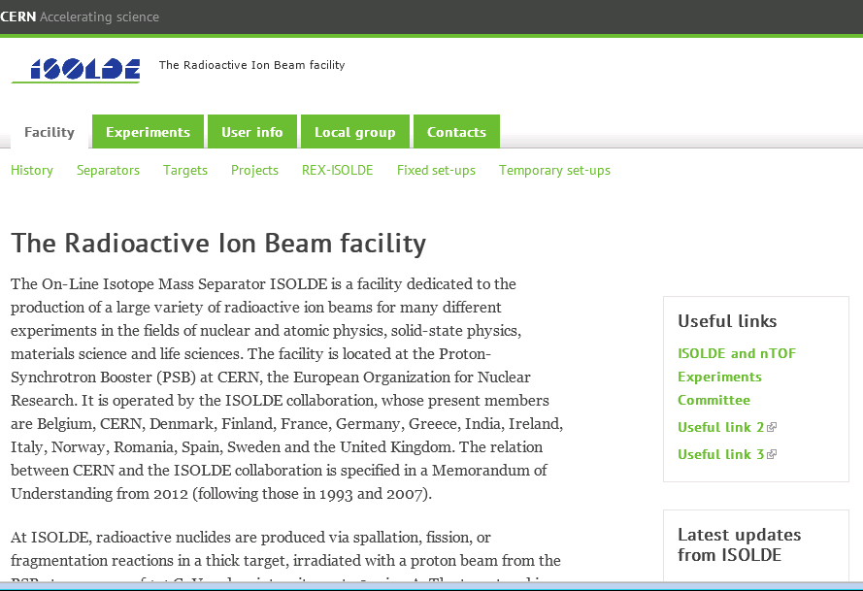
Website layout
Help from CERN communications team to make ISOLDE website CERN-standard
Our responsibility: copy content and keep it up to date (easier than now)

Slide 10
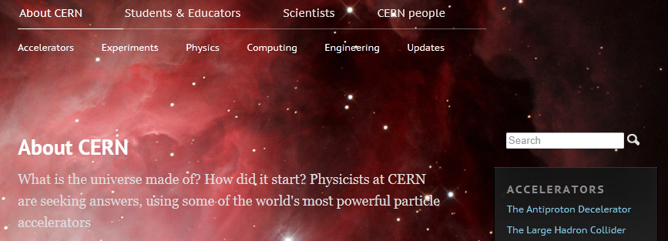
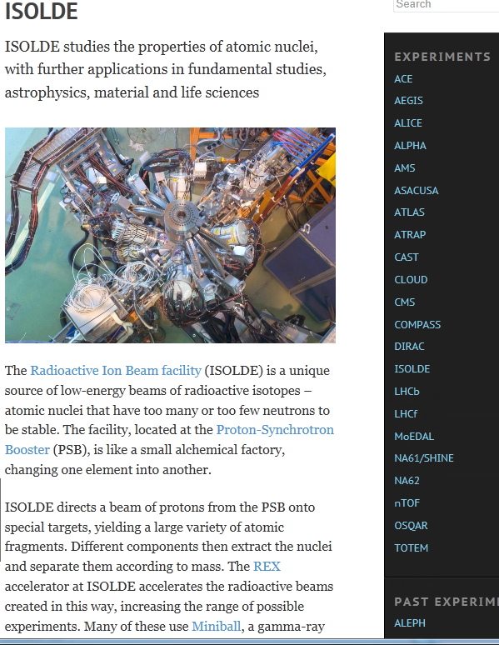
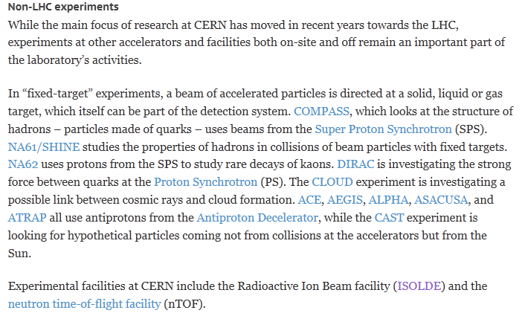
New CERN website

