Slide 1
ISOLDE PH report
Schedule 2012
Physics results 2012
Experiments, users
New template
Safety
Long shutdown
PH and ENSAR news
Magdalena Kowalska
Yorick Blumenfeld

Slide 2
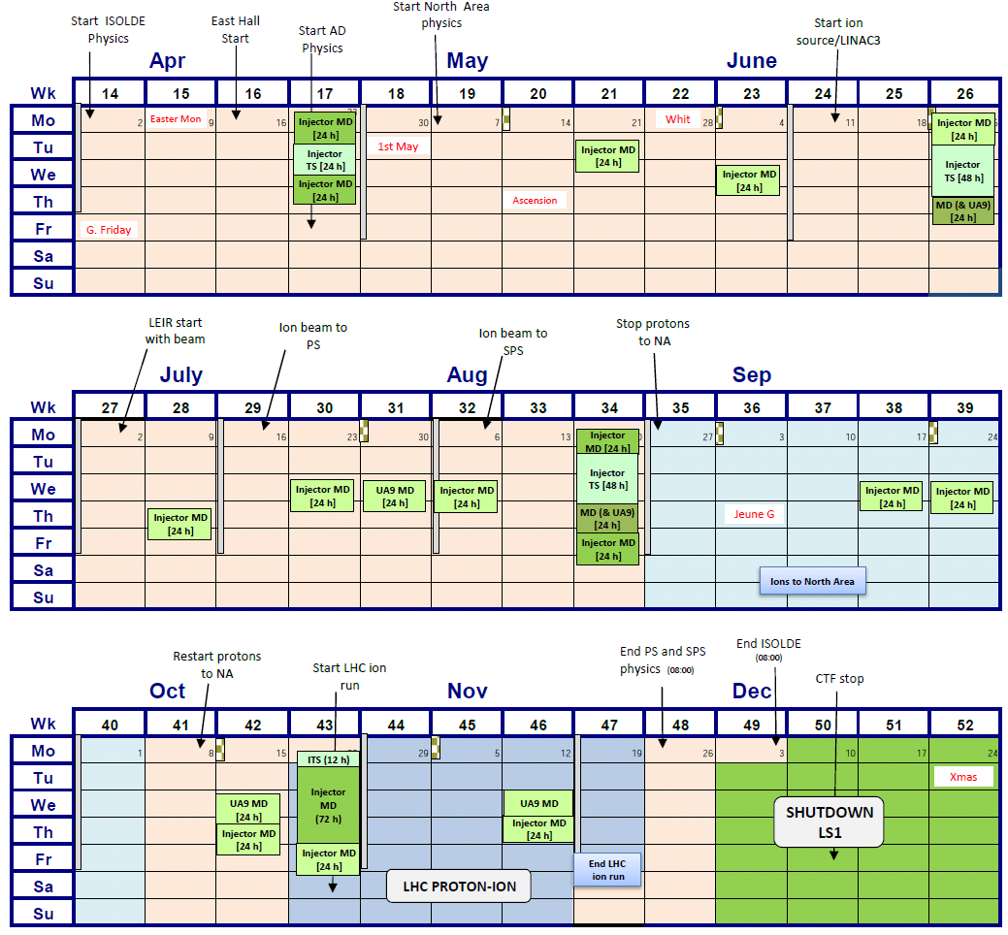
Injector schedule
35 weeks of physics
Available protons:
37-46 %
(46% requested)
Last week of running – protons only for ISOLDE

Slide 3
Schedule 2012
Shift balance: 1009 open shifts for IS experiments, 53 shifts for LOIs
Shift requests: 833 shifts for 71 IS exp vs 657.5 in 2010; 40 shifts for 14 LOIs
20 IS experiments with no beam requests
REX requests: 377.5 shifts (IS + LOIs)
Scheduled runs:
  579 RIB shifts in total (491.5 in 2011): IS + LOI + MD
    537 RIB shifts for 53 experiments (440 in 2011) and for 13 LOIs
    2.36 RIB shifts/day vs 2.42 in 2011 and 2.31 in 2010
    38 experiments not scheduled (18 of those requested beam, vs 11 in 2011)
    211+9 shifts for 11 REX runs (vs 190.5 in 2011); 17 IS exp (vs 14 in 2011) and 1 LOI

Slide 4
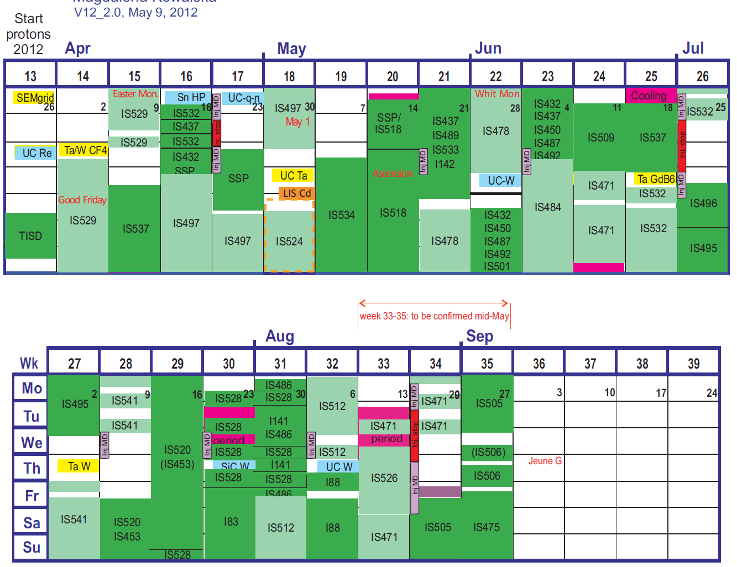
Running period 2012
April/May very difficult: many groups not ready or willing to run (Easter), RILIS not available for 2 weeks - > COLLAPS as the only available for part of the time
ISOLDE program 2012
(v2.0 + v3.0):
physics started April 2
protons stop Dec 4
35 weeks
for physics
(vs 29 in 2011)
Scheduled:
53 IS experiments
TISD: 3 runs + 3 IS exp
13 LOIs
579 RIB shifts
GPS
HRS

Slide 5
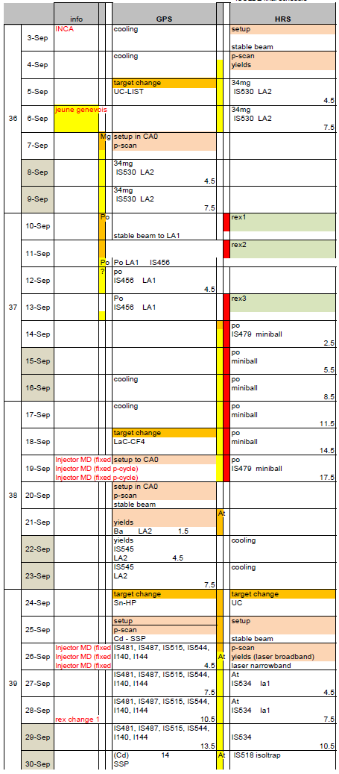
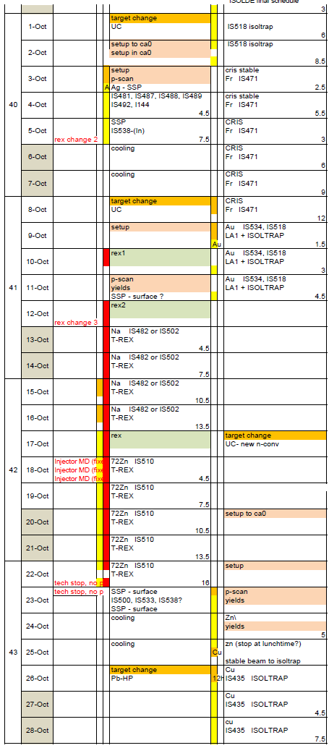
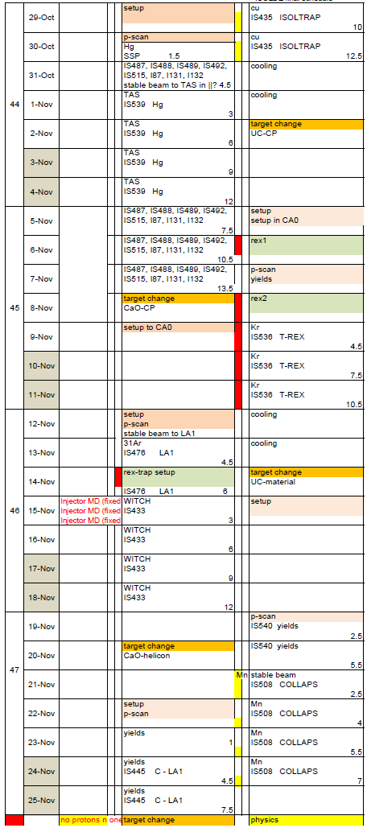
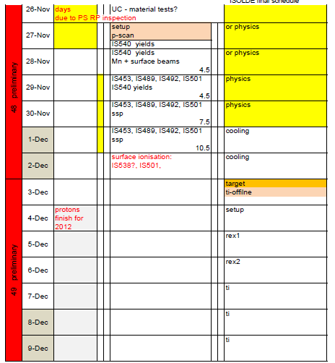
Running period 2012
Last week preliminary – kept for runs to reschedule
End of protons
(will it change?)

Slide 6
Long shutdown
Presently still December 4 to spring 2014
Maybe it’s shifted – decision to be made probably in September
What should/ can ISOLDE do in this case?

Slide 7
Physics runs
More numerous target team, so detailed yield checks possible before each physics run – thanks for the strong support!
First online diffusion profile using the new online diffusion chamber (slide)
Successful operation of a molten salt target (NaF) for beta beams (e.g. from 18Ne)
Laser spectroscopy of Cd chain up to N=80, including discovery of new isomers (slide)
Coulomb excitation on 123Cd, aiming at obtaining angular correlations, as well
Finally everything working during 72Kr REX run
Beta-delayed fission of newly-laser ionised n-deficient At (slide)
Laser spectroscopy on n-rich K and Ca isotopes, probing the possible new magic number N=32
Mass of 53,54Ca
Coulomb excitation of 140,142Sm - ongoing
Broken target: Hf isomers, but rescheduled
CRIS run – missing offline time; rescheduled with proper offline time
YO -> Zr0 -> YO target useful for most beams (contamination)

Slide 8
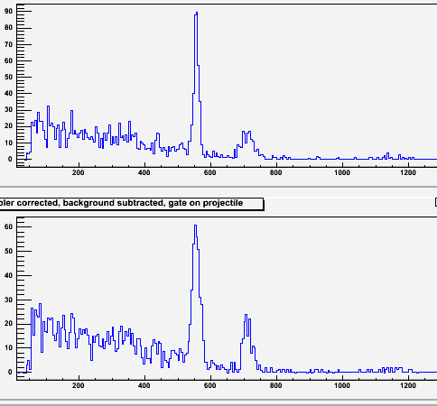
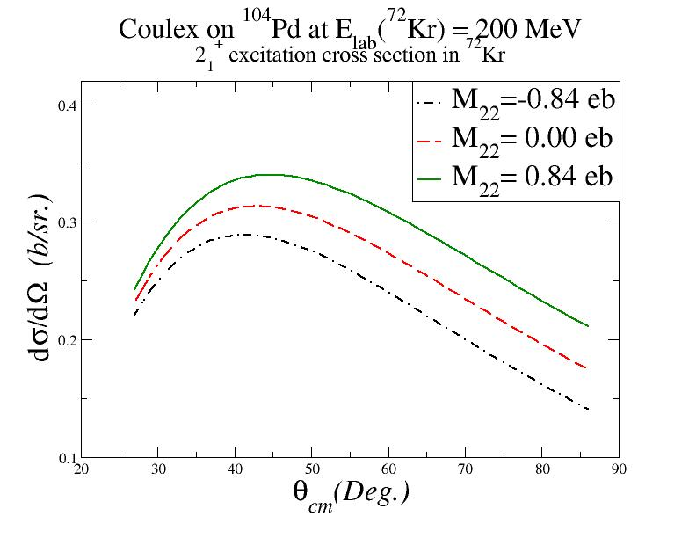
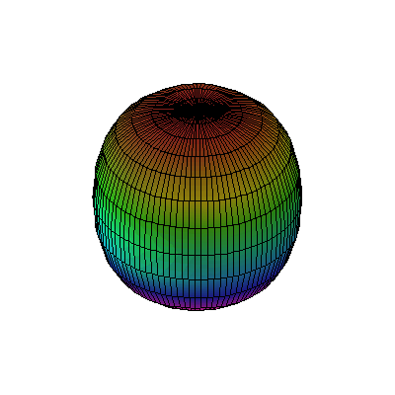
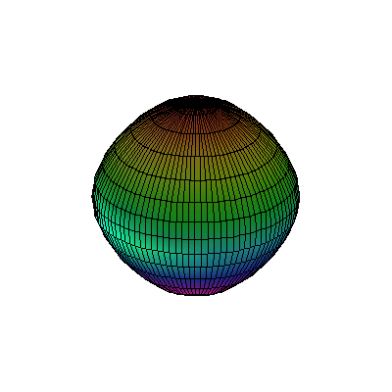

IS478: Coulomb excitation of 72Kr
Oblate ⁷²Kr expected
Coulex Spectra - number of counts in 710 keV depends on the shape of ⁷²Kr
The technique
Doppler Corrected for
¹⁰⁴Pd target excitation
Doppler Corrected for
⁷²Kr projectile excitation:
150 counts in 710 keV line

Slide 9
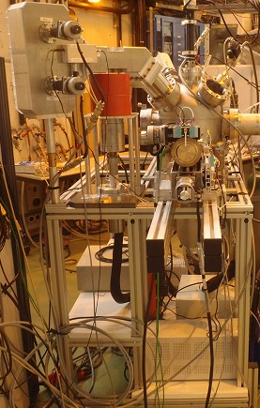
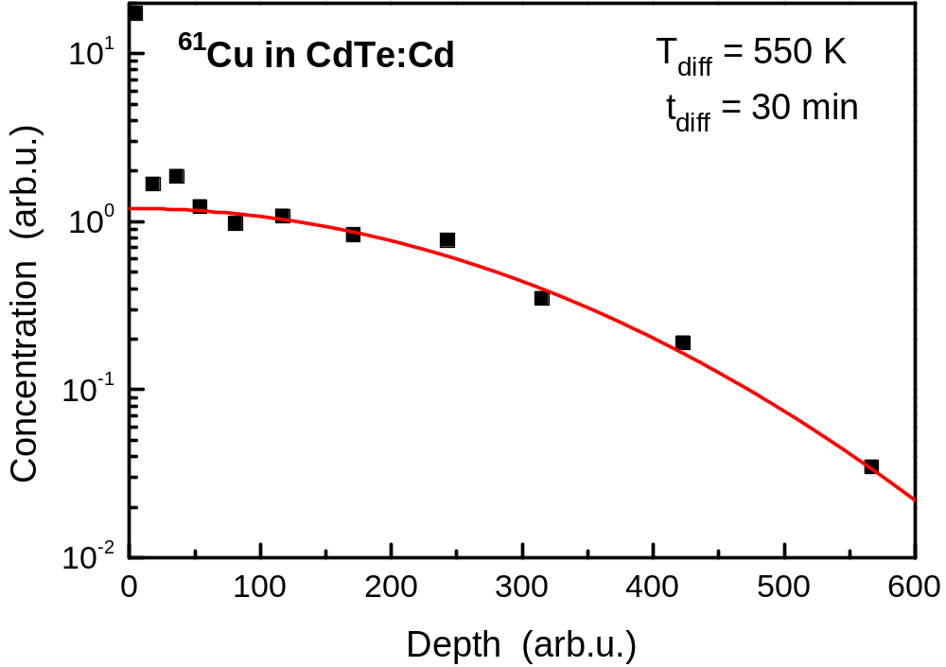
IS492: first online diffusion spectra
First concentration profile measured with the new online diffusion chamber.
The absolute depth is estimated to be in the order of about 2 µm.
(CdTe:Cd means Cd-rich CdTe material)

Slide 10
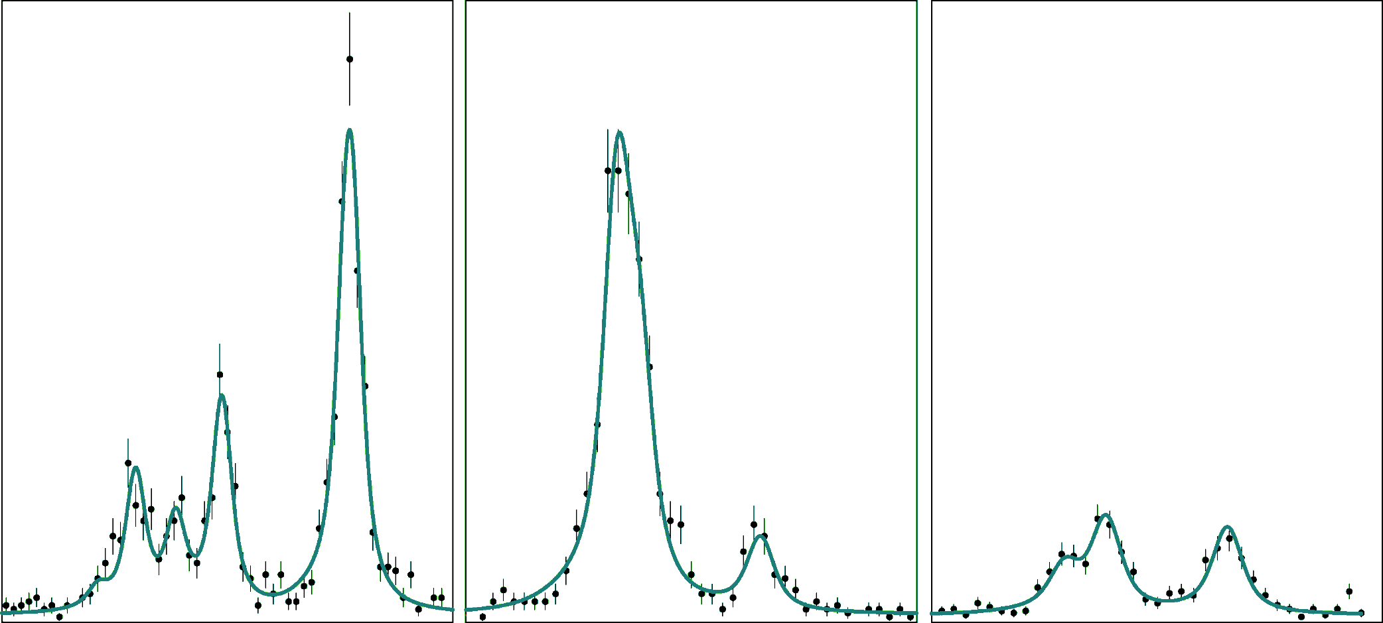
IS497: Collinear laser spectroscopy on Cd
Spins, charge radii and moments of 99-130Cd
Discovery on new long-lived isomers in 125,127,129Cd
I.
II.
III.
transition in Cd II:
5s ²S_{1/2} → 5p ²P_{3/2}
@ 214 nm
¹²⁹Cd
hfs - g.s. + isomer
# counts
Isotope shift relative to ¹¹⁴Cd

Slide 11
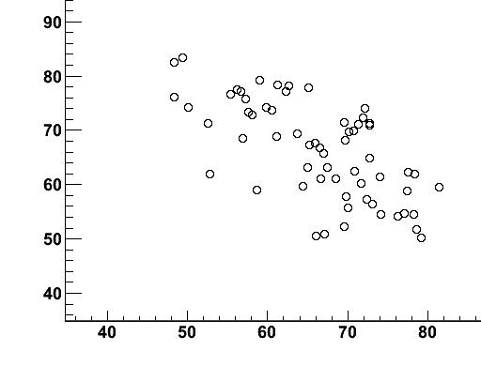
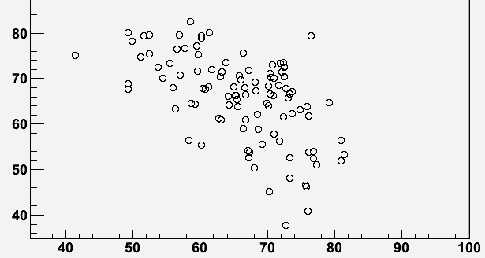
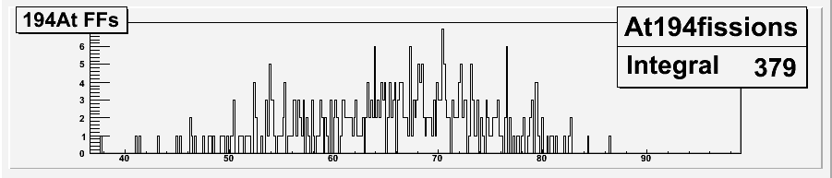
IS534: beta-delayed fission of At
Mass Distributions Measurements of 194,196Po via β-delayed fission of 194,196At
196At
194At

Slide 12
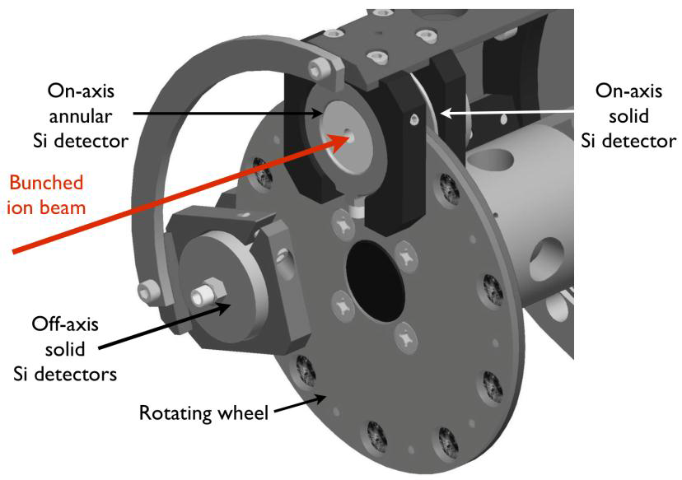
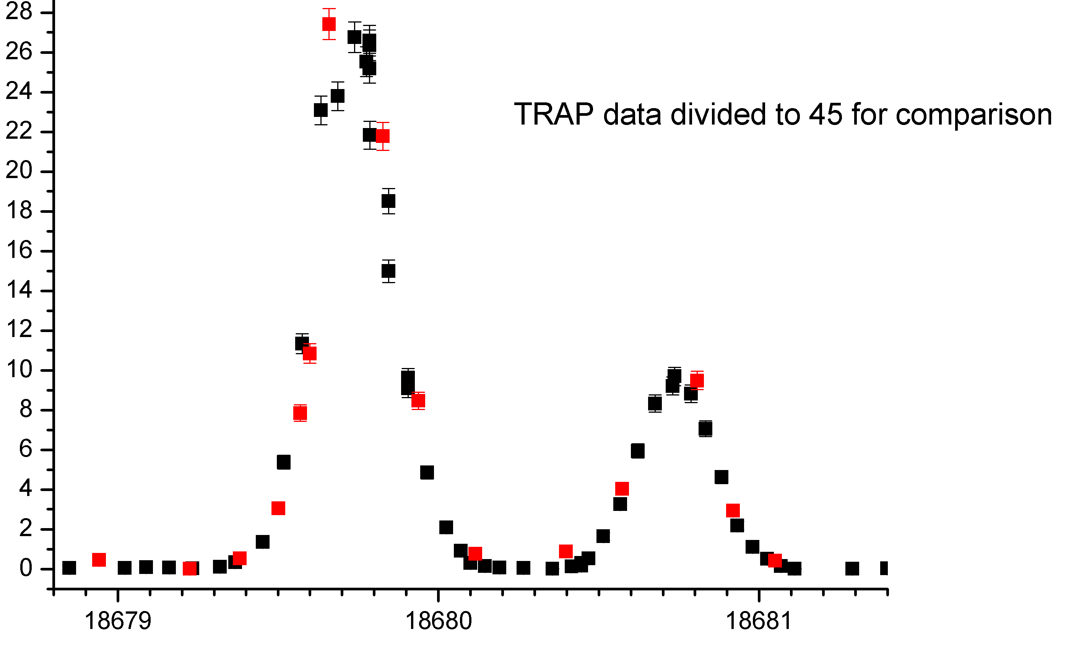
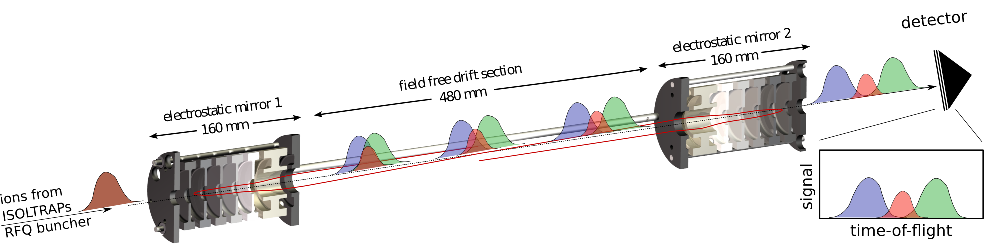
IS518& 534: Laser Spectroscopy of n-deficient Au
Wind mill – decay spectrometer ( )
¹⁷⁹Au
counts
preliminary!
wave number / cm⁻¹
ISOLTRAP – detector for single ions ( )
HFS studies: all isotopes are accessible due to complementarity (decay vs. counting)
  Region of deformed nuclei in neutron-rich gold isotopes
State-selective spectroscopy on pure samples (isomer selectivity at RILIS + isobar selectivity at ISOLTRAP)
  Determination of excitation energies

Slide 13
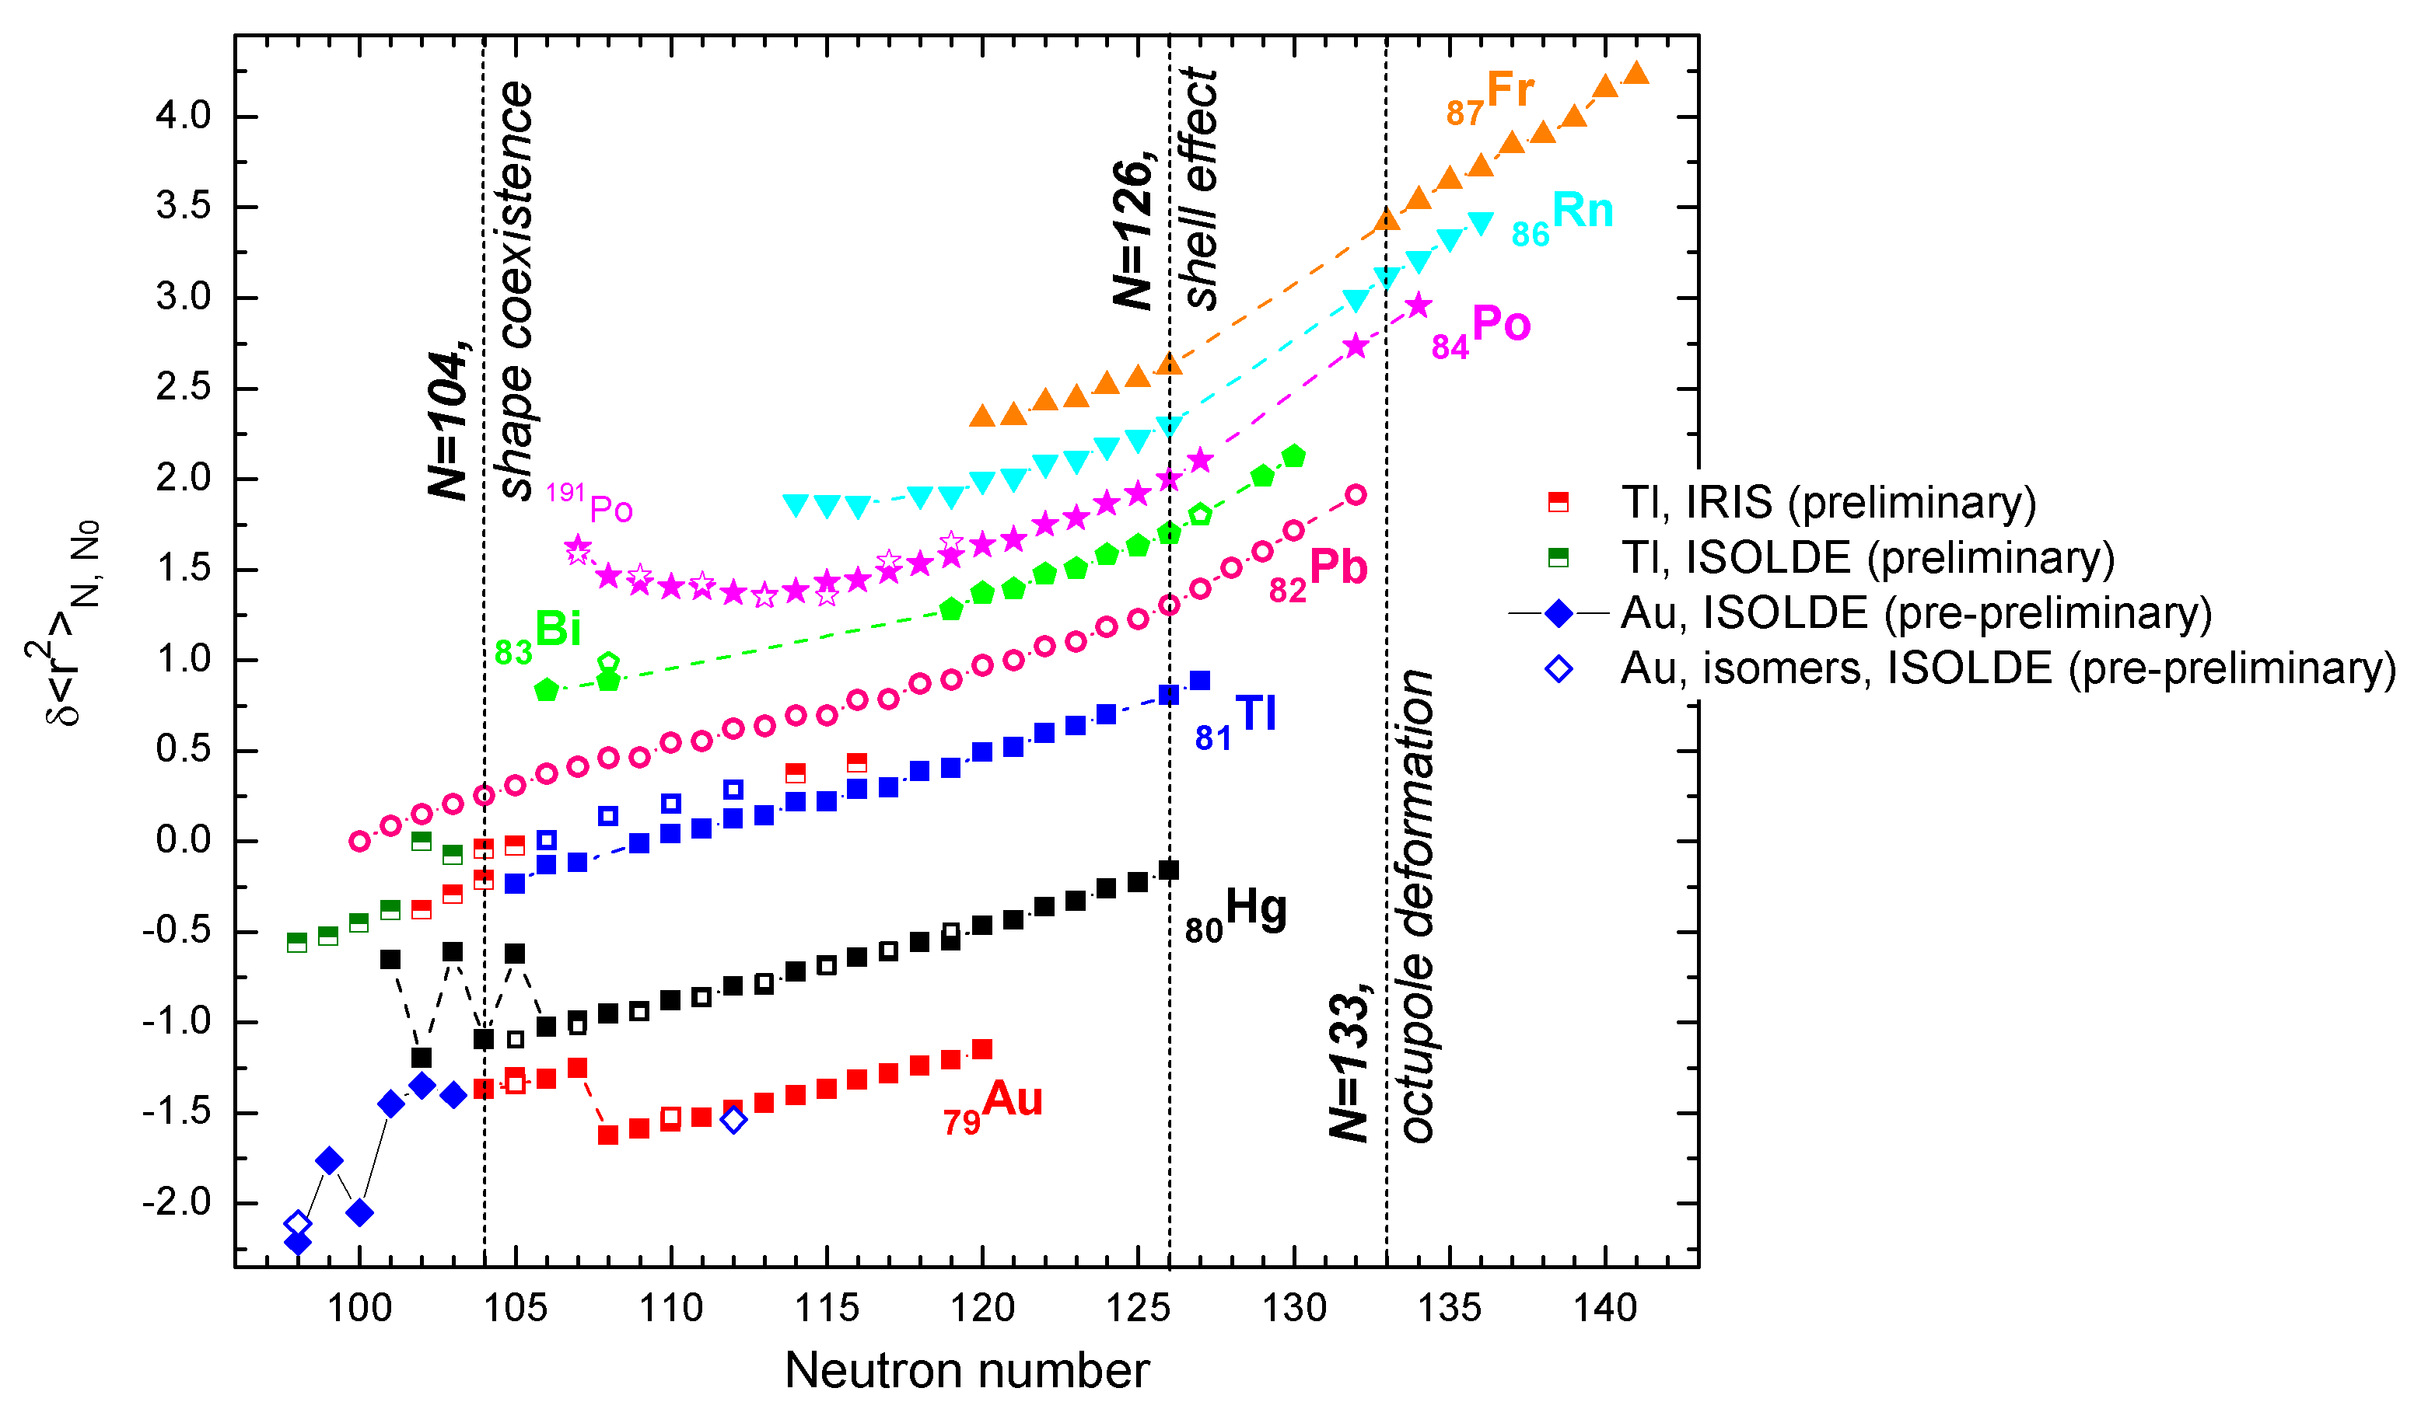
IS534: Charge radii in Pb region
Courtesy Anatoly Barzakh (PNPI)

Slide 14
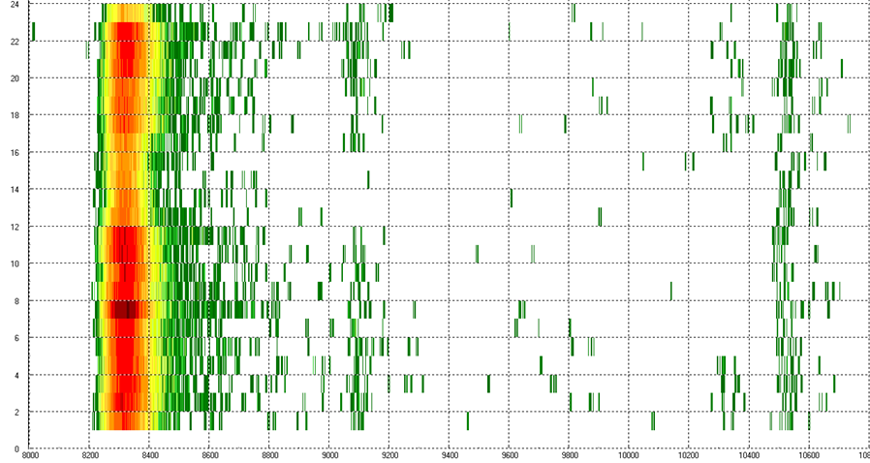
IS532: N-rich Ca masses at ISOLTRAP
protons off
Measurement time / arb. units
lasers off
⁵⁴Cr
Time of flight / arb. units
Expected
TOF ⁵⁴Ca
Masses of ^{51,52}Ca measured with conventional TOF resonances in ISOLTRAP‘s precision trap. Agree with TITAN, uncertainty reduced by at least a factor of 10
Direct mass-measurement using the MR-TOF on ⁵²⁻⁵⁴Ca
On mass 54, 2000 ions detected in the TOF window of calcium.

Slide 15
ISOLDE template
For presentations and posters

Slide 16
Users, etc
More common equipment in the hall: fast scope, Ge detector with Be window back from repair, new NIM crate, VOULOMs
Group hostel booking – 10 rooms booked for ISOLDE at all times; additional rooms (also for non-shift stays) were found by hostel responsible (hostel offered to book 20 rooms in 2014; probably no booking for 2013?)
Greybook updated – now also deputy team leaders visible: good starting point for users who want to register

Slide 17
Safety
Online RP course promised for this April still not ready
Work on split use of temporary dosimeters ongoing (1 month in several parts)
Access to ISOLDE:
  This year access door moved (some problems with deliveries) but access procedure unchanged
  2013: ISOLDE as worksite, thus helmets and safety shoes necessary also for physicists; visits should be still possible (with helmets ?)
Move of b275 SSP lab to b115 – presently not moving at all

Slide 18
Physics Group Personnel
Fellows:
  Thomas Cocolios (Cris + ISOLTRAP + Windmill)> Sept 2012 – Advanced fellowship at Manchester starting Oct. 2012; will remain at ISOLDE at least until end of running period
  Jan Kurcewicz (Data Acq)> Nov. 2013 funded by ENSAR
  Elisa Rapisarda (Miniball) Sept 2012>Sept. 2014
  Susanne Kreim (ISOLTRAP)> Dec. 2014
  Andreas Knecht (1/2 AD; ½ WITCH) starts Aug 2012.
Associates:
  PDAS Marek Pfutzner (sept. 2012 – feb. 2013)
  CASS Olof Tengblad (Jan. 2013 – Apr. 2013)
  CASS Guilherme Correia (4 months)

Slide 19
Physics Group Personnel (2)
Students
  Hans Tornqvist (Miniball + beta-NMR) >Aug 2012
  Kara Lynch (CRIS) > Aug 2013
  Hossein Aghai Khozani (1/2 CRIS; ½ AD) > Sep 2014 Funded by German grant
  Rikard Vinge (EBIS with F. Wenander) Technical student partly funded by Swedish grant (Aug 2012>Aug 2013)
Technician
  Julien Thiboud Funded ½ coll; ½ ENSAR. ENSAR funding ends Aug 2013. He could be continued 1 year with full collaboration funding: to be discussed.
User support
  Jenny Weterings: Renewable Norwegian contract funded ½ CERN; ½ collaboration

Slide 20
ENSAR
TNA
  For 2012: increase to 100 KEuros; 869 days
  Spent up to now: 37.5 KE; 326 days
  Available for Sept-Dec: 42 KE; 364 days
  Available for 2014(Apr.-Aug.): 40 KE; 350 days
EURISOL-NET
  EURISOL week in Lisbon 15-19 Oct. http://cfif.ist.utl.pt/~eurisol/
CERN/ISOLDE hosted the ENSAR PCC and GA meetings on April 23-24, 2012

Slide 21
ISOLDE Workshop and MOU
For 2012: December 17-19, 2012 at CERN
For 2013 shutdown period:
  Should we hold a workshop?
  At CERN or outside?
  If outside, where?
MOU: Jenny.

