Slide 1
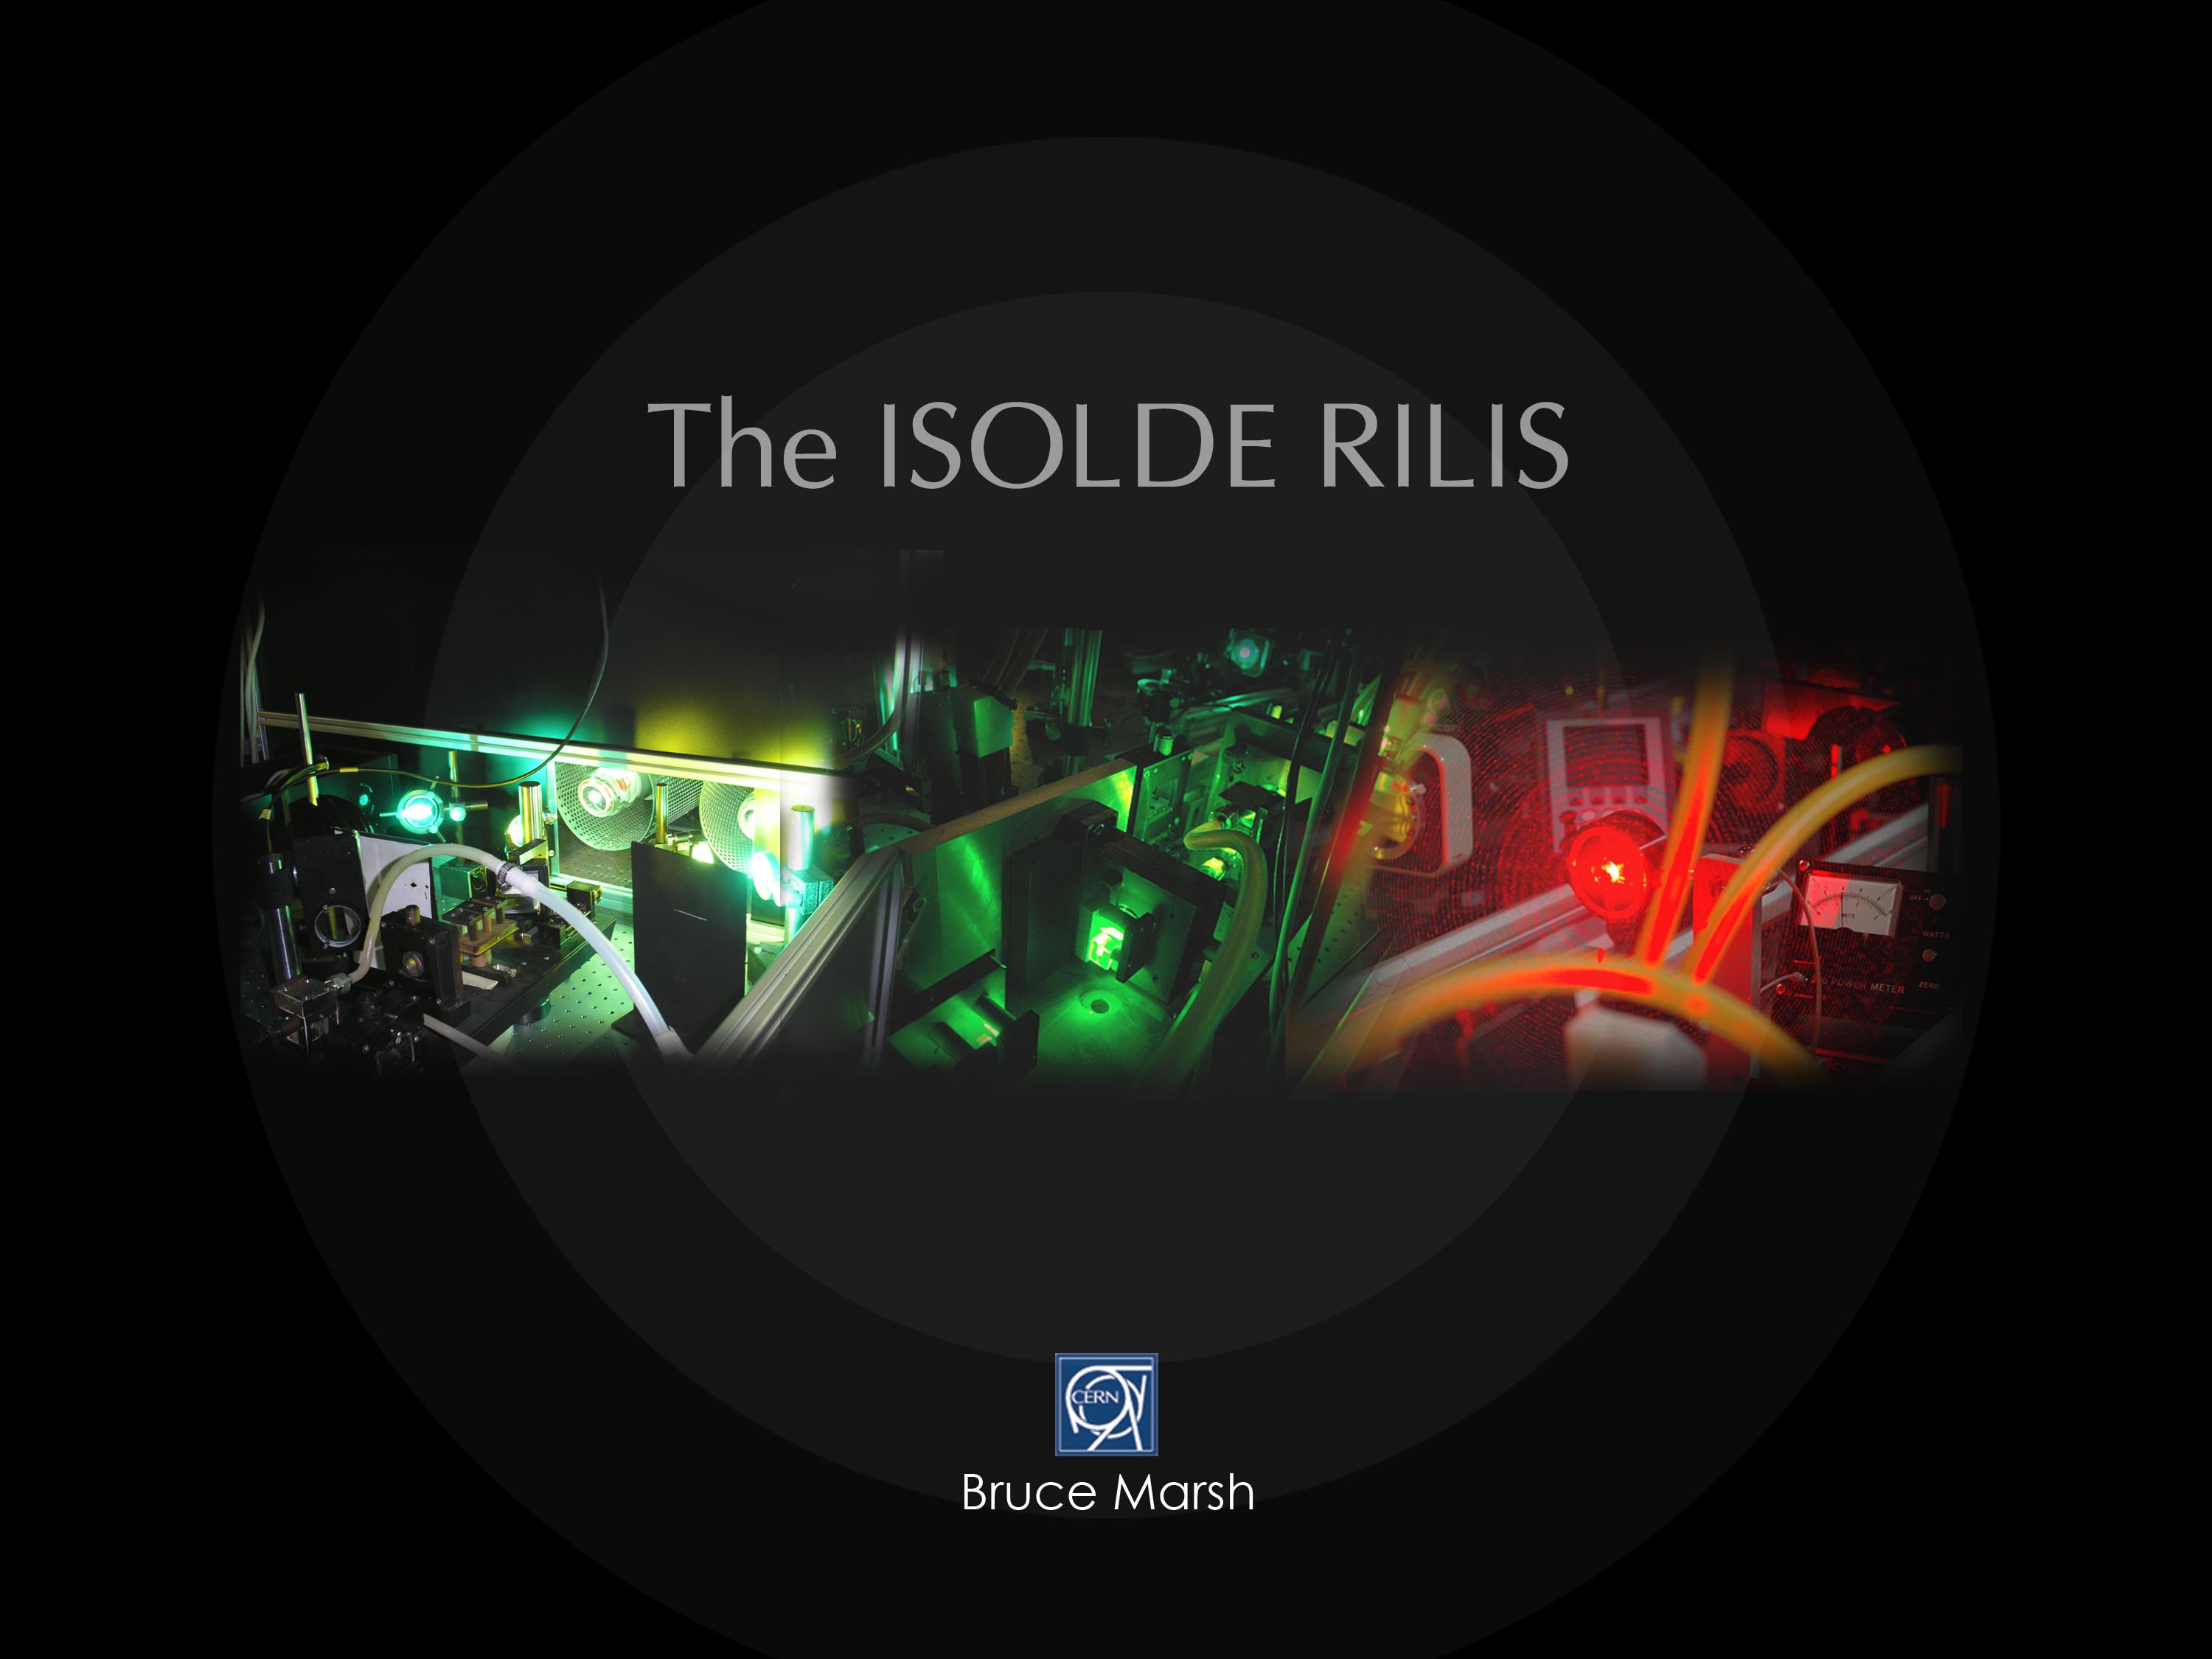
  Implementing the Solid State Laser upgrade
  Ionization scheme development at LARIS
Notes:
1

Slide 2
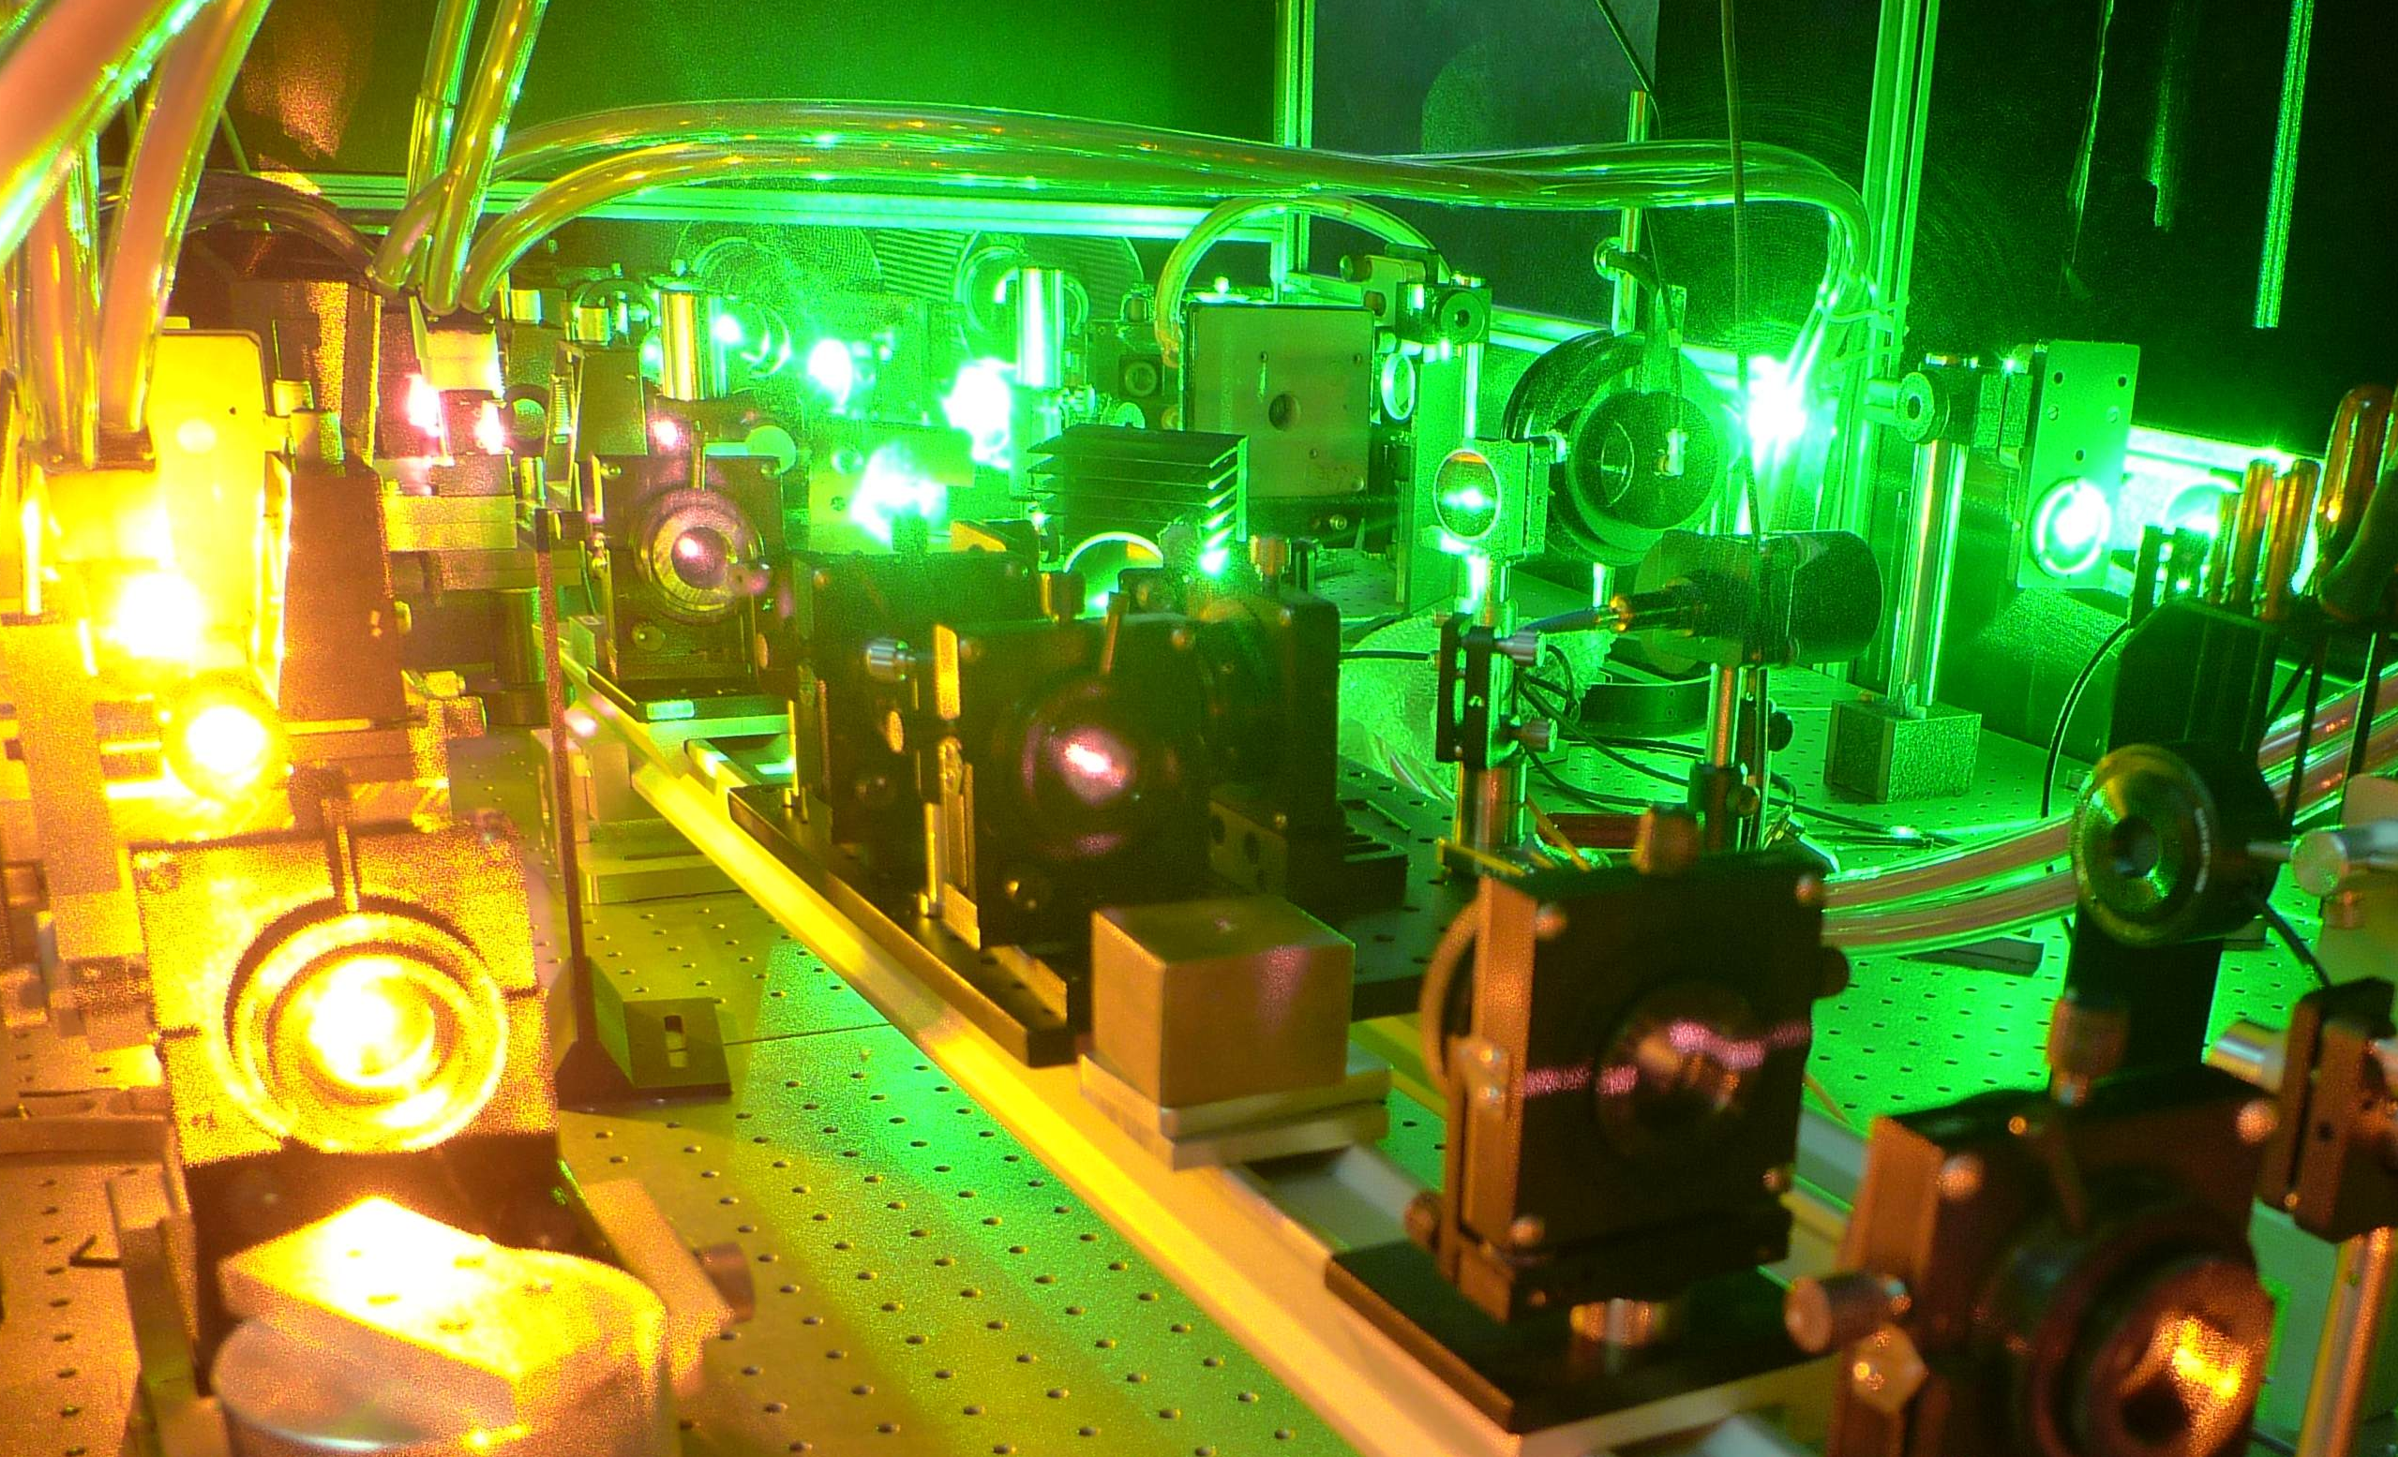
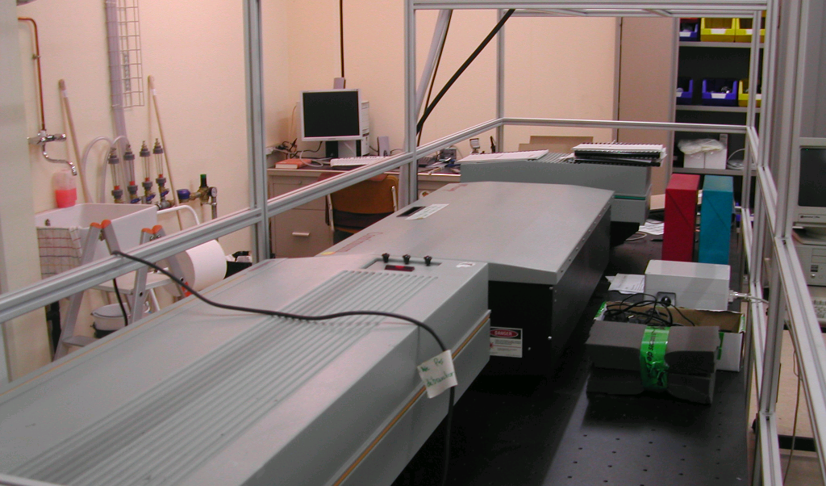
Overview
RILIS upgrade:
New Nd:YAG laser details
Performance and operation in 2008
Planned operation during 2009
RILIS upgrade timeline
LARIS
Laboratory overview
RILIS scheme for manganese
Study of RILIS lead scheme
Potential for RILIS scheme development

Slide 3
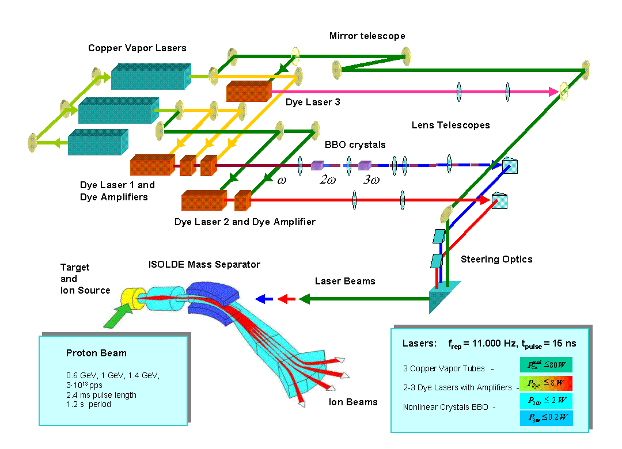
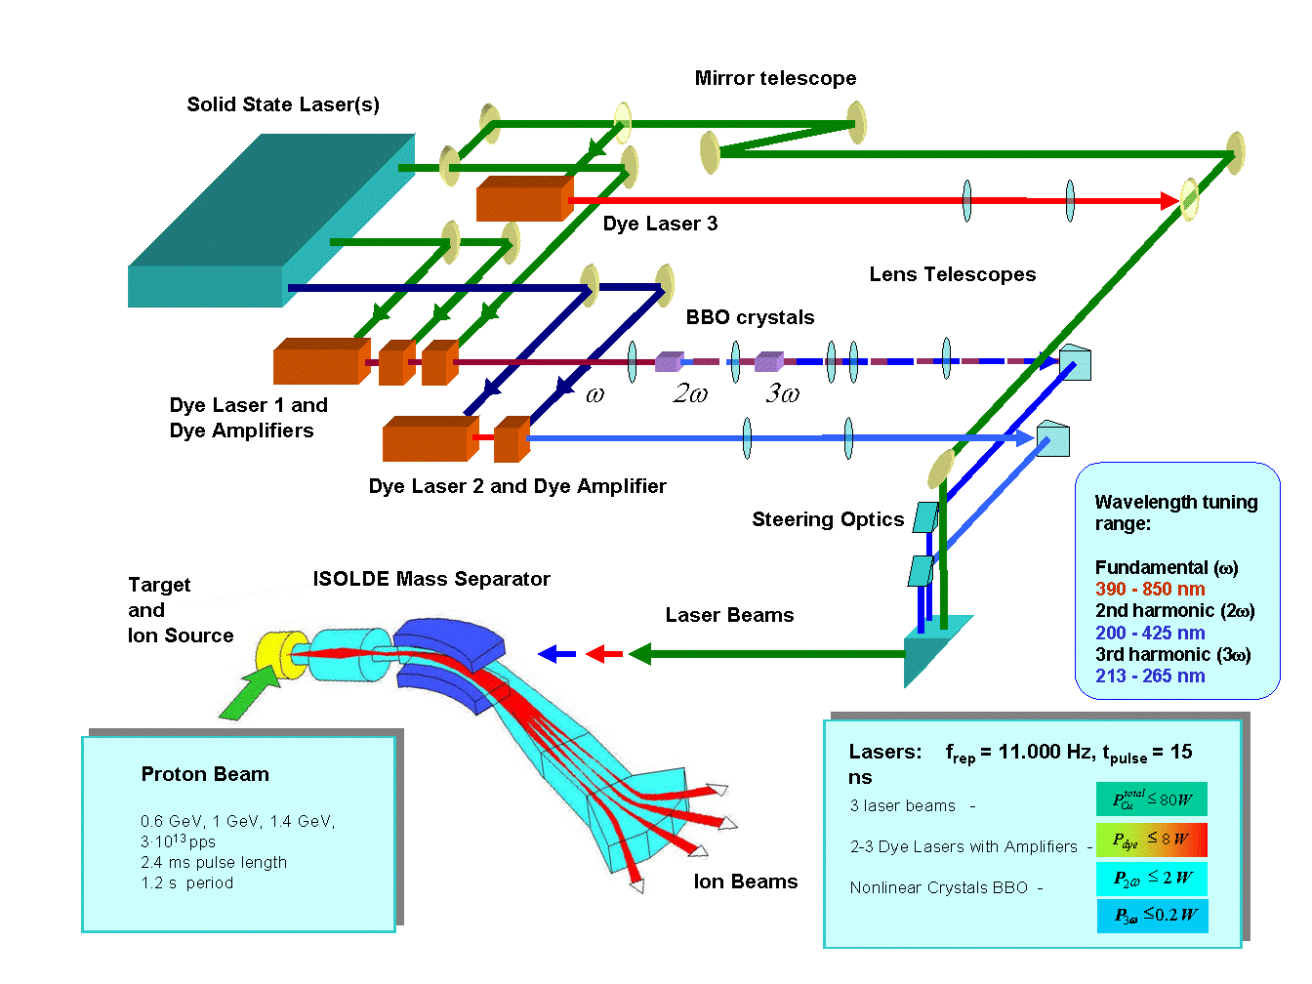
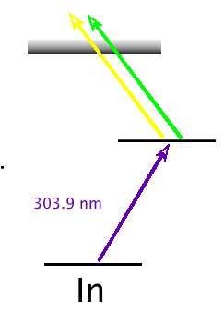
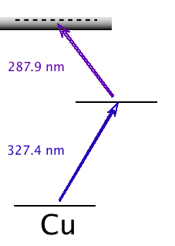
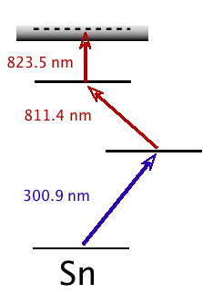
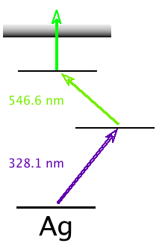
Upgrade of RILIS lasers
Replacement of CVL by SSL
Advantages:
Better beam quality
Stability of operation
Spectral coverage UV-NIR without gaps
Complications:
New ionization schemes are needed (Mn, Au)
Service by manufacturer only
Wavelength tuning range:
Fundamental (ω)
390 - 850 nm
2nd harmonic (2ω)
210 - 425 nm
3rd harmonic (3ω)
213 - 265 nm
Wavelength tuning range:
Fundamental (ω)
530 - 850 nm
2nd harmonic (2ω)
265 - 425 nm
3rd harmonic (3ω)
213 - 265 nm
Wavelength tuning range:
Fundamental (ω)
390 - 850 nm
2nd harmonic (2ω)
210 - 425 nm
3rd harmonic (3ω)
213 - 265 nm

Slide 4
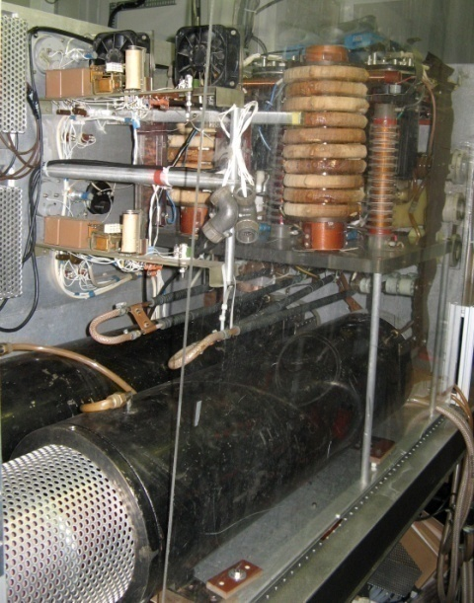
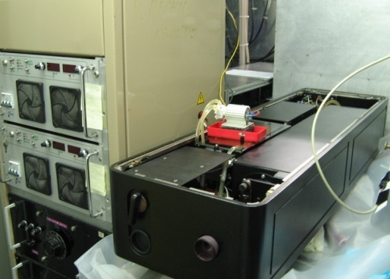
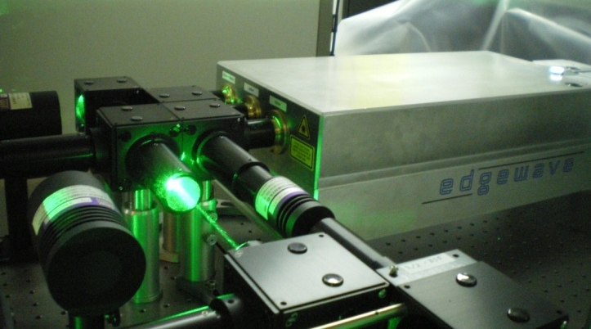
RILIS pump laser overview
- CVL AND Nd:YAG pump lasers
CVL
SSL
15 ns @ 11 kHz 8 ns @ 10 kHz
Green Beams
45 W @ 511 nm
Green Beams
85 W (+11 W)
@ 532 nm
OR
Yellow Beams
35 W @ 578 nm
UV Beam
18 W @ 355 nm
Simultaneous use not yet possible
CVL electrical noise
destroys YAG trigger signal
IR Beam
45 W @ 1064 nm
2 hr start up time
Varying power output over time
30 min start up time
Reliable long term power output

Slide 5
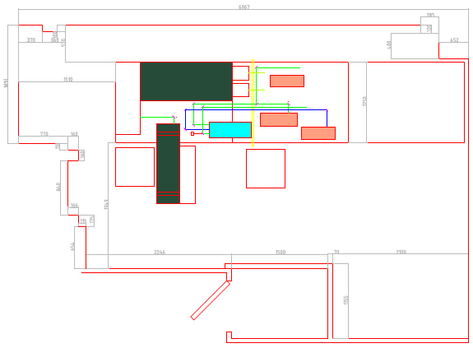
Making room for the new laser
YAG
Power supply
+ chiller
Space for
two laser
heads

Slide 6

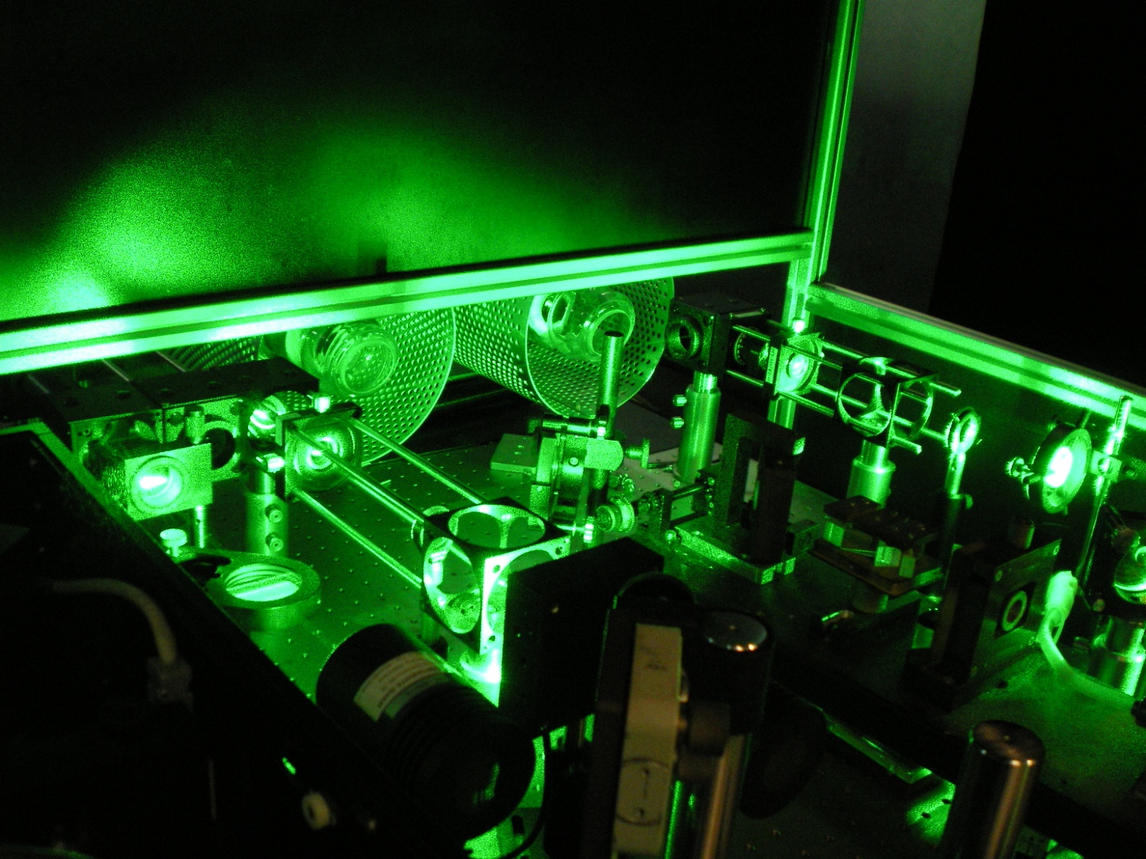
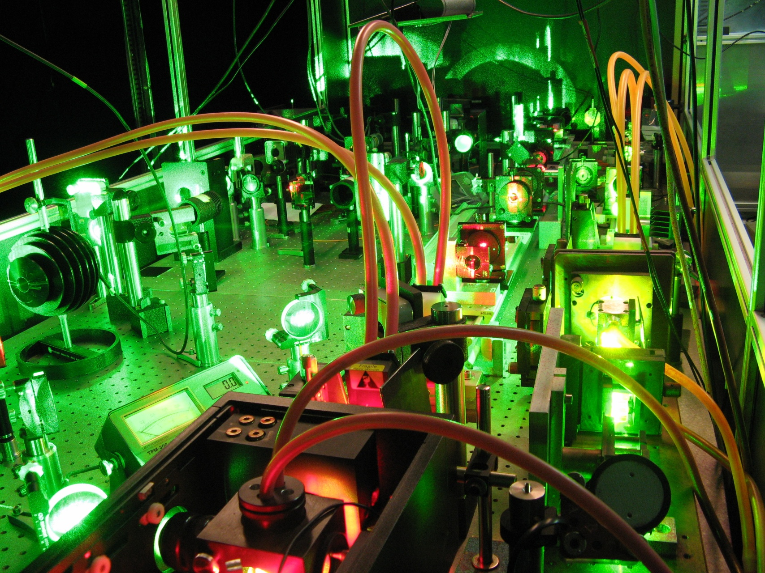
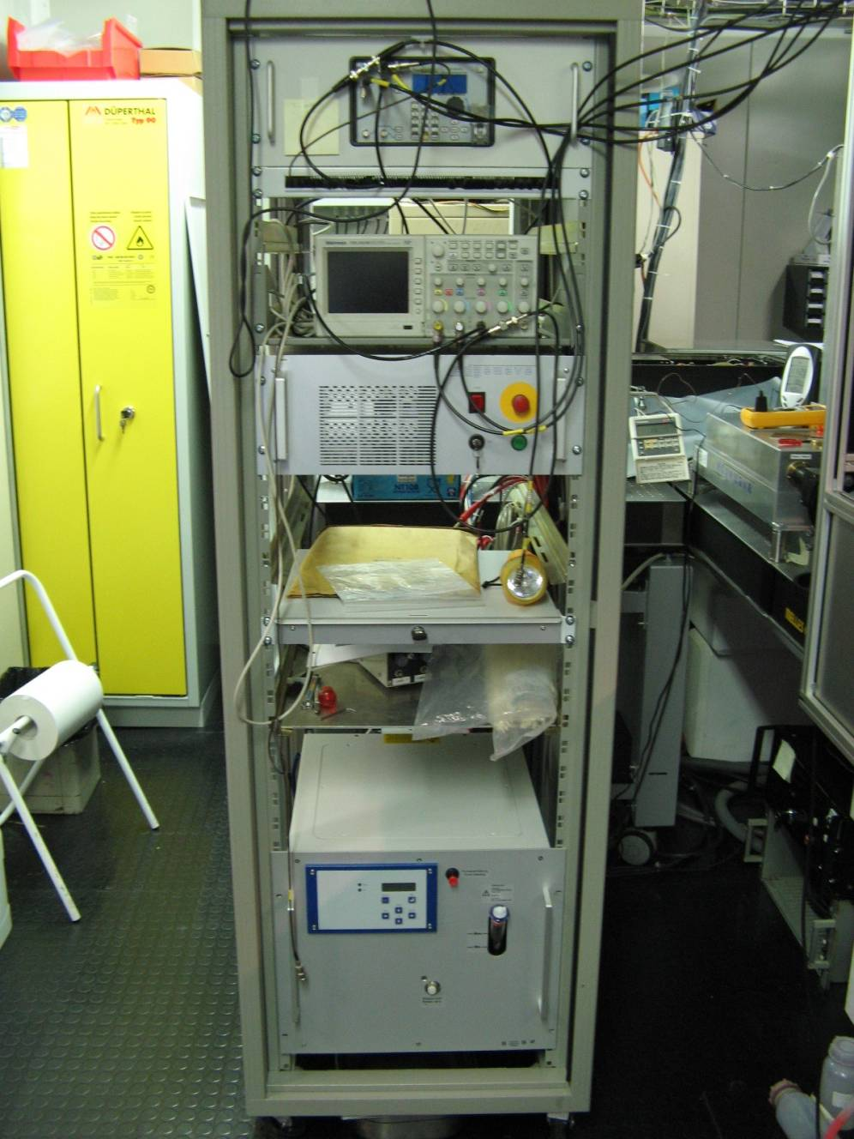
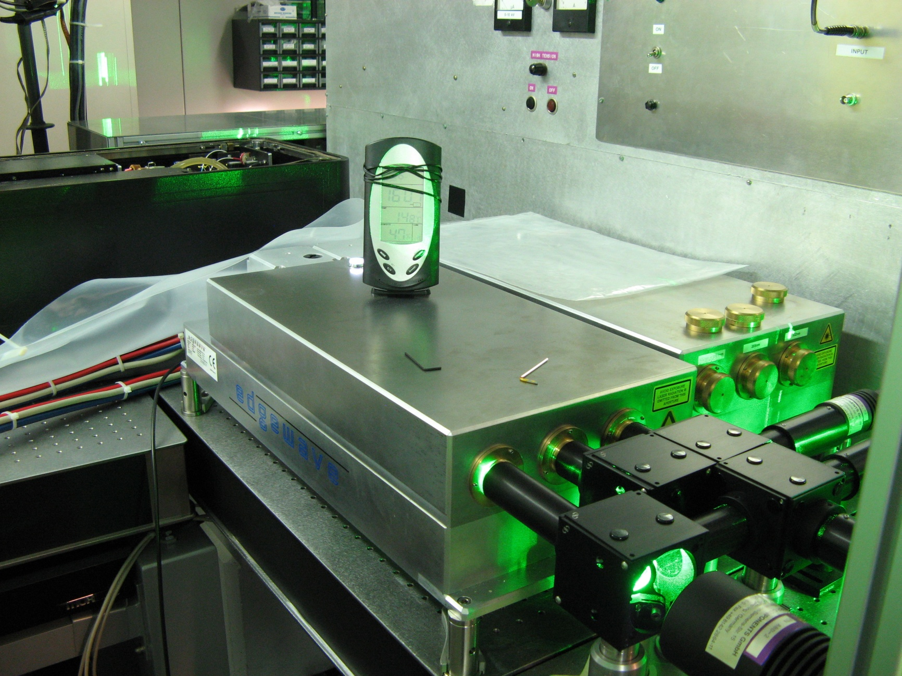

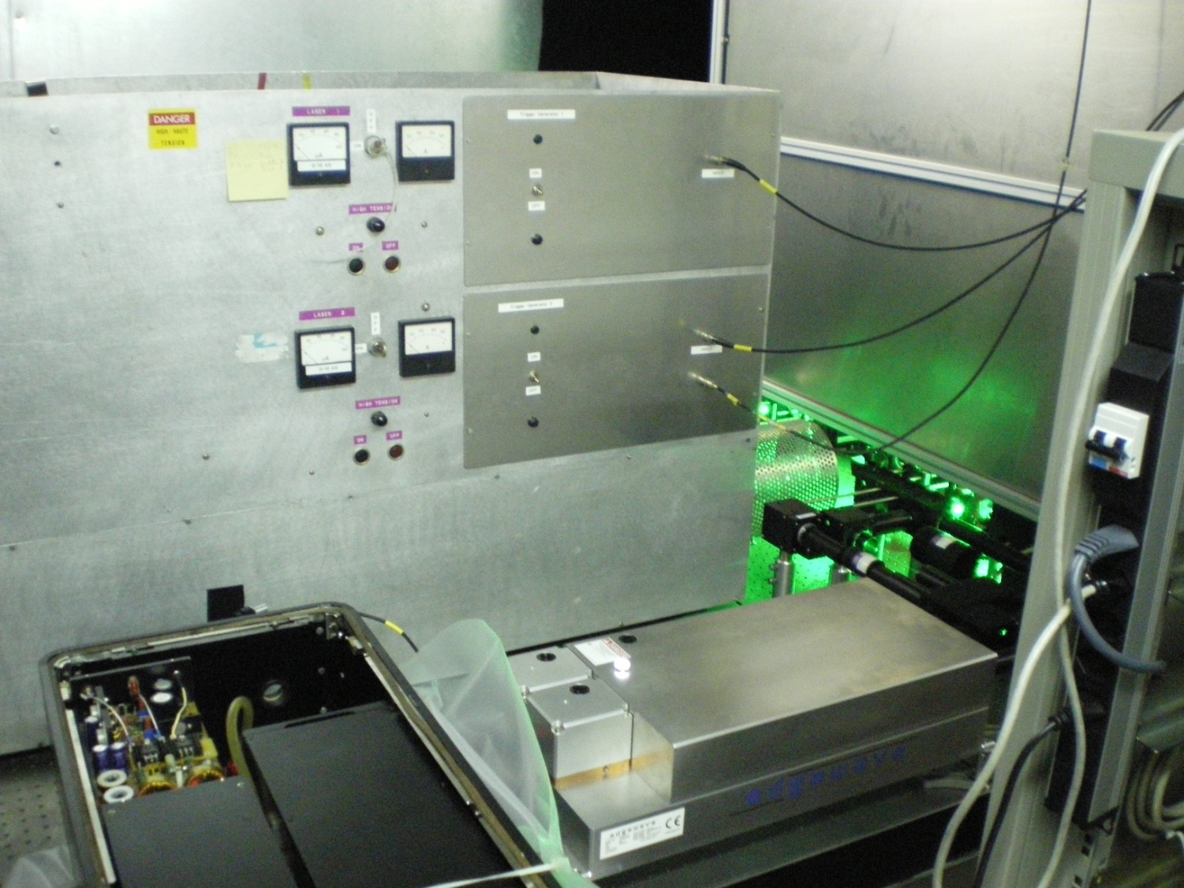
SSL laser in use at RILIS: some photos

Slide 7
Pump beam distribution: example for Be ionization
CVL1
CVL2
Rhod 700
6 W
11 W
10 W
3.3 W
610 mW
110 mW
CVL
R6G + Rhod B
7 W
7.5 W
13.5 W
15 W
1.2 W
SSL
SSL
Green 1
Green 2
Pyridin 1
5.7 W
9.5 W
24 W
4 W
620 mW
110 mW
R6G + Rhod B
5.5 W
8.8 W
20.8 W
8.1 W
1.4 W

Slide 8
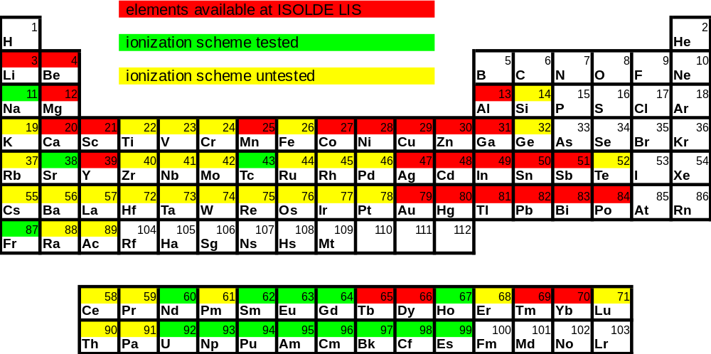


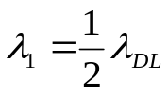
SSL use: enhancements and current limitations
+ More green power
- 532 nm dye pumping instead of 511 or 578 nm
Good example: Gallium
( used in 2008 and last week for COLLAPS)
Two dye lasers were applied at 1st step of excitation - >2x improvement
More power could be delivered to HRS target at the 2nd step of excitation
54%
46%
46%
Most schemes are likely to benefit from increased final step power
Some schemes are no longer useable due to the 532 nm pump beam
- lower final step efficiency or absorption cross section (Mn)
- Need for a < 540 nm fundamental wavelength.
Notes:
Check au?

Slide 9
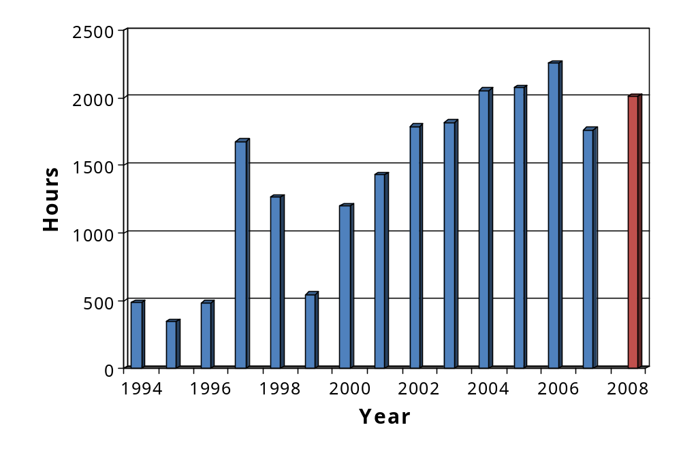
Annual RILIS operation
- 100 % Nd:YAG use is planned for 2009
2250 h
2013 h
1763 h
SSL = 61%
CVL = 39%
Ion beam produced with the CVL in 2008:
Be, Cd, Mn, Au
Ion beam produced with the SSL in 2008:
Ga, Tl, Be, Nd, Cu, Mg, Pb

Slide 10
RILIS pump laser upgrade key points
More laser power
Short-time stability of SSL power is much higher
SSL requires much less supervision
Time from cold start of SSL to nominal operation ~ 30 min.
No electromagnetic noise to experimental hall from RILIS
SSL alignment and repair is possible only at EdgeWave
SSL beam focusing in a far-field is not so efficient as expected
Use of UV beam should be minimized to avoid crystal damage
Efficiency of dye lasers is reduced due to shorter pump pulse
More time is required between runs for RILIS setup optimization
New ionization scheme is needed for Mn
CVL is to be kept as a backup during at least 2009
Operation of dye lasers and harmonics generators still requires continuous supervision by laser specialists

Slide 11

The LAser Resonance Ionization Spectroscopy Laboratory
- Introduction
Primary objectives:
  Investigate new ionization schemes (free from ISOLDE scheduling)
  Improve upon current schemes that rely on non-resonant ionization
  - search for auto-ionizing states
  Prepare for RILIS transition Solid State Laser system
    - different wavelength range (532 nm and 355 nm pumped dye lasers)
Secondary objectives:
  Investigate RILIS selectivity improvements
  - HFS measurements (isomer selectivity)
  - Hot cavity optimization / material testing
Tertiary objectives:
  Questions related to fundamental atomic spectroscopy, e.g. accurate determination of atomic ionization potentials.
CERN/KTH collaboration
FEDOSSEEV, Valentine (CERN)
LINDROOS, Mats (CERN)
LOSITO, Roberto (CERN)
MARSH, Bruce (CERN)
BERG, Lars-Erik (Royal Institute of Technology)
LAUNILA, Olli (Royal Institute of Technology)
SJOEDIN, Marica (Royal Institute of Technology)
TRANSTRÖMER, Göran (Royal Institute of Technology)
Funding: Knut and Alice Wallenberg Foundation

Slide 12
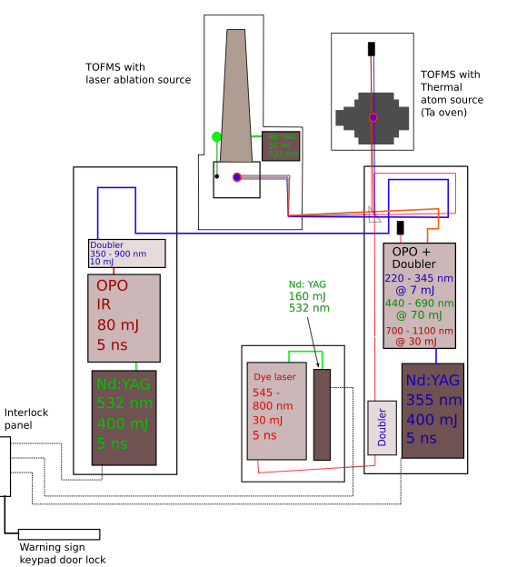
LARIS overview
Versatile system of three tunable lasers operating at 10 Hz:
Nd:YAG pumped dye laser
Nd:YAG UV pumped OPO
Nd:YAG Green pumped OPO
3 frequency doubler/tracker units
Frequency tripling without tracking.
Two complimentary atomic beam sources:
Rotating rod laser ablation source with gas extraction and TOFMS.
Suitable for study of refractory elements.
Tantalum oven atom source with residual gas analyzer and TOFMS.
For ISOLDE specific elements
Well equipped for more fundamental studies of atomic or molecular spectroscopy, determination of ionization potentials and hyperfine structure measurements of stable isotopes.

Slide 13
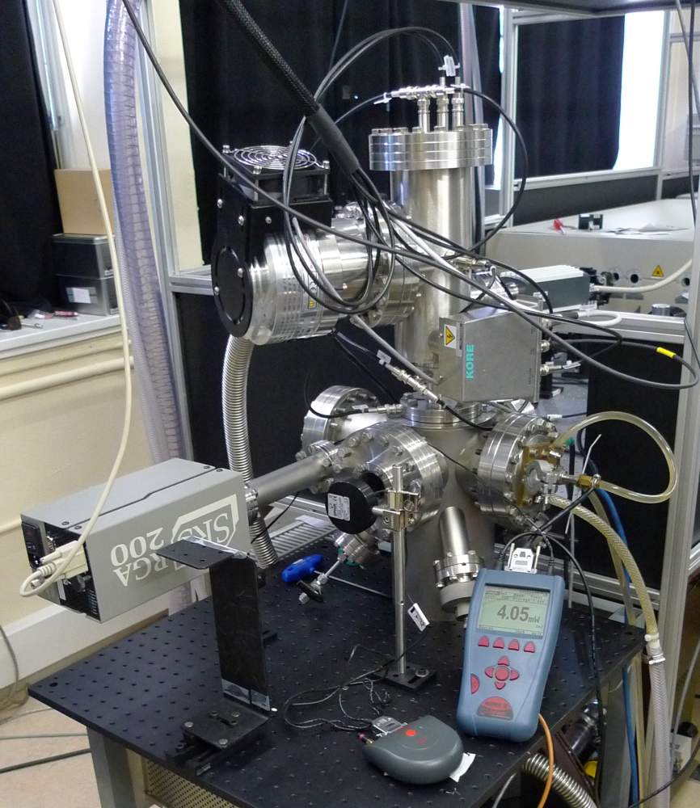
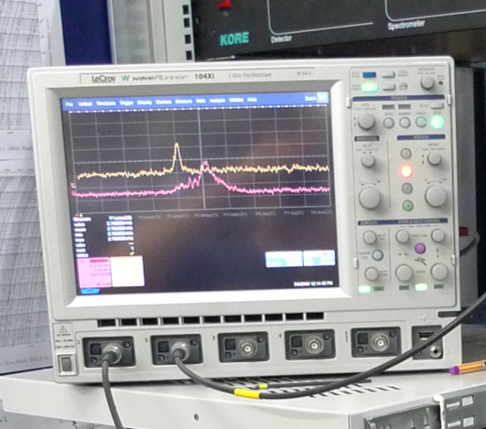
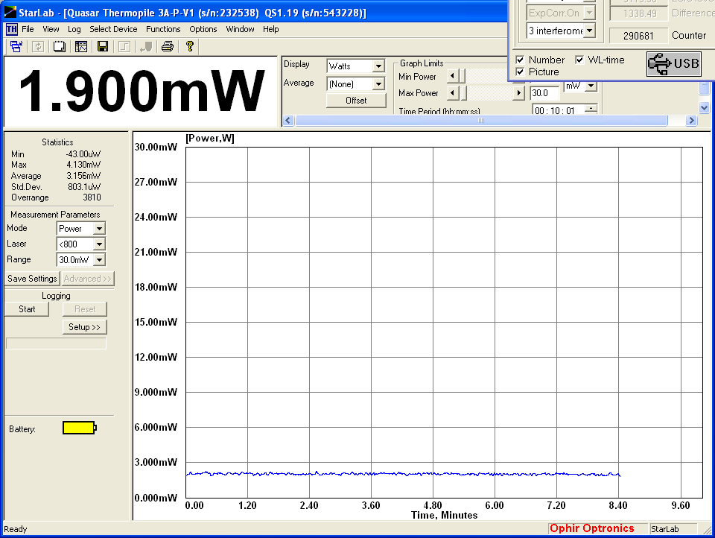
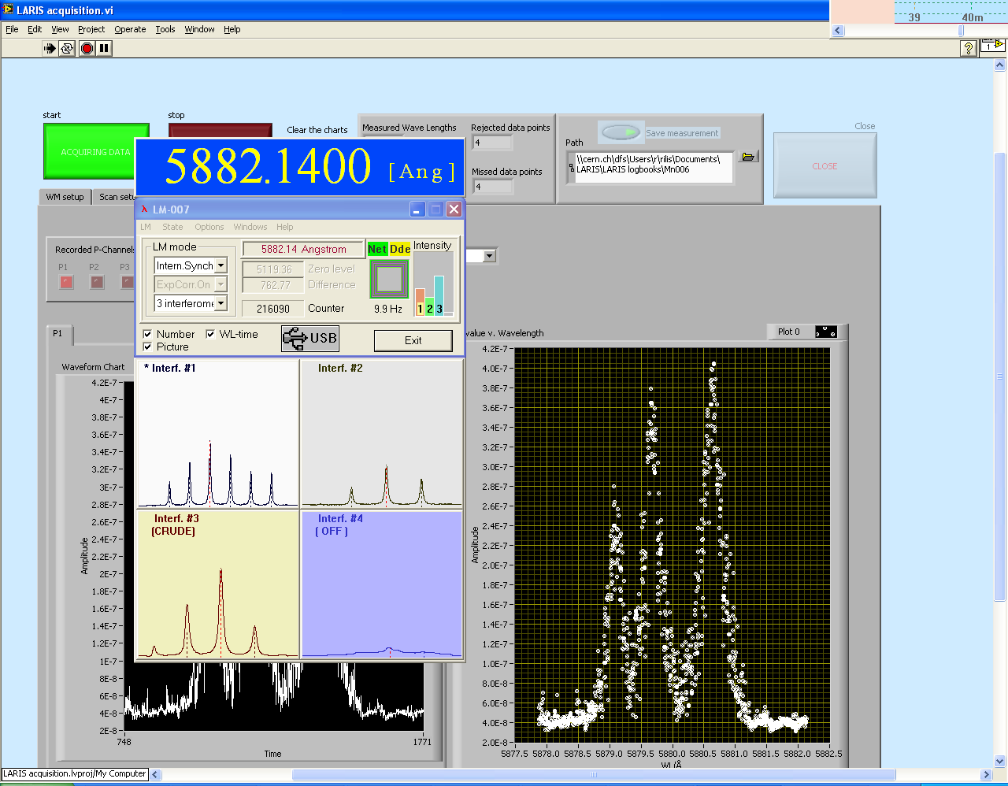
LARIS developments – New thermal atom source/TOFMS installed
- For ionization scheme development for RILIS specific elements
Residual gas analyzer
for monitoring partial
pressure of element of interest
Time of flight
mass spectrometer
Water cooled Ta oven
>1500 ºC
Labview/ DSO DAQ system records multiple isotopes ‘gates’, laser power and laser frequency measurements of any scanning laser.
Bad data caused by laser frequency instabilities are rejected.

Slide 14
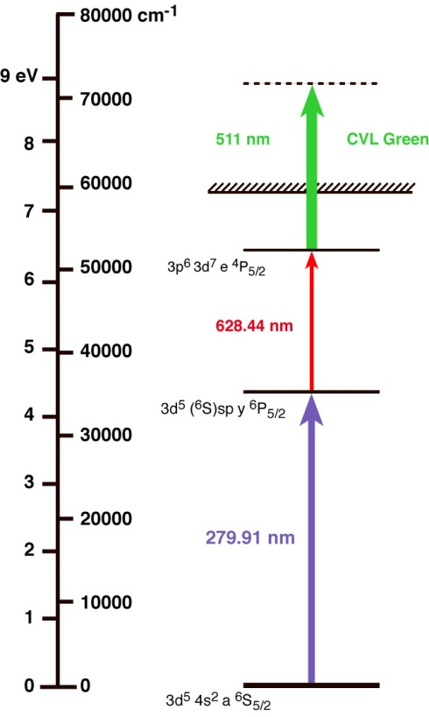
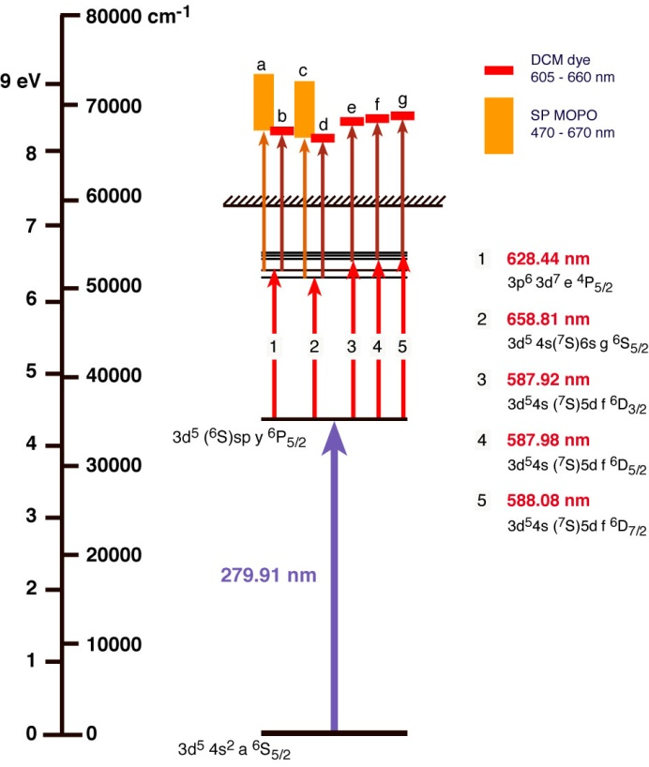
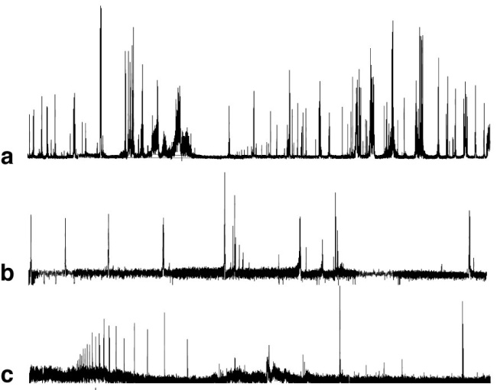
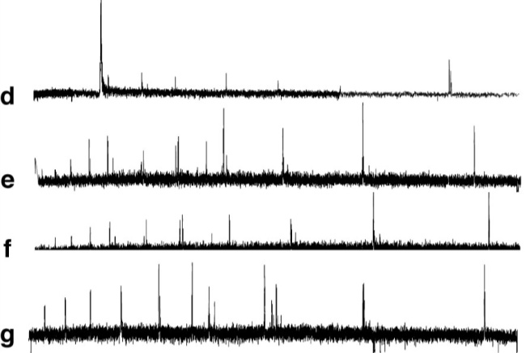
LARIS results – A new RILIS scheme for manganese
- Replacement of current scheme which uses the CVL green beam.
Fortuitous
Auto-ionizing transition
at CVL wavelength
AIS search at LARIS
Outcome of RIS study of Mn at LARIS:
Many new auto-ionizing states found
Various promising Nd:YAG based schemes tested and ready for efficiency measurement at RILIS

Slide 15
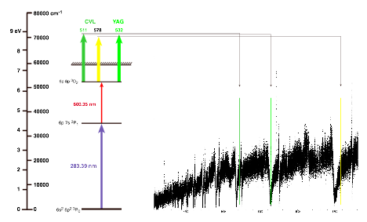
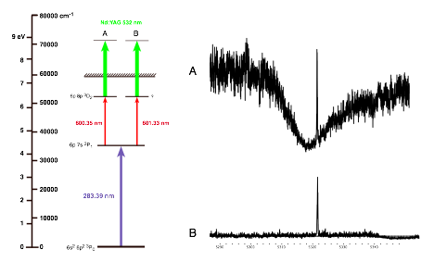
LARIS results – Pb scheme test
- Check performance of 532 nm final step compared to CVL beams
For the current RILIS scheme, the 532 nm YAG wavelength falls in the trough of a Rydberg/continuum interference profile.
The 511 nm and 578 nm CVL wavelengths are more efficient.
An alternative RILIS second step gives access to a flat continuum region with the 532 nm YAG beam.
Notes:
15

Slide 16
Prioritizing the LARIS workload
- Based upon user input/requests and room for improvement over current schemes
Ionization scheme in use
Currently using non resonant ionization - could be improved through AIS search
Atomic data known but Ionization scheme not tested
1 |  |  |  |  |  |  |  |  |  |  |  |  |  |  |  |  | 2
H |  |  |  |  |  |  |  |  |  |  |  |  |  |  |  |  | He
3 | 4 |  |  |  |  |  |  |  |  |  |  | 5 | 6 | 7 | 8 | 9 | 10
Li* | Be |  |  |  |  |  |  |  |  |  |  | B | C | N | O | F | Ne
11 | 12 |  |  |  |  |  |  |  |  |  |  | 13 | 14 | 15 | 16 | 17 | 18
Na* | Mg |  |  |  |  |  |  |  |  |  |  | Al | Si | P | S | Cl | Ar
19 | 20 | 21 | 22 | 23 | 24 | 25 | 26 | 27 | 28 | 29 | 30 | 31 | 32 | 33 | 34 | 35 | 36
K* | Ca | Sc | Ti | V | Cr | Mn | Fe | Co | Ni | Cu | Zn | Ga | Ge | As | Se | Br | Kr
37 | 38 | 39 | 40 | 41 | 42 | 43 | 44 | 45 | 46 | 47 | 48 | 49 | 50 | 51 | 52 | 53 | 54
Rb* | Sr* | Y | Zr | Nb | Mo | Tc | Ru | Rh | Pd | Ag | Cd | In | Sn | Sb | Te | I | Xe
55 | 56 | 57 | 72 | 73 | 74 | 75 | 76 | 77 | 78 | 79 | 80 | 81 | 82 | 83 | 84 | 85 | 86
Cs* | Ba* | La | Hf | Ta | W | Re | Os | Ir | Pt | Au | Hg | Tl | Pb | Bi | Po | At | Rn
87 | 88 | 89 | 104 | 105 | 106 | 107 | 108 | 109 | 110 | 111 | 112
Fr* | Ra | Ac | Rf | Ha | Sg | Ns | Hs | Mt
*Useful RILIS ionization would require SI suppression (new cavities or LIST)
 |  | 58 | 59 | 60 | 61 | 62 | 63 | 64 | 65 | 66 | 67 | 68 | 69 | 70 | 71
 |  | Ce | Pr | Nd | Pm | Sm | Eu | Gd | Tb | Dy | Ho | Er | Tm | Yb | Lu
 |  | 90 | 91 | 92 | 93 | 94 | 95 | 96 | 97 | 98 | 99 | 100 | 101 | 102 | 103
 |  | Th | Pa | U | Np | Pu | Am | Cm | Bk | Cf | Es | Fm | Md | No | Lr
2009 RILIS beams: Be, Ga, Po, Mg, Ni, Nd, Ag, Mn, Zn, Pb
< 5% efficiency:
Co, Zn, Sb, Pb, Bi
User requests:
Gd, Ca
Surface ion suppression
would greatly increase
need for scheme development,
particularly for the rare earths (Miniball)
Low work function cavity test planned for RILIS Nd run in June 2009

Slide 17
RILIS upgrade timeline
Installation of solid state lasers for dye laser pumping. Keeping CVL lasers at RILIS as backup until reliable SSL performance is reached.
Upgrade of dye lasers: purchasing and installation of commercial dye lasers
Installation of solid-state tunable lasers with own pump laser in addition to the dye laser system
Duo-RILIS: two laser systems available for operation with a possibility of quick switch from one element to another
2008
2009
2010
2011

Slide 18
Acknowledgements
- Specifically related to the RILIS upgrade
KTH – Royal Institute of Technology
Stockholm, Sweden
CERN, AB department
Geneva, Switzerland
Lars-Erik Berg
Olli Launila
Fabian Österdahl
Marica Sjödin
Bruce Marsh
Valentin Fedosseev
Mats Lindroos
Roberto Losito
Jacques Lettry
Supported by
EURONS
JRA8 “LASER”
University of
Mainz:
Petersburg Nuclear Physics Institute, Gatchina:
M. Seliverstov
D.V. Fedorov
Y. Volkov
P. Molkanov
A. Barzakh

