Slide 1
HIE-ISOLDE
The technical options
Yacine Kadi, Mats Lindroos and Matteo Pasini, the ISOLDE technical team and the ISOLDE collaboration

Slide 2
HIE-ISOLDE: Next step with three objectives
ENERGY: REX energy upgrade and increase of current capacity (Matteo Pasini)
  Energy upgrade in 3 stages: 8 MeV and 10 MeV/u and lower energy capacity
QUALITY: ISOLDE radioactive ion beam quality – more than half already financed through the ISOLDE collaboration
  Smaller longitudinal and transverse emittance
    Done
  RILIS upgrade and LARIS construction
    Done
  Charge breeder upgrade
  Better mass resolution
  Continued target and ion source developments
    On-going and absolutely essential!
INTENSITY: ISOLDE proton driver beam intensity upgrade - strongly linked to PS Booster improvements including linac4 (INTENSITY WP, Richard Catherall)
  Faster cycling of the booster
  New target stations for ISOLDE
  New target design
  New target handling system

Slide 3
HIE-ISOLDE project
HIE-ISOLDE 1
  Energy upgrade up to 8-10 MeV/u with a superconducting linac, beam quality improvements and the design study of the intensity upgrade
    R&D activity for LINAC funded
HIE-ISOLDE 2
  Intensity upgrade for 30 kW on target
    Linac 4 beam via PSB and Light SPL beam to ISOLDE
  Super-HRS

Slide 4
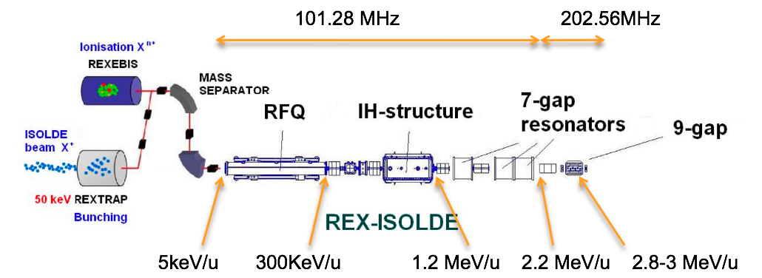
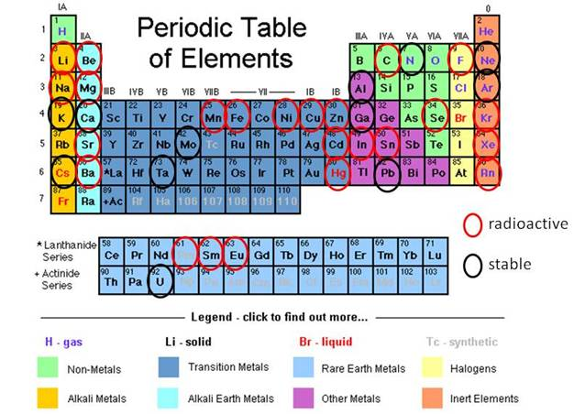
Existing REX-ISOLDE linac – a world leading RIB facility

Slide 5
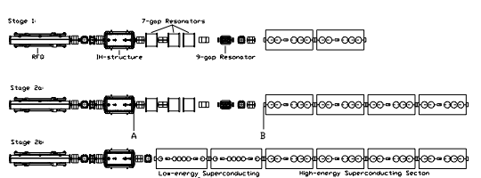
HIE-ISOLDE LINAC - layout
3 stages installation
1.2 MeV/u
3
MeV/u
5.5 MeV/u
8
MeV/u
10 MeV/u
M. Pasini EURISOL Town Meeting Pisa, 30.03-01.04 2009

Slide 6
HIE-ISOLDE SC-linac
SC-linac between 1.2 and 10 MeV/u
Energy fully variable; energy spread and bunch length are tunable. Average synchronous phase φ_{s}= -20 deg
2.5<A/q<4.5 limited by the room temperature cavity
16.02 m length (without matching section)
No ad-hoc longitudinal matching section (incorporated in the lattice)

Slide 7
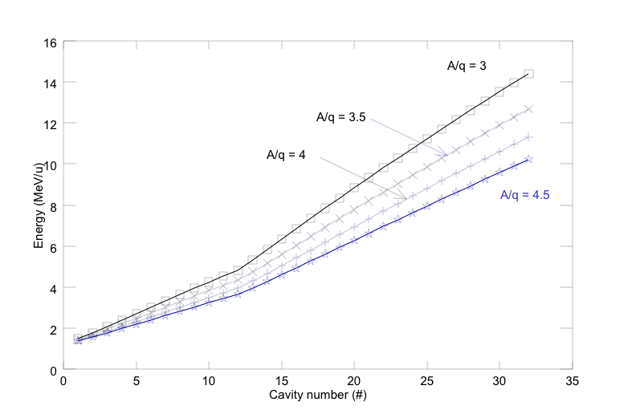

Final Beam Energies
N.B! With ECR technology:
A/q=6 7.9 MeV/u
A/q=9 5.4 MeV/u
M. Pasini EURISOL Town Meeting Pisa, 30.03-01.04 2009

Slide 8
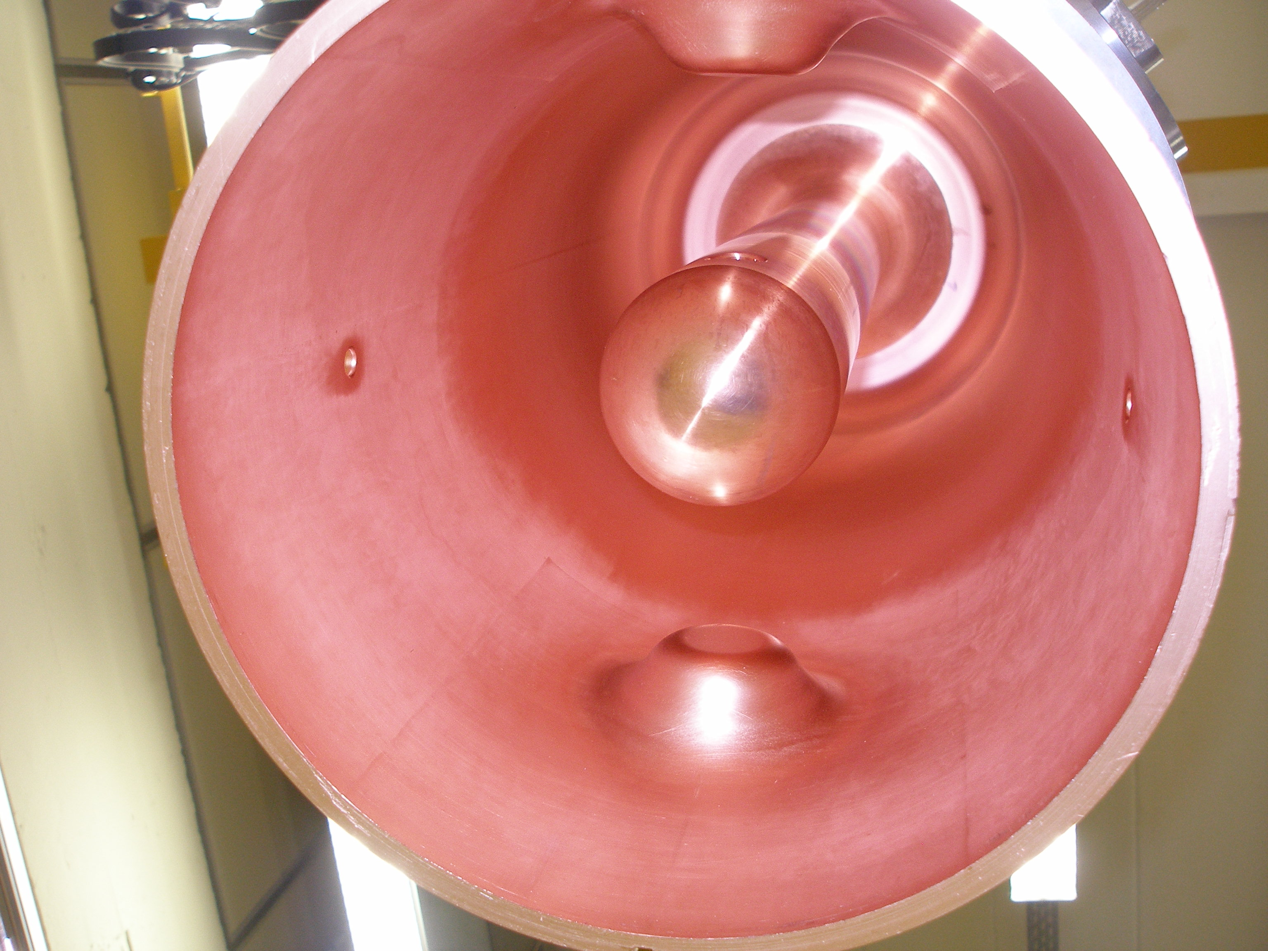
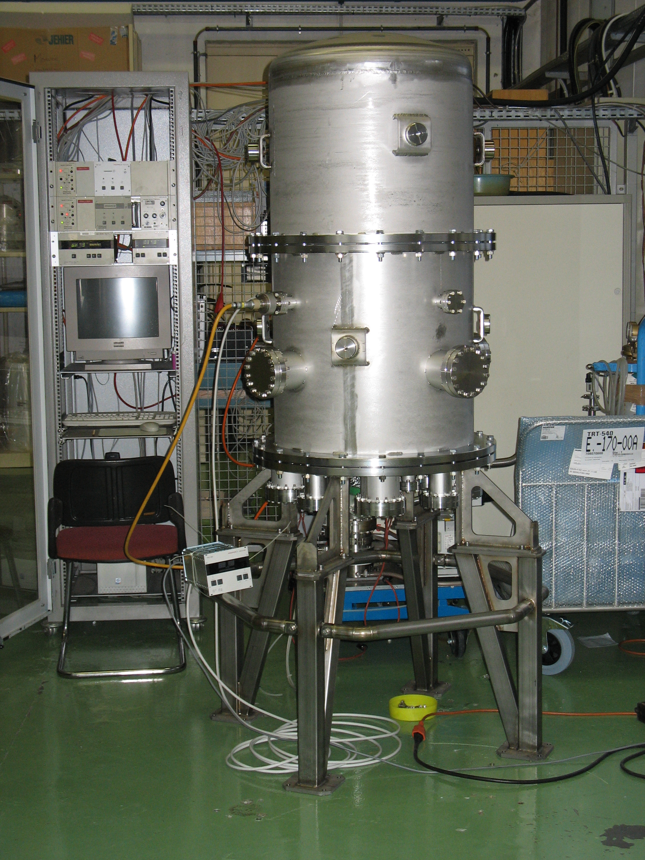
Cavity prototype

Slide 9
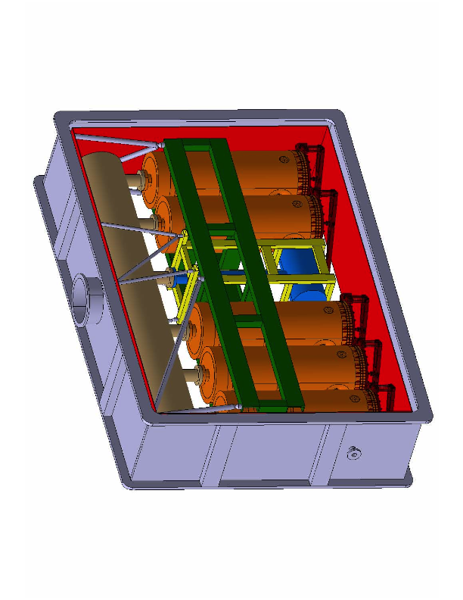
Cryomodule design
Each cryomodule can be isolated and taken out in case of failure.
Common vacuum concept to minimize the inter-cryomodule distance
This concept foresees the possibility to align the solenoid when cold from the outside (beam alignment)

Slide 10
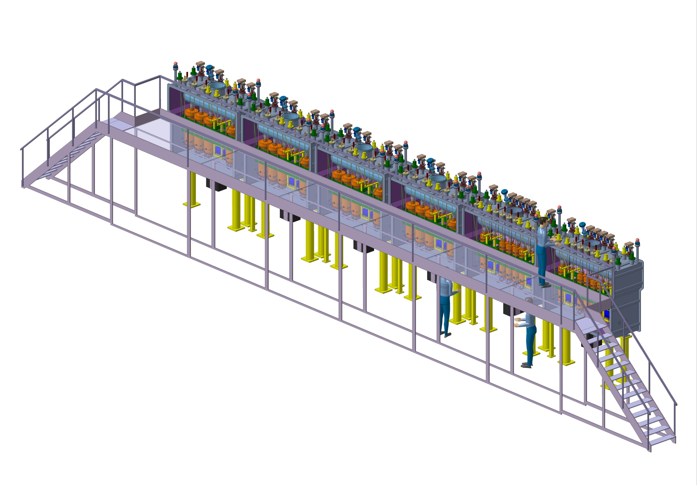
HIE-ISOLDE SC linac

Slide 11
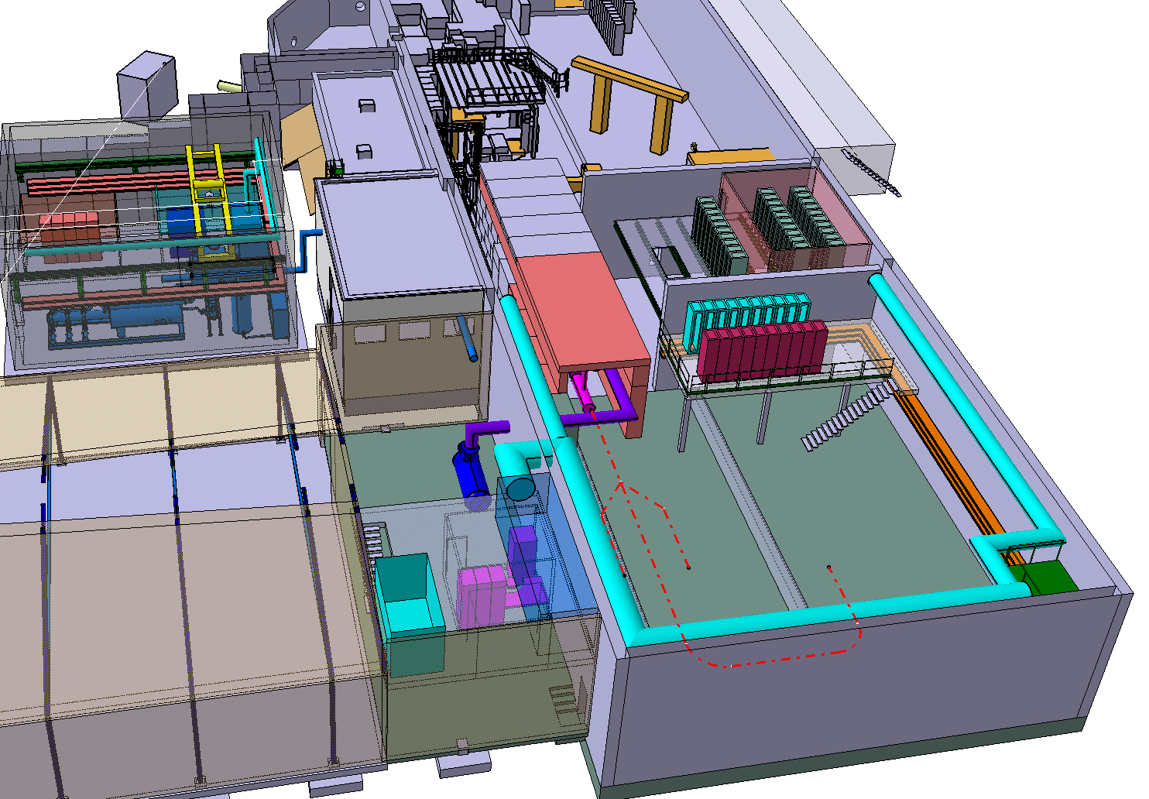
Buildings and infrastructures
M. Pasini EURISOL Town Meeting Pisa, 30.03-01.04 2009

Slide 12
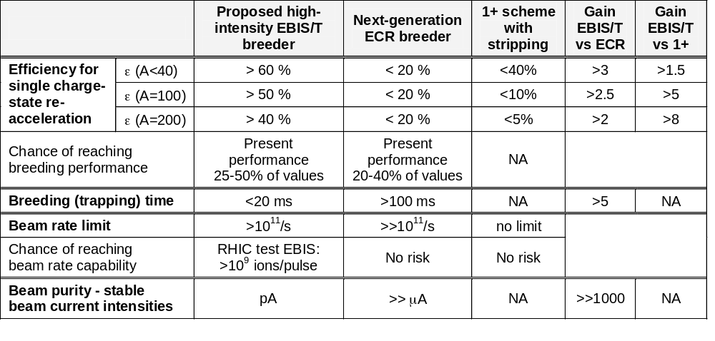
DOE proposal - Comparison EBIS/ECR/1+
 | Proposed High-Intensity EBIT | MSU EBIT | TITAN EBIT | BNL test EBIS | REX-EBIS
Electron beam energy (keV) | < 60 | < 30 | < 60 | <30 | < 6
Electron beam current (A) | < 10 | < 5 | <5 | <20 | < 0.5
Central current density (A/cm²) | <10⁵ | <10⁴ | <10⁴ | <600 | <200
Magnet design | Helmholtz Coil + Solenoid | Helmholtz Coil + Solenoid | Helmholtz Coil | Solenoid | Solenoid
Maximum magnetic field (T) | 9 | 6 | 6 | 5 | 2
Trap length (m) | 1 m | 0.5 m | 0.1 m | 0.7 m | 0.8 m
O. Kester et al.

Slide 13
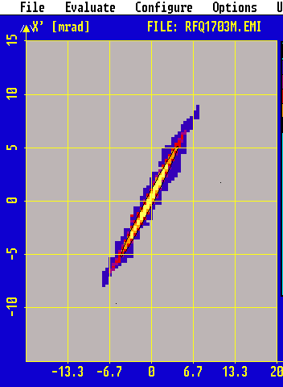
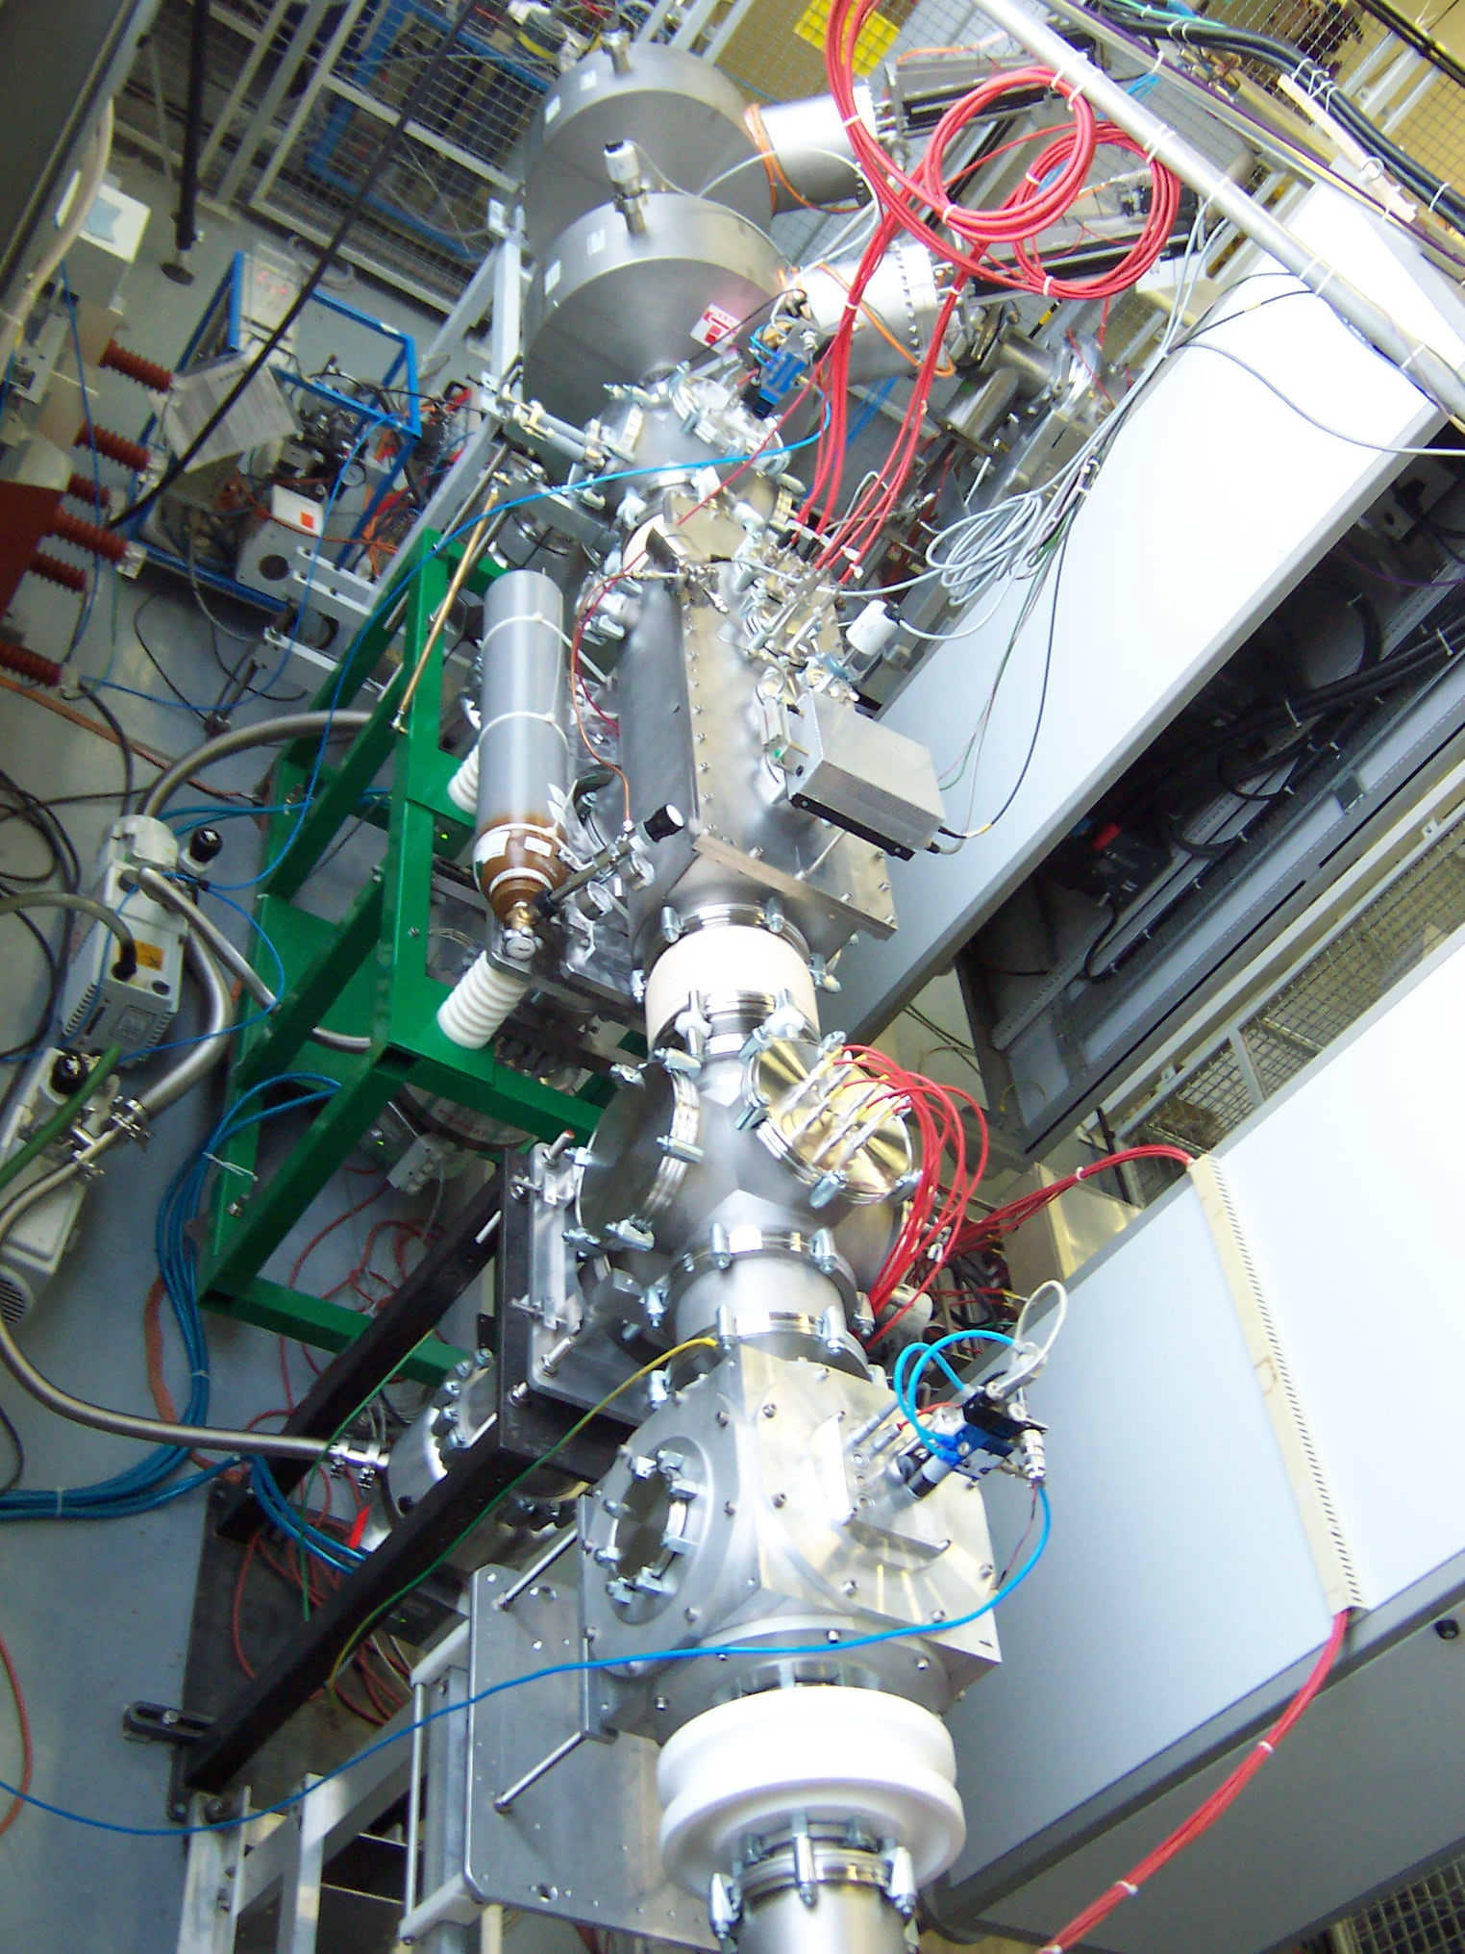
RFQ cooler “ISCOOL” - DONE
EPSCR grant (Manchester, Birmingham)
Continuous mode
Emittance meter
~5π·mm·mrad 90% emittance
~30π·mm·mrad 90% emittance as input
RFQ cooler
Ion | transmission
Li⁺ | 17%
Na⁺ | 27%
K⁺ | 60%
Cs⁺ | 70%
Alkali ion source

Slide 14
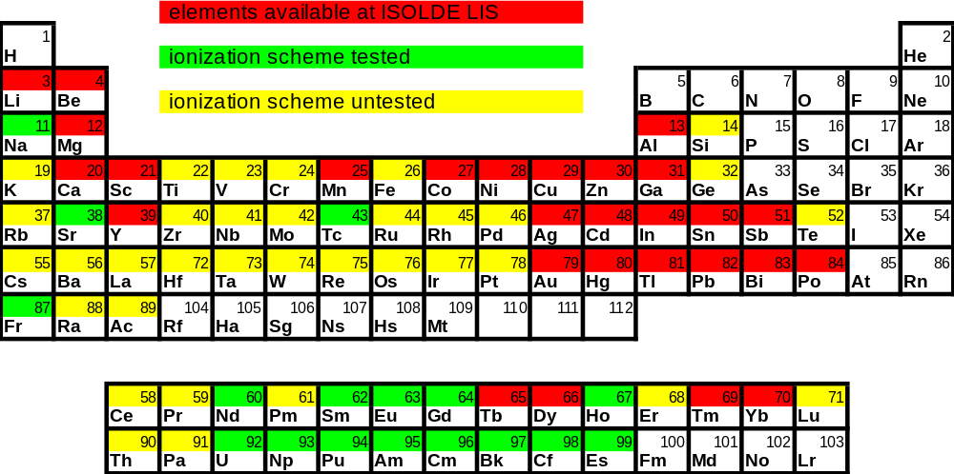
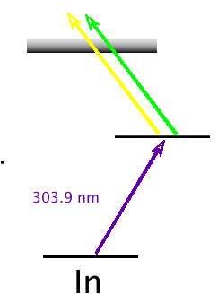
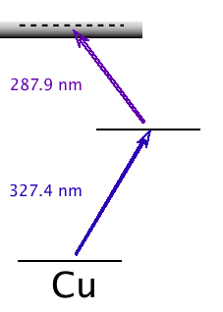
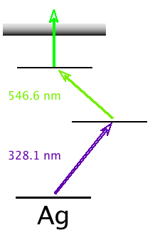
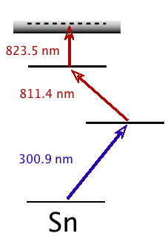
The Resonance Ionization Laser Ion Source
RILIS beams of 28 elements are available so far:
4 types of ionization scheme:
2-step: (1 resonance)
(2 resonance)
3-step: (2 resonance)
(3 resonance)

Slide 15
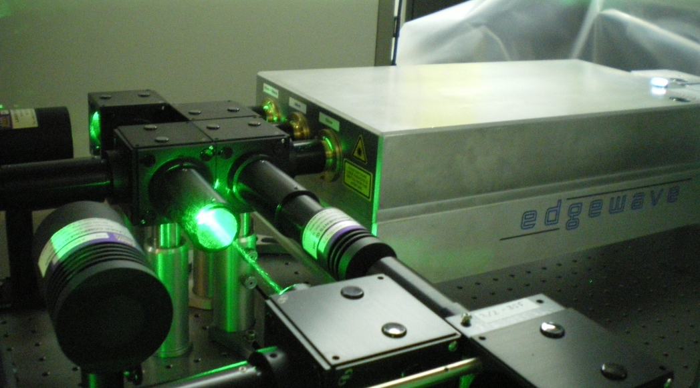


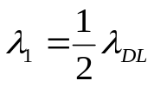
New Nd:YAG lasers at ISOLDE RILIS - DONE
Diode Pumped Solid State Nd:YAG Lasers as replacement of Copper Vapor Lasers:
CVL
SSL
15 ns @ 11 kHz 8 ns @ 10 kHz
Green Beams
90 - 100 W @ 532 nm
Green Beams
45 W @ 511 nm
UV Beam
18 W @ 355 nm
Yellow Beams
35 W @ 578 nm
IR Beam
35 W @ 1064 nm
CVL scheme
SSL scheme
Improvement of Ga ionization efficiency by SSL :
Two dye lasers were applied at 1st step of excitation - x 2
More power could be delivered to HRS target at the 2nd step of excitation
Better power stability
54%
46%
46%
Knut and Alice Wallenberg foundation grant

Slide 16
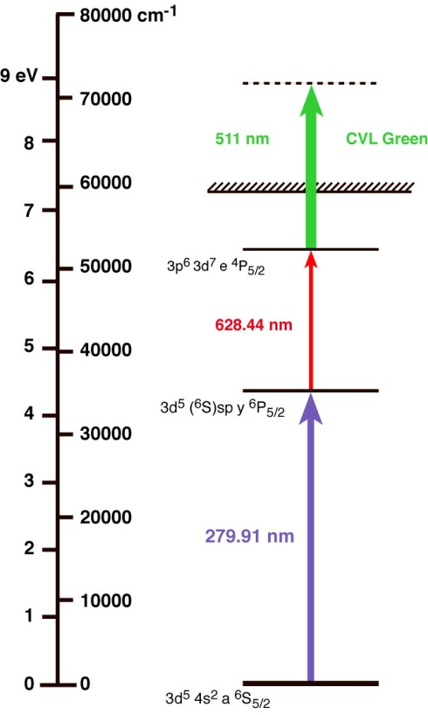
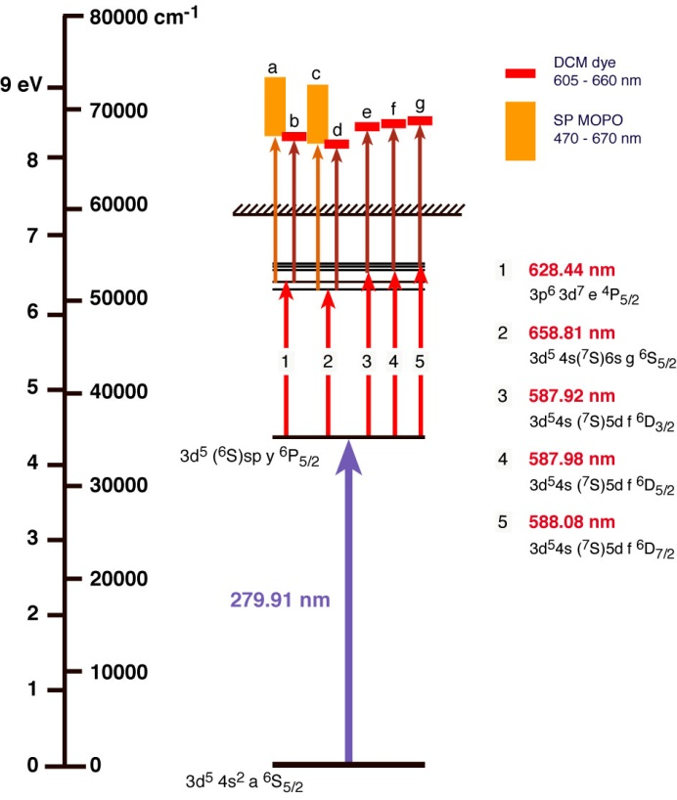
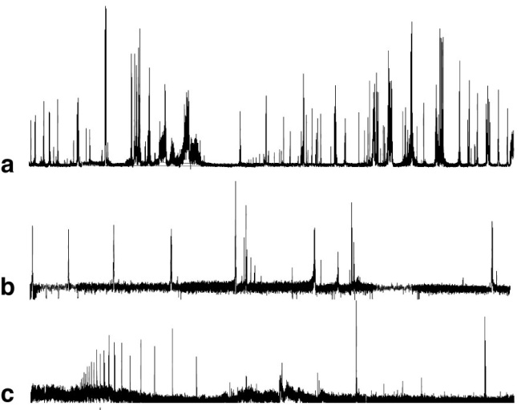
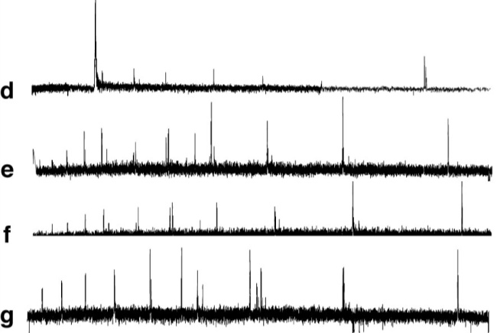
LARIS results – A new RILIS scheme for Manganese - DONE
- Replacement of current scheme which uses the CVL green beam.
Fortuitous
Auto-ionizing transition
at CVL wavelength
AIS search at LARIS
Outcome of RIS study of Mn at LARIS:
Many new auto-ionizing states found
Various promising Nd:YAG based schemes tested and ready for efficiency measurement at RILIS
Knut and Alice Wallenberg foundation grant

Slide 17

Road map of RILIS upgrade
Installation of solid state lasers for dye laser pumping. Keeping CVL lasers at RILIS as backup until reliable SSL performance is reached.
Upgrade of dye lasers: purchasing and installation of commercial dye lasers
Installation of solid-state tunable lasers with own pump laser in addition to the dye laser system
Duo-RILIS: two laser systems available for operation with a possibility of quick switch from one element to another
2008
2009
2010
2011
Knut and Alice Wallenberg foundation grant

Slide 18
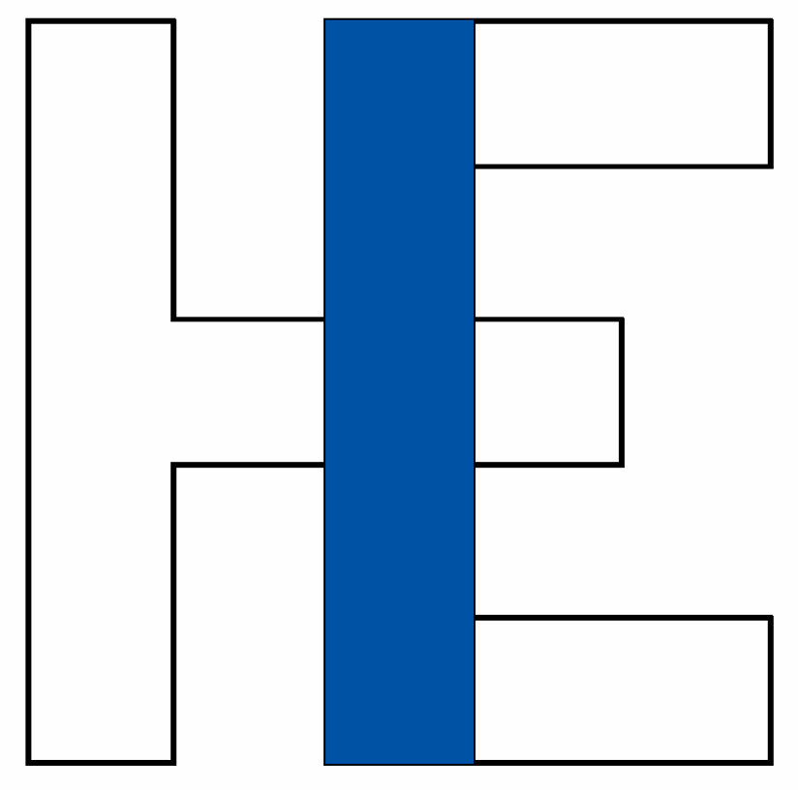
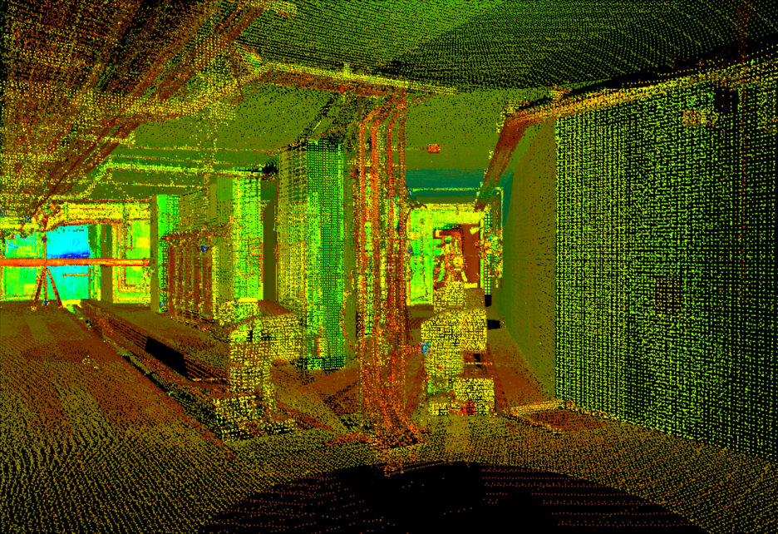
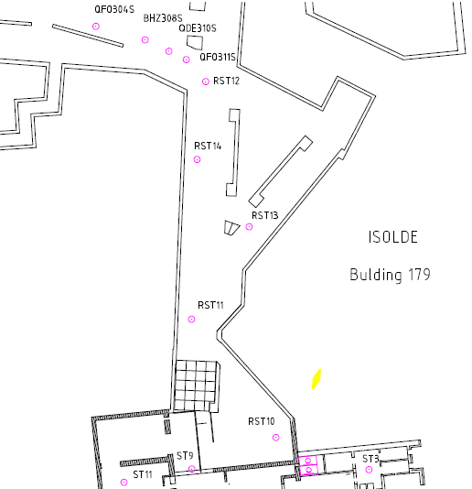
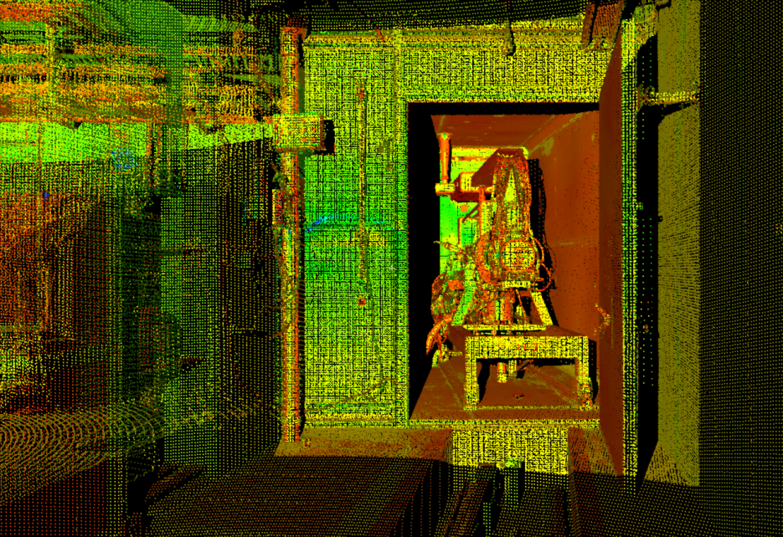
ISOLDE target area - The 3D Laser Scan
Cloud of point in the CERN coordinate system
Reference Points
J. Sarret, L. Bruno

Slide 19
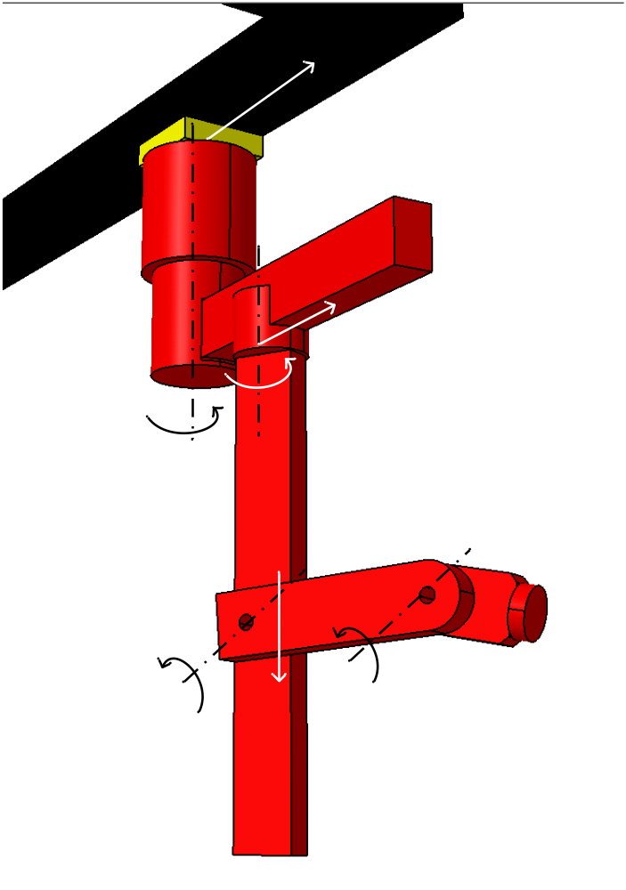
Manipulator concept design
6-DOF Manipulator mounted on ceiling monorails
Equipped with tool changer for mounting different tools
Recoverable by decoupling (remotely) rail gear drive
High lifting capacity (FFE)
Target & electrode accurate / sensitive operations

Slide 20
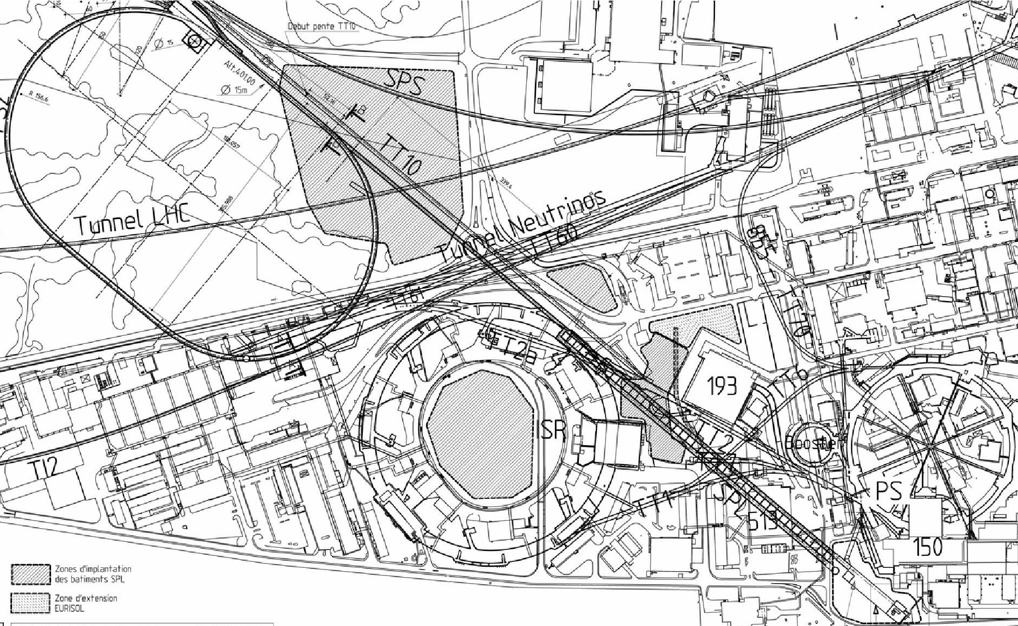
Overall layout of the new injectors (1/2)
SPS
PS2
ISOLDE
PS
SPL
Linac4

Slide 21
Analysis
SPL block diagram
Main impact of faster cycling rate: klystron modulators (SPL + Linac4)
Limited P_{average} + technology limited cycling rate (~ 15 Hz)
P_{average} ∝ Modulator pulse length x Rep. rate
P_{average} ∝ (Modulator rise + Cavity fill + Beam pulse) x Rep. rate
Other consequences of faster cycling rate:
  Magnets power supplies
  Beam instrumentation
  Controls…
732 MeV
(560 MeV)
1.4 GeV
(1 GeV)
160 MeV
2.5 GeV
4-5 GeV
Linac4
β=0.65
β=1
β=1
β=1
Extraction to ISOLDE
200 μs
∝ E_{acc}²

Slide 22
Minimum cost options
LP-SPL type modulators (P_{nominal} ≡ 0.35 % duty cycle)
* Basic period : 600 ms – PS2 cycling time: 2.4 s
Beam energy (GeV) | Max. pulse duration (ms) | Max. current during pulse (mA) | Cycling rate* (Hz) | Max. protons /pulse (x10¹³) | Max. beam power (kW)
1.4 | 0.9 | 20 | 1.25 (3 out of 4 pulses) | 11 | 31
1 | 0.35 | 28 | 2.92 (7 out of 8 pulses) | 6.1 | 29
Baseline solution
Need for wide range high power RF phase shifters… => Cost!

Slide 23
Summary
Planning for a staged implementation project
HIE-ISOLDE 1
  HIE LINAC R&D within the EUCARD I3 and with Belgium grant is making good progress
  Test of the first cavity for the SC linac are expected in June/July at TRIUMF in Vancouver
  On-going beam quality development e.g. RFQ cooler and RILIS
  Construction of linac and design study of new target area
HIE-ISOLDE 2
  Construction of new target area and Super-HRS
  Linac 4 (10 kW) and LP-SPL (30 kW)
M. Pasini EURISOL Town Meeting Pisa, 30.03-01.04 2009

