Slide 1
HIE-ISOLDE Project
Y. Kadi (EN-STI)
On behalf of the HIE-ISOLDE Coordination team

Slide 2
Overview
HIE-ISOLDE Proposal
Project Breakdown Structure
Schedule
Budget and Manpower Estimates
Status of External Funding
Status of HIE-ISOLDE
Summary
Y. Kadi HIE-ISOLDE Proposal, IEFC, August 21, 2009

Slide 3
The HIE-ISOLDE Proposal
The High Intensity and Energy (HIE) ISOLDE proposal presented today for approval builds on the success of the REX-ISOLDE post accelerator and will focus on an upgrade of the REX facility that shall make available a higher final energy (10 MeV/u) and several intermediate energy levels improving the flexibility of the ISOLDE facility
In order to cope with the limited resources available, the design study of the target and front-end part of ISOLDE to fully profit from upgrades of the existing CERN proton injectors, e.g. faster cycling of the PS Booster, LINAC4 (10 kW) and later LP-SPL (30 kW) is proposed to be delayed and eventually re-analyzed in 2012.
Y. Kadi HIE-ISOLDE Proposal, IEFC, August 21, 2009

Slide 4
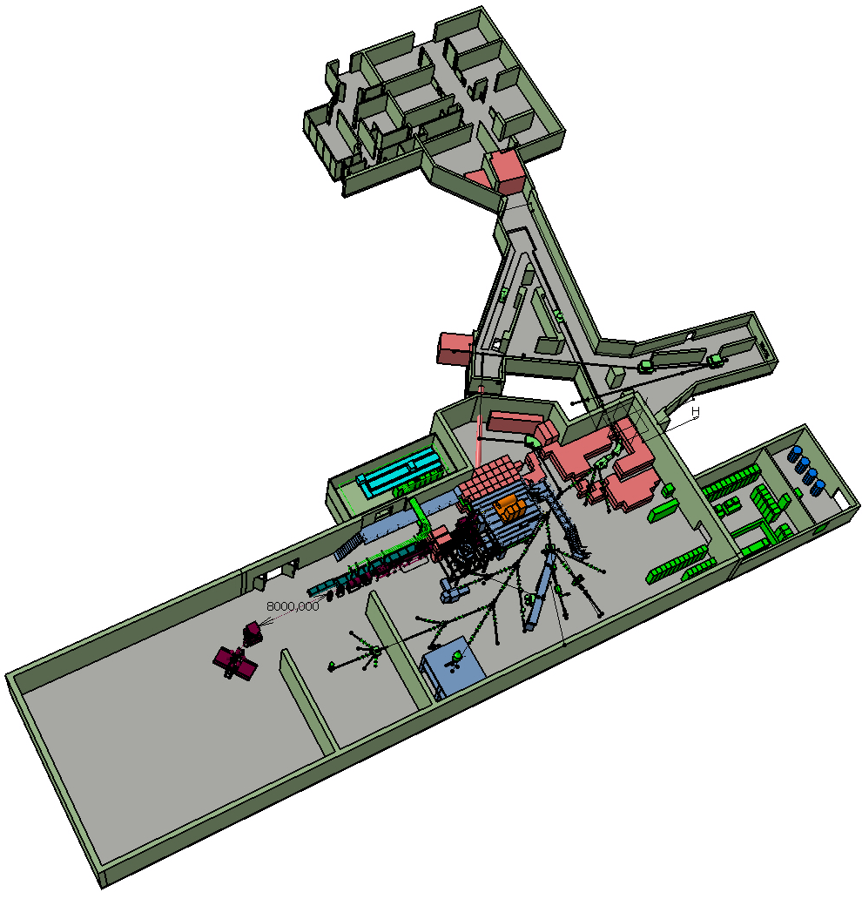
The Scope of the Project
Intensity Upgrade:
Design Study of target Area, Class-A Lab and beam lines
Energy Upgrade:
Construction of SC Linac
& service building
Solid state laser, prototype RFQ cooler for beam purification and quality improvement (complete)
Prototyping of linac cavities (ongoing), energy upgrade up to 5.5 MeV/u
Installation of cryogenic infrastructure
Energy upgrade to 10 MeV/u,
Design study of the intensity upgrade for SPL beams

Slide 5
Project Breakdown Structure Overview
 | Steering Committee |  |  | Safety Coordination
 | 1. Project Management
HIE-ISOLDE Project | HIE-Linac | 2. Linac Systems
 |  | 3. Infrastructure and Integration
 |  | 4. Installation and Commissioning
 | Target Area Design Study | 5. Target Study
 |  | 6. Target Area and Class A Lab
 |  | 7. Injection and Beam Preparation
 |  | 8. Safety | 8.1 Radiation Protection |  | Simulations, shielding, operation, waste…
 |  |  | 8.2 General Safety |  | Risk analysis, safety files…
 |  |  | 8.3 Access |  | Interlocks, control…
 |  |  | 8.4 Fire Detection

Slide 6
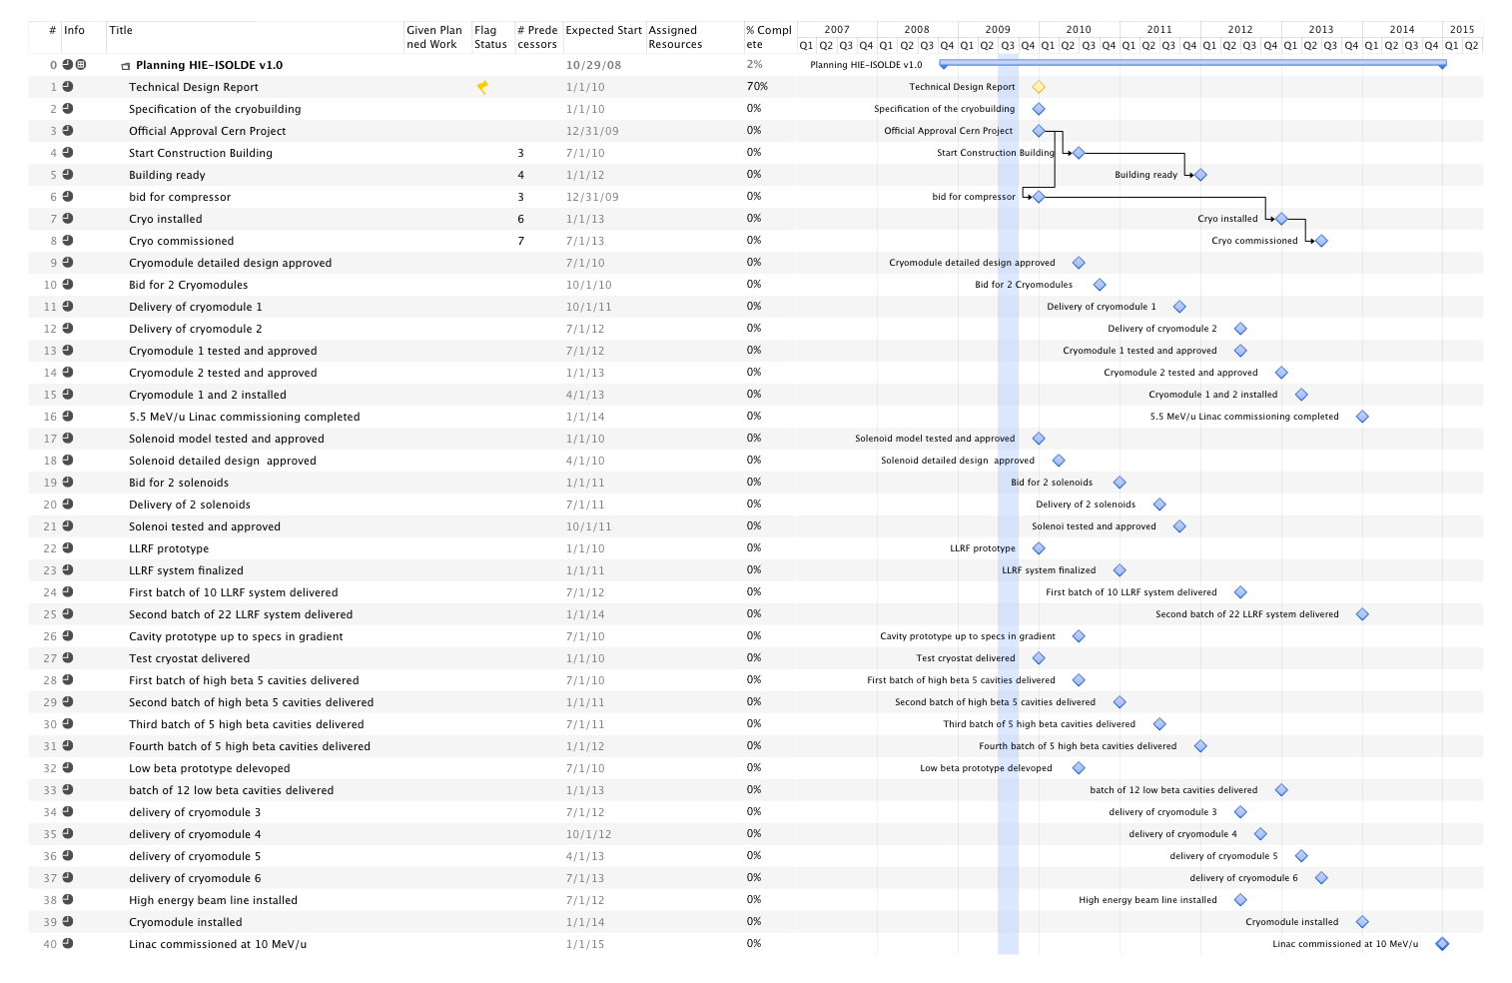
HIE-ISOLDE Schedule
Important milestones for Energy Upgrade:
Start project Jan 1st 2010
Cryogenics building ready Dec 2011
Installation infrastructures completed Dec 2012
Cryogenics installed and commissioned Jun 2013
High energy beam line (5.5 MeV/u) installed by March 2013
Full Linac (10 MeV/u) installed by Jan 2014
Commissioning completed by June 2014 inline with L4 and PSB commissioning (Oct. 2013 to July 2014)

Slide 7
Current Cost Estimate
 | Materials MCHF | staff | Fellows/students
Beam quality improvements | 4
Prototyping, Linac up to 5.5 MeV/u | 8 | 21 | 26
Infrastructure, management and safety | 14 | 30 | 7
Linac up to 10 MeV/u | 8 | 6 | 3
Design study for intensity upgrade | 2 | 14 | 17
The current cost of HIE-ISOLDE 1 is 36 MCHF materials and 124 FTE (71 staff + 53 Fellows/Phd)
This includes the beam quality improvement and part of the linac design study & prototyping costs (5 MCHF including FTE) that have already been spent, and necessary consolidation costs. Of the assured external funding (see below) 5 MCHF remains unspent

Slide 8
Cost and Manpower for Linac
Code | Description |  |  | Total Cost (kCHF) | 2010 | 2011 | 2012 | 2013 | 2014 |  | FTE | 2009 | 2010 | 2011 | 2012 | 2013 | 2014 | 2015
1 | Project Management
1.1 | Project leader |  |  |  |  |  |  |  |  |  | 4.5 |  | 0.9 | 0.9 | 0.9 | 0.9 | 0.9
1.2 | Linac coordination |  |  |  |  |  |  |  |  |  | 2.5 |  | 0.5 | 0.5 | 0.5 | 0.5 | 0.5
1.3 | Design study coordination |  |  |  |  |  |  |  |  |  | 2.0 |  |  | 0.5 | 0.5 | 0.5 | 0.5
1.4 | Budget and planning management |  |  |  |  |  |  |  |  |  | 1 |  | 0.2 | 0.2 | 0.2 | 0.2 | 0.2
2 | Linac system
2.1 | Cavity RF
2.1.1 | Cavity Design |  |  |  |  |  |  |  |  |  | 0.45 |  | 0.25 | 0.2
2.1.2 | LLRF system |  |  | 1930 | 300 | 700 | 500 | 320 | 110 |  | 6 |  | 1 | 1.5 | 1.5 | 1.5 | 0.5
2.1.3 | Power RF system |  |  | 300 | 200 | 100 |  |  |  |  | 1.55 |  | 0.75 | 0.8
2.1.4 | Tuning and interlocks |  |  | 390 | 20 | 145 | 145 | 80 |  |  | 4.4 |  | 1 | 1 | 1 | 1 | 0.2 | 0.2
2.2 | Cavity Manufacturing
2.2.1 | Copper Substrate |  |  | 2350 | 700 | 700 | 700 | 250
2.2.2 | Surface treatment NB Sputttering |  |  | 553 | 200 | 200 | 153 |  |  |  | 8.48 | 0.78 | 2.4 | 3.1 | 1.05 | 0.95 | 0.2
2.2.3 | IS TE/VSC |  |  | 355 | 25 | 110 | 80 | 70 | 70
2.3 | Beam Dynamics |  |  |  |  |  |  |  |  |  | 1.5 |  | 1 | 0.5
2.4 | Cryomodules |  |  | 4600 | 800 | 650 | 2500 | 650 |  |  | 7.75 | 0.6 | 1.9 | 2.95 | 1.5 | 0.7 | 0.1
2.4.1 | Design Office EN/MME |  |  | 413 | 161 | 96 | 116 | 29 | 11
2.5 | Beam Instrumentations |  |  | 1406.5 | 100 | 500 | 500 | 150 | 156.5 |  | 8.04 |  | 1.5 | 1.5 | 1.5 | 1.5 | 1.34 | 0.7
2.6 | SC solenoids
2.6.1 | Solenoid |  |  | 360 | 45 | 90 | 90 | 90 | 45 |  | 0.4 | 0.4
2.6.2 | Current leads |  |  | 240 | 30 | 60 | 60 | 60 | 30
2.6.3 | Power supply |  |  | 56 | 7 | 14 | 14 | 14 | 7
2.7 | Beam transfer line
2.7.1 | Magnets |  |  | 1463 | 146 | 293 | 585 | 439 |  |  | 6.7 |  | 1.3 | 2.1 | 2.3 | 1
2.7.2 | Supports |  |  | 250 |  |  | 250
2.8 | Linac integration |  |  | 80 | 80 |  |  |  |  |  | 1 |  | 0.2 | 0.2 | 0.2 | 0.2 | 0.2
3 | Infrastructure & Integrations
3.1 | Civil engineering |  |  | 1460 | 1000 | 460 |  |  |  |  | 2 |  | 1 | 1
3.2 | Cooling & ventilation |  |  | 3065 | 350 | 2015 | 700 |  |  |  | 2.6 |  | 0.5 | 1.1 | 1
3.3 | Electrical systems |  |  | 734 |  |  | 734
3.4 | Vacuum |  |  | 1400 |  | 500 | 500 | 400
3.5 | Cryogenic system |  |  | 3500 | 350 | 2800 | 350 |  |  |  | 2.8 |  | 0.55 | 0.55 | 0.9 | 0.6 | 0.1 | 0.1
3.6 | Power converters |  |  | 2400 | 50 | 1400 | 950 |  |  |  | 6.0 | 0.1 | 0.7 | 2.7 | 2.5
3.7 | Control system |  |  | 15 |  |  |  | 15 |  |  | 1 |  |  |  |  | 0.5 | 0.5
3.8 | Survey |  |  | 439.44 | 11.6 | 104.16 | 175.68 | 99 | 49 |  | 4.6 |  |  | 1.4 | 1.4 | 1.4 | 0.4
4 | Installations and commissioning
4.1 | Single cavity test |  |  |  |  |  |  |  |  |  | 5 |  | 2 | 2 | 1
4.2 | Cryomodule test |  |  |  |  |  |  |  |  |  | 2 |  |  |  | 1 | 1
4.3 | Linac commissioning |  |  |  |  |  |  |  |  |  | 3 |  |  |  |  |  | 2 | 1
4.3.1 | Control applications |  |  |  |  |  |  |  |  |  | 2 |  |  |  |  |  | 1 | 1
 |  |  | TOTAL | 27761 | 4576 | 10937 | 9103 | 2666 | 479 |  | 87.27 | 1.88 | 17.65 | 24.7 | 18.95 | 12.45 | 8.64 | 3

Slide 9
Design Study Cost and Manpower
Code | Description |  |  |  | Principal Groups Involved | Total (kCHF) | 2010 | 2011 | 2012 | 2013 |  | Total FTE | 2010 | 2011 | 2012 | 2013
5 | Target Study
5.1 | Conceptual target design
5.1.1 | Target Material |  |  |  | EN/STI | 150 | 75 | 75 |  |  |  | 3 | 1.5 | 1.5
5.1.2 | Target Design |  |  |  | EN/STI | 200 | 100 | 100 |  |  |  | 3 | 1.5 | 1.5
5.1.3 | Target handling and storage |  |  |  | EN/HE | 150 | 75 | 75 |  |  |  | 3 | 1.5 | 1.5
5.2 | Front ends |  |  |  | EN/STI
5.2.1 | HV and high current systems |  |  |  |  | 250 | 50 | 75 | 75 | 50 |  | 4.3 | 1.1 | 1.2 | 1 | 1
5.2.2 | Extraction optics |  |  |  |  | 50 |  | 50 |  |  |  | 0.5 | 0.25 | 0.25
5.2.3 | FE design |  |  |  | EN-TE | 200 | 100 | 100 |  |  |  | 3 | 1.5 | 1.5
5.3 | Beam diagnostics |  |  |  | BE/BI |  |  |  |  |  |  | 0.2 | 0.1 | 0.1
6 | Target Area and Class-A lab Integration
6.1 | Layout upgrade |  |  |  | EN/MEF | 120 |  | 120
6.2 | Cooling and Ventilation |  |  |  | EN/CV | 115 | 115 |  |  |  |  | 1 | 1
6.3 | Electrical systems |  |  |  | EN/EL |  |  |  |  |  |  | 0.4 | 0.1 | 0.1 | 0.1 | 0.1
6.4 | Vacuum |  |  |  | TE/VSC | 100 | 50 | 50 |  |  |  | 2 | 1 | 1
6.5 | Survey |  |  |  | BE/ABP |  |  |  |  |  |  | 0.4 | 0.1 | 0.1 | 0.1 | 0.1
6.6 | Civil engineering |  |  |  | GS/SEM | 50 |  | 50 |  |  |  | 0.4 | 0.1 | 0.1 | 0.1 | 0.1
6.7 | LL controls |  |  |  | EN/STI | 100 | 50 | 50 |  |  |  | 2 | 0.25 | 1 | 0.75
7 | Injection and beam preparation
7.1 | Beam line magnets |  |  |  | TE/MSC |  |  |  |  |  |  | 0.1 |  | 0.1
7.2 | Off line separator |  |  |  | EN-STI | 200 | 100 | 100 |  |  |  | 1 | 0.5 | 0.5
7.3 | Separator areas
7.3.1 | HRS magnet |  |  |  | EN/STI | 25 |  | 25 |  |  |  | 1 | 0.5 | 0.5
7.3.2 | RFQ cooler |  |  |  | EN/STI | 50 | 25 | 25 |  |  |  | 1 | 0.5 | 0.5
7.3.3 | Pre Separator |  |  |  | EN/STI | 50 | 25 | 25 |  |  |  | 1 | 0.5 | 0.5
7.4 | Experiment Hall |  |  |  | EN/MEF | 100 | 50 | 50 |  |  |  | 0.2 | 0.1 | 0.1
7.5 | Beam lines |  |  |  | PH/SME | 100 | 50 | 50 |  |  |  | 0.2 | 0.1 | 0.1
8 | Safety
8.1 | Radioprotection
8.1.1 | Linac |  |  |  | SC/RP | 500 |  |  | 250 | 250 |  | 4 | 1 | 1 | 1 | 1
8.1.2 | Design study |  |  |  | SC/RP |  |  |  |  |  |  | 4 | 1 | 1 | 1 | 1
8.2 | Safety |  |  |  | DG/SCR |  |  |  |  |  |  | 4 | 1 | 1 | 1 | 1
8.3 | Access system |  |  |  | GS/ASE | 165 |  |  |  | 165
8.4 | Fire detector |  |  |  | GS/ASE | 40 |  |  | 40
 |  |  |  |  | Total | 2715 | 865 | 1020 | 365 | 465 |  | 39.7 | 15.2 | 15.15 | 5.05 | 4.3

Slide 10
Status of External Funding
Main funds from K.U. Leuven – Belgium (4.3 MCHF + 4 FTE, 1 MCHF + 2 FTE already spent on R&D activity)
Additional funds provided by ISOLDE coll. (2.0 MCHF)
Other beam quality investments (new RILIS, RFQ cooler,…) – funded by Sweden, UK (4 MCHF already spent)
Other opportunities (Scandinavian Interregional Package, KoRIA Project) being explored.
Special Technical Training Program (2 FTE funded by Spain)
Marie-Curie Fellowships within ITN3 (Fall 2010 / 2011 ) – request for 23 fellows for 3 years = 69 FTE’s (deadline Dec. 22, 2009)

Slide 11
Research Training Themes Addressed by this ITN Proposal
HIE-ISOLDE Subsystem | Research Training Theme | No. ESR | No. ER
I. Linac | 1. Super-conducting Cavity RF (LLRF system) | 1 | -
 | 2. Super-conducting Cavity manufacturing | 1 | -
 | 3. Beam Instrumentation | 1 | 1
 | 4. Transfer Line magnets | 1 | -
 | 5. Linac Integration | 1 | -
 | 6. Linac Alignment | 1 | -
 | 7. Single Cavity and complete Cryomodule tests | 1 | -
 | 8. Linac commissioning and control applications development | 1 | -
II. Design Study for intensity upgrade | 9. Target Material Development | 1 | -
 | 10. Target design | 2 | -
 | 11. High voltage and high current systems | 1 | -
 | 12. Extraction optics and front-end design | 1 | -
 | 13. Cooling and ventilation | 1 | -
 | 14. Vacuum systems | 1 | -
 | 15. Low-Level controls | 1 | -
 | 16. Off-line separator and HRS magnet | 1 | -
 | 17. RFQ cooler and Pre-separator | 1 | -
 | 18. Beam lines (REX-EBIS studies) | 1 | -
III. Safety | 19. Radiation protection systems for the Linac. | - | 1
 | 20. Radiation protection studies for the Intensity Upgrade | 1 | -
Y. Kadi HIE-ISOLDE Proposal, IEFC, August 21, 2009

Slide 12
R&D activity on HIE-LINAC
RF – Beam dynamics studies
High β cavity prototype
Copper substrate manufacturing
Chemical etching
Nb sputtering
RF sub-system prototypes
Tuner
Power coupler
SC solenoid prototype
Cryomodule design
In parallel preparation of a test stand for QWR at CERN
Y. Kadi HIE-ISOLDE Proposal, IEFC, August 21, 2009

Slide 13
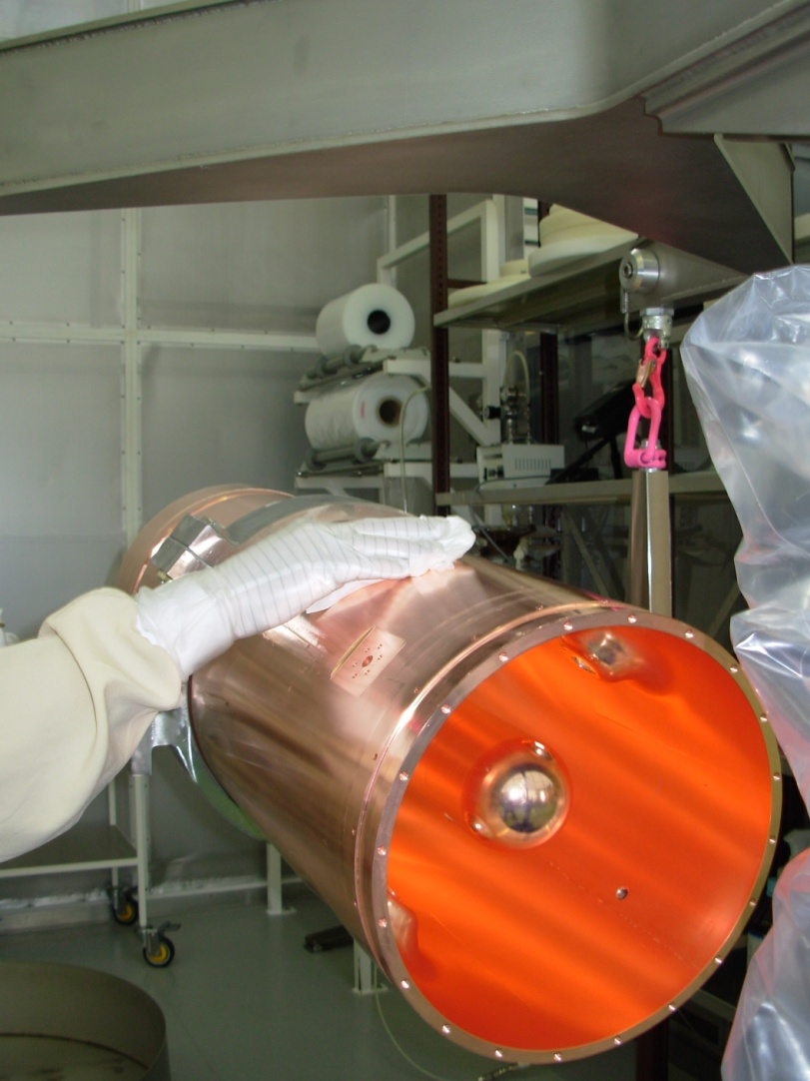
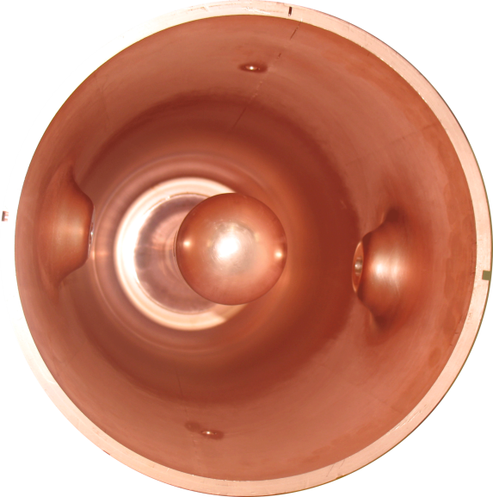
High –beta cavity final welding and cleaning
THPPO010
M. Pasini SRF09 Berlin, 20-25.09 2009
Notes:
Cavity has been sputtered successfully with the magnetron technique (new technique for this kind of cavity geometry)
All the cavity ancillaries are have been designed and are now in fabrication

Slide 14
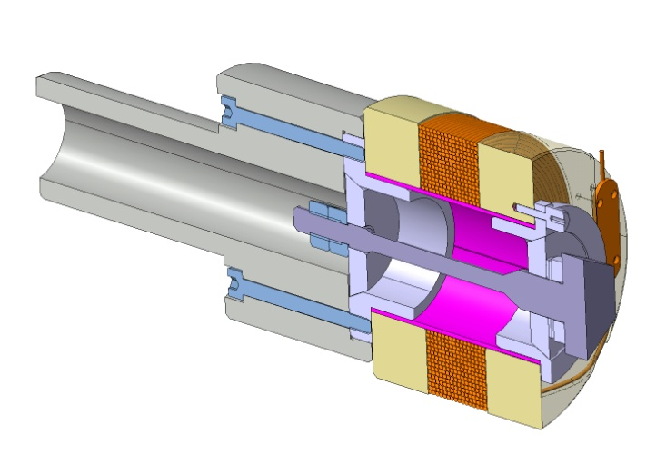
SC solenoid prototype (Nb3-Sn technology)
Magnetic length | 0.16 | m
∫ B² dz | >16.2 | T²m
Max mechanical length | <0.4 | m
Operating temperature | 4.5 | K
Inner Diameter | 30 | mm
Mechanical drawings for the model are completed
M. Pasini SRF09 Berlin, 20-25.09 2009
Notes:
Model of the SC solenoid has been constructed test will happen beginning of next year.

Slide 15
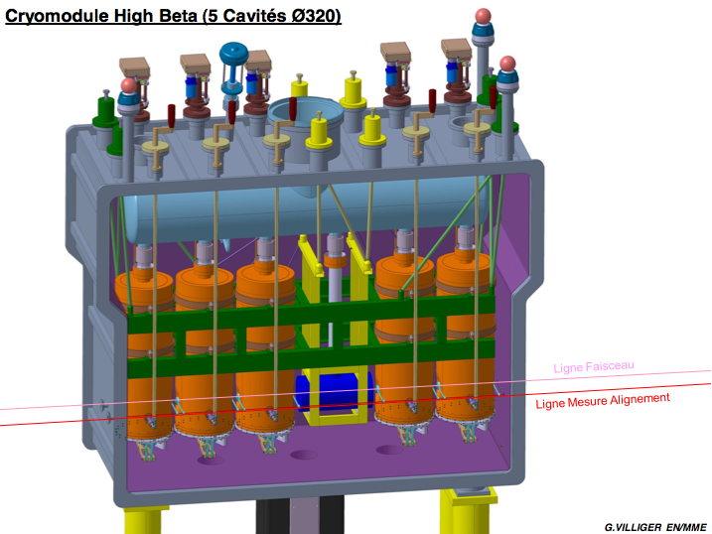
Cryomodule design
Features:
Single vacuum cryostat
Side loading of the cold masses
Independent alignment of the cavities w.r.t. solenoid
Heat shield cooled by He cold gas
M. Pasini SRF09 Berlin, 20-25.09 2009
Notes:
Conceptual design of the cryomodule completed, need to start detailed design

Slide 16
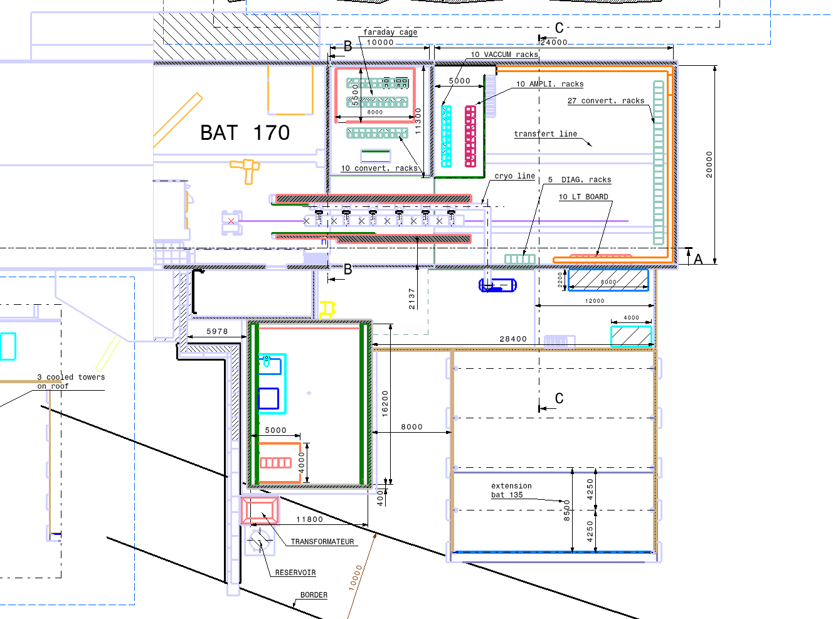
The HIE-ISOLDE facility
M. Pasini SRF09 Berlin, 20-25.09 2009
Notes:
Civil engineering study in advanced status. Will be ready to detailed design at the beginning of next year. Construction is expected to last 18 months and will start depending on cash flow available from cern.

Slide 17
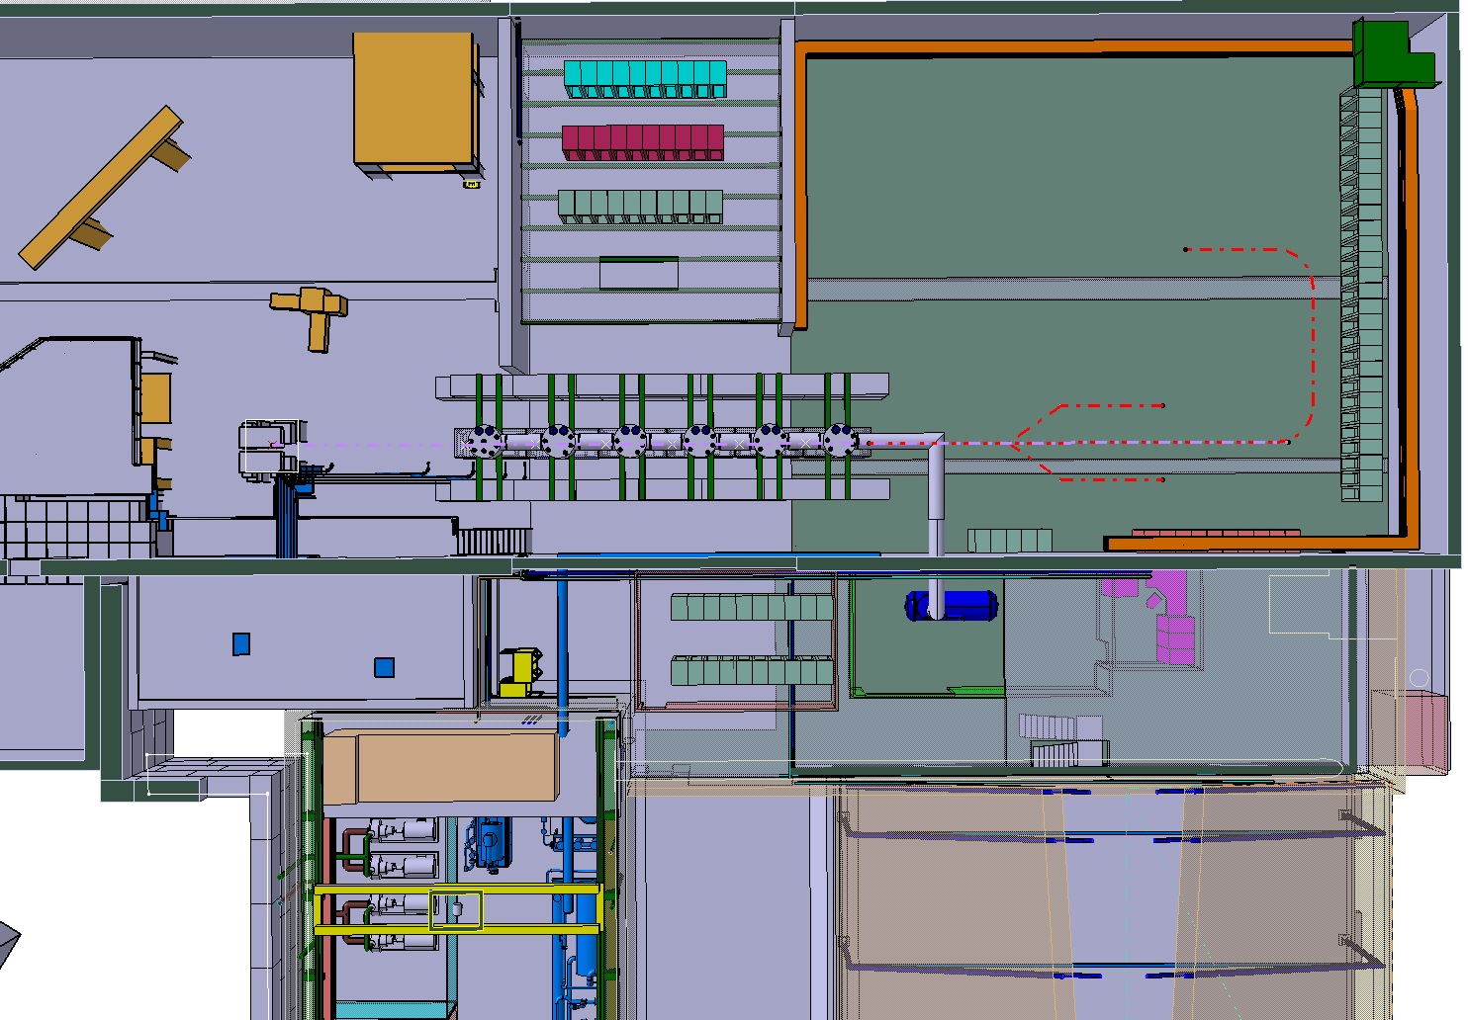
Zone au rez de chaussé libre
Cage de faraday

Slide 18
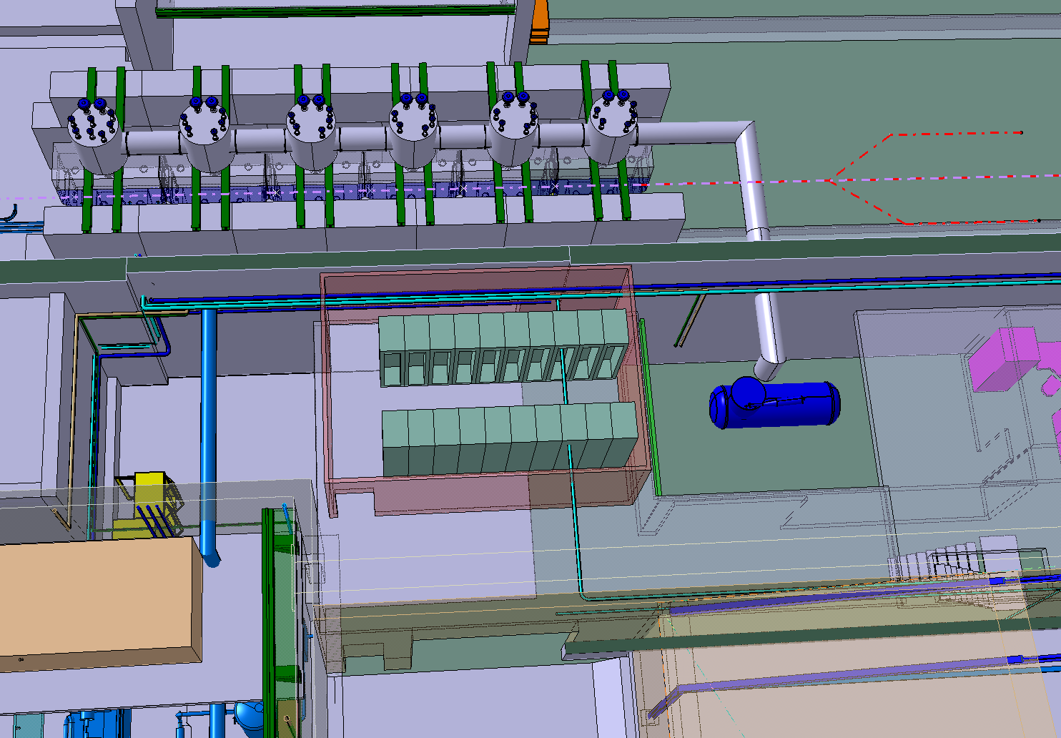

Slide 19
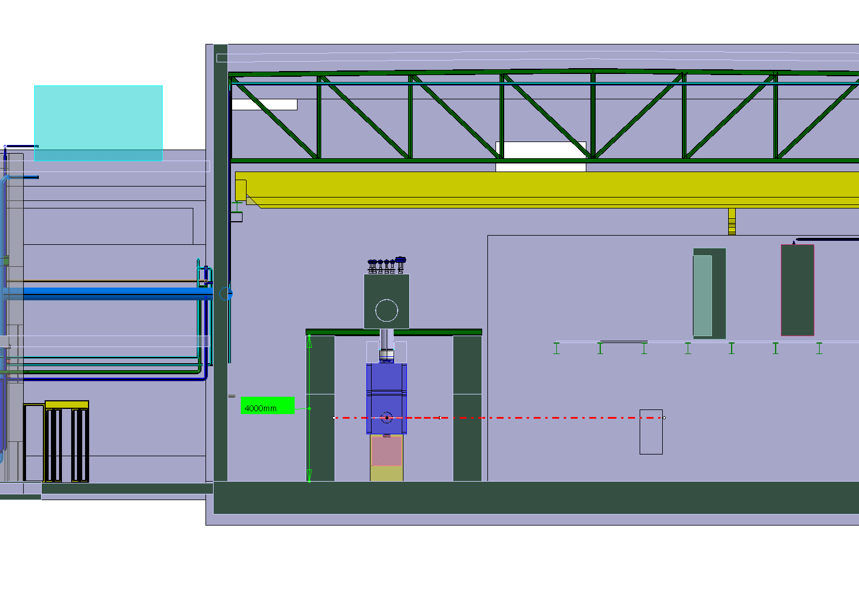

Slide 20
Summary (1/2)
HIE ISOLDE R&D activity is in good health and ongoing:
Cavity prototype completed. Tests to be done @ TRIUMF before the end of the year
Cryomodule concept design completed, will start detailed design as soon as manpower is available
Preparation of test bench at CERN of QWR resonators (new test cryostat is planned to be ready by Feb/Mar 2010)
Complete Cavity configuration test is planned by the end of 2010.
M. Pasini SRF09 Berlin, 20-25.09 2009

Slide 21
Summary (2/2)
Fellow for RF Cavity Tests => launch fabrication of 5 series cavities (50% paid by SPL)
Fellow for Cryomodule detailed design due by mid-2010
Fellow for radiation protection => validate layout
Prepare Resource-loaded Plan for CERN Management => release resources as early as possible (mid-2010/2011)
If construction starts by mid-2010, then installation and commissioning of the first 2 cryo-modules for 2013
M. Pasini SRF09 Berlin, 20-25.09 2009

Slide 22
Acknowledgements
The coordination team would like to express their sincere gratitude to all those who have contributed to this project plan.

Slide 23
Material Cost Spending Profile
Linac + Infrastructure 28.97 MCHF
Fell/Ass 3.72 MCHF
PhD/TS 0.20 MCHF

Slide 24
Manpower Requirements (FTE)
Staff:
Management 14.5 FTE
HIE-Linac 40.2 FTE
Safety 3 FTE
Material spending per FTE/year: 100kCHF

Slide 25
Material Cost Spending Profile
Design Study 2.03 MCHF
Fell/Ass 2.04 MCHF
PhD/TS 0.10 MCHF

Slide 26
Manpower Requirements
Staff:
Design Study 7.5 FTE
Safety 2 FTE

Slide 27
INTERREG_IV_A Proposal (Norway)
A University Cluster and Regional Industry Collaboration in High‐Tech Accelerator Development for Subatomic Physics and Neutron Scattering
The aim is to provide the opportunity for local companies to take part in an ongoing accelerator development project to enhance the long term capability and competence of these companies to participate in the continuous maintenance and development of the ESS proton driver and associated equipment. The project falls under eligibility criteria A of interregional program IV of the European Union. It aims to support sustainable economic development in the region by developing local enterprise with the regional profile provided by ESS.
Participating universities in the region include Lund University, Aarhus University, Chalmers University of Technology and Oslo University. Contacts have also been initiated with local companies such as Danfysik. The groups at these participating universities have long standing knowledge of accelerator based research and are currently participating in a development project for a new accelerator for radioactive ion beams at CERN.
The aim of the collaboration is to perform prototyping and development work within the following areas or a subset thereof:
‐ Design and prototyping of normal conducting magnets
‐ Copper cavity machining and electron beam welding for superconducting cavity construction
‐ Design and manufacturing of liquid helium based cryogenic transfer lines
‐ Yoke sub‐assembly of super conducting magnets
‐ Design and construction of RF cryostat
‐ Clean room assembly of RF ancillaries
The gain for the participating university groups is also the establishment of a close collaboration in the field of subatomic physics within the region that will be
maintained over at least the coming 20 years and this in collaboration with local industry.

Slide 28
HIE-LINAC WBS
2.0 Linac system |  |  |  | Groups
 | 2.1 Cavity RF |  |  | BE/RF
 |  | 2.1.1 Cavity Design
 |  | 2.1.2 LLRF system
 |  | 2.1.3 Power RF system
 |  | 2.1.4 Tuning and interlocks
 | 2.2 Cavity Manufacturing |  |  | EN/MME-TE/VSC
 |  | 2.2.1 Copper Substrate
 |  | 2.2.2 Surface treatment Nb Sputtering
 | 2.3 Beam Dynamics |  |  | BE/RF-ABP
 | 2.4 Cryomodules |  |  | TE/MSC-EN/MME
 | 2.5 Beam Instrumentation |  |  | BE/BI
 | 2.6 SC solenoids |  |  | TE/MSC
 |  | 2.6.1 Solenoid
 |  | 2.6.2 Current leads
 |  | 2.6.2 Power supply
 | 2.7 Beam transfer line |  |  | TE/MSC
 |  | 2.7.1 Magnets
 |  | 2.7.2 Supports
 | 2.8 Linac integration |  |  | EN/MEF
3.0 Infrastructure
 | 3.1 Civil engineering |  |  | GS/SEM
 | 3.2 Cooling & ventilation |  |  | EN/CV
 | 3.3 Electrical systems |  |  | EN/EL
 | 3.4 Vacuum |  |  | TE/VSC
 | 3.5 Cryogenic system |  |  | TE/CRG
 | 3.6 Power converters |  |  | TE/EPC
 | 3.7 Control system |  |  | BE/CO
 | 3.8 Survey |  |  | BE/ABP
4.0 Installations and commissioning
 | 4.1 Single cavity test |  |  | BE/RF
 | 4.2 Cryomodule test |  |  | BE/RF-TE/MSC
 | 4.3 Linac commissioning |  |  | BE/RF
 |  | 4.3.1 Control applications |  | BE/OP

Slide 29
Target Area Design Study WBS
5.0 Target Study |  |  |  | GROUPS
 | 5.1 Conceptual target design |  |  | EN/STI-HE
 |  | 5.1.1 Target Material
 |  | 5.1.2 Target Design
 |  | 5.1.3 Target handling and storage
 | 5.2 Front ends |  |  | EN/STI-TE/EPC/VSC/ABT
 |  | 5.2.1 HV and high current systems
 |  | 5.2.2 Extraction optics
 |  | 5.2.3 FE design
 | 5.3 Beam diagnostics |  |  | BE/BI
6.0 Target Area and Class-A lab Integration
 | 6.1 Layout upgrade |  |  | EN/MEF
 | 6.2 Cooling and Ventilation |  |  | EN/CV
 | 6.3 Electrical systems |  |  | EN/EL
 | 6.4 Vacuum |  |  | TE/VSC
 | 6.5 Survey |  |  | BE/ABP
 | 6.6 Civil engineering |  |  | GS/SEM
 | 6.7 LL controls |  |  | EN/STI
7.0 Injection and beam preparation
 | 7.1 Beam line magnets |  |  | TE/MSC
 | 7.2 Off line separator |  |  | EN/STI-TE/EPC/VSC/ABT
 | 7.3 Separator areas
 |  | 7.3.1 HRS magnet |  | EN/STI-TE/MSC
 |  | 7.3.2. RFQ cooler |  | EN/STI-TE/EPC/VSC/ABT
 |  | 7.3.3 Pre Separator |  | EN/STI-TE/EPC/VSC/ABT
 | 7.4 Experiment Hall |  |  | EN/MEF
 | 7.5 Beam lines |  |  | PH/SME

Slide 30
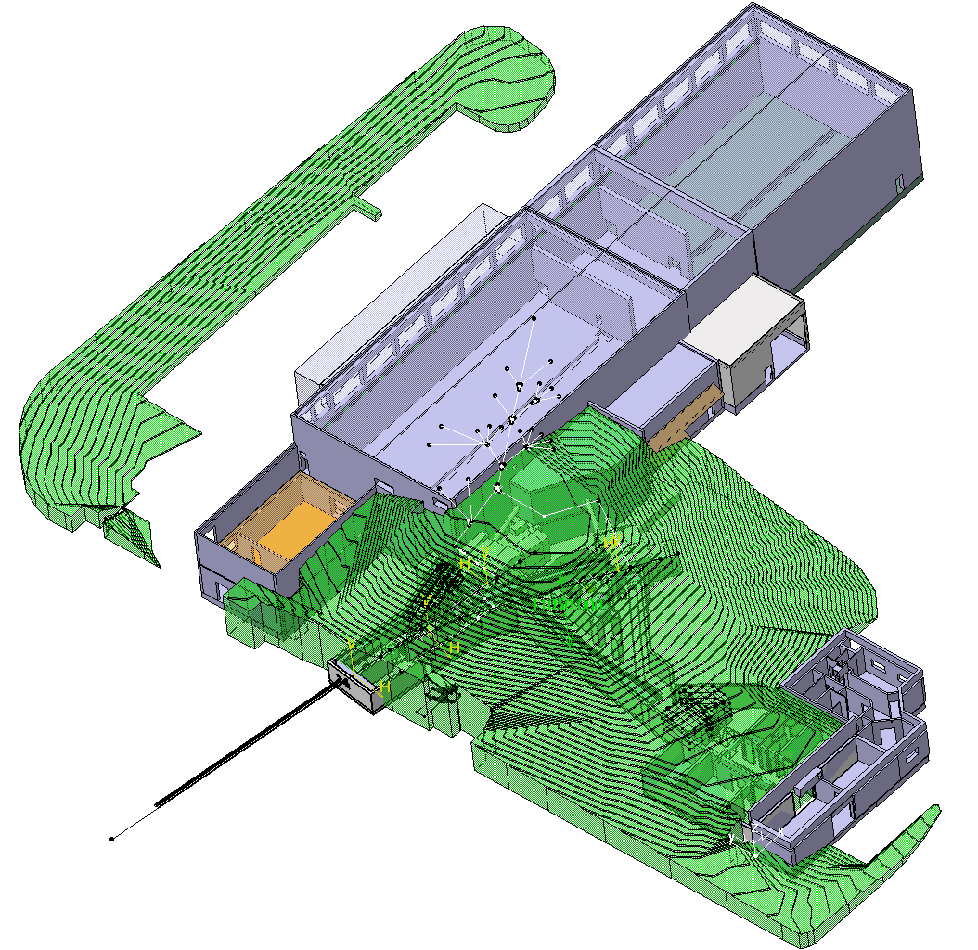
Safety
All safety aspects of the project should be addressed by an independent safety commission who should evaluate and approve the proposed modifications to the facility. However the following tasks should be a part of the safety work package.
Radiation Protection
Fluka simulations, shielding calculations
Radioactive waste inventory and conditioning, transport, elimination pathway.
Operational boundary conditions
Safety
Risk analysis, safety files, safety management plan, general safety
Access
Interlocks, protocol, primary and secondary areas.
Fire detection

