Slide 1
CERN’s MidTermPlan and the consequences for HIE-ISOLDE
Yacine Kadi on behalf of the HIE-ISOLDE project team
ISCC, 4 November 2010

Slide 2
Outline
Project Status
M&P Budgets
New Planning
Summary

Slide 3
Project Status
New website in place http://hie-isolde.web.cern.ch
Project included in MTP 2010 – Approved by Council -> Sep. 2010
Planning shift
Revised budget/resources
CATHI being signed
Start Nov.1 2010
Fellows by Jan. 2011
Submission of Spanish Grant proposal
3 projects within “Industry for Science” => 350 k€, 6FTE
MiCINN project => 998 k€, 1FTE
New Cavity RF tests taking place @ SM18
2nd prototype cavity (slightly modified) in fabrication
New layout of the facility

Slide 4
Material Budget
Total remaining material budget of 35.3 MCHF shared between(2010 – 2016):
External funding
LINAC (17.7 MCHF)
CERN budget
Infrastructure (14.7 MCHF)
Design studies for intensity upgrade (2.1 MCHF)
Safety (0.8 MCHF)

Slide 5
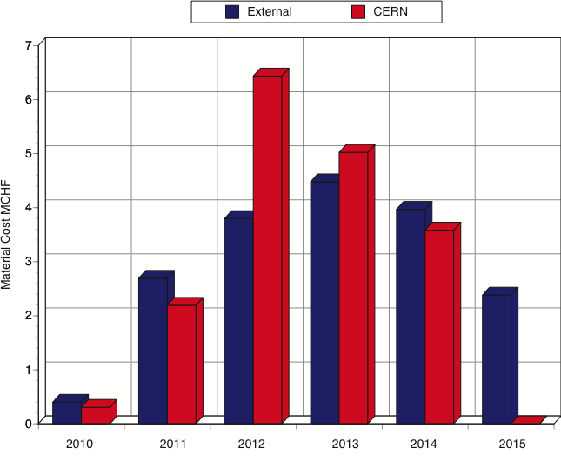
Material Budget

Slide 6
Personnel budget
CERN Staff
Resources defined by group leaders (105 FTE over 5 years)
Fellows (70 FTE)
5 FTE paid on departmental budget
9 FTE paid by Isolde Collaboration
56 FTE paid by ITN3 Marie Curie Contract (20 fellows)

Slide 7
Fellows paid on T131910
Mathew FRASER (PhD, BE/RF) : 3917 CHF/month (100%) -> beam dynamics
Francesca ZOCCA (fellow, BE/BI): 2000 CHF/month on top of Spanish salary (100%)-> beam instrumentation
Mathieu THERASSE (fellow, BE/RF): 9000 CHF/month (50% in 2010) - SC cavity RF
Yuriy ROMANETS (UPAS from ITN Lisbon, EN/STI): 4128 CHF/month (100%) -> radioprotection (from July)
Yann LECLERQ (fellow, TE/MSC): 9000 CHF/month from August 2010 (100%) -> cryomodule design

Slide 8
CATHI Open Positions
ESR2: Cavity and Cryomodule tests
ESR4: New Magnet
ESR5: Development and participation to the integration studies
ESR6: Development and participation to the control, alignment and positioning metrology
ESR8: Target material studies
ESR13:Cooling and Ventilation Design Study
ESR14:Design study of the vacuum system for the Front End of the Isolde facility
ER3: Design study of a replacement charge breeder for REXEBIS

Slide 9
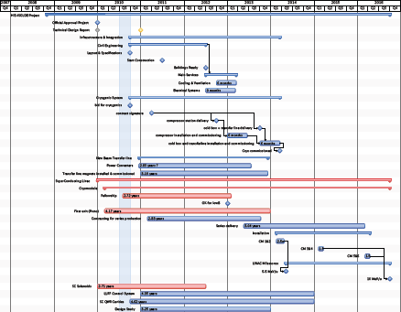
HIE-ISOLDE Schedule
PSB SHUTDOWN
Physics @ 5.5 A MeV
Physics @ 10 A MeV

Slide 10
Summary
SC Cavity prototype cold tests @ SM18
New SC cavity with modified design for sputtering tests
Cryostat design well underway
Radiation protection calculations ongoing
Tendering —> Civil Engineering (Mar. 2011 FC) Cryogenics (Mar. 2011 FC)

