Slide 1
HIE-ISOLDE contribution packages
M. Pasini BE/RF

Slide 2
HIE-ISOLDE Schedule
PSB SHUTDOWN
Physics @ 5.5 A MeV
5.5 MeV/u Linac commissioned
10 MeV/u Linac commissioned

Slide 3
Cu substrate Cavity Package
Description: high precision 3D copper machining.
Cost:33kCHF/unit
Quantity: 10 to 22
Technical Specs: Available
Timing: ASAP
Nature: in-kind and funding, industrial involvement
Manpower: 0.1 FTE for quality control

Slide 4
RF Special Components Package
Description: the package consists in the realization of the high precision tuning system with relative mechanical driving system and high power coupler system.
Cost:46 kCHF/unit
Quantity: 10 to 22
Technical Specs: Available
Timing: ASAP
Nature: in-kind and funding
Manpower: 0.3 FTE for Quality control and assembly

Slide 5
Cryomodule Package
Description: the cavity package consists in the realization of the vacuum vessel which will house the SC cavities and solenoid.
Cost:600 kCHF/unit
Quantity: 2 to 4
Technical Specs: available at the end of 2010
Timing: starting mid 2013
Nature: in-kind and funding
Manpower: 1FTE specialized technician able to work in the cleaning room

Slide 6
Beam Diagnostics Short Box Package
Description: the beam diagnostics short box package consists in the realization of a ultra compact highly engineered chamber filled with new generation of precision measurement devices for the SC linac, namely beam position, profile and intensity.
Cost:46 kCHF
Quantity: 6
Technical Specs: available at the end of 2011
Timing: first installation foreseen by end 2013
Nature: in-kind and funding
Manpower: 0.3 FTE specialized technician + 0.3 FTE application engineer

Slide 7
Emittance meter Package
Description: this package consists in the realization of a new generation of high sensitivity emittance meter for ultra low intensity radioactive beam intensity
Cost:70 kCHF
Quantity: 1
Technical Specs: Available at the end of 2011
Timing: installation foreseen by end of 2013
Nature: in-kind and funding
Manpower: 1 FTE engineer

Slide 8
Beam Energy Measurement Package
Description: this package consists in the realization of silicon/diamond detectors that will be used to measure the beam energy and energy profile and will allow the tuning if the SC cavities
Cost:50 kCHF
Quantity: 1
Technical Specs: available at the end of 2010
Timing: ASAP
Nature: in-kind and funding
Manpower: 0.5 FTE physicist

Slide 9
Beam lines Package
Description: Fully equipped high energy beam transfer line for different experiments
Cost:~700kCHF/line
Quantity: 3
Technical Specs: Available by end of 2010
Timing: first beam line to be installed by end of 2012
Nature: in-kind and funding
Manpower: 1 FTE installation and alignment

Slide 11
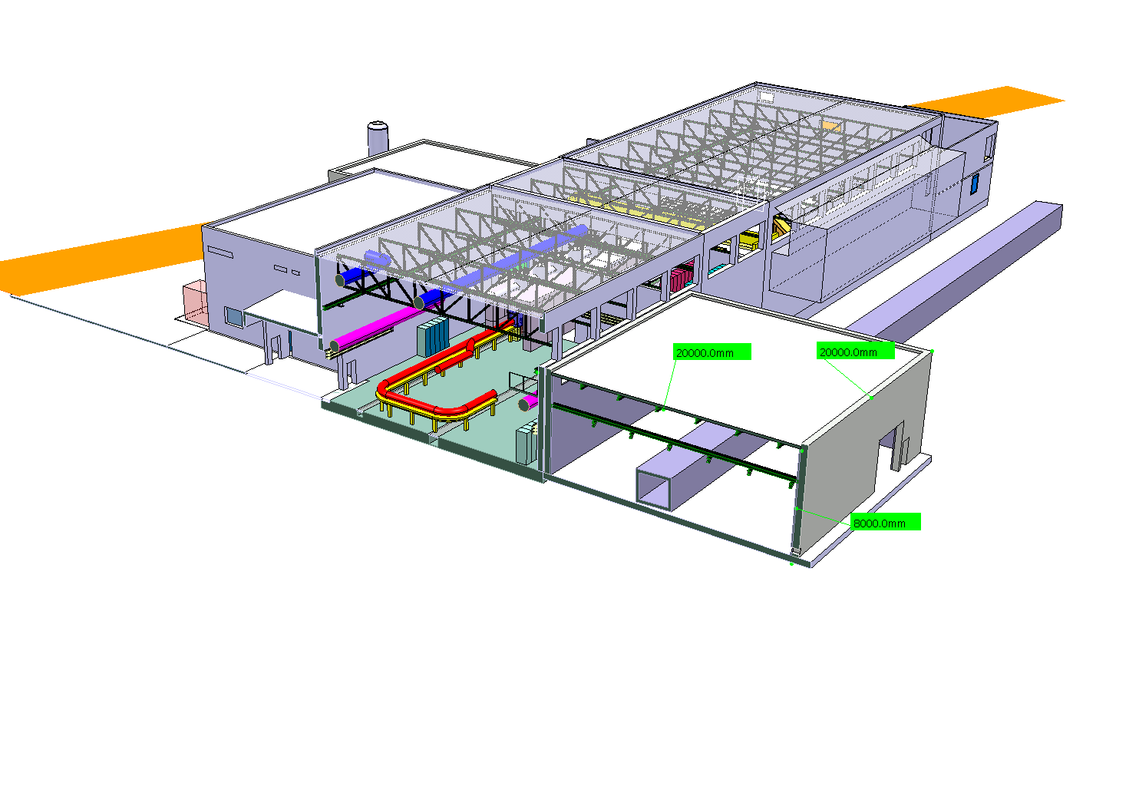
Possible extension for HIE-ISOLDE (Jura side)

Slide 12
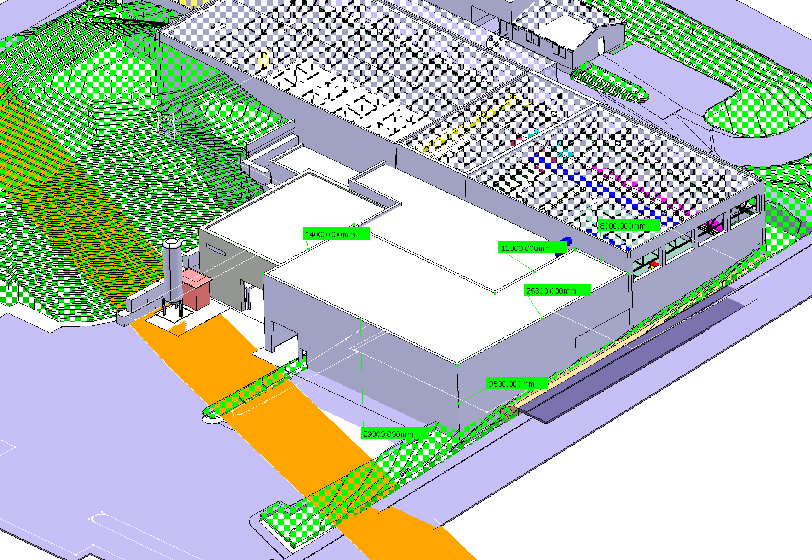
Possible extension for HIE-ISOLDE (Geneva side without labs)

Slide 13
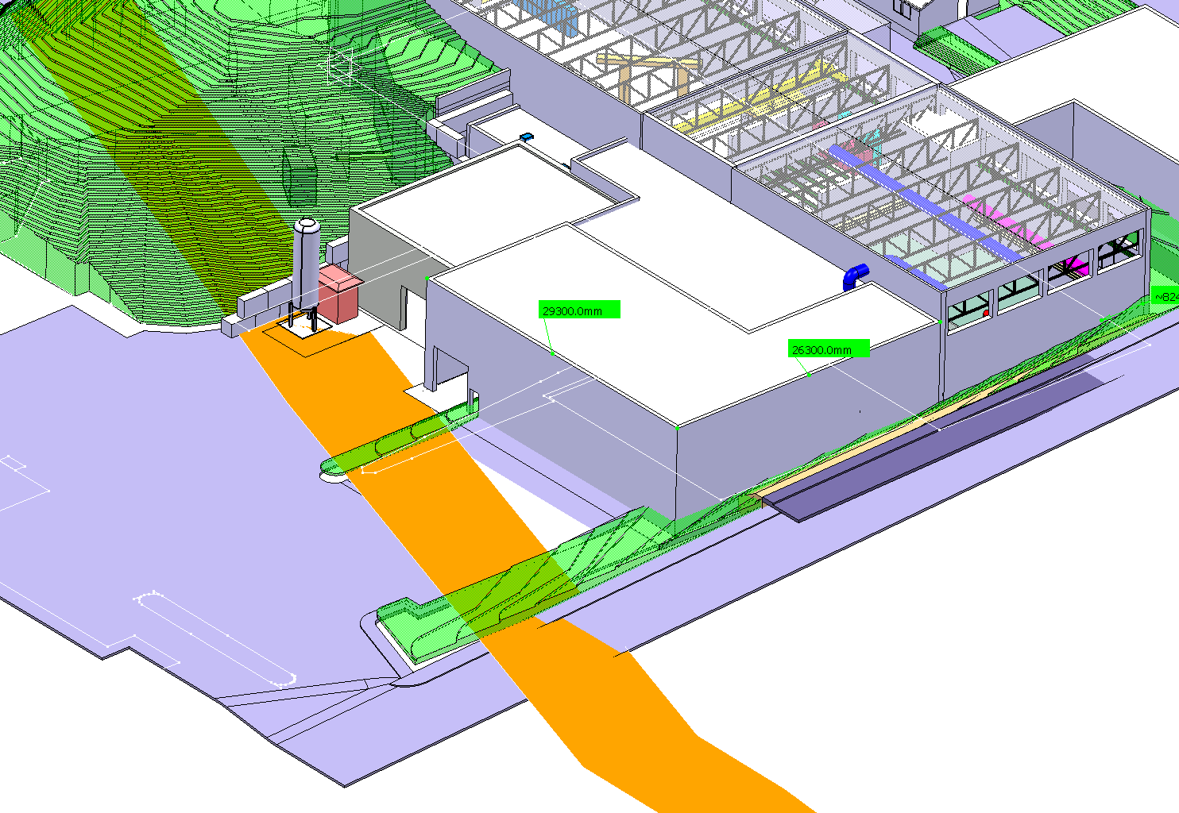
Possible extension for HIE-ISOLDE (Geneva side including labs)

