Slide 1
New procedures 2013: registration access
.
Magdalena Kowalska

Slide 2
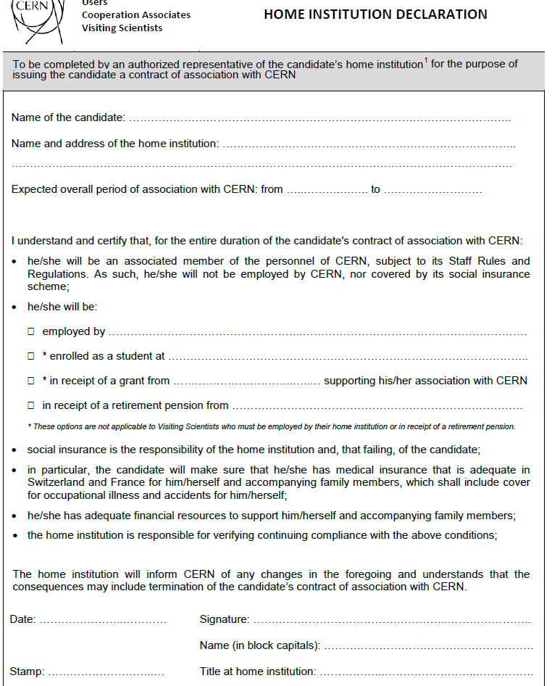
Registration
User registration form, as before
New: 1st registration for up to 3 years and prolongation – 5 years (before: 2 and 3)
New: Home Institution Declaration -> problems with getting the signatures
Team leader and deputy cannot sign
To be signed by administration (HR team) or management (Department/Institute Head or Director)
In principle: Home Institution is only an Institute that signed a MoU with ISOLDE

Slide 3
Dosimeters
At the moment– as before: temporary dosimeter once/year and permanent dosimeter (with medical certificate and RP course)
Soon (coming weeks): new requests and when RP course expired:
30-min online course
No medical certificate needed
(permanent dosimeter)
From 2014 start-up (possible ISOLDE change from supervised to controlled area): under discussion

Slide 4
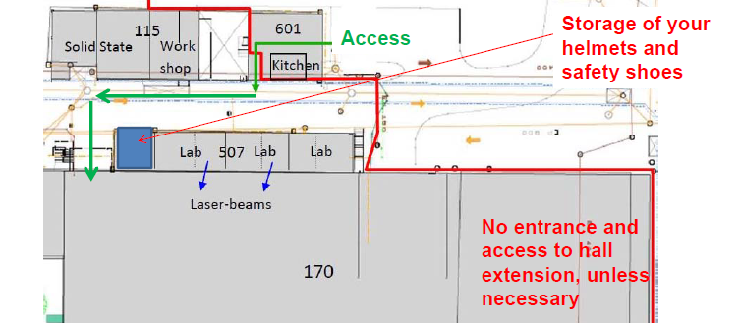
ISOLDE access
From March 1, during LS1:
Helmets and safety shoes required – provided by experiments
Access via kitchen
Avoid hall extension

