Slide 1
HIE-ISOLDE
2013 HIE ISOLDE work in the ISOLDE hall
Implications for the Users
66th Isolde Collaboration Committee
CERN, 29 Jan 2013
Erwin Siesling on behalf of the HIE integration team

Slide 2
Outline
Hie-Isolde – 2013: work in the hall 170
Hall 170 preparations
Cooling & Ventilation
Civil engineering & shielding tunnel
Metal structures
Survey work
Cable trays & cabling, power distribution
Infrastructure tunnel & HEBT
Safety systems

Slide 3
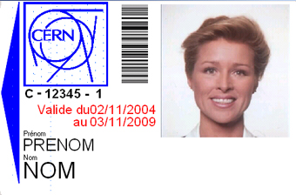
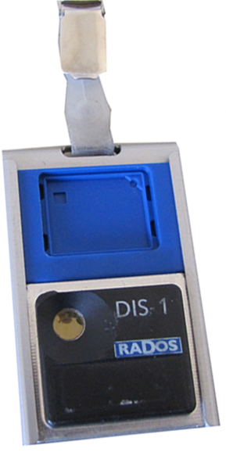
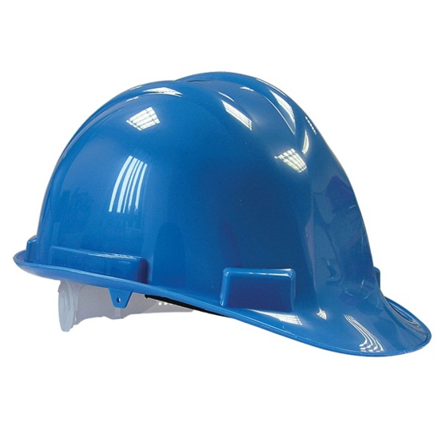
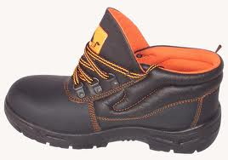
Safety first
For all users and staff entering the ISOLDE hall
+
+
Safety shoes & helmet mandatory for LS1 (and after?)

Slide 4
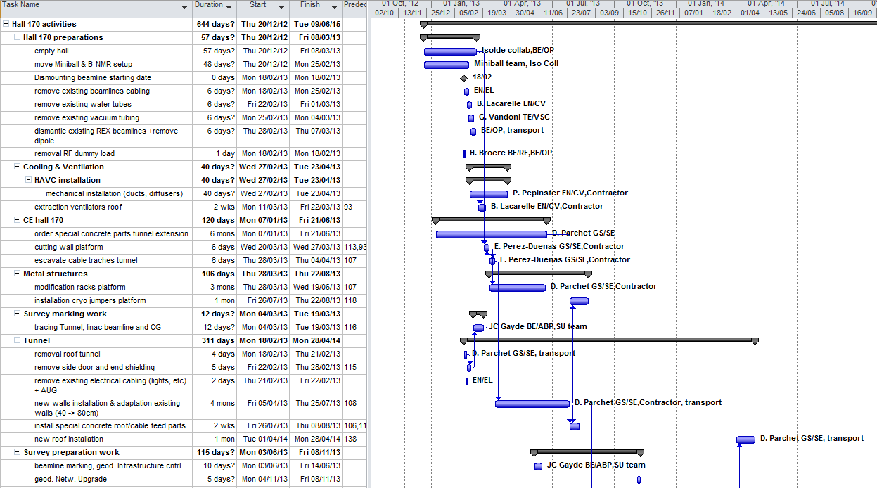
2013 Co-Activities Hall 170
EDMS: Projects – Accelerators - Hie-Isolde – Infrastructure & Integration - Planning
https://edms.cern.ch/nav/P:CERN-0000072786:V0/P:CERN-0000090679:V0/TAB3

Slide 5
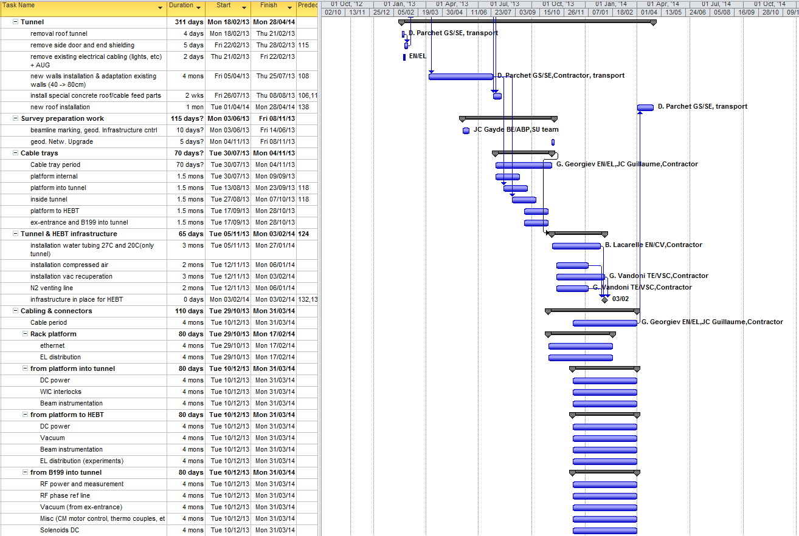
2013 Co-Activities Hall 170

Slide 6
2013 Co-Activities Hall 170
Safety systems
Ana-Paula Bernardes EN/STI: All HIE Isolde relate safety issues

Slide 7
Preparations – until March
Emptying the extension & work zones
Water cut as of 15 Feb – dismantling existing water station B197
Electrical installation activities - transformers
Dismounting existing REX beamlines
Implications for the users:
Clearing the areas: storage and removal (M. Kowalska, M, Pfutzner, J. Thiboud & users)
No cooling water available till end Summer 2013
No power-cuts foreseen (if - then info in time)
High activity around the REX lines as of 15 Feb

Slide 8
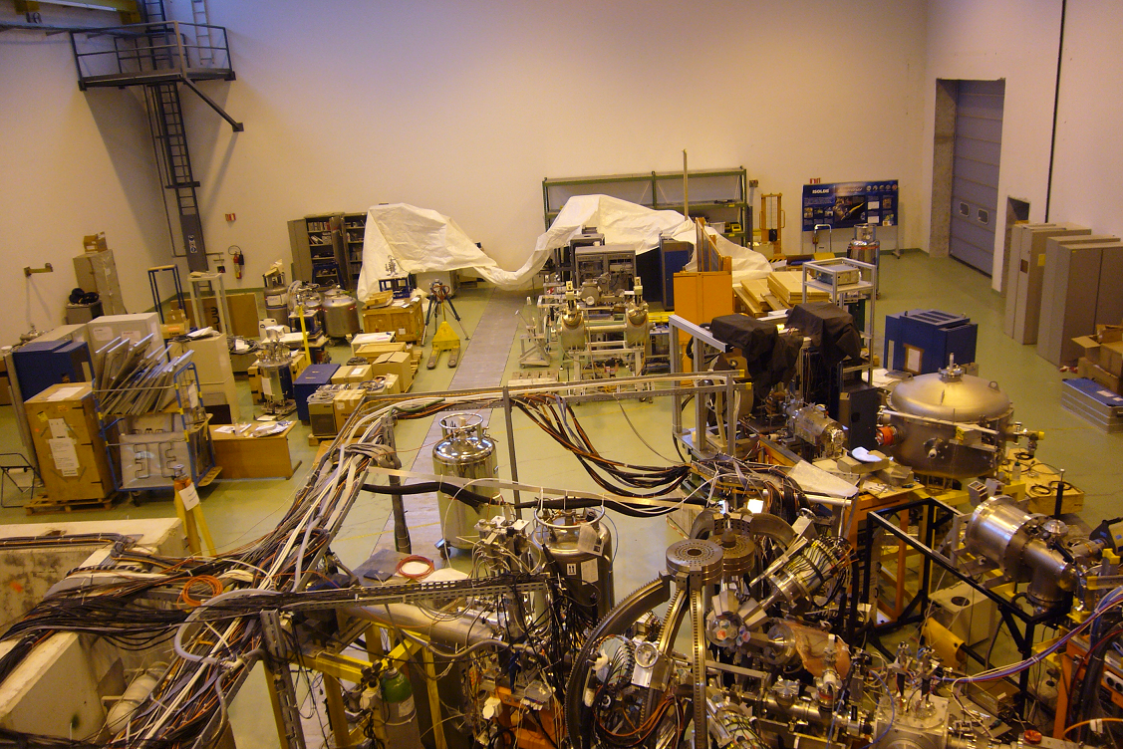
Emptying the hall
Extension to be empty by March 2013

Slide 9
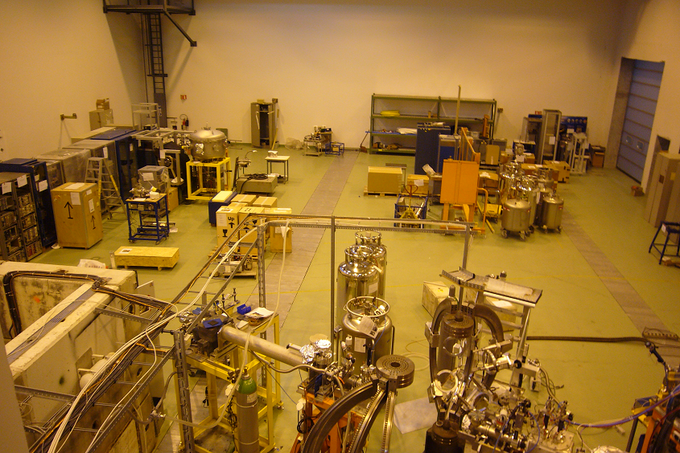
Emptying the hall
Situation today: Many thanks to all !

Slide 10
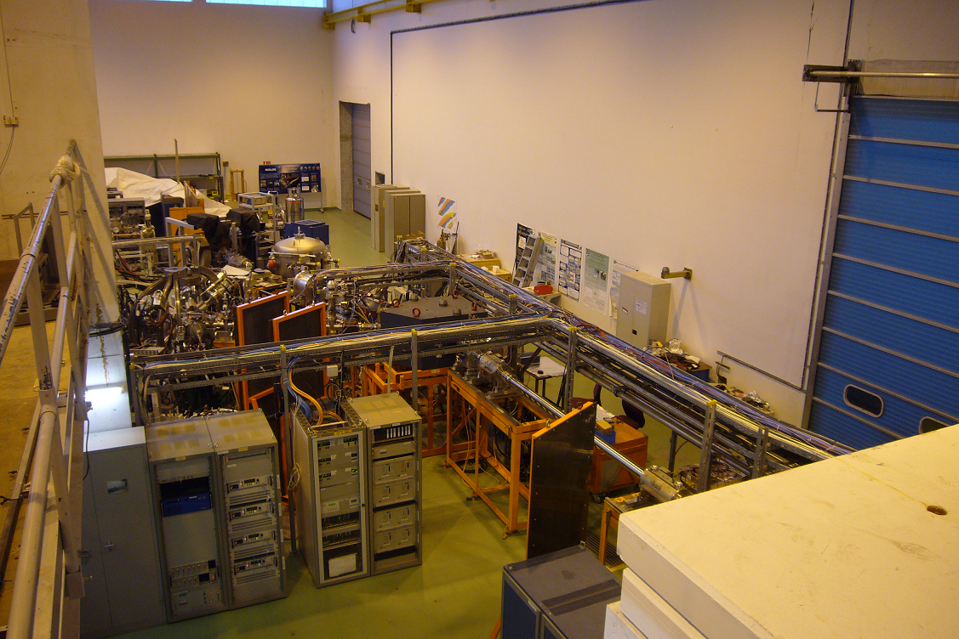
Dismounting REX lines
Dismounting existing REX lines as of 16 Feb

Slide 11
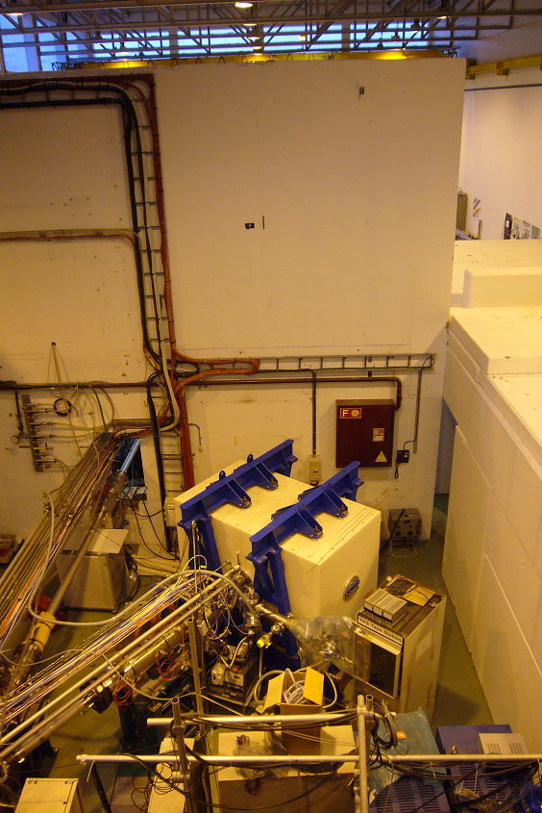
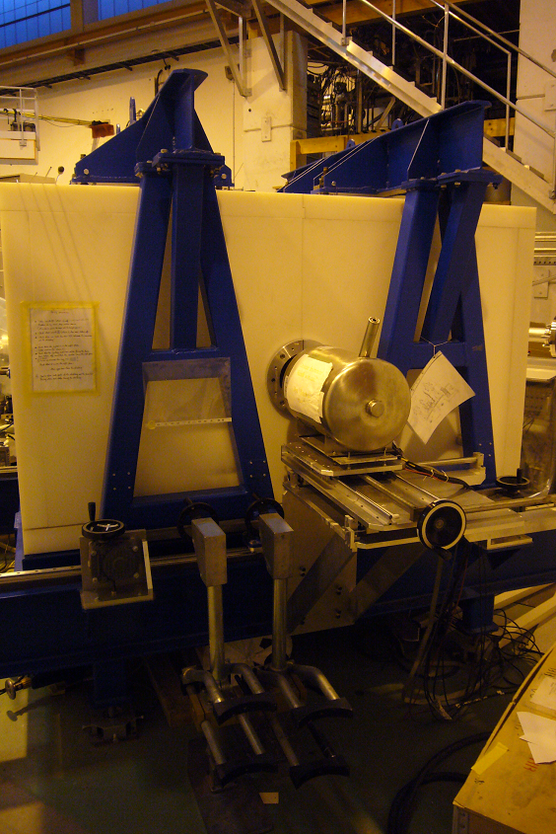
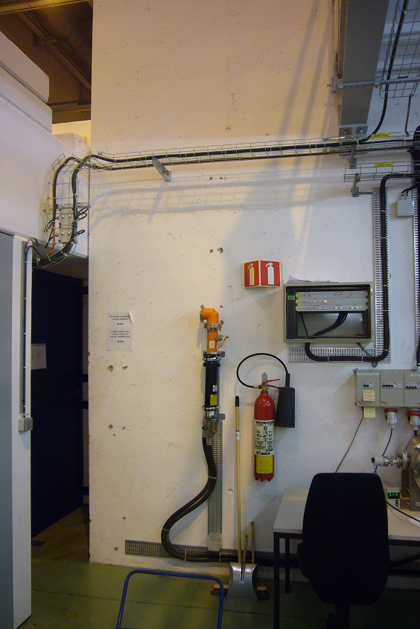
Prepare work zones
TAS: Dismount detector and table before mid March
RF: Dismount dummy load before mid March

Slide 12
Cooling & Ventilation
Air ducts on roof and along wall in the extension
Ventilation diffusers in the extension
Extraction ventilators on the roof
Implications for the users:
Work at heights: stay out of the extension
Use B.601 entrance at the back of Isolde
Noise & (minor) dust – protect stored equipment (extension)
Restricted use of the overhead crane
Hall Cooling & Ventilation work Feb - May 2013

Slide 13
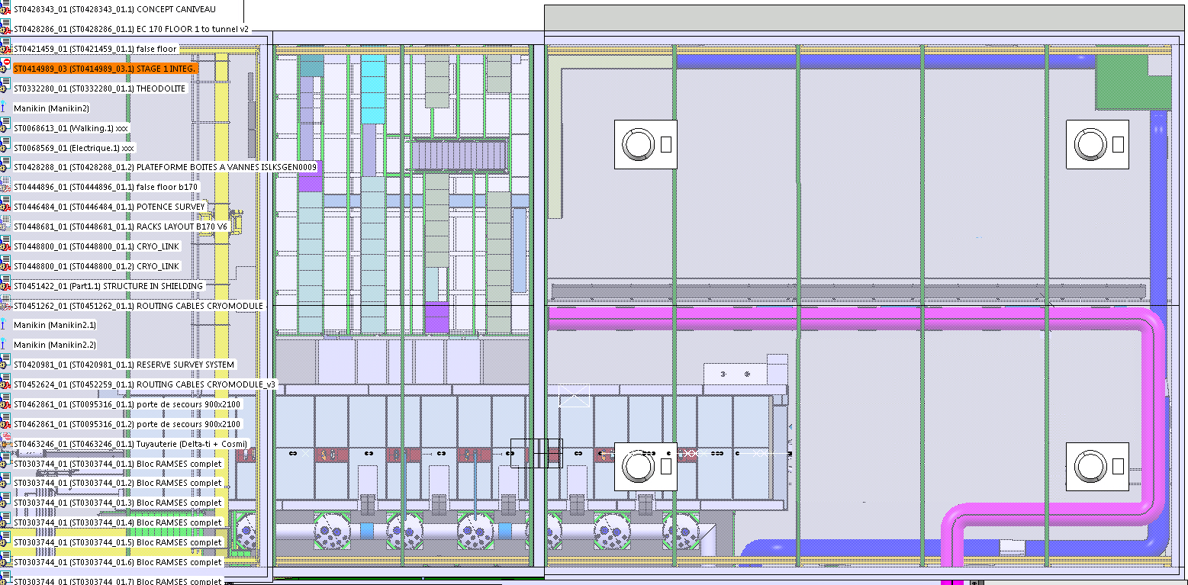
Ventilation on the roof
Roof ventilator units

Slide 14
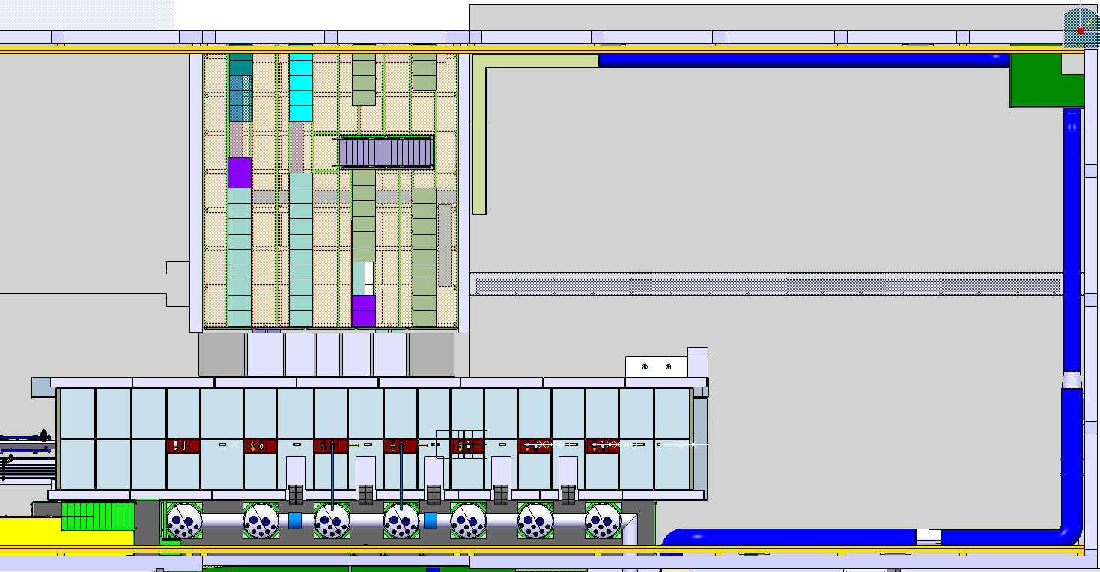
Hall storage space
220cm
Storage space
Miniball, β-NMR & scattering chamber
750cm
750cm
240cm

Slide 15
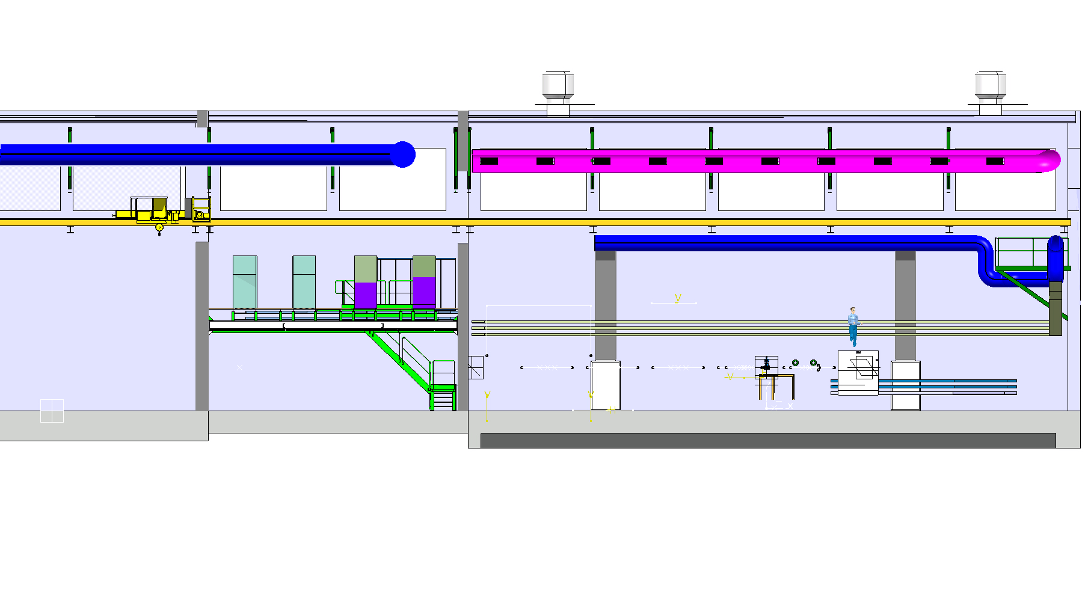
Hall 170 ventilation systems
wall
existing duct
New ducts
platform
wall
wall
New diffusers
1st extension
2nd extension

Slide 16
Civil Engineering
Cutting the platform wall
Excavating cable trench(es)
Adaptation and construction of the tunnel
Implications for the users:
Make sure the areas are free and equipment protected (TAS experiment)
No dust foreseen.. Relatively clean cutting using water both for wall as for trench cutting
Transport of heavy concrete blocks: stay away!
Use of overhead crane in high demand
Noise
Civil Engineering work March – Autumn 2013

Slide 17
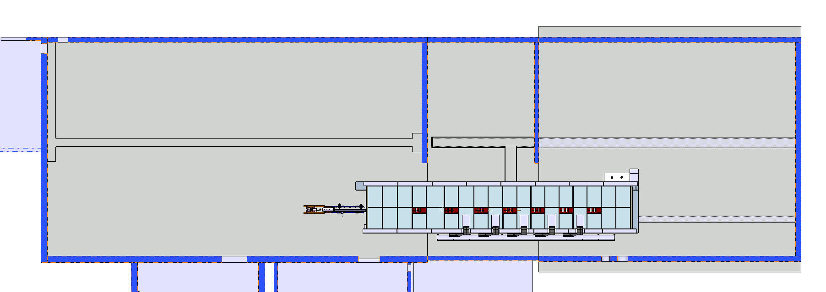
Civil Engineering in the hall
Wall to be cut
Extension future shielding
End existing tunnel
Tunnel, walls and tranches March – Aug 2013

Slide 18
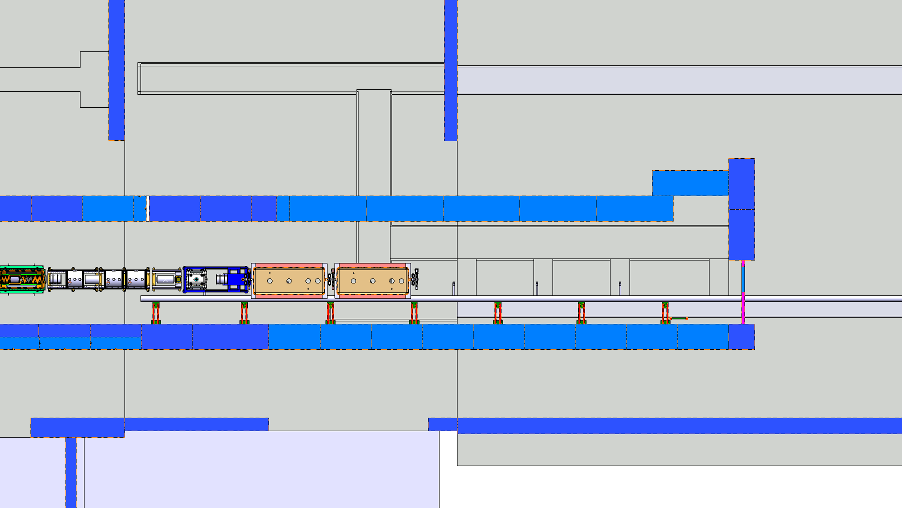
Civil Engineering in the hall
New trenches
Tunnel, walls and tranches March – Aug 2013

Slide 19
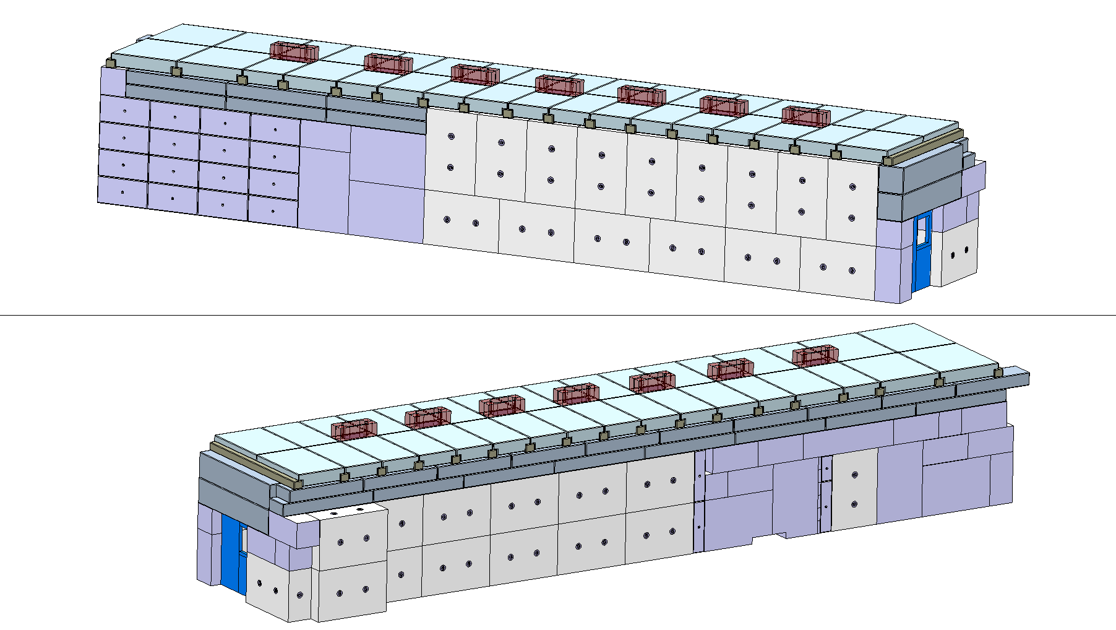
Shielding tunnel
Modification blindage

Slide 20
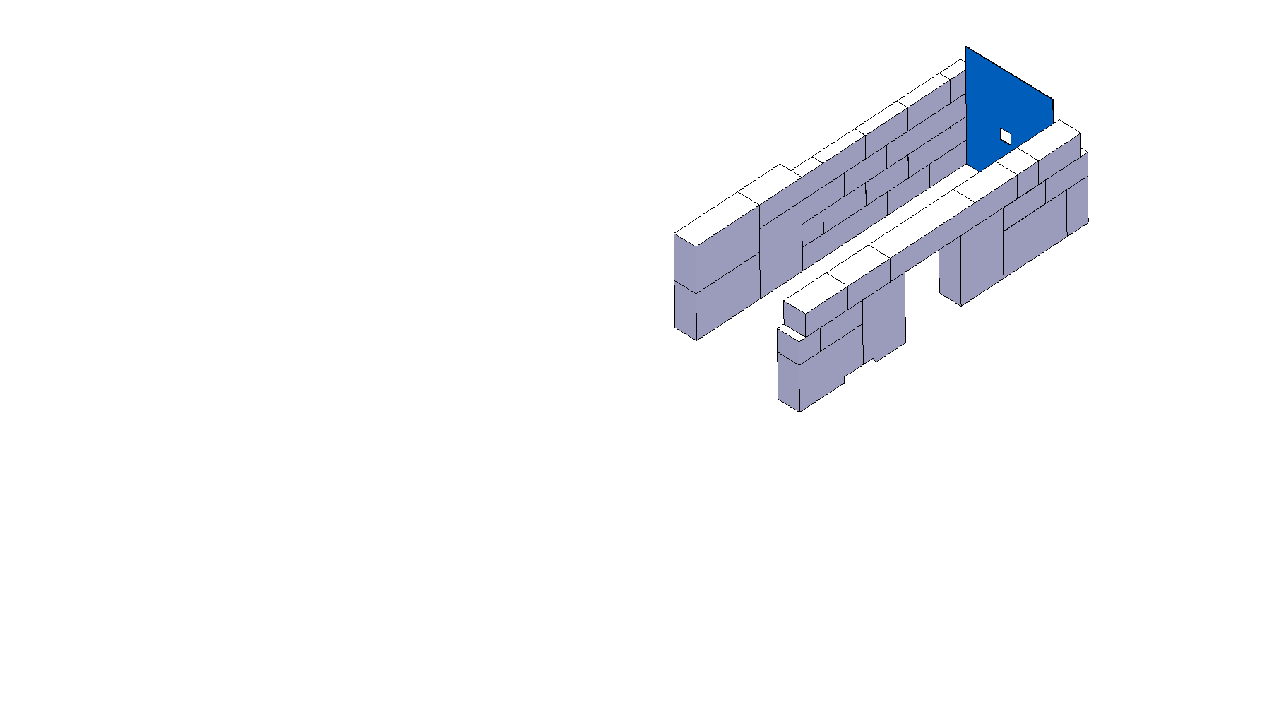

Slide 21
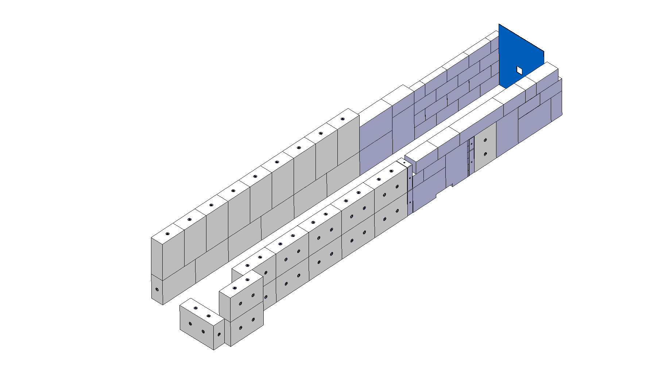

Slide 22
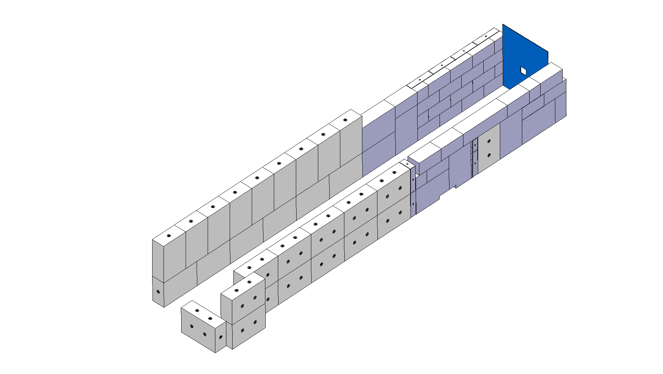

Slide 23
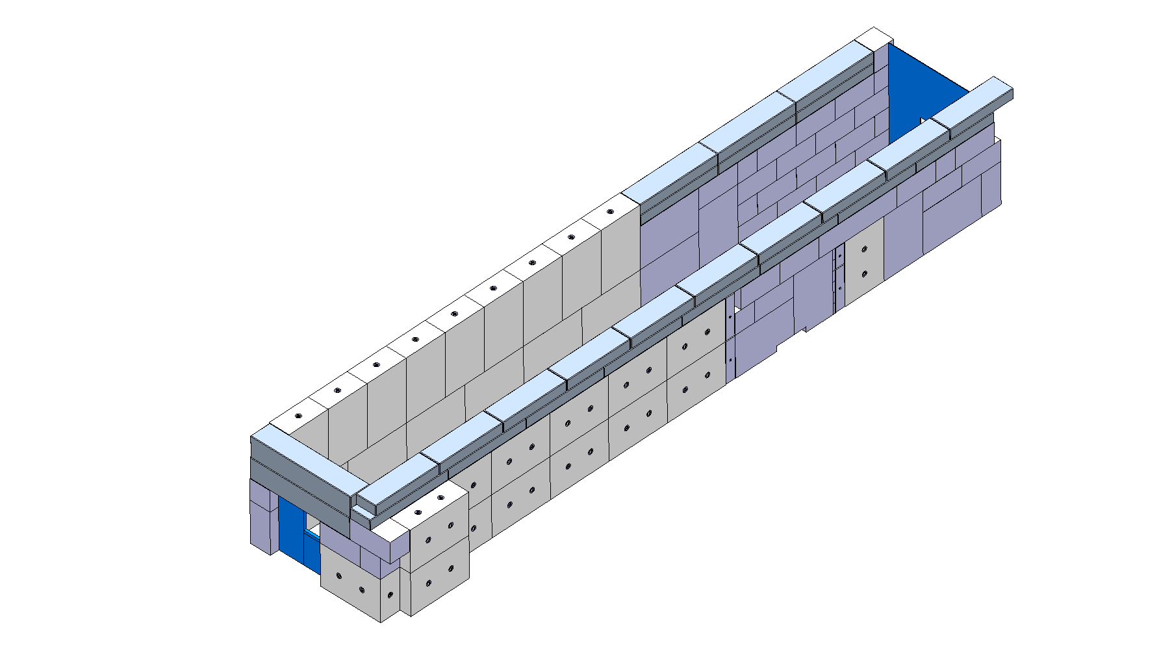

Slide 24
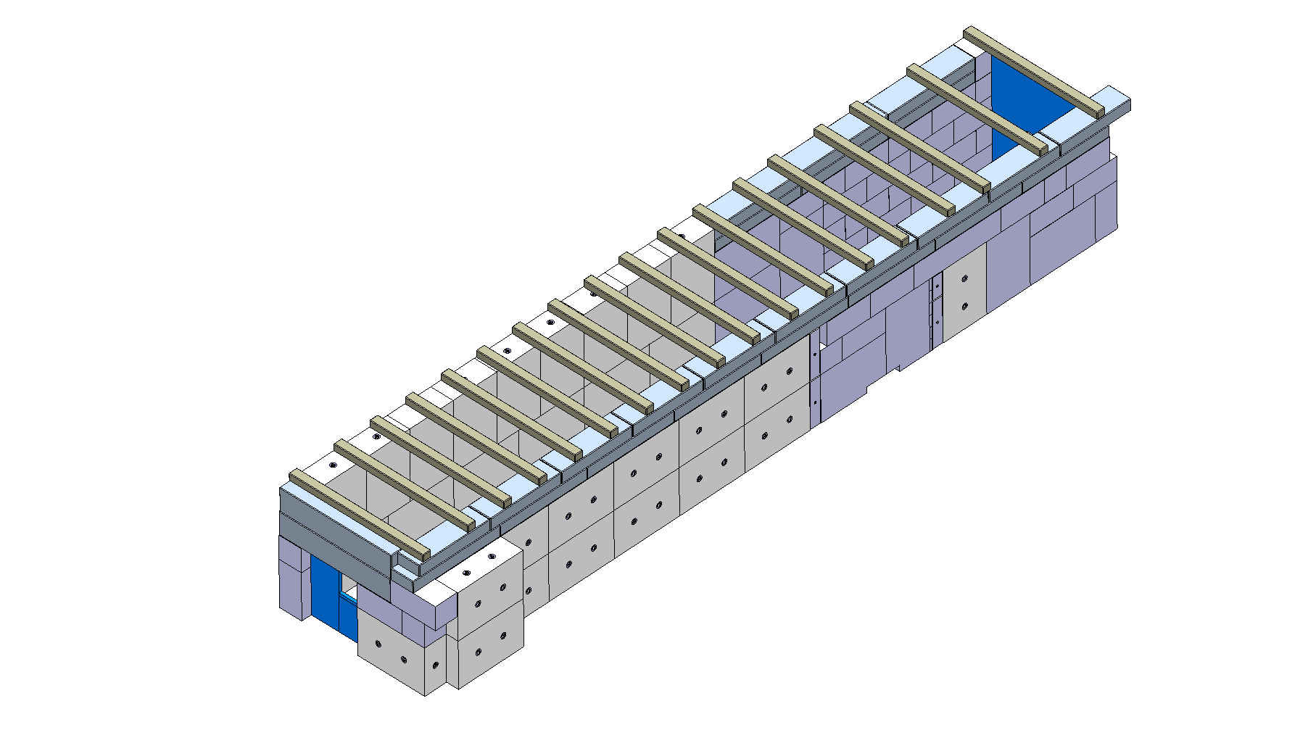

Slide 25
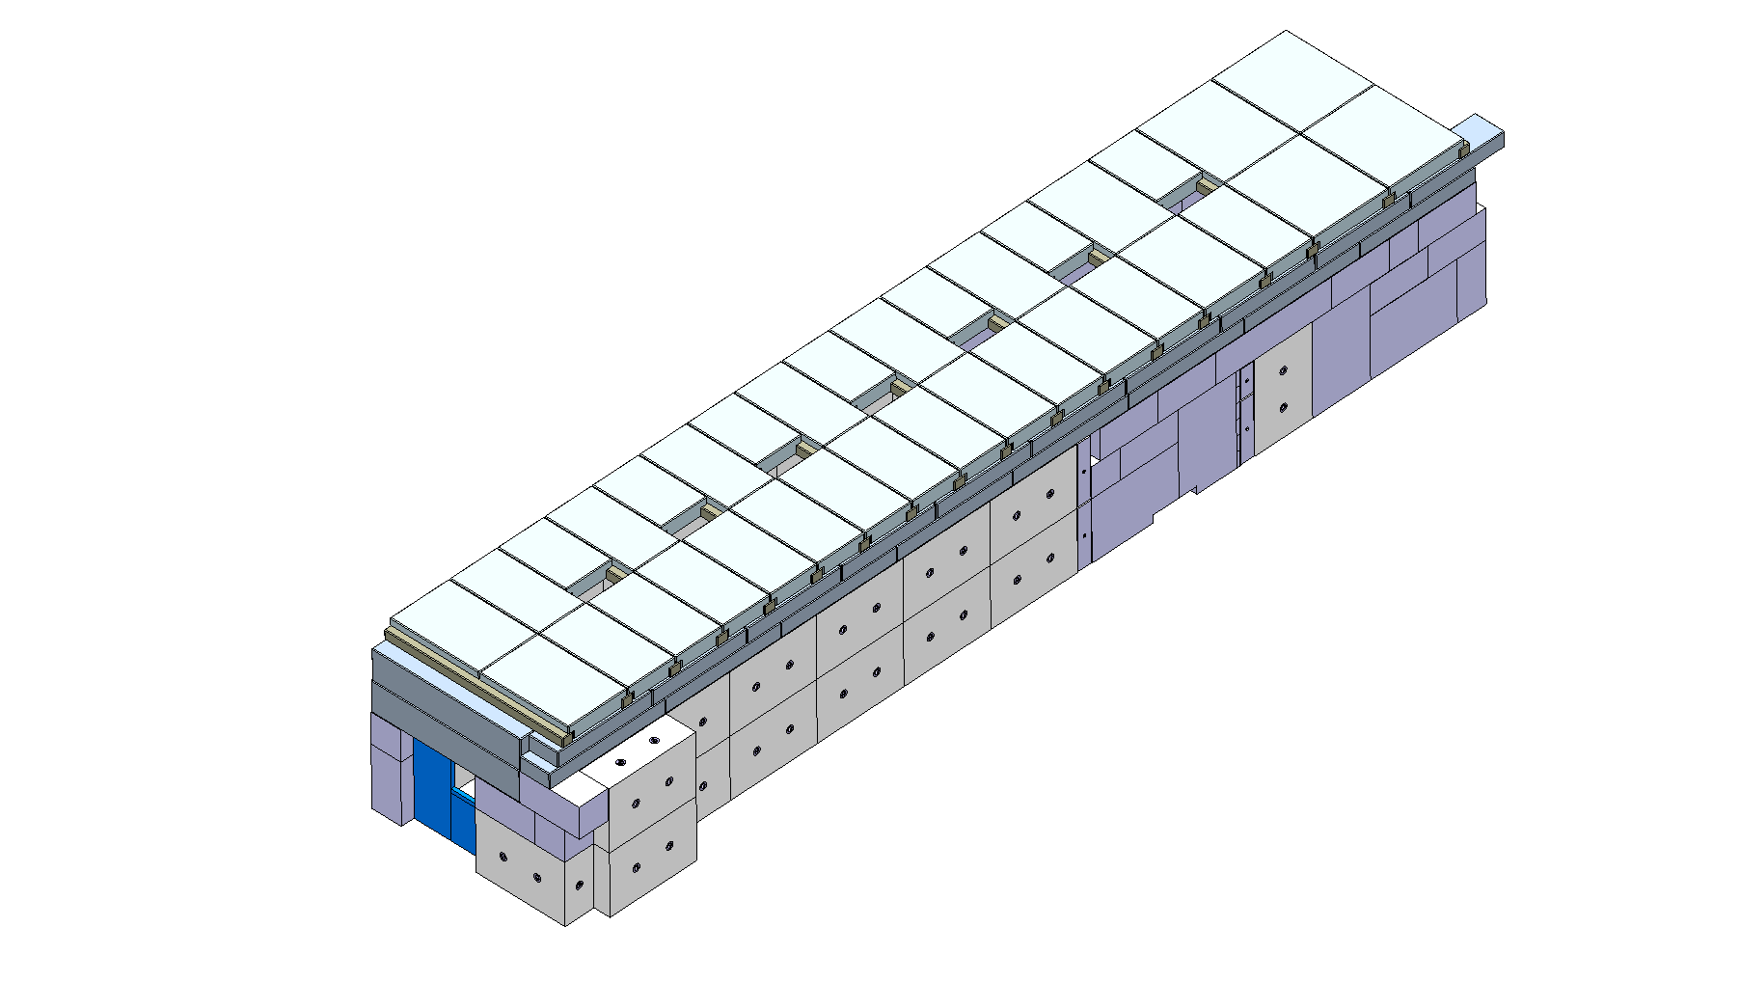

Slide 26
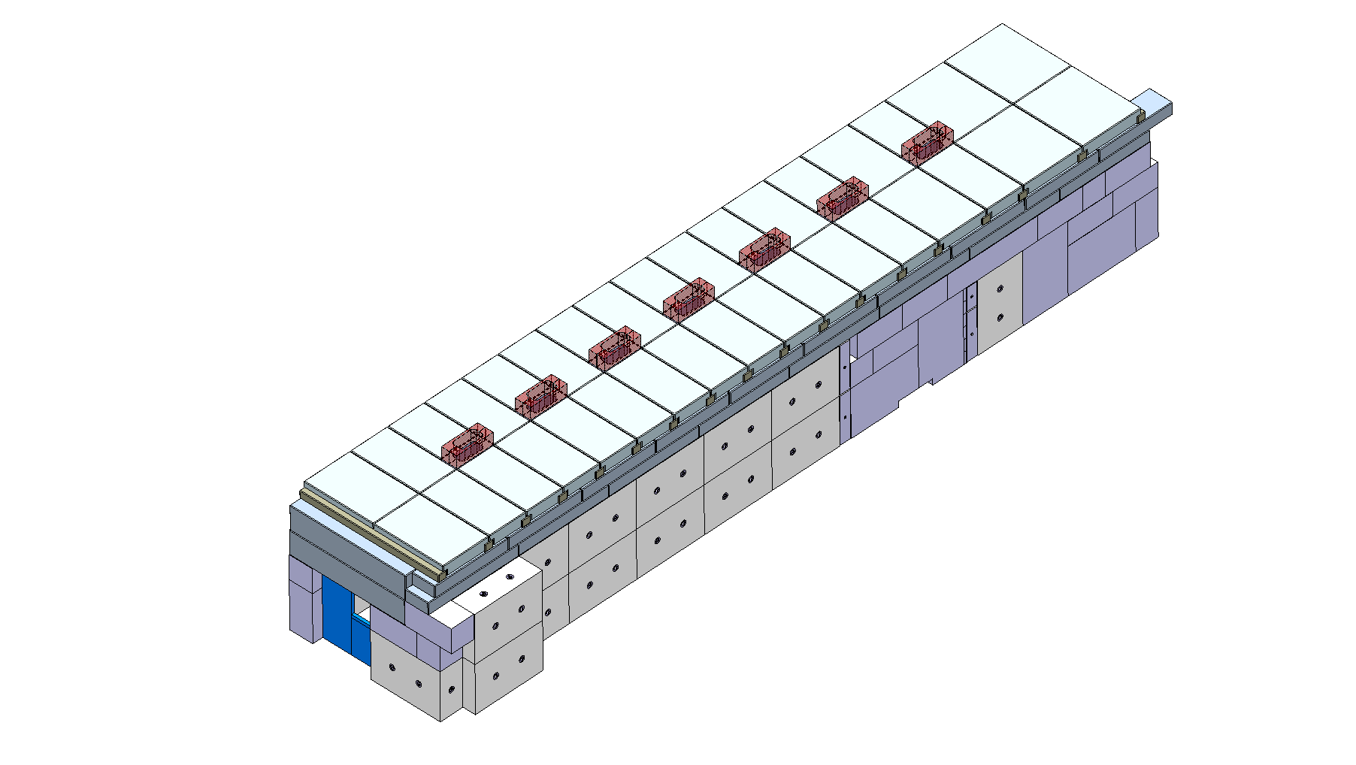

Slide 27
Metal structures
Adaptation of the platform for the racks: - removal wooden floor - installation steel beams false floor - adaptation or removal stairs
Installation platform for Cryo Jumper Boxes
Implications for the users:
Graining, cutting and welding on the platform: protect / remove equipment underneath
Noise
Metal structures May – Oct 2013

Slide 28
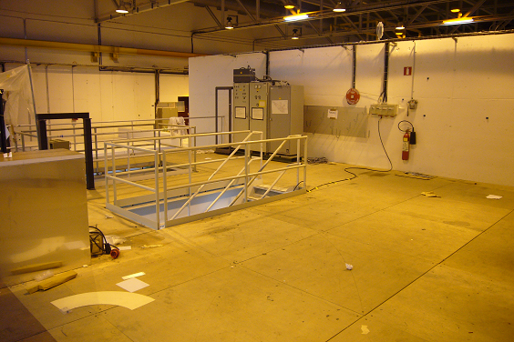
Metal structures
Platform system racks
Platform cryo jumper boxes
Platforms modification and installation April – Sept 2013

Slide 29
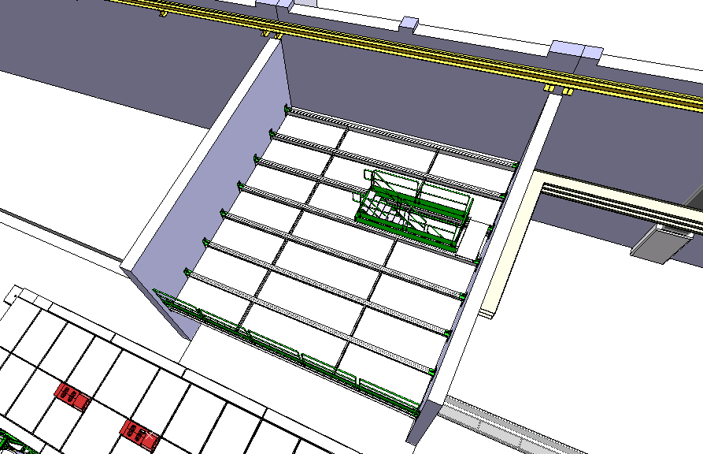
Metal structures
Platforms modification and installation April – Sept 2013

Slide 30
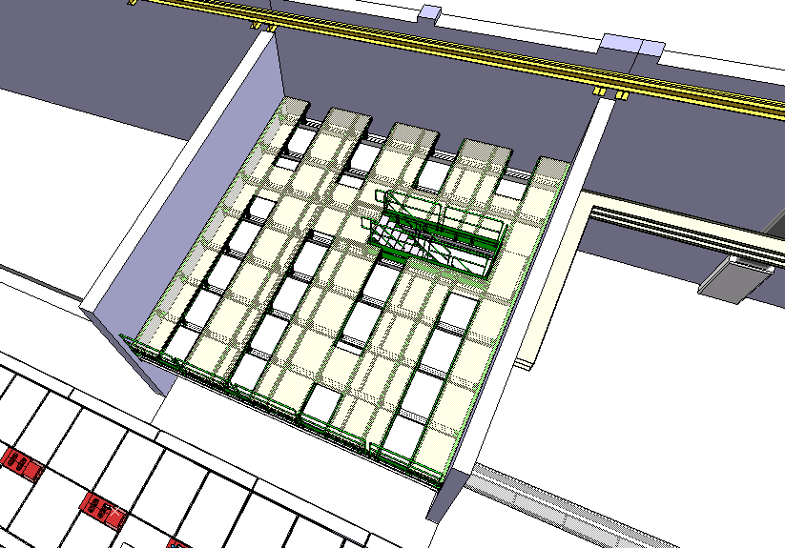
Metal structures
Platforms modification and installation April – Sept 2013

Slide 31
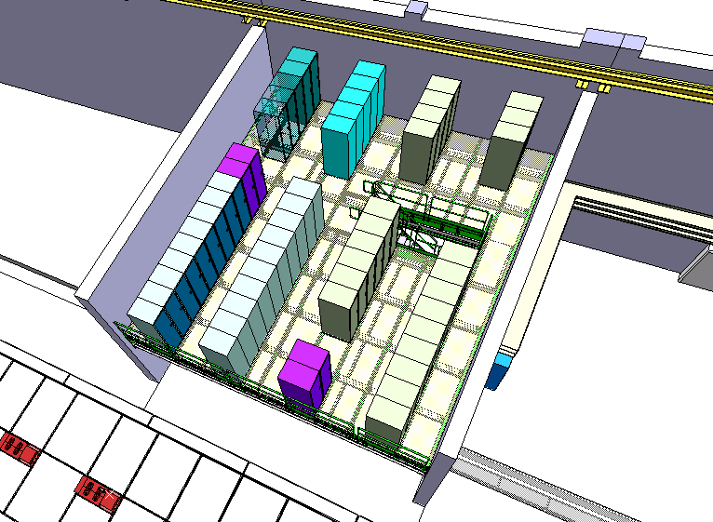
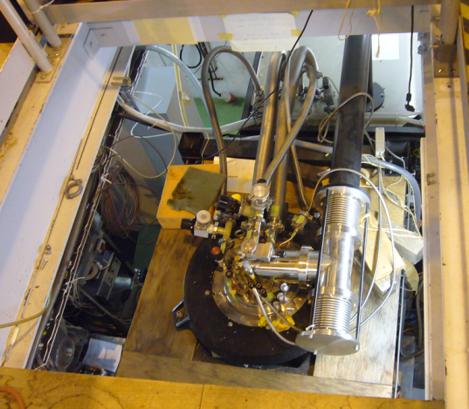
Metal structures
Access to Nicole
Platforms modification and installation April – Sept 2013

Slide 32
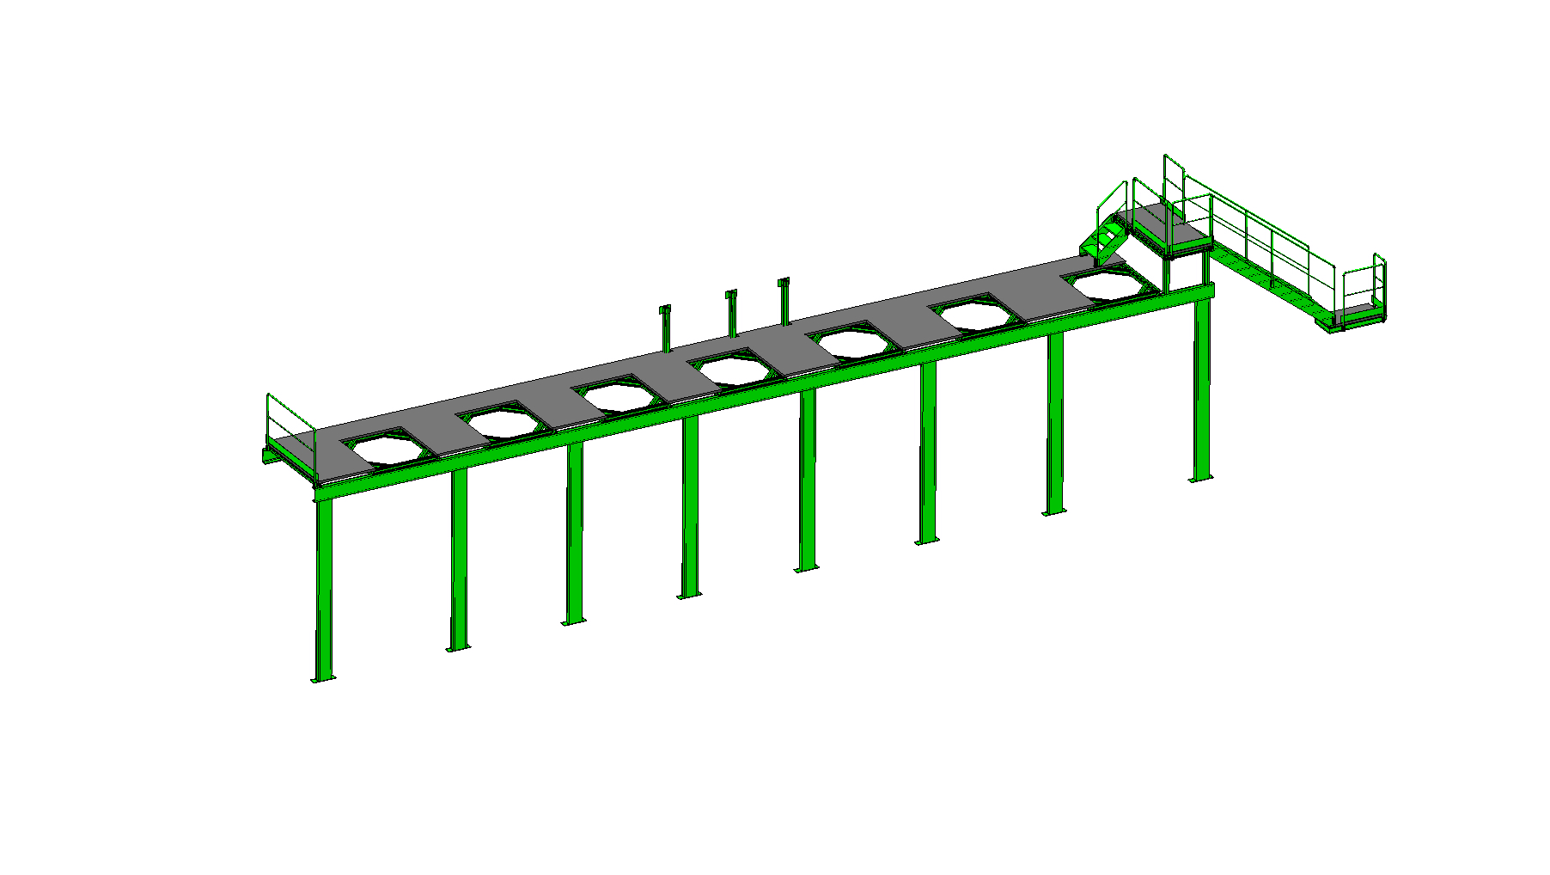
Metal structures
Platforms Cryo Jumper Boxes July – Sept 2013

Slide 33
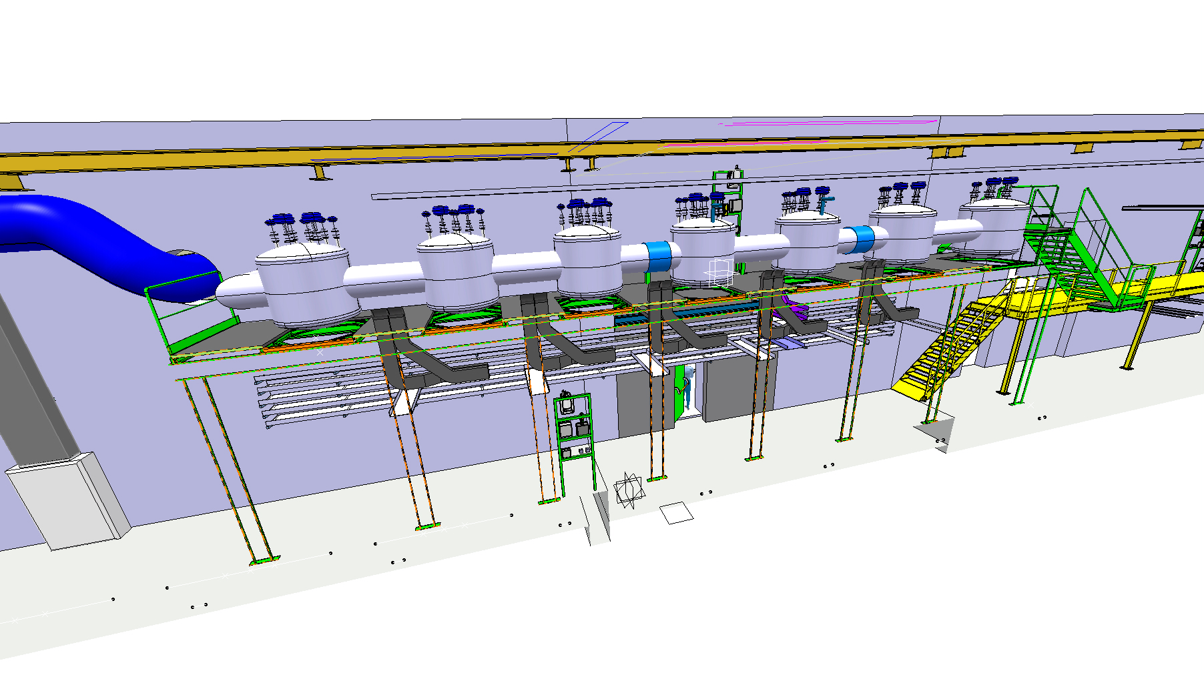
Metal structures
Platforms Cryo Jumper Boxes July – Sept 2013

Slide 34
Cabling and infrastructure
Large cable trays and cables campaign: - rack platform internal - rack platform into tunnel - inside tunnel - rack platform to HEBT - ex-entrance & B199 into tunnel
Power distribution
Infrastructure tunnel & HEBT
Implications for the users:
No power-cuts foreseen (if - then info in time)
Cable trays Aug – Nov 2013
Cables & connectors Nov 2013 – April 2014

Slide 35
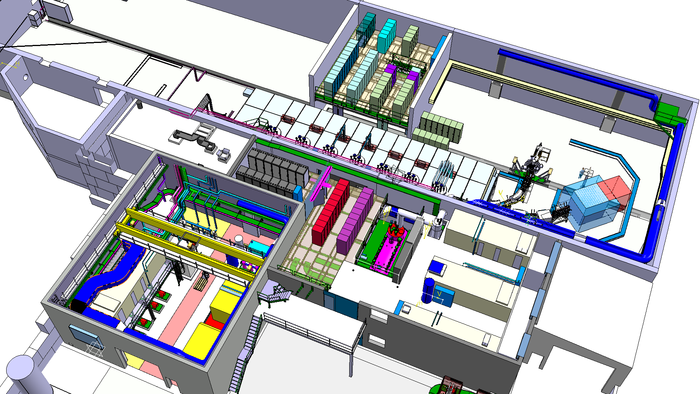
Cable trays and cabling
B. 170
B. 199
B. 198
Cable trays and cabling Aug 2013 – March 2014

Slide 36
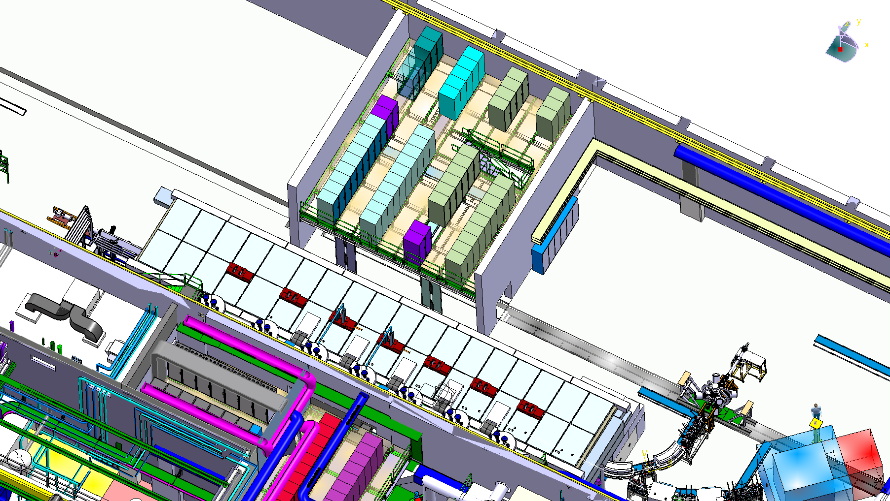
Racks sub systems
5 instrumentation racks
5 vacuum racks
7 dipole power convertor racks
Experimental hall 170
4 interlock racks
Power distribution cabinet
19 steerer/quads power convertor racks
15 dipole power convertor racks
Cable trays and cabling March – Mai 2014

Slide 37
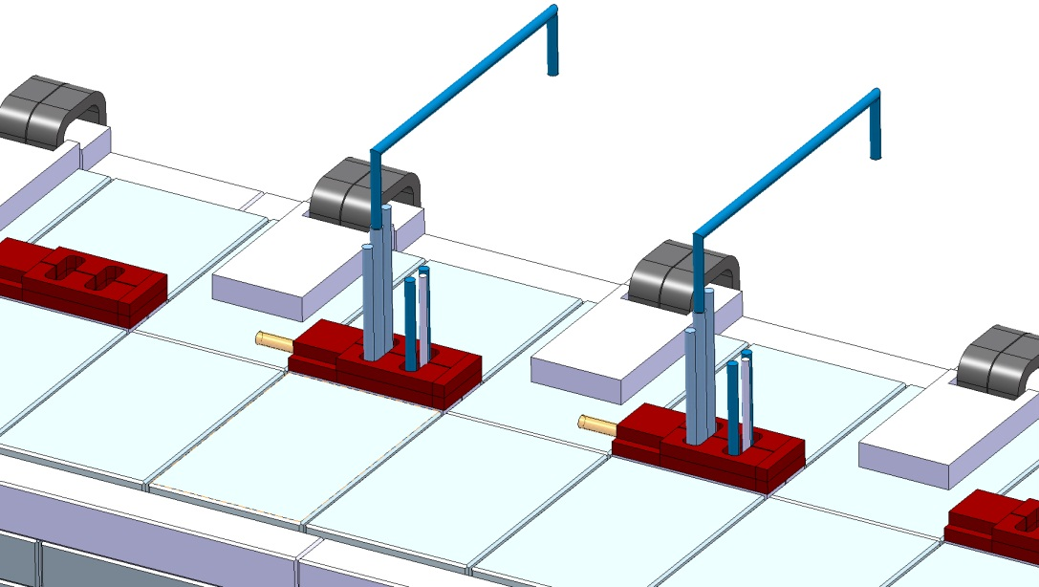
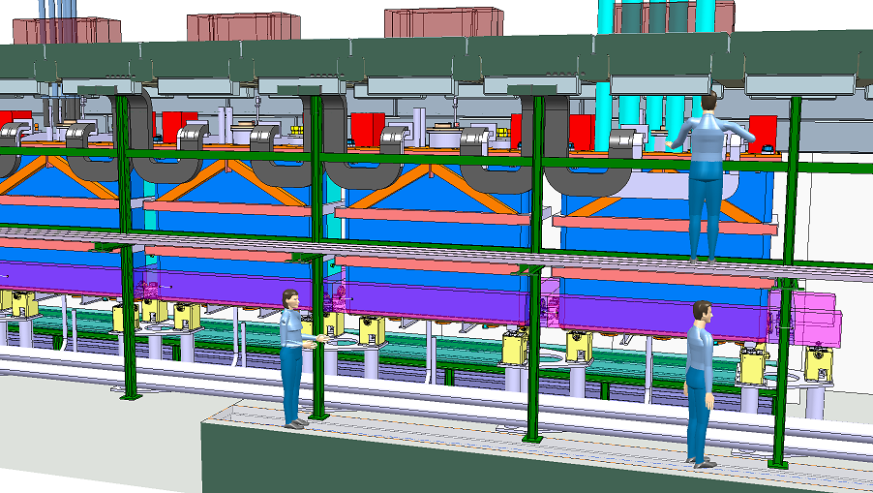
Tunnel cabling and tubing
RF cables, Cryo flexibles & He release

Slide 38
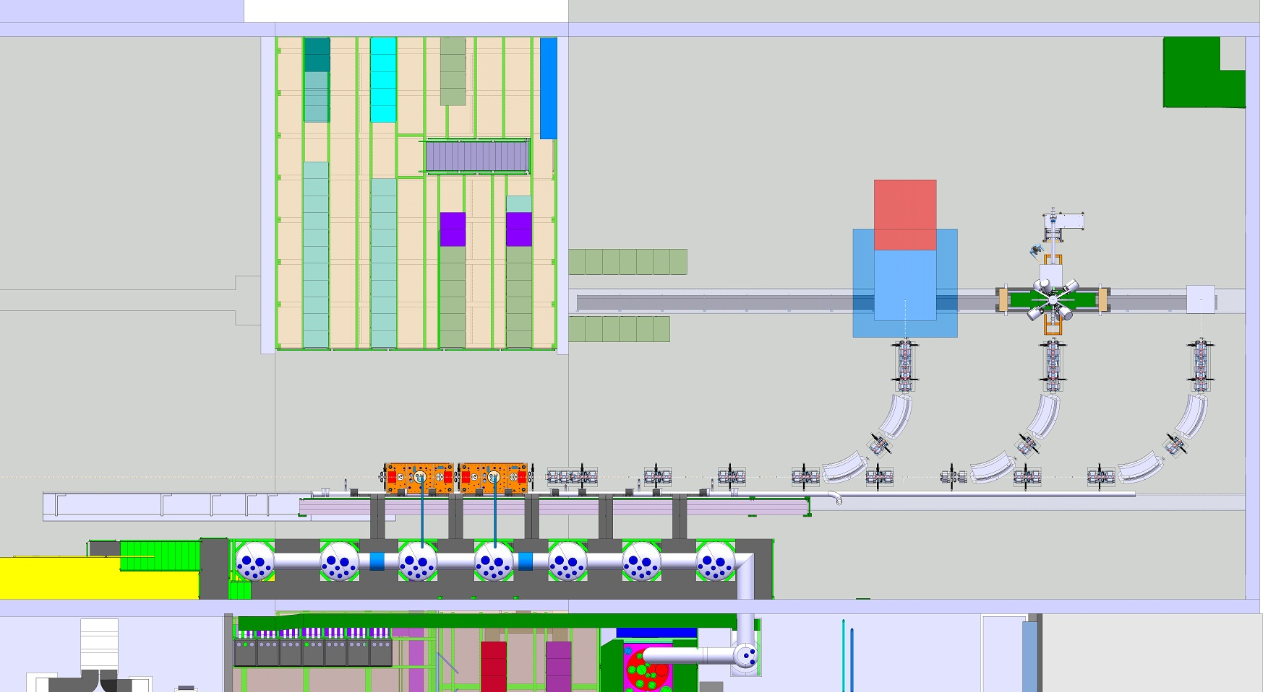
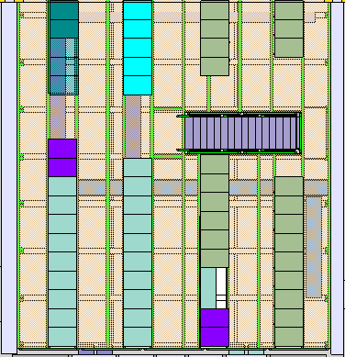
Cabling & infrastructure
Cable trays and cabling March – Mai 2014

Slide 39
Summary
Hie-Isolde – 2013: work in the hall 170
Main rule: avoid the extension & tunnel area
Use entrance at the back B.601
Hazards: Noise, dust and handling of heavy weights
Restricted use of the crane: Feb - May 2013
High demand of crane use: March – Autumn 2013
Coordination M. Kowalska, M. Pfutzner, E. Siesling
Planning on EDMS: HIE-ISOLDE integration

Slide 40
Safety first
For all users and staff entering the ISOLDE hall
+
+
Stay away from the work areas & Use entrance B.601

Slide 41
HIE ISOLDE integration
GS/SE : DANIEL PARCHET, ELISEO PEREZ-DUENAS
EN/MEF : STEPHANE MARIDOR, ELEFTHERIOS ZOGRAFOS
BE/ABP : FREDERIK WENANDER
BE/OP : DIDIER VOULOT
PH/SME : YORICK BLUMENFELD, MARIA BORGE
EN/HDO : YACINE KADI
BE/RF : MATTEO PASINI, MATTHEW FRASER, DANIEL VALUCH, WALTER VENTURINI, LUCA ARNAUDON
EN/CV : PAUL PEPINSTER, BENOIT LACARELLE
EN/EL : RENE NECCA, JEAN-CLAUDE GUILLAUME, GEORGI GEORGIEV, JEAN-PIERRE BILLON-GRAND EN/EL
TE/CRG : NICOLAS DELRUELLE, JOS METSELAAR
EN/STI : RICHARD CATHERALL, ANA-PAULA BERNARDES
GS/DI : CYRILLE BEDEL
TE/MSC : JEAN-PHILIPE TOCK, YANN LECLERCQ, LLOYD WILLIAMS, ARNAUD BOUZOUD
DSG/RP : JOACHIM VOLLAIRE, SANDRA GIRON
TE/ABT : BRENNAN GODDARD

Slide 42
Thank you for your attention

