Slide 1


HIE-ISOLDE
Infrastructure and Installation
Project schedule
2nd HIE ISOLDE Management meeting
CERN, 29 June 2012
Erwin Siesling

Slide 2
Abstract
  HIE-ISOLDE – integration
  Civil Engineering, Main Services and Cryogenics
  Tunnel and Superconducting Linac
  High Energy Beam Transfer line
  Urgent issues:
  Civil Engineering 1 ½ month delay
  Heat dissipation and power consumption
  Cryo Line – modular installation
  Linac and HEBT cabling solutions
  HEBT dipole power convertor racks

Slide 3
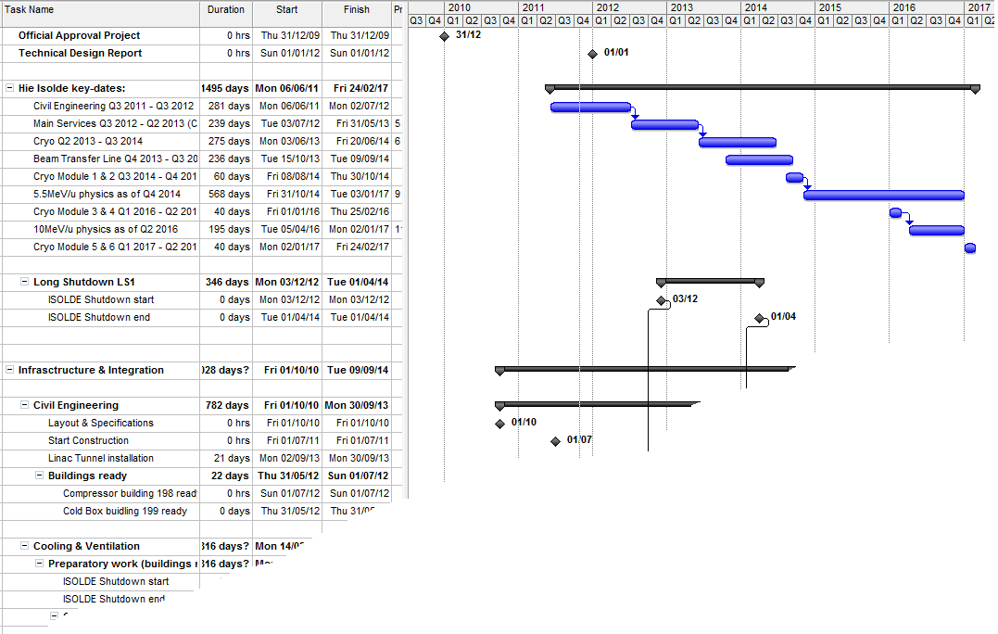
Hie-Isolde Planning
Hie-Isolde installation planning in EDMS:
Projects – Accelerators - Hie-Isolde – Infrastructure & Integration - Planning
https://edms.cern.ch/nav/P:CERN-0000072786:V0/P:CERN-0000090679:V0/TAB3

Slide 4
Hie-Isolde Planning
  Activities until LS1: Civil Engineering & Main Services
Start LS1
3 dec 2012
2011
2012
2013
2014
2015
2016
Q1
Q2
Q3
Q4
Q1
Q2
Q3
Q4
Q1
Q2
Q3
Q4
Q1
Q2
Q3
Q4
Q1
Q2
Q3
Q4
Q1
Q2
Q3
Q4
Beam Transfer Line
Civil
Cryo
Main services
Ventilation
Demi water
CM 1&2
Electrical syst.s
CM 3&4
CM 5&6
5.5MeV/u
10MeV/u
Timeline:
sd
sd
LS1
CM1&2
sd
sd
Dec 2012 - Apr 2014
shutdown
Cryo Mod 1 & 2 install
(Isolde normal operations)
(REX perturbations)
Isolde & REX Ops

Slide 5
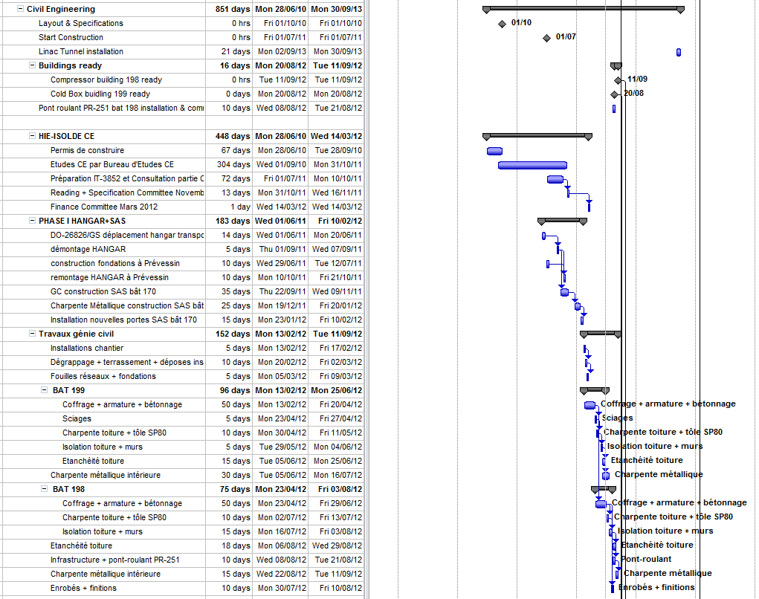
Until LS1
Civil Engineering
LS1
GS/SE : DANIEL PARCHET, ELISEO PEREZ-DUENAS

Slide 6
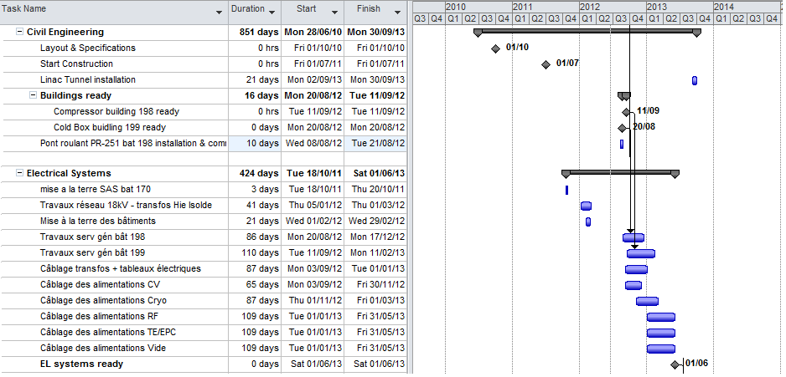
Until LS1
Civil Engineering
LS1
Delay 1 ½ month
Buildings ready October:
End Sept: roof & isolation installed
End Oct: metal structures in place
GS/SE : DANIEL PARCHET, ELISEO PEREZ-DUENAS

Slide 7
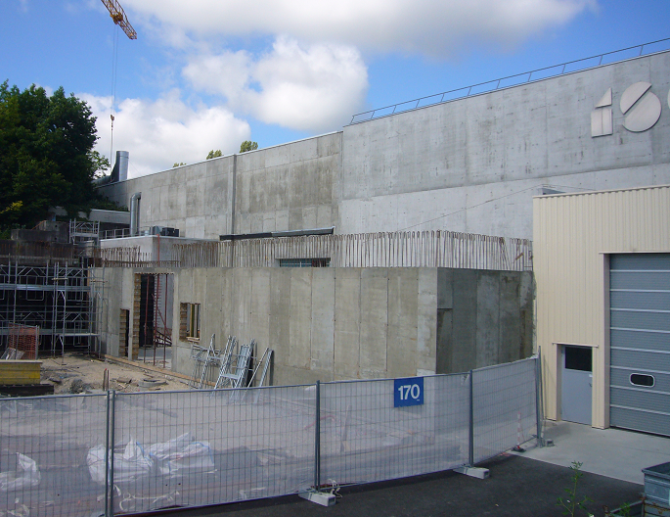
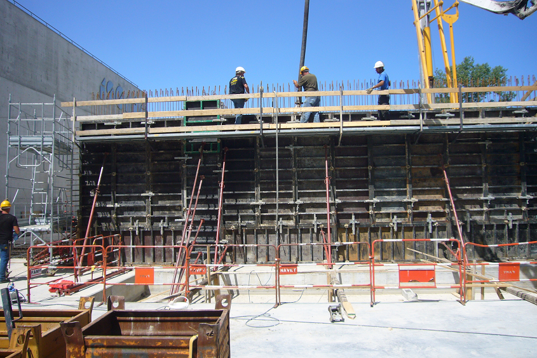
Civil Engineering
27 June: outer walls 1st floor B199, first wall B198

Slide 8
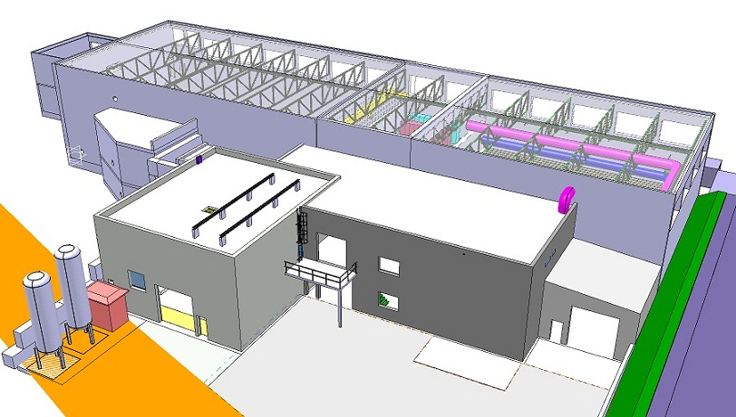
Civil Engineering
Compressor and Cold Box Building
Autumn 2012 !
Civil Engineering finished summer 2012

Slide 9
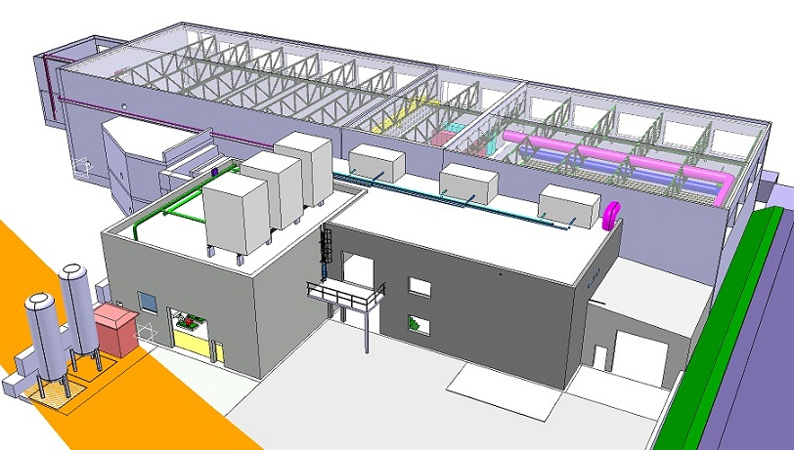
Main Services
Electrical systems, Cooling & Ventilation
Start installation Main Services Oct 2012

Slide 10
Into LS1
Civil Engineering
LS1
Delay 1 ½ month
Buildings ready October:
End Sept: roof & isolation installed
End Oct: metal structures in place
GS/SE : DANIEL PARCHET, ELISEO PEREZ-DUENAS

Slide 11
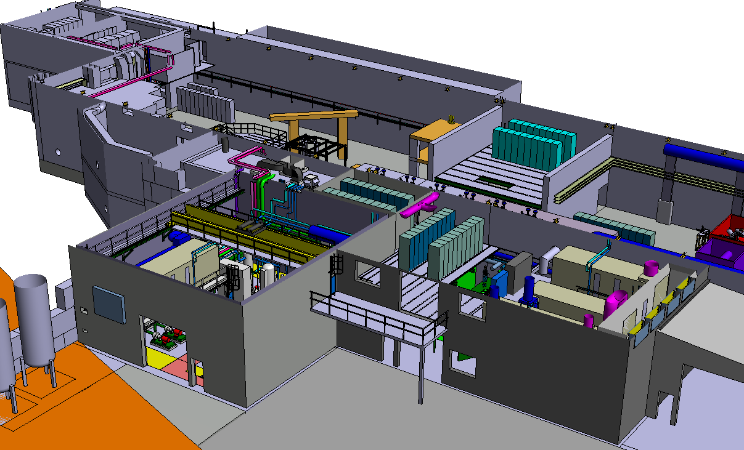
Electrical systems
Electrical systems: Oct 2012 – June 2013

Slide 12
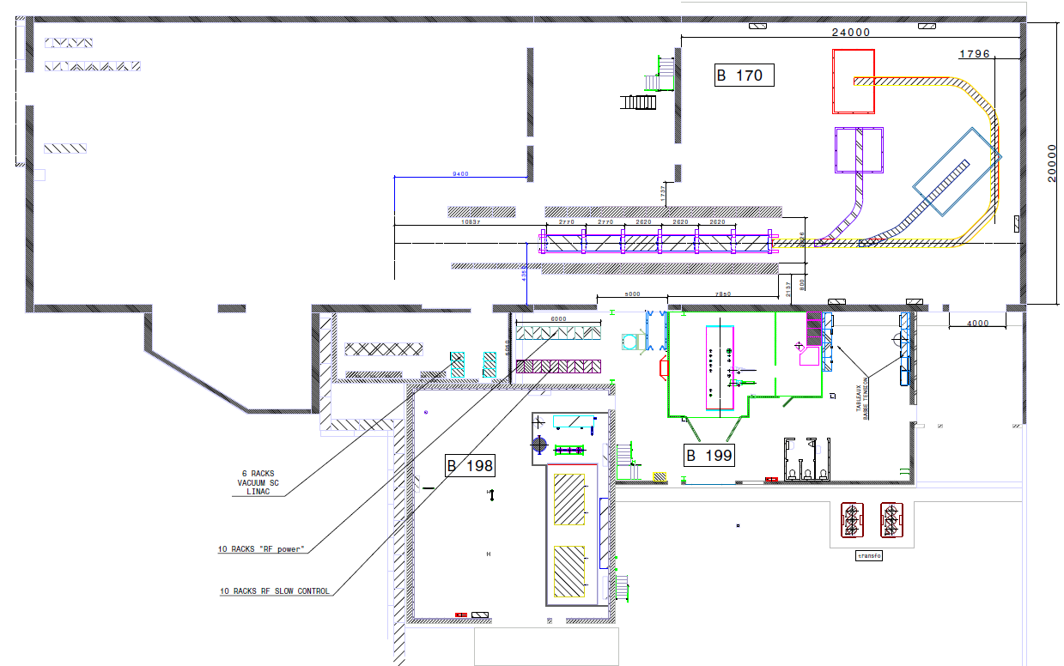
Racks sub systems
Courtesy: Stephane Maridor

Slide 13
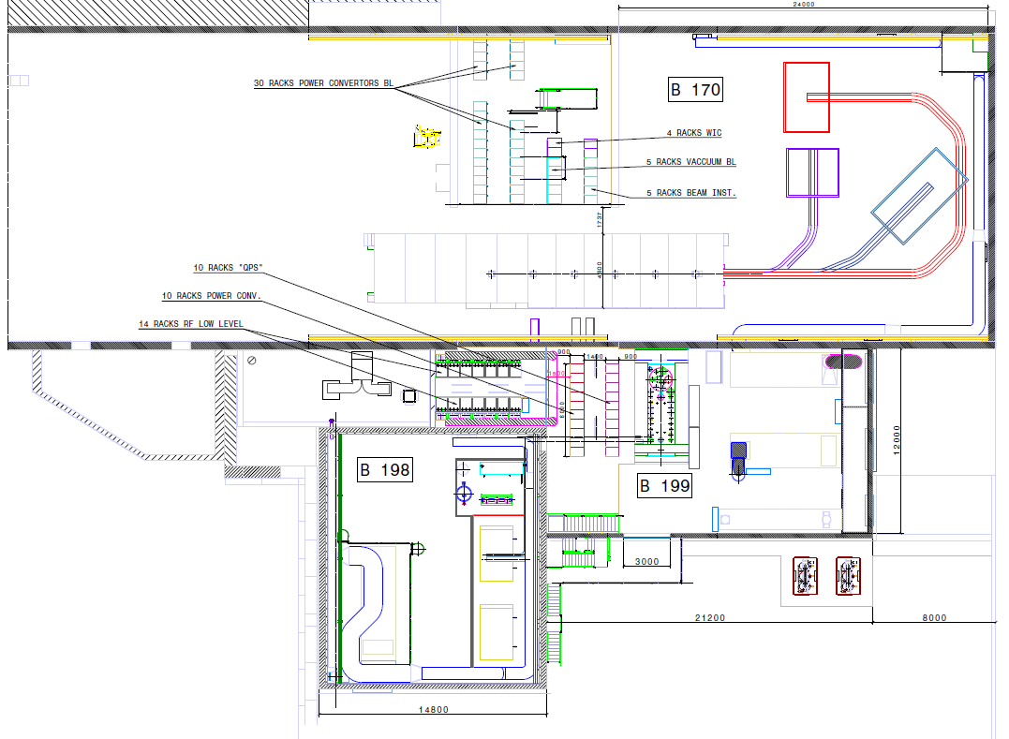
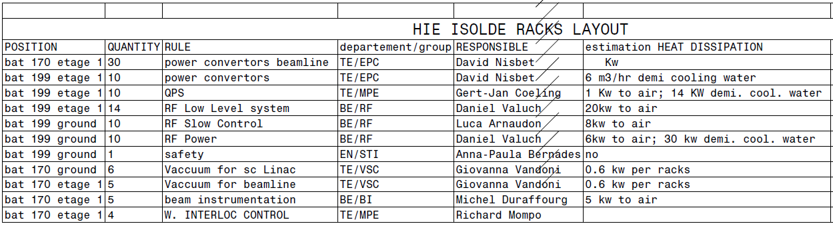
Racks sub systems
URGENT: For the different equipment:
CV: heat dissipation to air and water
EL: power consumption
32kW (str & quads) + 70kW (dipl) = 102 kW air

Slide 14
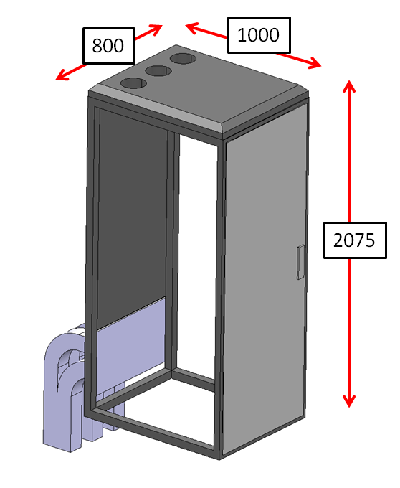
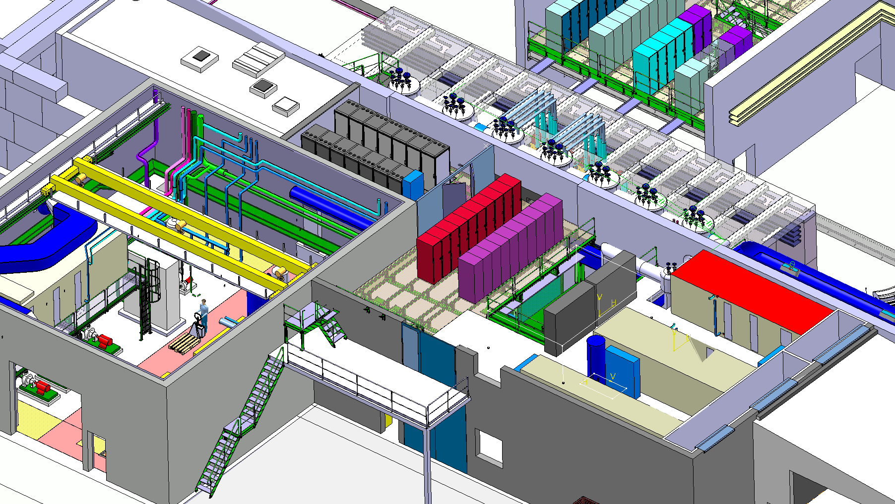
Faraday Racks
Courtesy: Stephane Maridor / Daniel Valuch

Slide 15
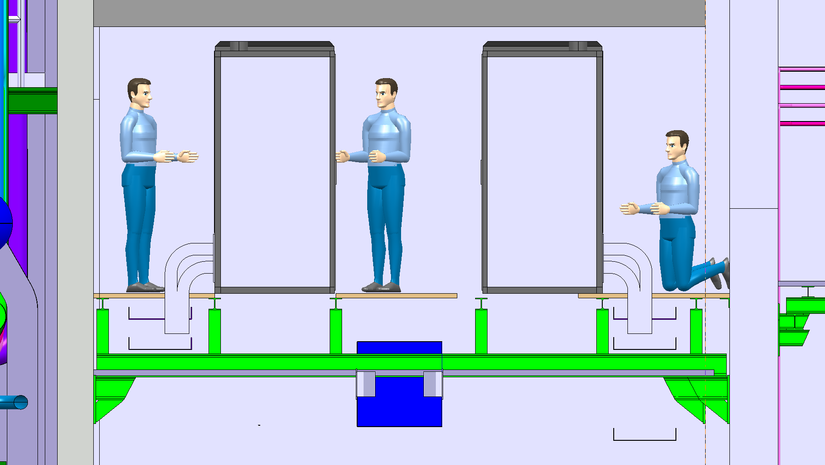
Faraday Racks
Hot air exhaust
Hot air exhaust
Cold air inlet
Cold air inlet

Slide 16
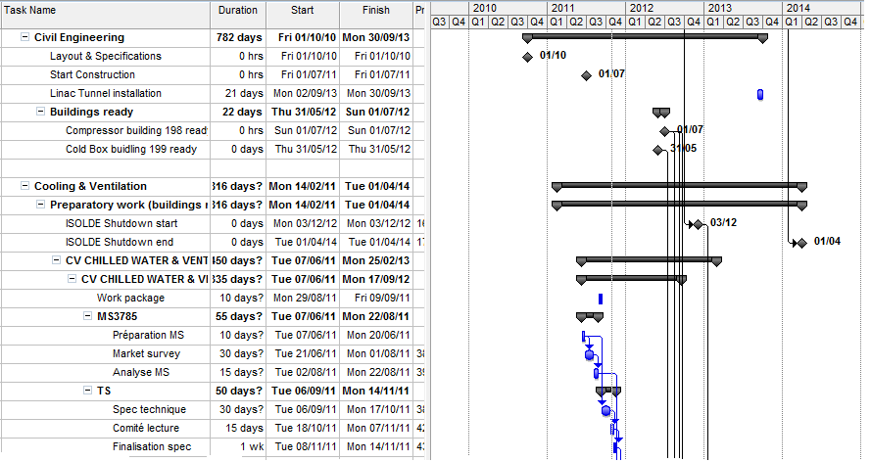
Cooling & Ventilation
LS1
Buildings ready October:
Start of LS1:
3 dec - Keydate!
EN/CV : PAUL PEPINSTER, BENOIT LACARELLE

Slide 17
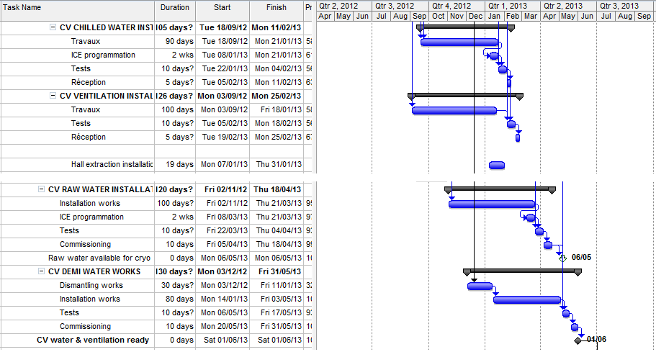
Cooling & Ventilation
LS1
Point of No Return!
EN/CV : PAUL PEPINSTER, BENOIT LACARELLE

Slide 18
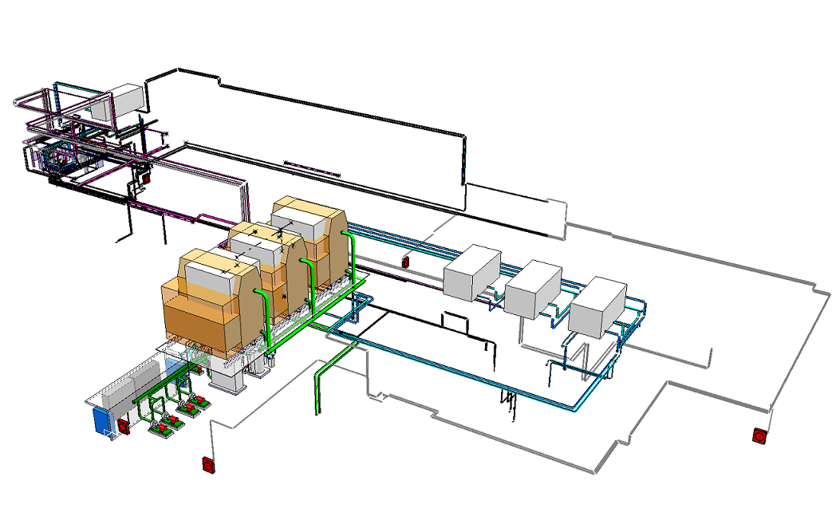
Cooling & Ventilation
Cooling & Ventilation: Oct 2012 – June 2013

Slide 19
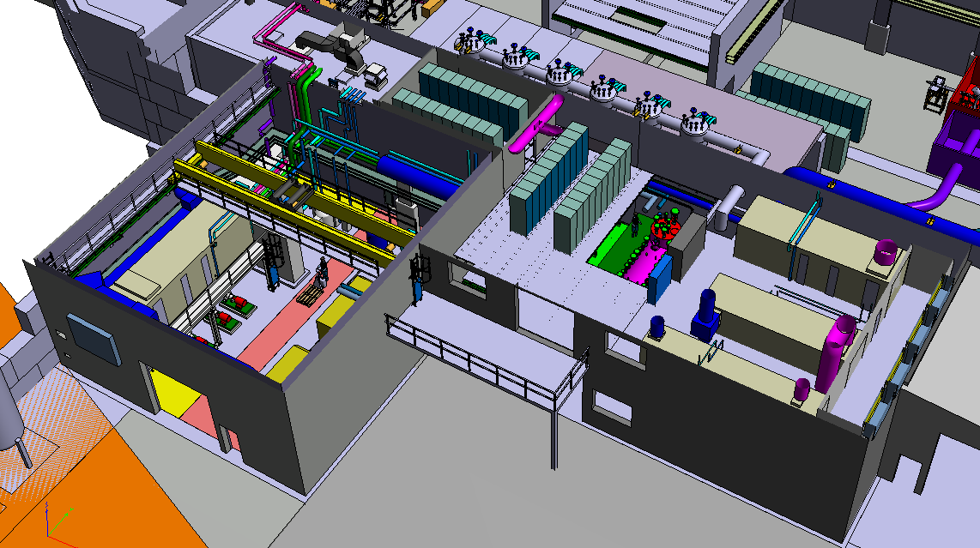
Cooling & Ventilation
Ventil units
Ventil units
Cooling pumps
Cooling & Ventilation: Oct 2012 – June 2013

Slide 20
LS1 into 2014 run
  Activities LS1 into 2014 run: Cryogenics, Beam transfer Line, Cryo Modules, commissioning
End LS1:Start Low E physics apr 2014
2011
2012
2013
2014
2015
2016
Q1
Q2
Q3
Q4
Q1
Q2
Q3
Q4
Q1
Q2
Q3
Q4
Q1
Q2
Q3
Q4
Q1
Q2
Q3
Q4
Q1
Q2
Q3
Q4
Beam Transfer Line
Civil
Cryo
Main services
Ventilation
Demi water
CM 1&2
Electrical syst.s
CM 3&4
CM 5&6
5.5MeV/u
10MeV/u
Timeline:
sd
sd
LS1
CM1&2
sd
sd
Dec 2012 - Apr 2014
shutdown
Cryo Mod 1 & 2 install
(Isolde normal operations)
(REX perturbations)
Isolde & REX Ops

Slide 21
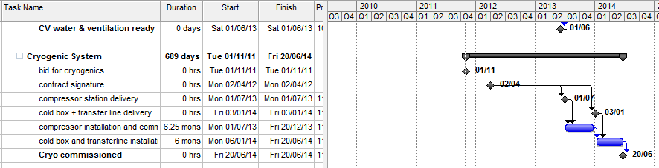
LS1 into 2014 run
Cryogenics
CM1&2
LS1
TE/CRG : NICOLAS DELRUELLE, JOS METSELAAR

Slide 22
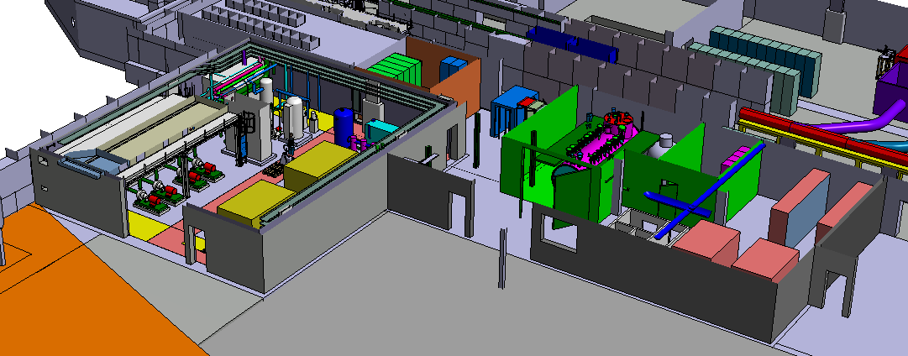
Cryogenics
Compressors: July 2013 – December 2013
Cold Box: Jan 2014 – June 2014

Slide 23
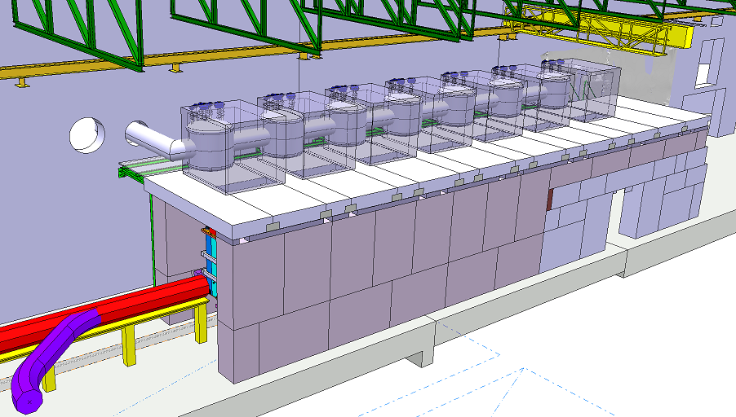
Tunnel and Cryo Line
Installation tunnel: Sep 2013 - LS1
Cryo Cold Line: January 2014 – June 2014

Slide 24
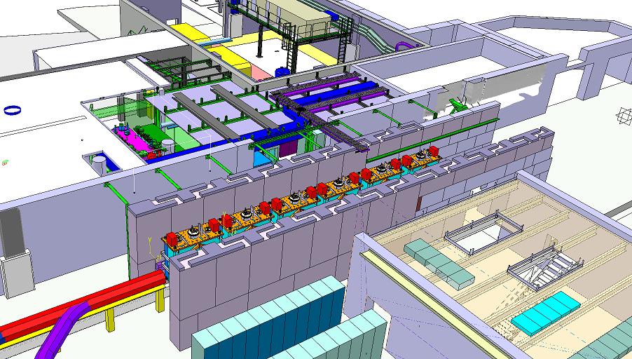
Tunnel

Slide 25
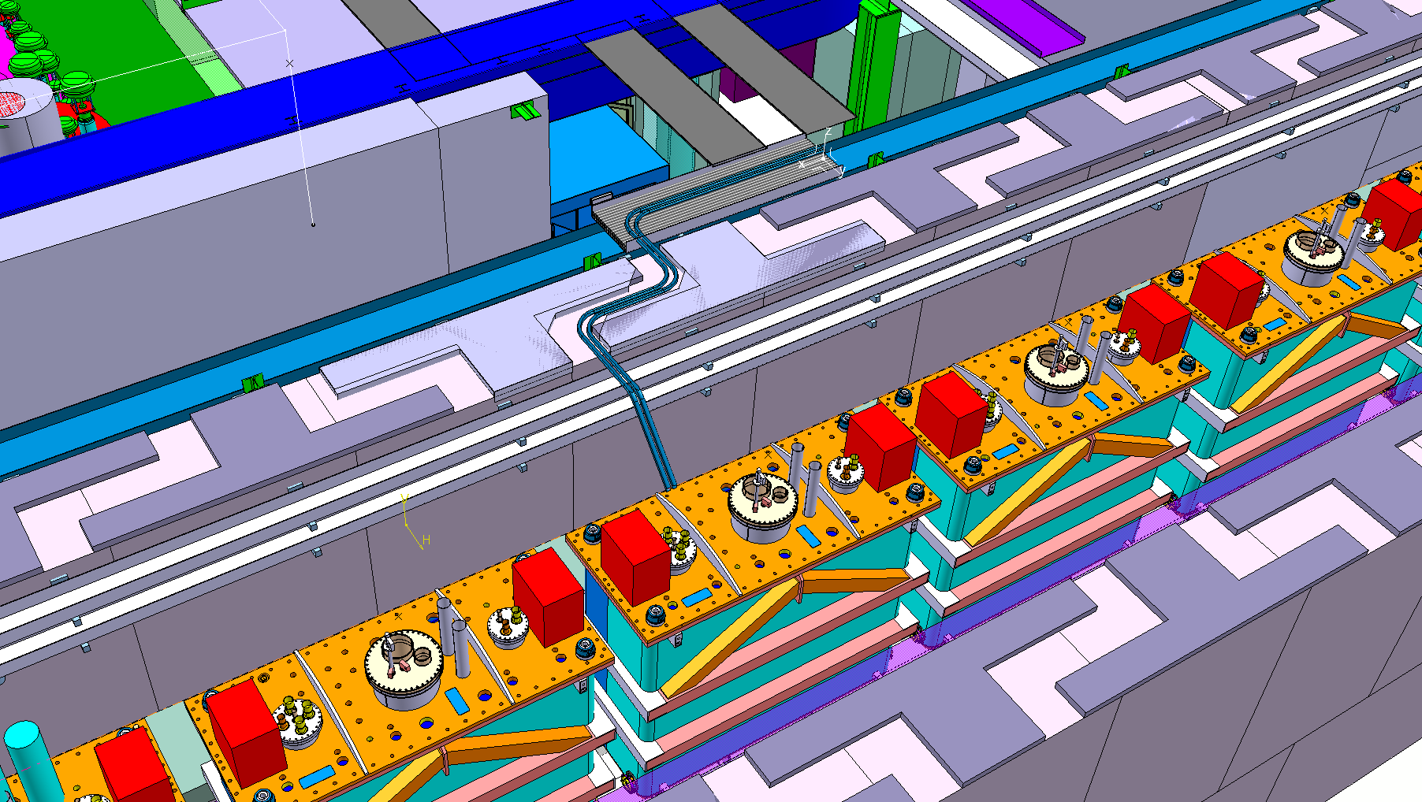
Tunnel
Cable feedthrough and He release

Slide 26
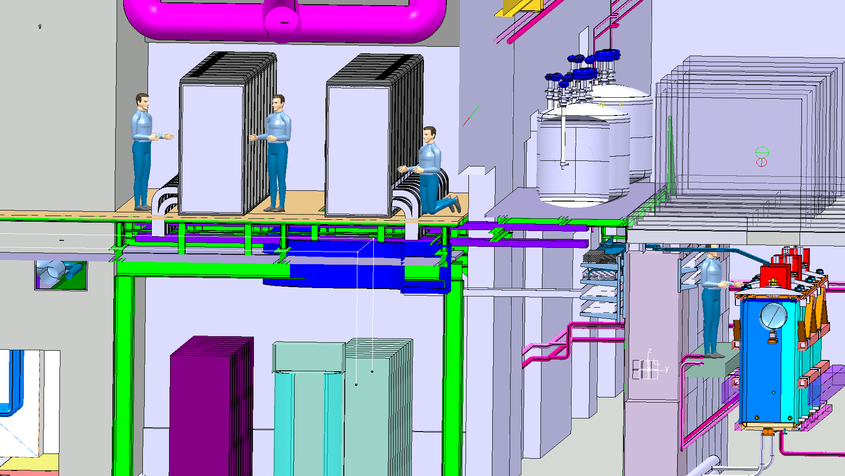
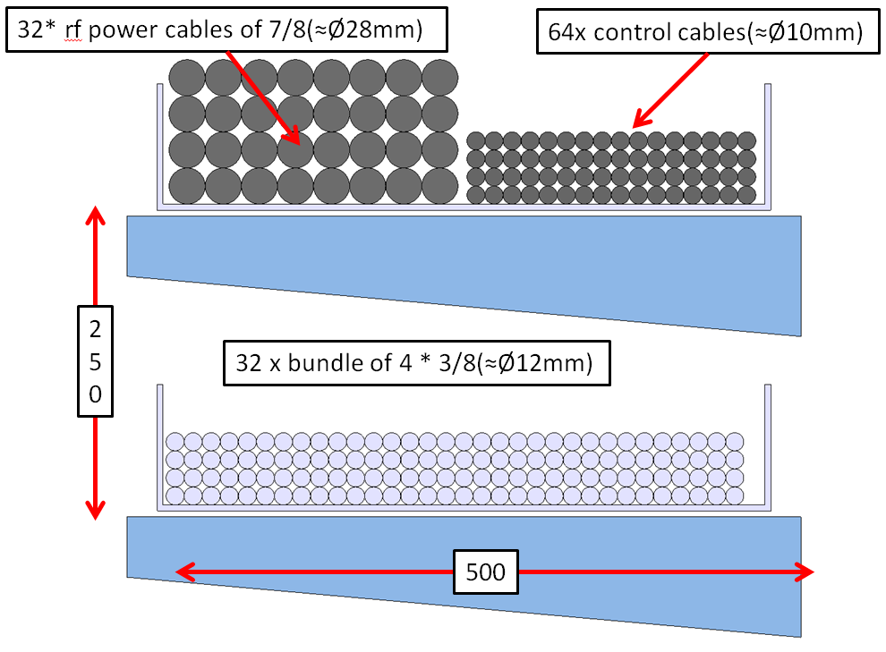
Tunnel- RF cabling

Slide 27
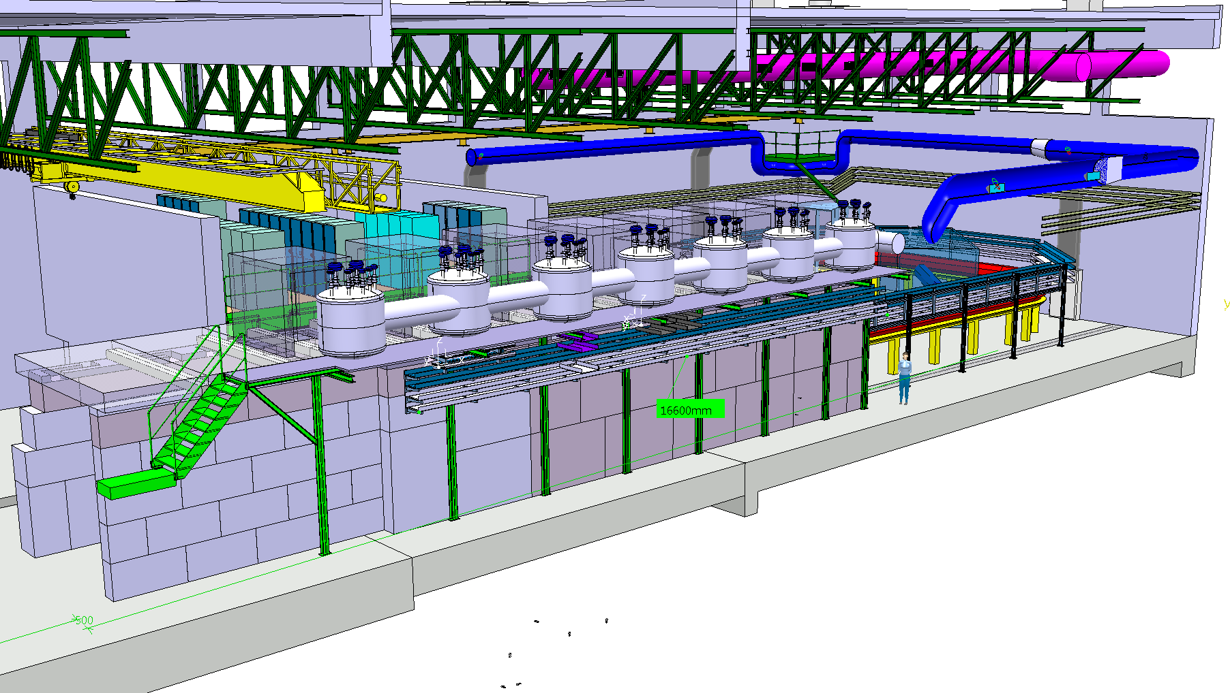
Tunnel
Cable feedthrough and He release also via niche
Safety aspects: Ana-Paula Bernardes EN/STI

Slide 28
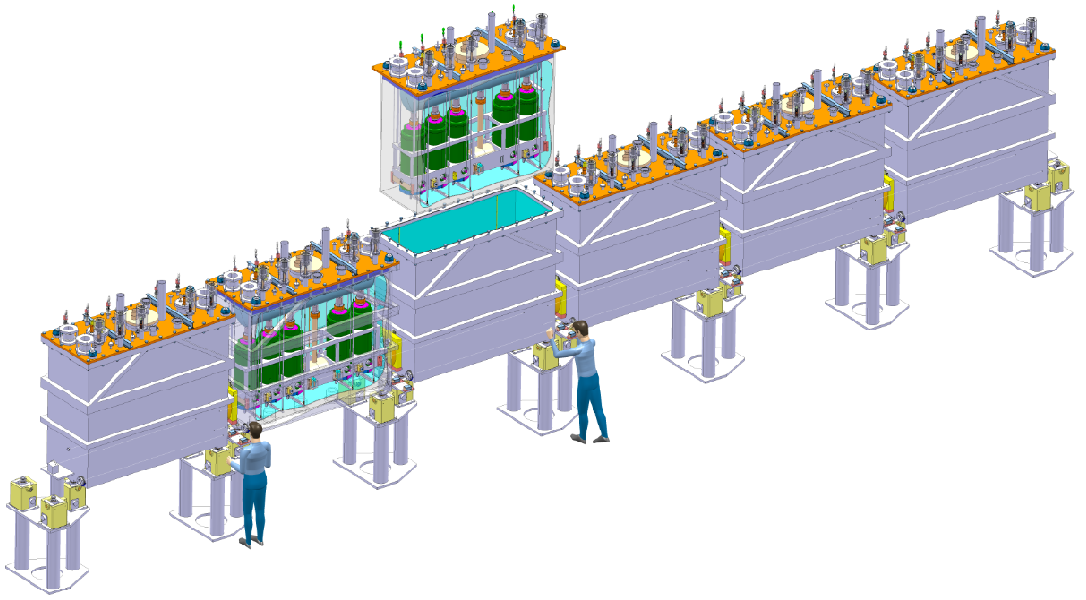
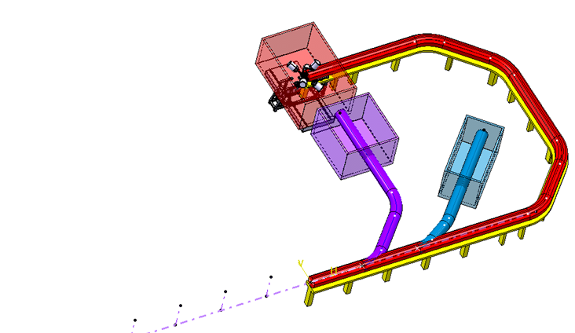
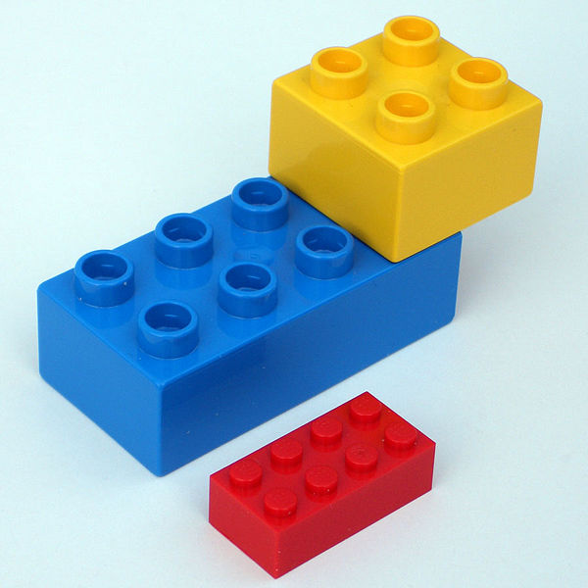
SC Linac, Cryo- & Beamline
HIE ISOLDE Superconducting Linac
High Energy Beam Transferline
Modular installation

Slide 29
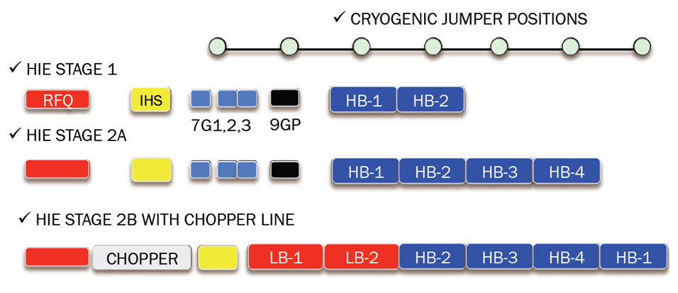
Modular installation
Schematic:
2014
5.5MeV/u
2016
10MeV/u
>2017
Courtesy: Matteo Pasini, Matthew Fraser

Slide 30
CM 1 & 2 and beamline
  Activities into 2014 run: Cryo Modules 1 &2 and Beam transfer Line
HEBT & Linac commissioning
End LS1:Start Low E physics as of apr 2014
hardware sept.2014
beam oct.2014
2011
2012
2013
2014
2015
2016
Q1
Q2
Q3
Q4
Q1
Q2
Q3
Q4
Q1
Q2
Q3
Q4
Q1
Q2
Q3
Q4
Q1
Q2
Q3
Q4
Q1
Q2
Q3
Q4
Beam Transfer Line
Civil
Cryo
Main services
Ventilation
Demi water
CM 1&2
Electrical syst.s
CM 3&4
CM 5&6
5.5MeV/u
10MeV/u
Timeline:
sd
sd
LS1
sd
sd
Dec 2012 - Apr 2014
shutdown
Isolde & REX Ops
Cryo Mod 1 & 2 + HEBT install (Isolde running)

Slide 31
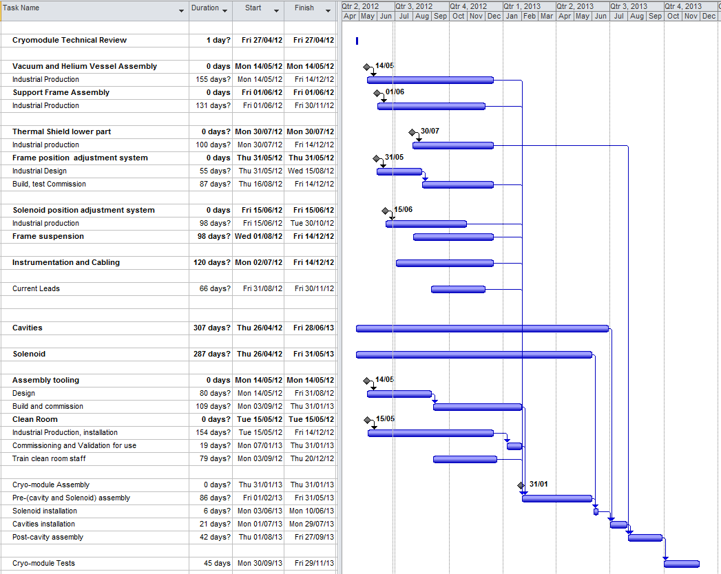
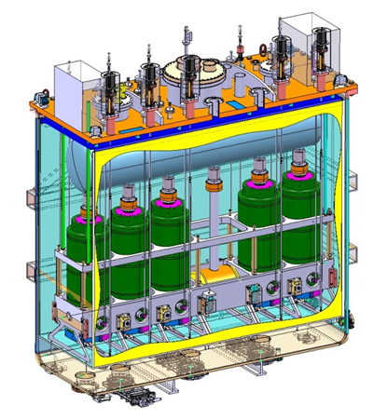
First High-β Cryo Module
TE/MSC: JEAN-PHILIPE TOCK, YANN LECLERCQ, LLOYD WILLIAMS, ARNAUD BOUZOUD

Slide 32
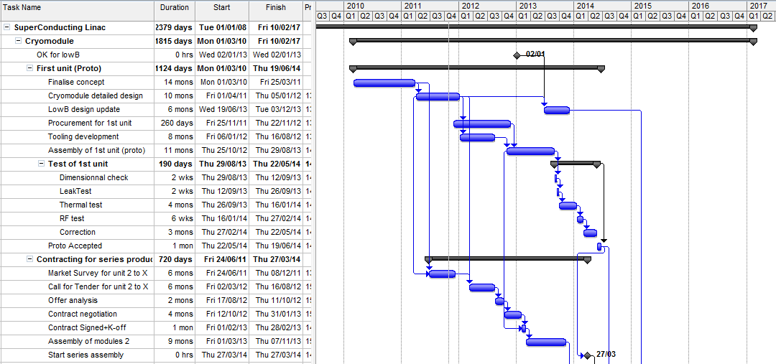
Superconducting Linac
LS1
TE/MSC: JEAN-PHILIPE TOCK, YANN LECLERCQ, LLOYD WILLIAMS, ARNAUD BOUZOUD

Slide 33
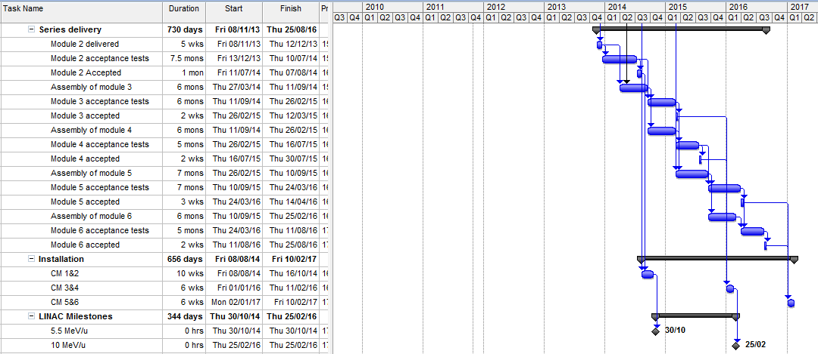
Superconducting Linac
LS1
CM1&2
TE/MSC: JEAN-PHILIPE TOCK, YANN LECLERCQ, LLOYD WILLIAMS, ARNAUD BOUZOUD

Slide 34
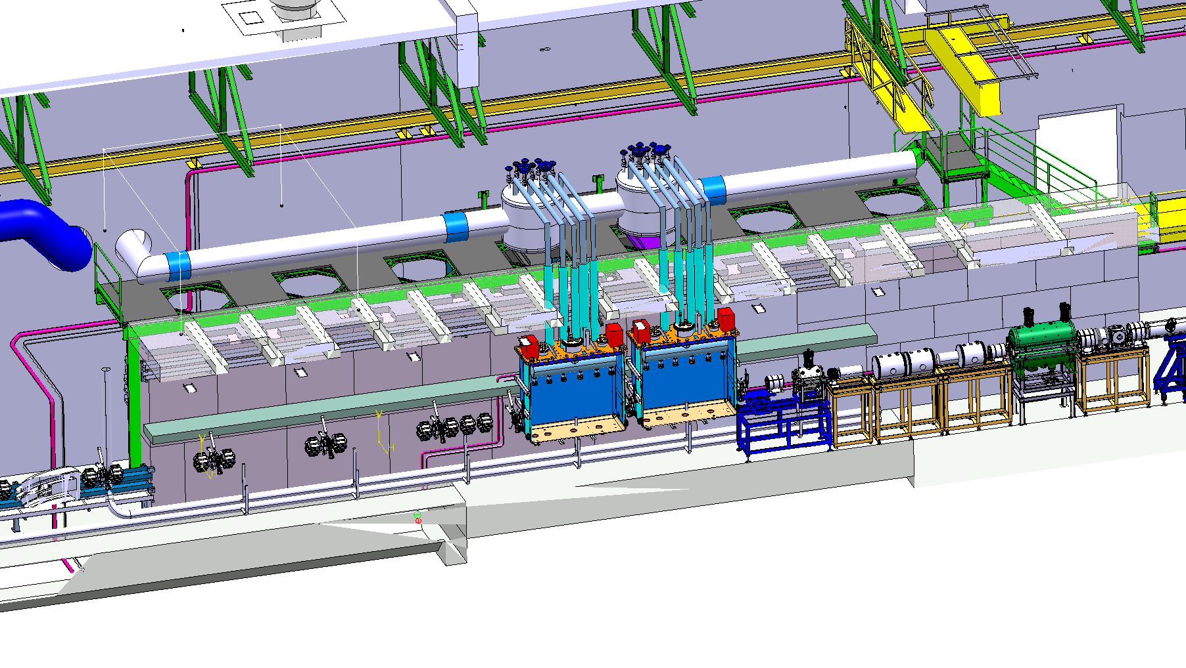
Modular Linac & Cryo Line
Courtesy: Stephane Maridor
2014
5.5MeV/u
Cryo Cold Line- stage 1: January 2014 – June 2014
Linac CM 1&2 - stage 1: August 2014 – October 2014

Slide 35
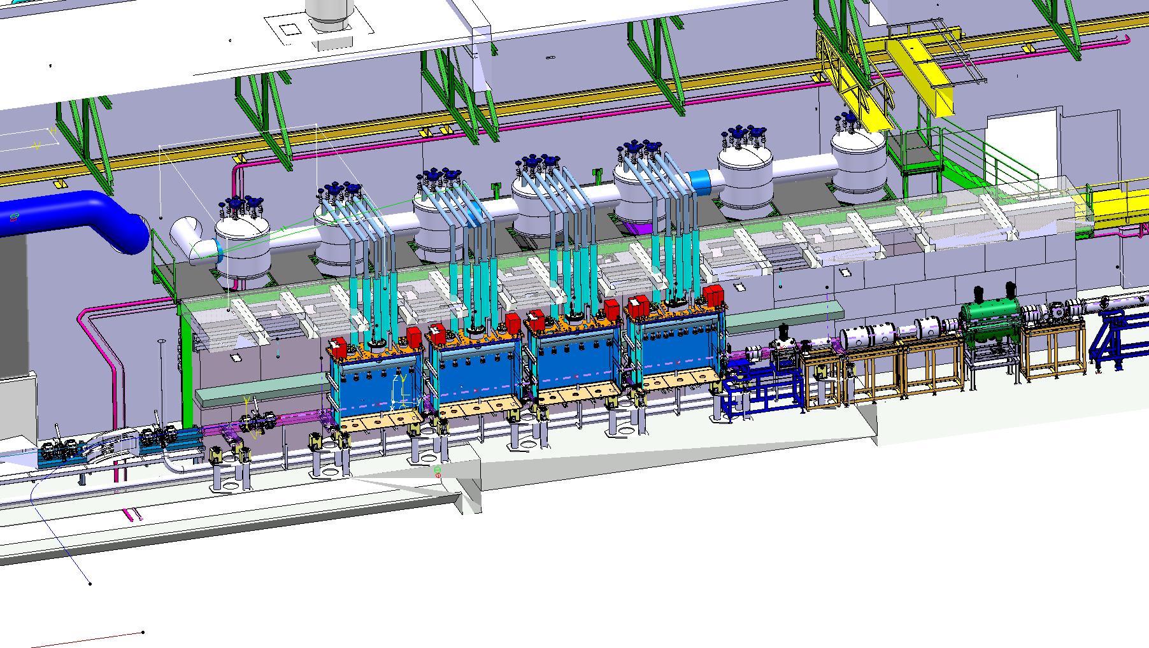
Modular Cryo Line
Courtesy: Stephane Maridor
2016
10MeV/u
Cryo Cold Line- stage 2a
Linac CM High-β 1,2,3&4 - stage 2a

Slide 36
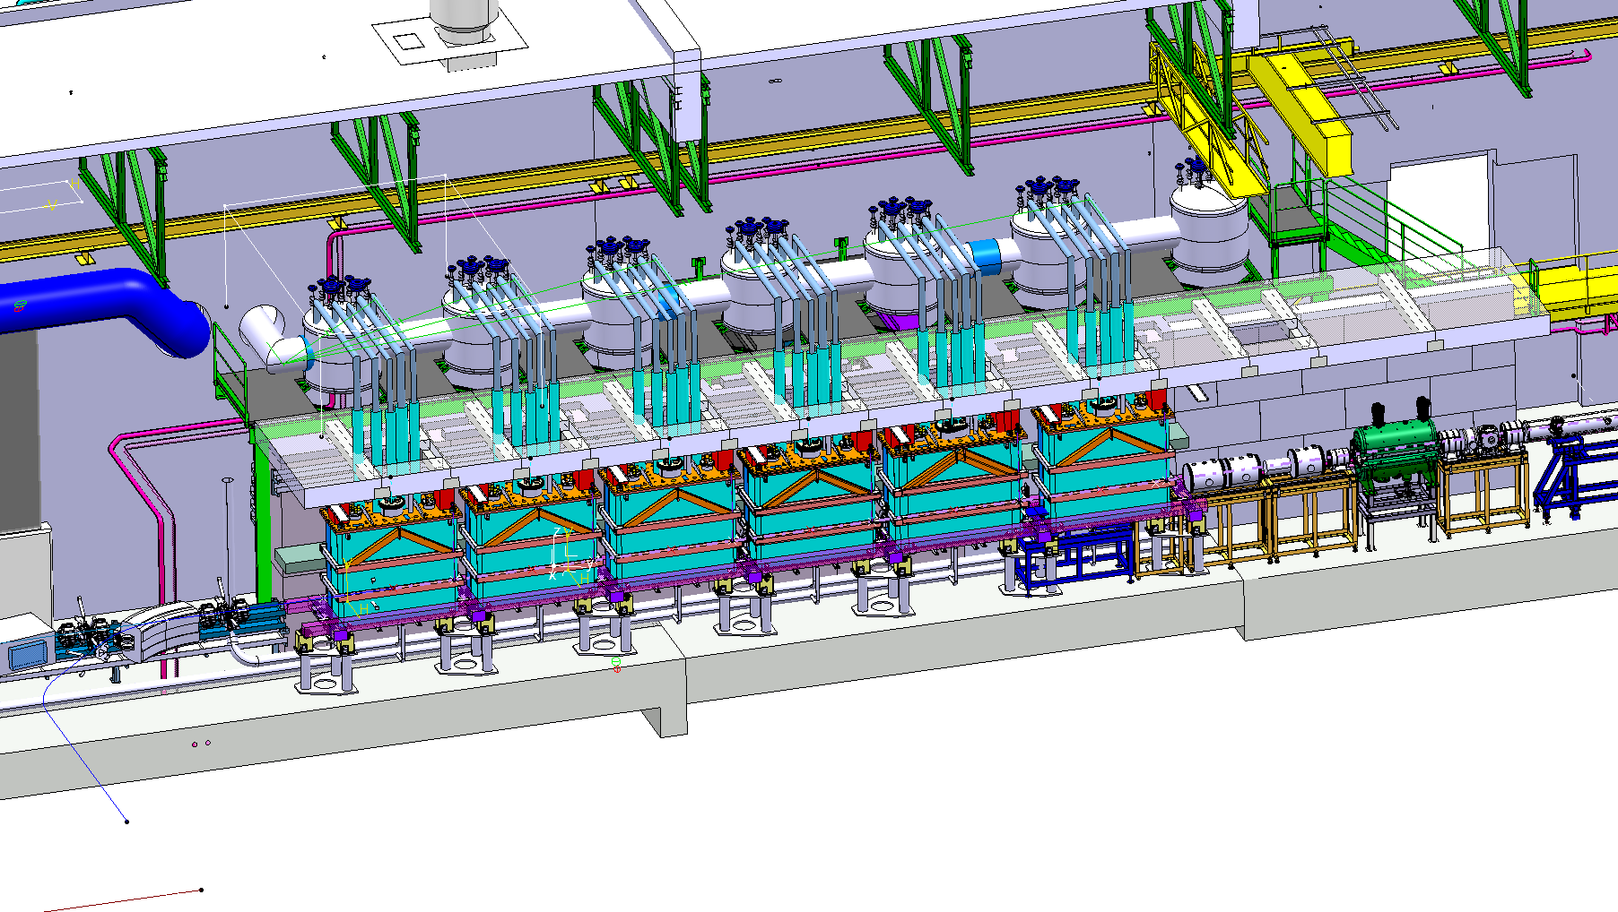
Modular Cryo Line
Courtesy: Stephane Maridor
>2017
Cryo Cold Line- stage 2b
Linac CM High-β 1,2,3&4 + Low-β 1&2 - stage 2b

Slide 37
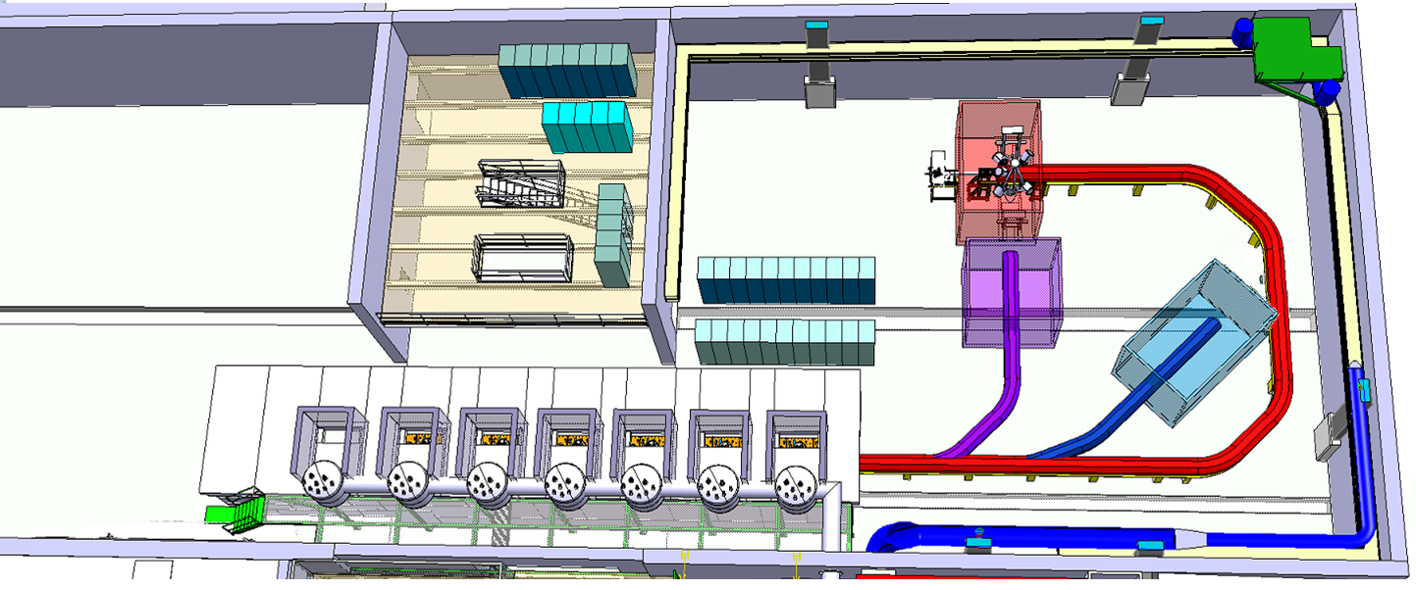
High Energy Beam Tranfer

Slide 38
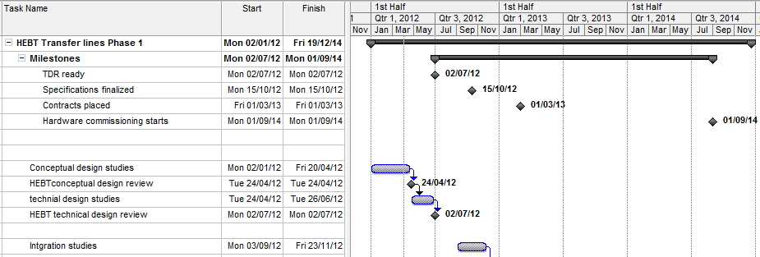
Beam Transfer Line
LS1
EN/HDO : YACINE KADI, TE/EPC: DAVID NISBET, TE/MSC: JEREMIE BAUCHE, TE/ABT: BRENNAN GODDARD, BE/OP: DIDIER VOULOT

Slide 39
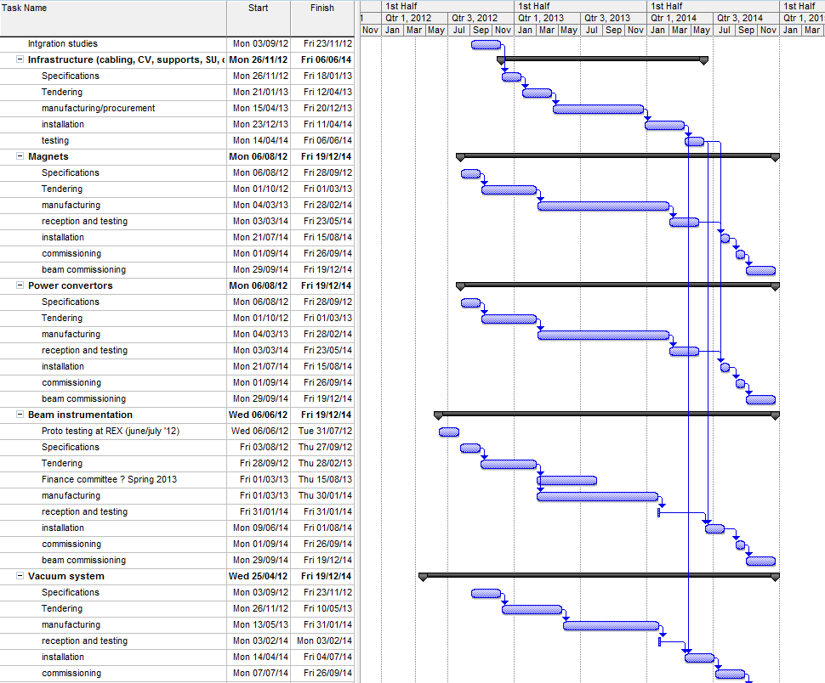
Beam Transfer Line
LS1

Slide 40
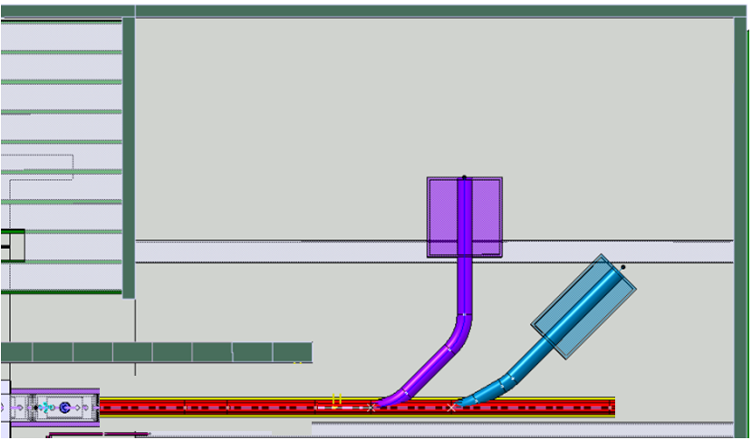

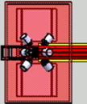


HEBT Stage 1
Exp.
Station 1
Miniball
Exp.
Station 2
Miniball
Beam diagnostics
Straight line with 2 branches – Oct 2013 - Sept 2014
Miniball move: Oct 2013 – April 2014

Slide 41
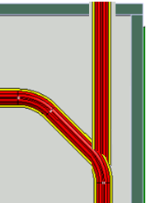
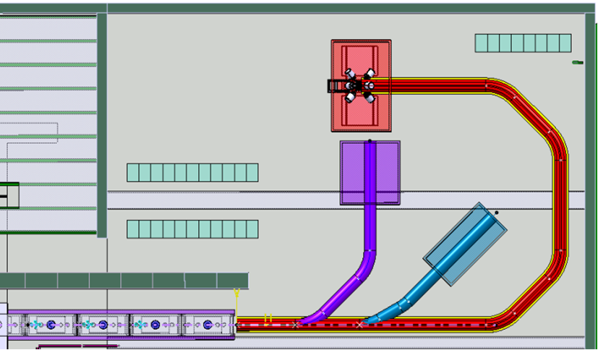

Next stages
TSR
Exp.
Station 3
Miniball
Helios
12 Tons
Steel frame work with
Magnetic shielding
approx size
5.5mL x 3.75 mW x 3 mH
Stage 2: The bend and 3rd Experiment station – 2016?
With HELIOS and Miniball occupying the two stations the bend will be in high demand
Stage 3: TSR and beyond..

Slide 42
Floor spacing
Increase experimental floor space by moving all power convertor racks onto existing platform

Slide 43
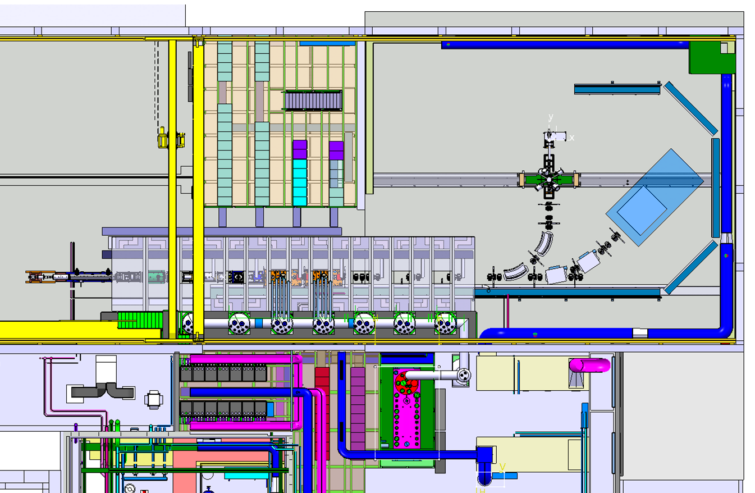
HEBT Stage 1
Courtesy: Stephane Maridor
Large dipole EPC racks
Cable trays
Collisions
Transport zone

Slide 44
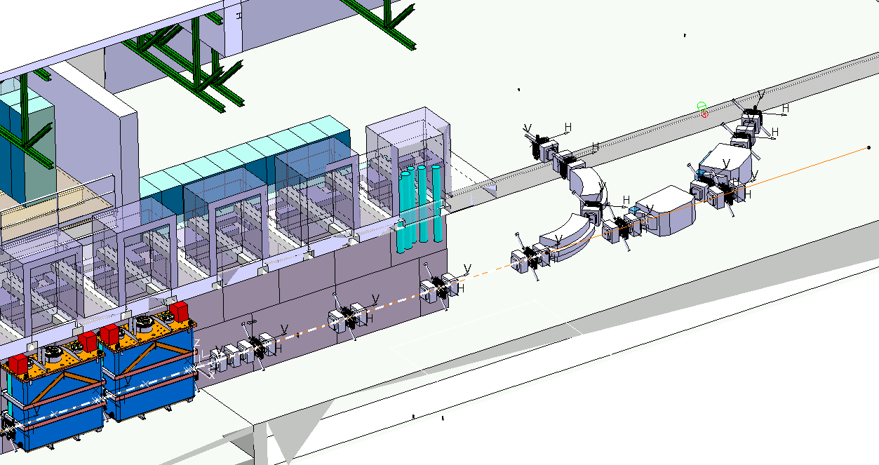
Linac & HEBT Infrastructure
Infrastructure:
electrical (power, signals & controls)
cooling water
compressed air
N2 venting line
vacuum exhaust line

Slide 45
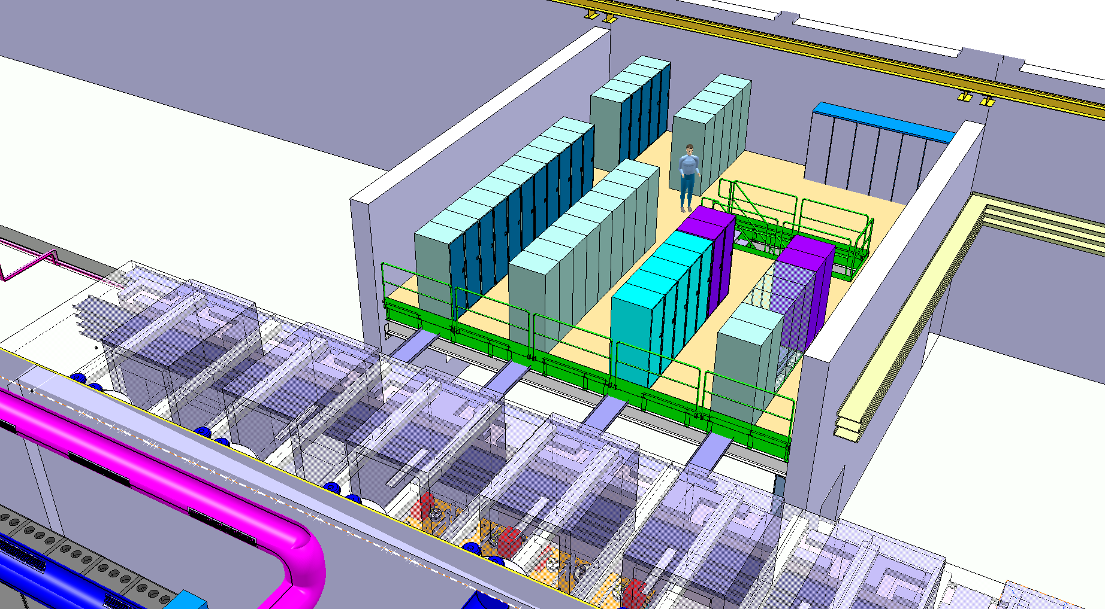
Cabling solution version 1
Electric. Dist. racks
30 power-concert. racks
5 vac. racks
4 WIC racks
2 b.i. racks(+3)
Courtesy: Stephane Maridor

Slide 46
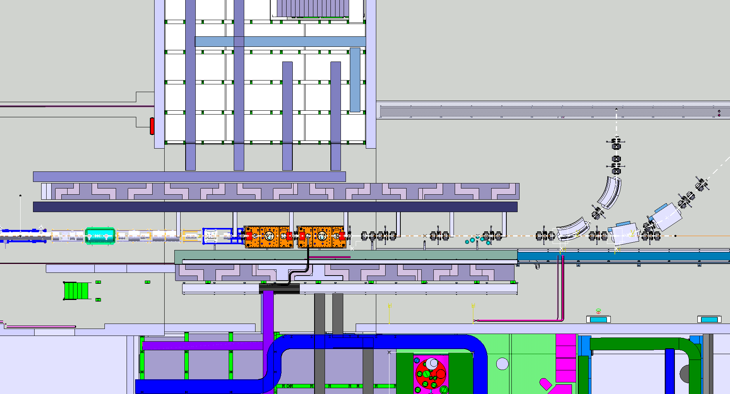
Cabling solution version 1
Courtesy: Stephane Maridor
7x cables trays (200x100)

Slide 47
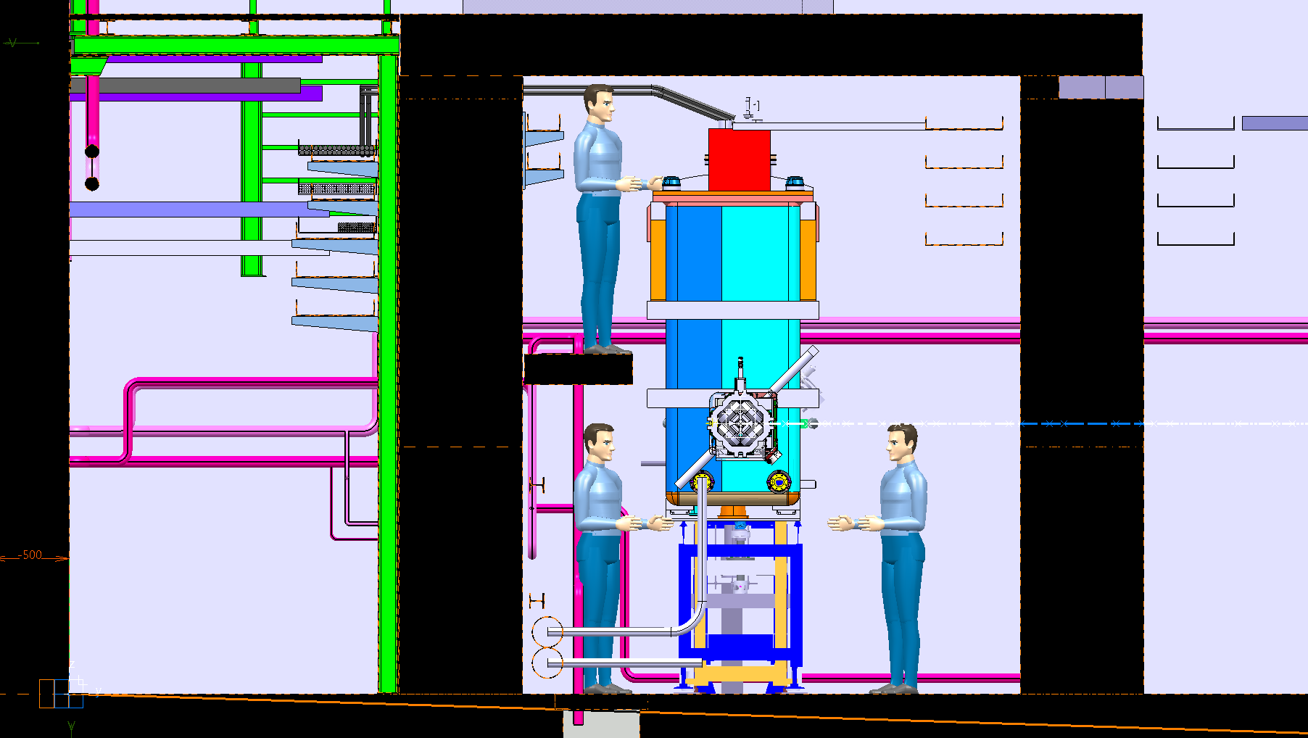
Cabling solution version 1
7x cables trays (200x100)
2x 4 cables trays (500x100)

Slide 48
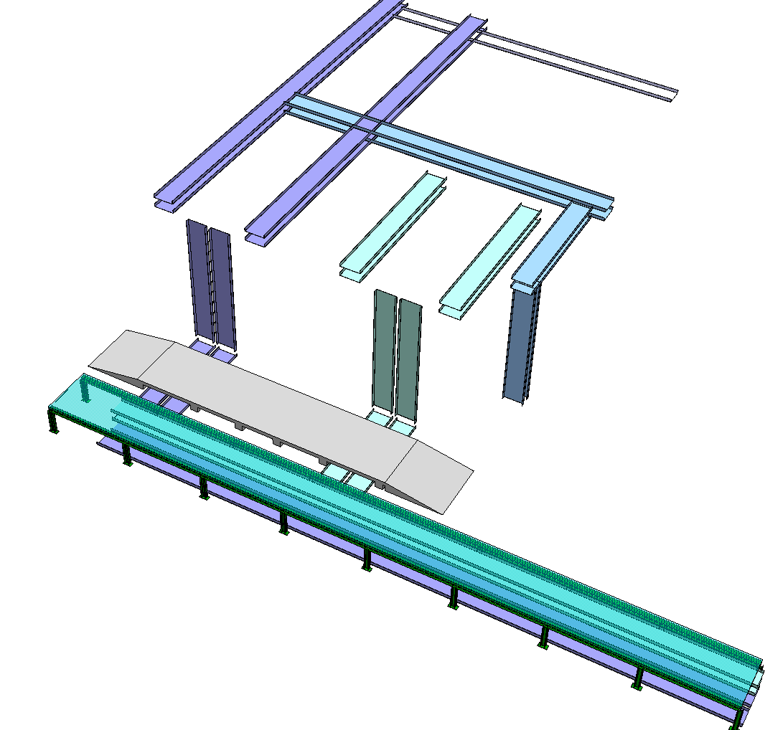

Cabling solution version 2
Cables trays under racks
Concrete duct
False floor in tunnel

Slide 49

Cabling solution version 2
750mm

Slide 50

Cabling solution version 2
Radiation issues?: Ana-Paula Bernardes EN/STI

Slide 51
Dipoles need larger power converter racks
HEBT Dipole EPC racks
1-Version rack DIPOLE “PC”(width 600 MM ) – preferred
500A : 3x600 ; 250A : 2x600
Space: 7x1.8m + 2x1.2m = 15m
2-Version rack DIPOLE “PC”(width 800 MM )
500A : 2x800 ; 250A : 1X800
Space: 7x1.6m + 2x0.8m = 12.8m
Before:
30x0.6m=18m – all on platform
Now:
20x0.6m=12m (steerers & quads)
+ 15m (version 1 – preferred) or 12.8m (version 2)

Slide 52

HEBT Dipole EPC racks
Situation before larger racks

Slide 53

HEBT Dipole EPC racks
QUAD/STEERER
DIPOLES
20 RACKS “PC”
7x3 RACKS “PC” 500A
2x2 RACKS “PC” 250A
Racks version 1 = 15m
Courtesy: Stephane Maridor

Slide 54

HEBT Dipole EPC racks
Racks version 1 = 15m

Slide 55

1
HEBT Dipole EPC racks
Restrictions on the platform:
CV -> needs new duct to bring in air: to air 102kW total (70kW from dipoles
EPC -> maintenance and intervention difficult. Heavy equipment
Needs displacement of the staircase
Spacing is a serious issue for version 1 (preferred)
Re-calculate weight for platform
Racks version 1 = 15m

Slide 56

1
HEBT Dipole EPC racks
Racks version 1 = 15m

Slide 57

2
HEBT Dipole EPC racks
Racks version 2 = 12.8m

Slide 58

HEBT Dipole EPC racks
Restrictions on the platform:
CV -> needs new duct to bring in air: to air 102kW total (70kW from dipoles
EPC -> maintenance and intervention difficult. Heavy equipment
Needs displacement of the staircase
Re-calculate weight for platform
Racks version 2 = 12.8m

Slide 59
Acknowledgement
GS/SE : DANIEL PARCHET, ELISEO PEREZ-DUENAS
EN/MEF : STEPHANE MARIDOR, ELEFTHERIOS ZOGRAFOS
BE/ABP : FREDERIK WENANDER
BE/OP : DIDIER VOULOT
PH/SME : YORICK BLUMENFELD
EN/HDO : YACINE KADI
BE/RF : MATTEO PASINI, MATTHEW FRASER, DANIEL VALUCH, WALTER VENTURINI, LUCA ARNAUDON
EN/CV : PAUL PEPINSTER, BENOIT LACARELLE
EN/EL : RENE NECCA
TE/CRG : NICOLAS DELRUELLE, JOS METSELAAR
EN/STI : RICHARD CATHERALL, ANA-PAULA BERNARDES
GS/DI : CYRILLE BEDEL
TE/MSC : JEAN-PHILIPE TOCK, YANN LECLERCQ,
LLOYD WILLIAMS, ARNAUD BOUZOUD
TE/ABT : BRENNAN GODDARD

Slide 60
Thank you for your attention

Slide 61
HIE-Isolde. RF system configuration per cavity

